Slide 1










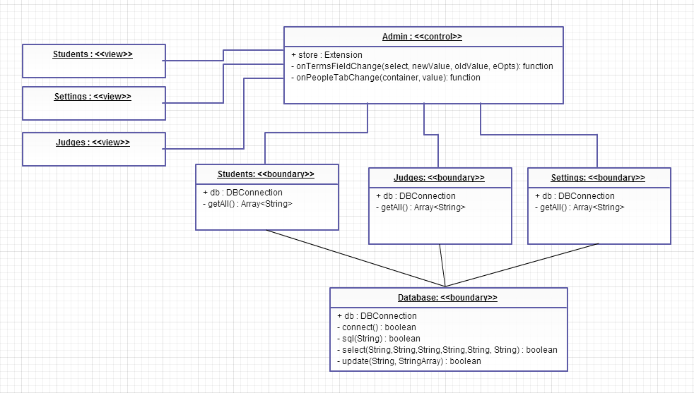
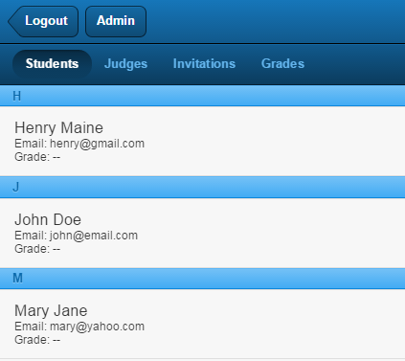
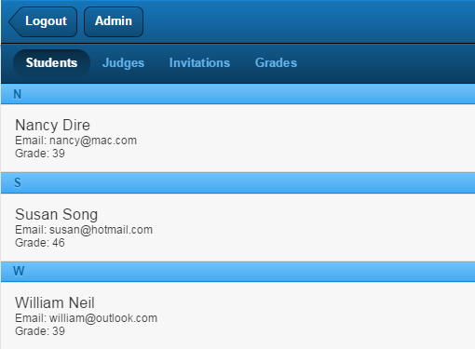
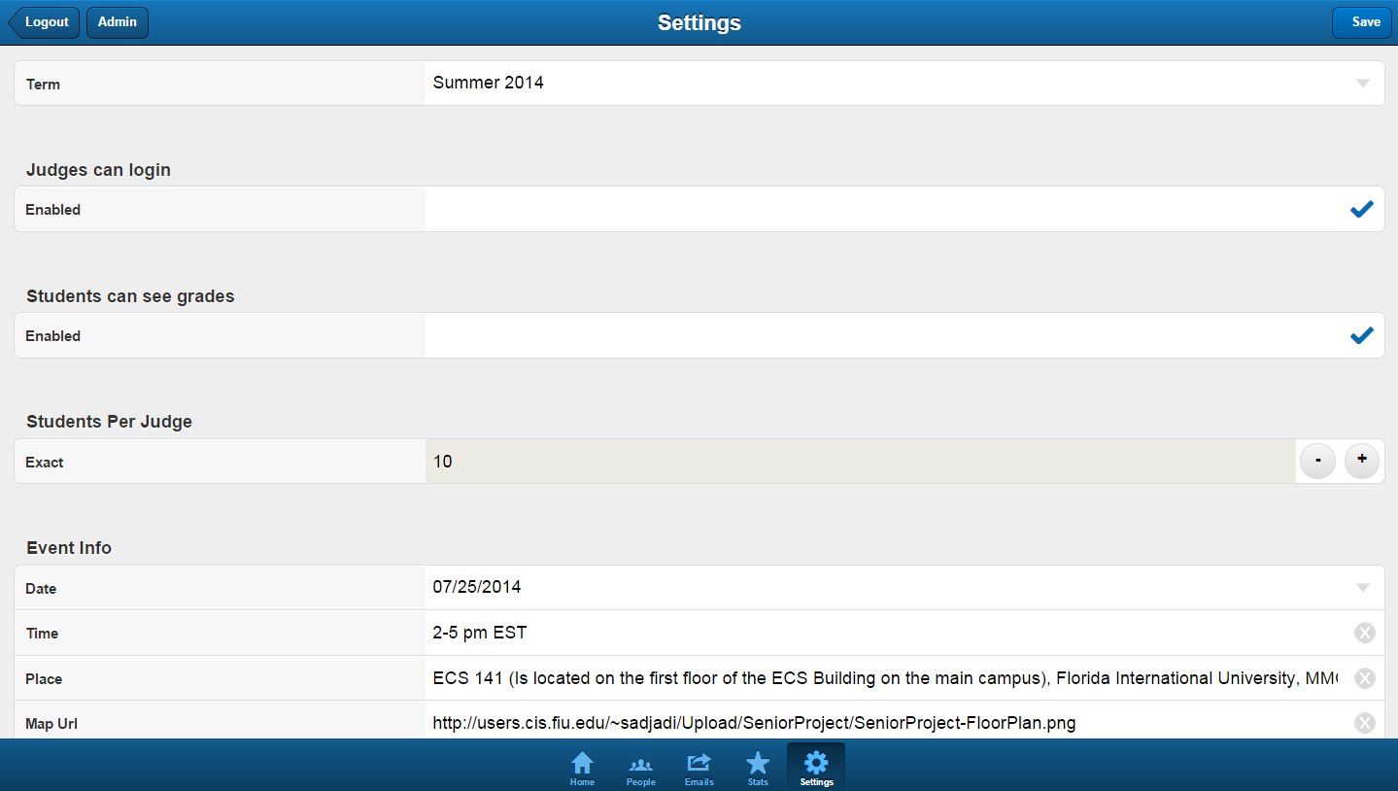
School of Computing & Information Sciences
Senior Project, 2014, Fall
Mobile Judge App Ver 4
Student: Carlos A. Morales, Florida International University
Mentor: Masoud Sadjadi, Florida International University
Instructor: Masoud Sadjadi, Florida International University
Problem
Current System
Requirements
Applications are mainly used for a specific situation and once a new issue arises, the data from the previous instance is no longer needed and thus discarded.
By being unable to archive that data, certain information that could have been used in the future will not be available within the application.
Although the current system has the option to change the semester in the settings page, there is no logic associated with the selection itself.
It also does not have the capability to read data from different semesters of initiation.
The solution should allow the user to still have access to the application during the semester in which it is currently in use but also have access to the data from previous semesters such as:
Students
Judges
Grades
Settings Configuration
System Design
Object Design
Implementation
View
Through the use of Visual Studio, I was able to write the necessary code in php in order to access the data from the database hosted by phpMyAdmin.
Once the term has been selected, the database will alter the currently showing term table and only the data initiated in the term will be shown.
UserInterface
Controller
Admin
_Logic
Database
DB_Caller
MySQL Database
Verification
Screenshots
Summary
Test ID | SwitchTerm_Students_01
Test Purpose | Show the Students for the Summer of 2014 in Students under the People tab.
Test Setup | User is logged in as Admin and currently in the Settings tab.
Inputs | User Clicks on Term drop down box. User clicks on “Summer 2014” User clicks on People tab
Expected Output | Students from the Summer 2014 term are being shown.
With the ability to switch between terms and view the corresponding data, the user is now able to view the archived information without the need of loading in the data from a different database. This implementation also follows the concept of front end to back end while using controllers to separate the logic from the interface thus allowing for clean code.
Acknowledgement
The material presented in this poster is based upon the work supported by my mentor Masoud Sadjadi and I am thankful to the help that I received from my group member Mohammed Albukhari.

