Slide 1







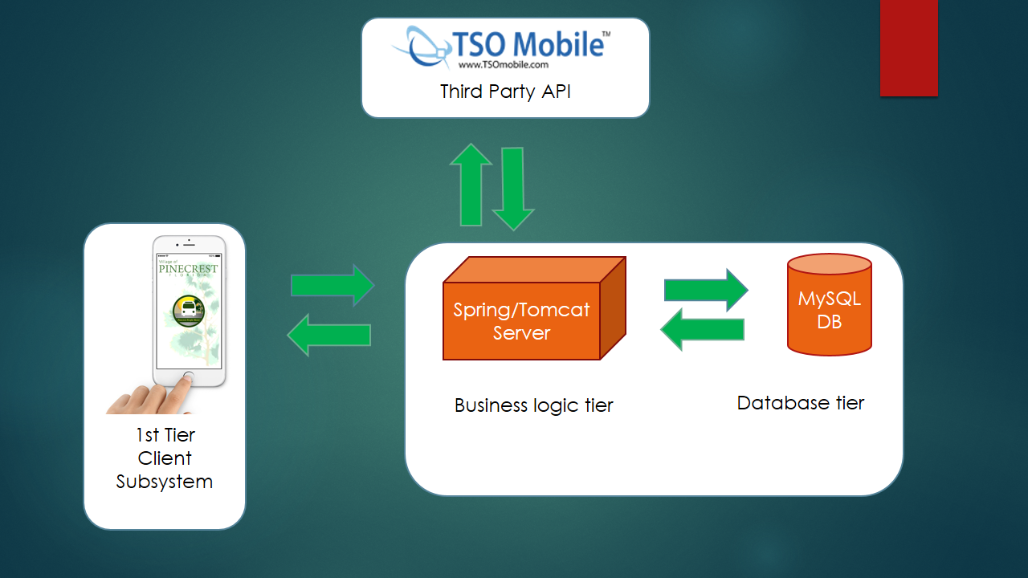
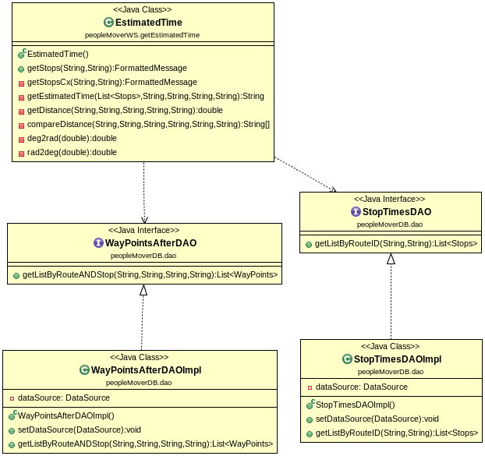
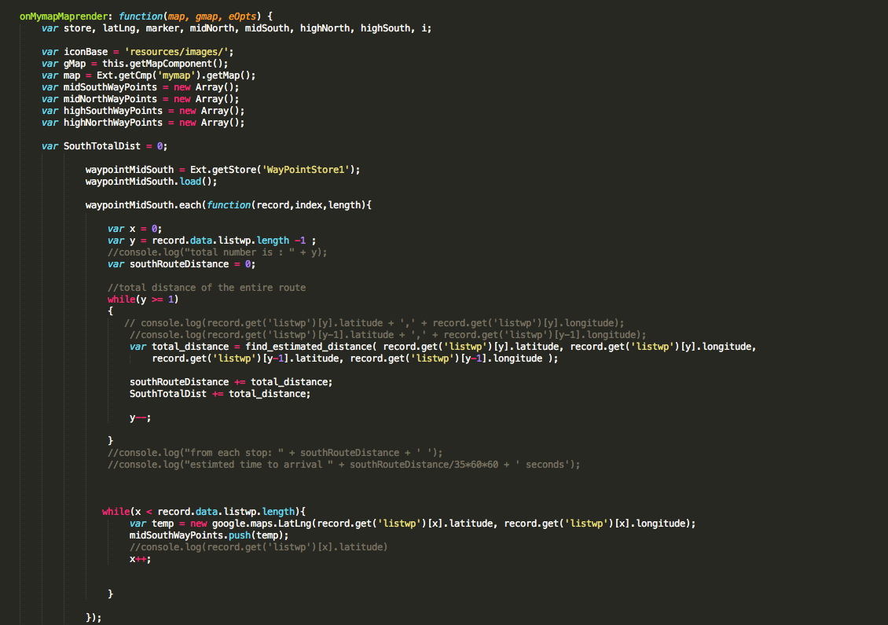
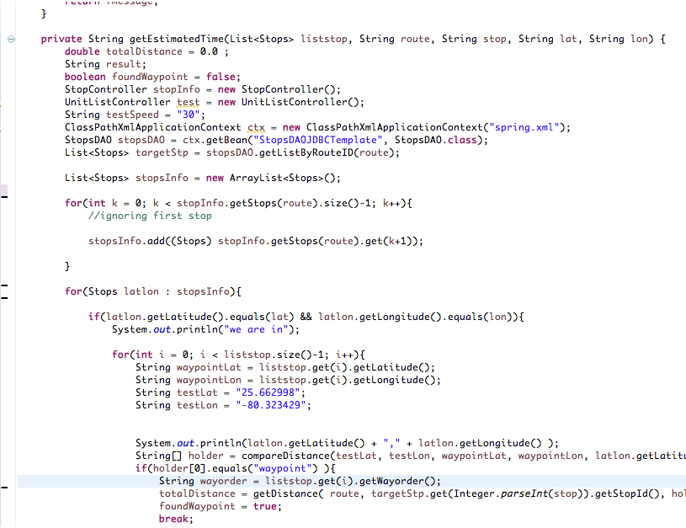
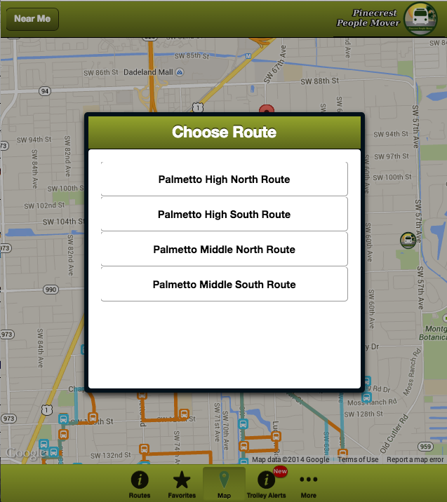
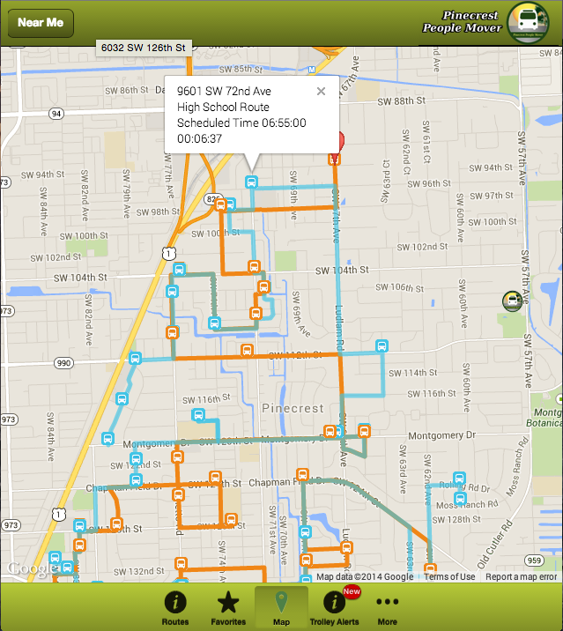
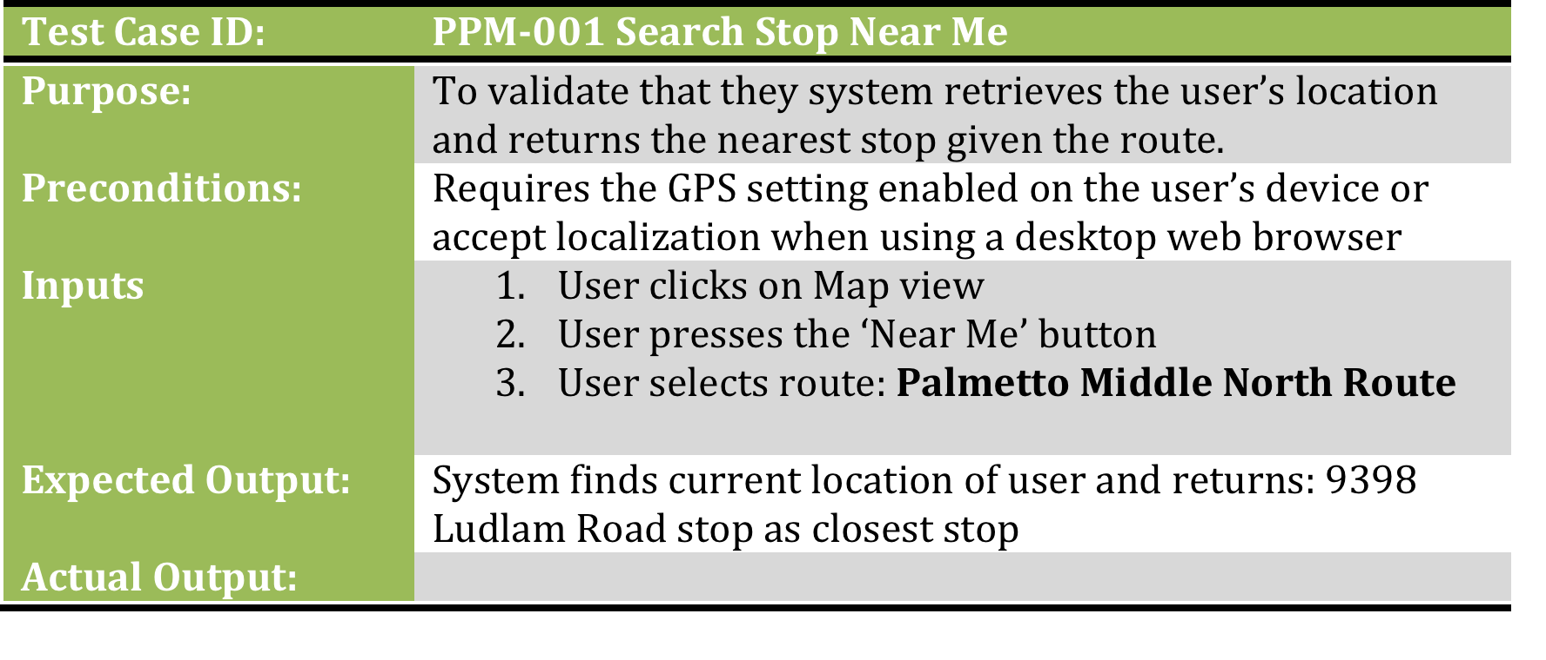
School of Computing & Information Sciences
Senior Project, 2014, Fall
Pinecrest People Mover
Student: Ricardo Martinez, Florida International University
Mentor: Gabriela Wilson, Village of Pinecrest
Instructor: Masoud Sadjadi, Florida International University
Problem
Current System
Requirements
The Pinecrest People Mover goes beyond the limits of a regular school bus.
Trolley gives students in the Village of Pinecrest an opportunity arrive to their local middle and high school from a location close to home.
Currently there is no system that will keep track of these trolleys.
Parents and students do not know how far a trolley is from their stop nor have the knowledge of the closest stop to their location.
The problem I had to tackle was to show the estimated arrival time of the bus for a particular stop, the location of the stop, and display the routes.
Currently, there are several trolley or bus trackers in Miami. However, there are no applications that focus only on the Village of Pinecrest. This application was made from scratch with the residents of Pinecrest in mind.
Requirements per request of the client that I developed:
Display stops on map
Display routes on map using Waypoints
Display routes in list view
Find nearest stop for current location
Estimated Time for Given Stop
Estimated Time for Favorite Stop
System Design
3-Tier Architecture
Presentation Layer – Sencha Application
Business Layer – Spring/Tomcat Server
Data Layer – MySQL Database
Object Design
Implementation
Verification
Testing for this project was divided into two sections: system testing and integration testing. Above is an example of a system test case.
System Testing – Dealt with the overall interaction of the user with the system, which was done manually. For each requirement, 3 test cases were completed, two sunny day and one rainy day
Sublime Text 2 was used to develop the Sencha application. Here you can see the Map Controller.
Above are the classes I implemented for the Estimated Time Functionality
Summary
Screenshots
After all the work that was implemented for this project, the application, in its first stage, can now be used for tracking the Pinecrest People Mover bus, show all stops, and estimate arrival time for the bus to a stop. With the help of Maurice Pruna, who was mainly in charge of the back end, the application will only have a 10 second delay when information is being updated. The application is compatible with both web and mobile devices.
Code in the backend was done in the
Spring Tool Suite:
Estimated Time
View when ‘near me’ button is selected
Main menu with estimated time functionality showing
Acknowledgement
The material presented in this poster is based upon the work supported by Gabriela Wilson and the Village of Pinecrest. I am thankful for the help that I received from my teammate Maurice Pruna

