Slide 1
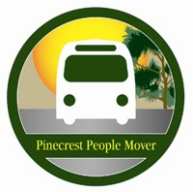


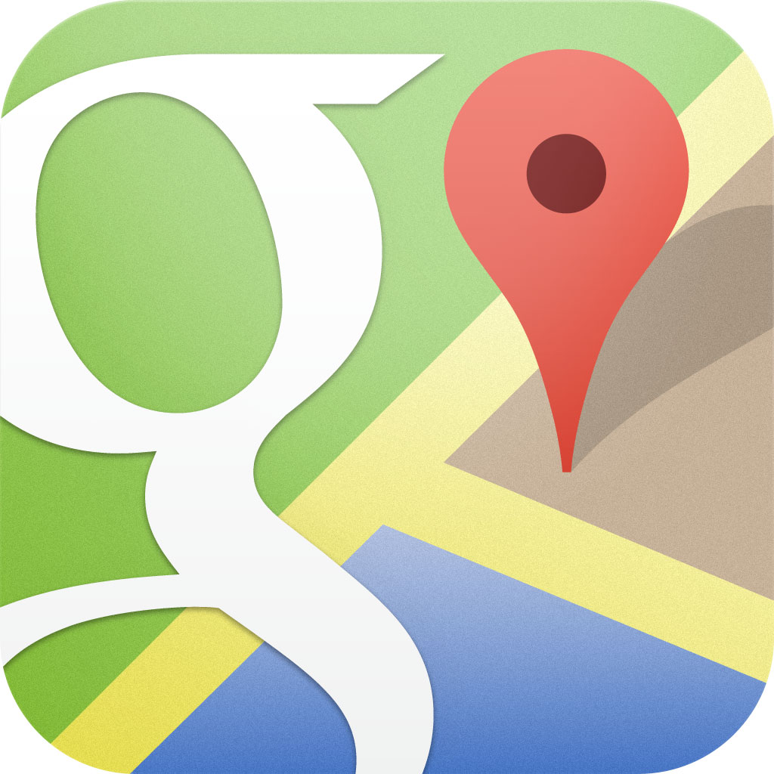



School of Computing & Information Sciences
Senior Project, 2014, Fall
Pinecrest People Mover
Student: Ricardo Martinez, Florida International University
Mentor: Gabriela Wilson, Village of Pinecrest
Instructor: Masoud Sadjadi, Florida International University
Problem
Current System
Requirements
The Pinecrest People Mover goes beyond the limits of a regular school bus. This trolley gives students in the Village of Pinecrest an opportunity arrive to their local middle and high school from a location close to home. However, currently there is no system that will keep track of these trolleys. Parents and students do not know how far a trolley is from their stop nor have the knowledge of the closest stop to their location.
Currently, there are several trolley or bus trackers in Miami. However, there are no applications that focus only on the Village of Pinecrest. This application gives the user a chance to see the routes, where the stops are, the estimated time for the trolley to arrive, and set alert notifications.
Requirements implemented per request of the client that I developed:
Estimated Time for Given Stop
Estimated Time for Favorite Stop
Display stops on map
Display routes on map using Waypoints
Display routes in list view
Find nearest stop for current location
System Design
Object Design
Implementation
Verification
Screenshots
Summary
After all the work that was implemented for this project, the application can now be used for tracking the Pinecrest People Mover bus. With the help of Maurice Pruna, who was mainly in charge of the back end, the application will only have a 10 second delay when information is being updated. The application can be used for both web and mobile.
Acknowledgement
The material presented in this poster is based upon the work supported by Gabriela Wilson and the Village of Pinecrest. I am thankful for the help that I received from my teammate Maurice Pruna

