Slide 1
Contributions

Slide 2

“Worklight”
Web
Apple
Android
Tablet

Slide 3

“Structure”
Ubuntu
IBM WebSphere
The “Stack”
Angularjs
MySQL
Linux (Ubuntu)
DataTables
GoogleAPI
MySQL

Slide 4
“Total Work Breakdown”
George
Worklight framework
Backend Database
Data Entry functionality
Mobile
Documentation
Monica
Front End
Game Aspect
Navigation
Look and Feel
Documentation

Slide 5
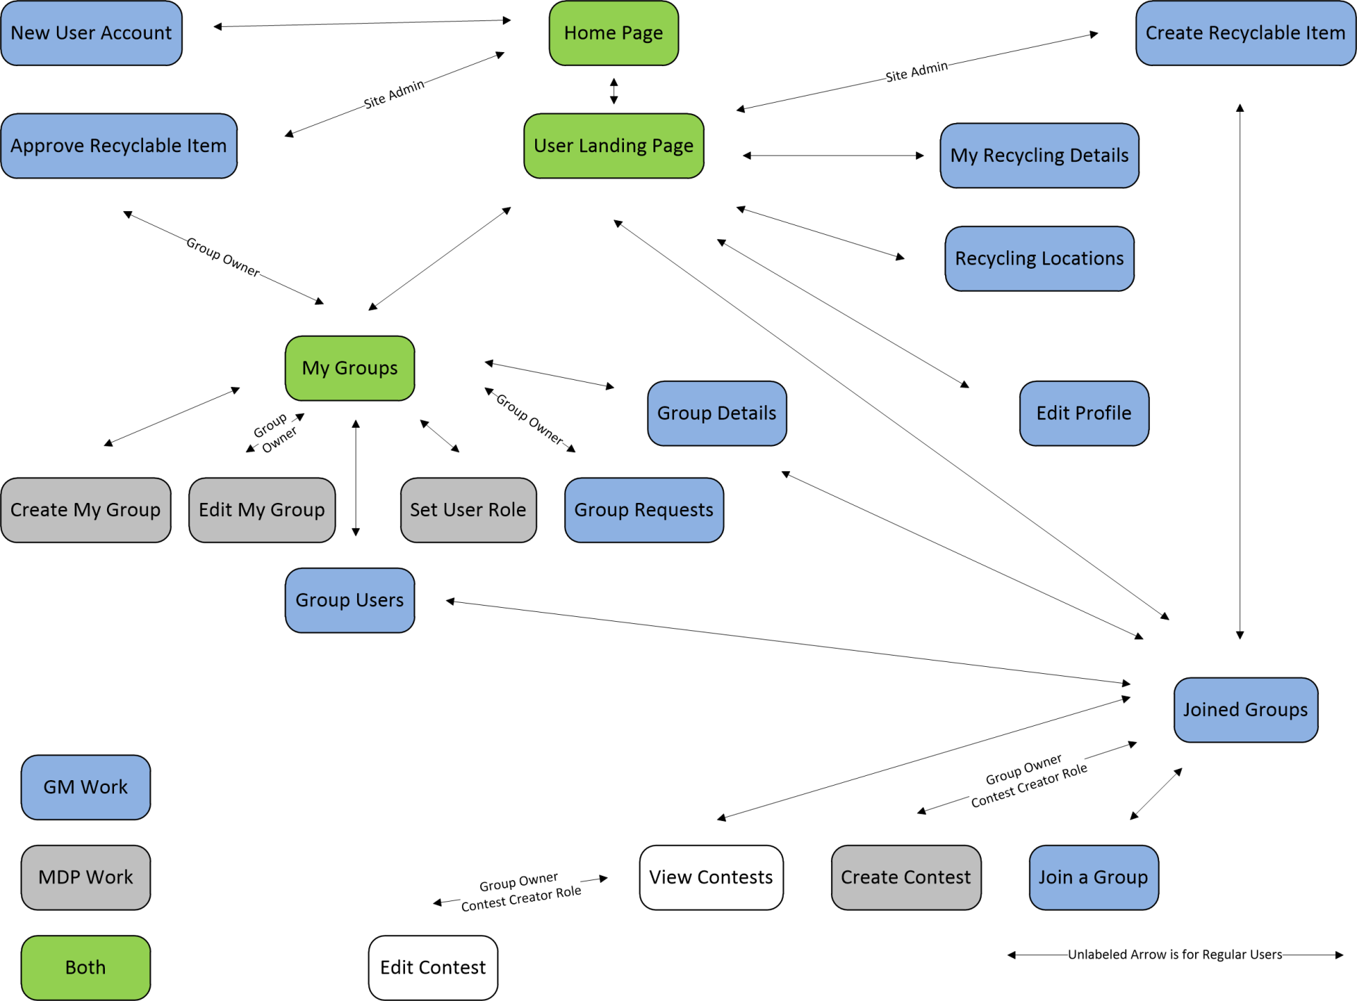
“Who”

Slide 6
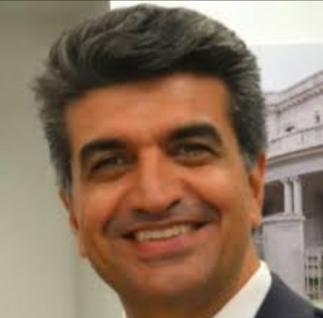
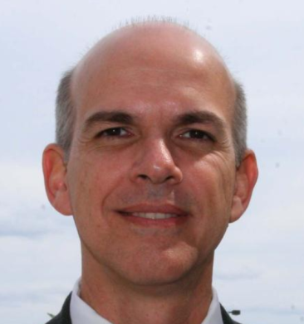

“Summary”
Registred Users
App
Register as User
Create Group
Create Contest
Request
Group
Accept
Group
Register as User
MySQL
Recycle Item(s) For Group
“Feel Good” Message
Wins Contest
Prize
You Graduate!

Slide 7
“Current Sprint”
George
Recycle Item
Create Material
Create Item
Join Groups
Accept users into Groups
Worklight Deployment
Documentation
Monica
Create Contest
Real time Chart (Game)
Documentation

