Slide 1
Virtual Queue Team Members: Kely Cid Mentor: Bernard Parenteau
CIS 4911 Senior Project
School of Computing and Information Sciences
Florida International University
December 12th, 2014

Slide 2
Problems and Limitations
On Parks with multiple recurring rides or events:
Customers have to wait in line until their time comes up (Time Consuming).
There is not a possibility of be doing something else like walking around, buying souvenirs, or food, or going perhaps to another ride.
Business side: Imagine the impact of advertising “No More Lines”.
Users will have a more satisfying experience, and that venue will definitely have an advantage over competitors.
Venue loses potential additional sales by having that customer in line rather than walking around visiting other areas like restaurants or shops.
There is no system to provide venue users a way so that they can queue for a ride and enjoy more activities of the park without the need to be standing long periods of time waiting for their turn.

Slide 3
The Proposed System (VQ)
The Virtual Queue System will give users the freedom they need to enjoy more of their free time from a touch on their phone, or any other device.
VQ system will allow users to:
Have access to the available rides once they login.
Queue for their favorite rides.
Keep track of all their activities they queued on for.
Dequeue themselves from a registered rides.
Be dequeue from their selected rides according to queue algorithm and jobs once their ride time has approached.
Receive an email notification before their rides time approaches.
Edit, enable and disable user’s account (Admin).
VQ will reduce the waiting time and give users a more satisfying experience.
By increasing user satisfaction, the venue business will have an advantage over competitors.
In addition, the venue will enhance revenue by getting users out of line so they can have more time to visit their shops and/or restaurants.

Slide 4
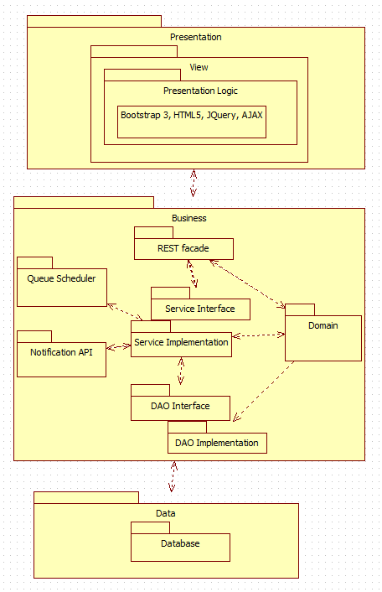
System Design
For the Virtual Queue system a three tier and a multilayer architecture were used. These will allow for horizontal scalability, which will let to multiple server instances to easily handle high traffic on the site.

Slide 5
Virtual Queue Implementation
For the VQ implementation HTML5, CSS, JavaScript, JQuery and Bootstrap 3 framework were used for the UI dynamic development, which allowed for a responsive, mobile first project that can be seen on all devices.
Spring MVC Java framework was used for the server side implementation. In addition, all state changes for any model goes through Rest API, which accesses the Services, and DAO layers to interact with MySQL database.
The combination of all these frameworks provided a robust and scalable system.
For the VQ implementation HTML5, CSS, JavaScript, JQuery and Bootstrap 3 framework were used for the UI dynamic development, which allowed for a responsive, mobile first project that can be seen on all devices.
Spring MVC Java framework was used for the server side implementation. In addition, all state changes for any model goes through Rest API, which accesses the Services, and DAO layers to interact with MySQL database.
The combination of all these frameworks provided a robust and scalable system.

Slide 6
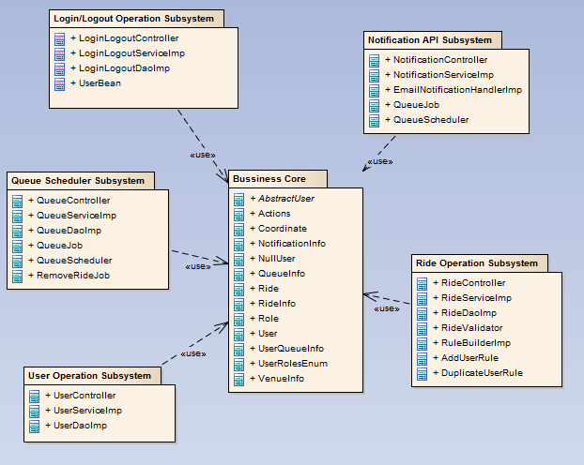
Package Diagram
The Virtual Queue system is divided into subsystems. Each one follows a multilayer architecture that allows decoupling each layer using interfaces contracts only to communicate between them and share the business domain.
For the VQ implementation HTML5, CSS, JavaScript, JQuery and Bootstrap 3 framework were used for the UI dynamic development, which allowed for a responsive, mobile first project that can be seen on all devices.
Spring MVC Java framework was used for the server side implementation. In addition, all state changes for any model goes through Rest API, which accesses the Services, and DAO layers to interact with MySQL database.
The combination of all these frameworks provided a robust and scalable system.

Slide 7
DEMO

