Slide 1



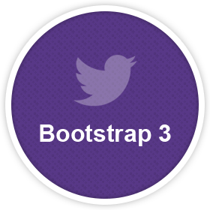
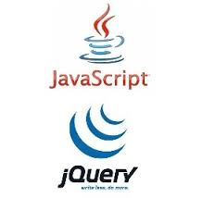





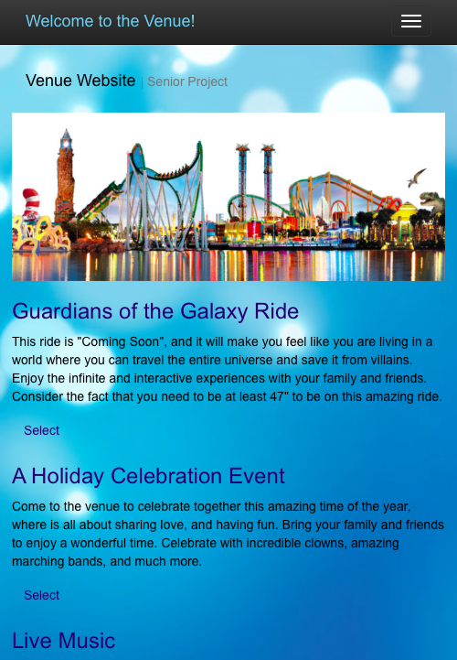
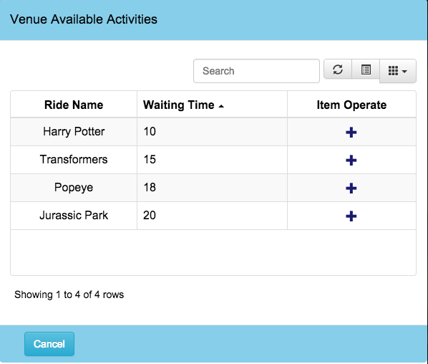
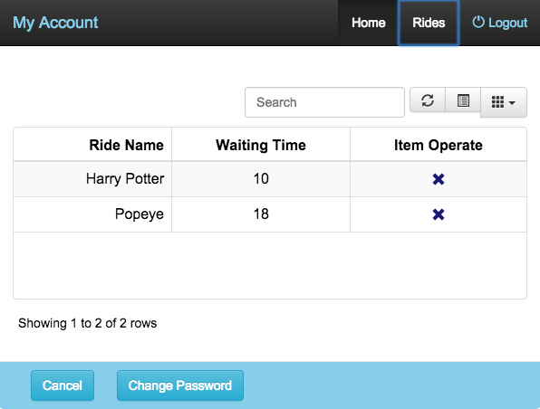
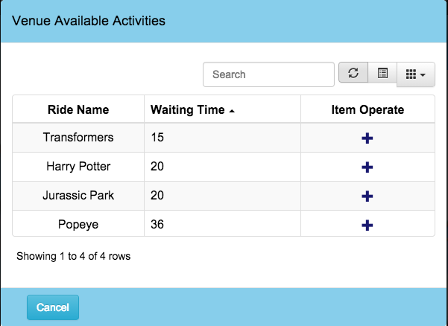
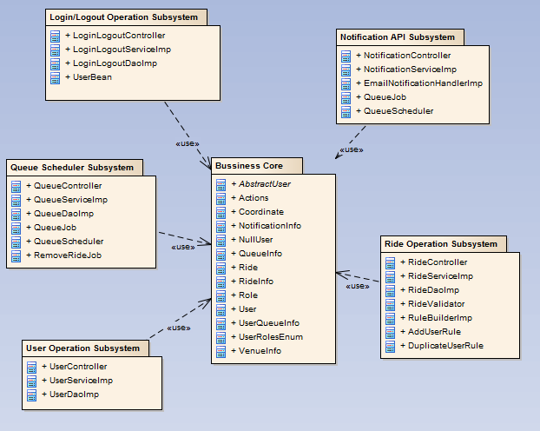
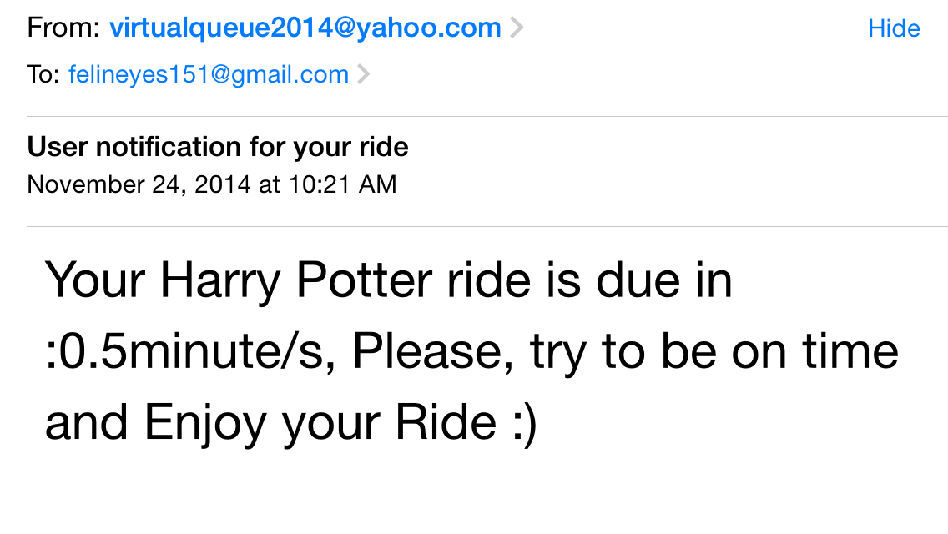
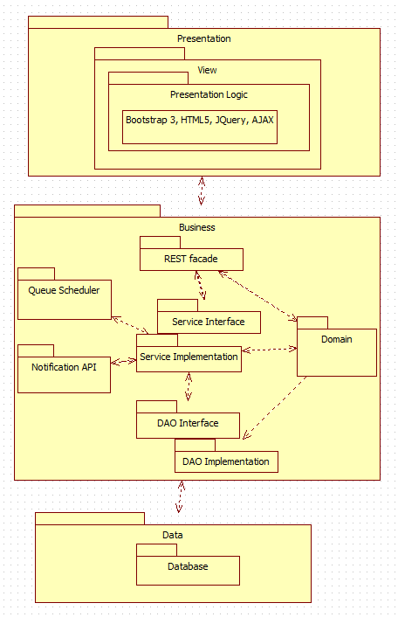
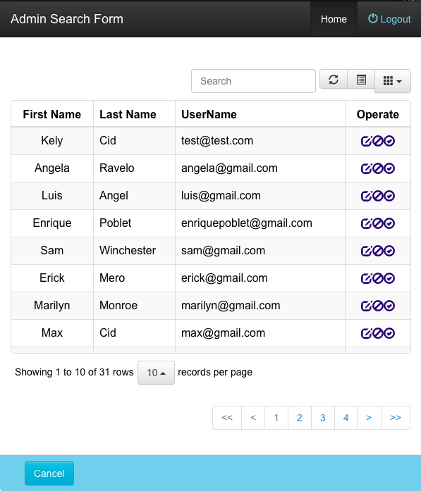
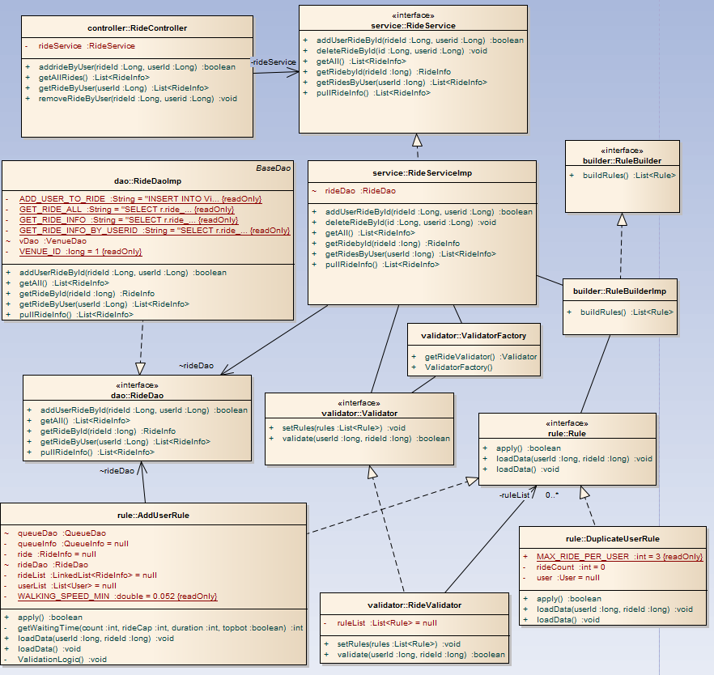
School of Computing & Information Sciences
Senior Project, Fall 2014
Virtual Queue
Student: Kely Cid, Florida International University
Mentor: Bernard Parenteau
Instructor: Masoud Sadjadi Florida International University
Juan Caraballo Florida International University
Problem
Requirements
Screenshots
When going to a park that provides multiple recurring rides or events, customers typically wait in line until their time comes up. This is definitely time consuming, since one could be doing something else like walking around, buying souvenirs, or food, or going perhaps to another ride. The venue is also losing potential additional sales by having that customer in line instead of visiting other areas of the venue like shops or restaurants.
The system shall…
Allow registered users to have access to the available rides/events once they login.
Allow registered users to select their favorite rides/events.
Allow registered users to be queued to their selected rides/events.
Allow registered users to see all the rides/events they queued on for.
Allow registered users to dequeue themselves from registered rides/events.
Allow dequeuing registered users from their selected rides according to the queue algorithm and jobs once user’s ride time comes has approached.
Allow the user to be notified before their rides/events approaches.
Allow the admin to edit, enable and disable user’s account.
Home View
Rides available with their waiting time
Current System
The current system requires the customers to buy their tickets and wait in line at the venue until it is their turn for their event or ride. There is no system to provide venue users a way so that they can queue for a ride and enjoy more activities of the park without the need to be standing long periods of time waiting for their turn.
User Account displaying activities added by user.
Rides available with waiting time updated
List of user’s activities.
Object Design
Proposed System
The Virtual Queue system shall be divided into subsystems. Each subsystem follows a multilayer architecture that allows decoupling each layer using interfaces contracts only to communicate between the layers.
The proposed system is called Virtual Queue,
which will give users the ability to see from any device all rides available and their waiting time so that they can queue for them and be notified as their time approaches, along with other functionalities. These will reduce the waiting time and give users a more satisfying experience. By increasing user satisfaction, the venue business will have an advantage over competitors. In addition, the venue will enhance revenue by getting users out of line so they can have more time to visit their shops and/or restaurants.
Package Diagram
Notification information sent to venue user.
System Design
For the Virtual Queue system a three tier and a multilayer architecture were used. These will allow for horizontal scalability, which will let to multiple server instances to easily handle high traffic on the site.
The ride operation subsystem will group all artifacts around the ride business logic, including all layers architectures of the system such as controllers, business services, data access objects, and validations. This subsystem also provides ride REST interface business services such as: add, delete, remove user from a specific queue, update and select new rides to the VQ system.
Admin view
Ride Operation Subsystem Class Diagram
Implementation
Summary
For the VQ implementation HTML5, CSS, JavaScript, JQuery and Bootstrap 3 framework were used for the UI dynamic development, which allowed for a responsive, mobile first project that can be seen on all devices.
Spring MVC Java framework was used for the server side implementation. In addition, all state changes for any model goes through Rest API, which accesses the Services, and DAO layers to interact with MySQL database.
The combination of all these frameworks provided a robust and scalable system.
The Virtual Queue system is a first prototype. It was successfully implemented according to the requirements and specifications given.
The system will keep all venue’s rides information and gives the ability to sign in and see all rides available as well as their waiting time, users can also queue and dequeue from rides, be notified as their time for that ride approaches, and take users out of the ride automatically once their turns comes up.
The system will give users a more satisfying experience by reducing their waiting time in line and enhance business revenue by having visitors walking around the park instead of waiting in line.
Future versions of the system may extend the system by allowing the user to enter the code using scan reader and expand the admin functionalities.
Verification
The Virtual Queue system verification was done using unit testing on controllers, services and daos. Then, integration test was done to validate the functionalities of the system. Afterwards, system testing was done by adopting the role of the user and admin in order to analyze the behavior of all features of the application based on the requirement specification.
Acknowledgement
The material presented in this poster is based upon the requirements specified by my mentor Bernard Parenteau. Special thanks to my family for their support, my mentor Bernard Parenteau for his guidance, and my professors Masoud Sadjadi and Juan Caraballo for all the feedback and support given throughout the semester.

