Slide 1
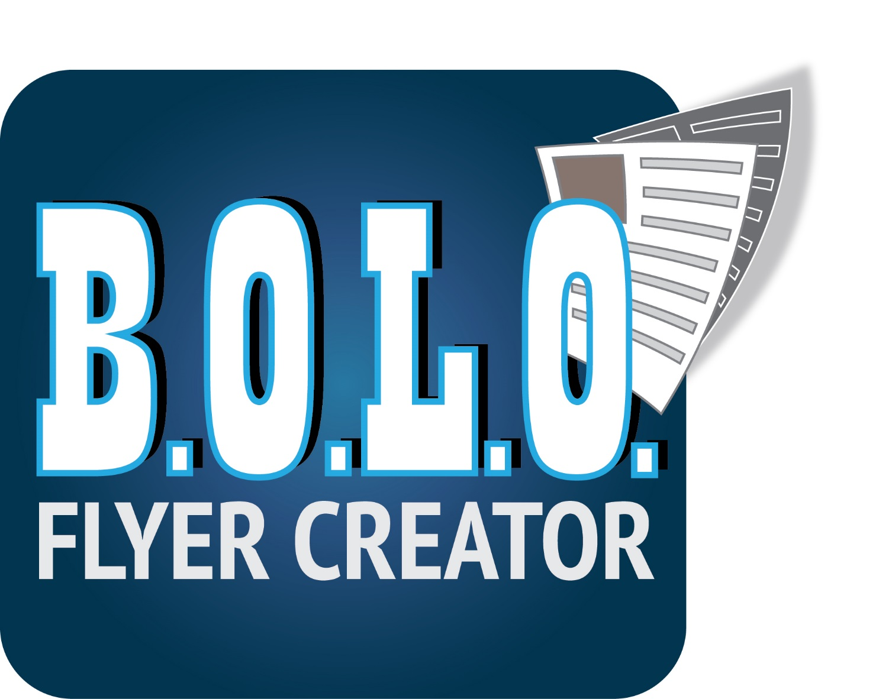



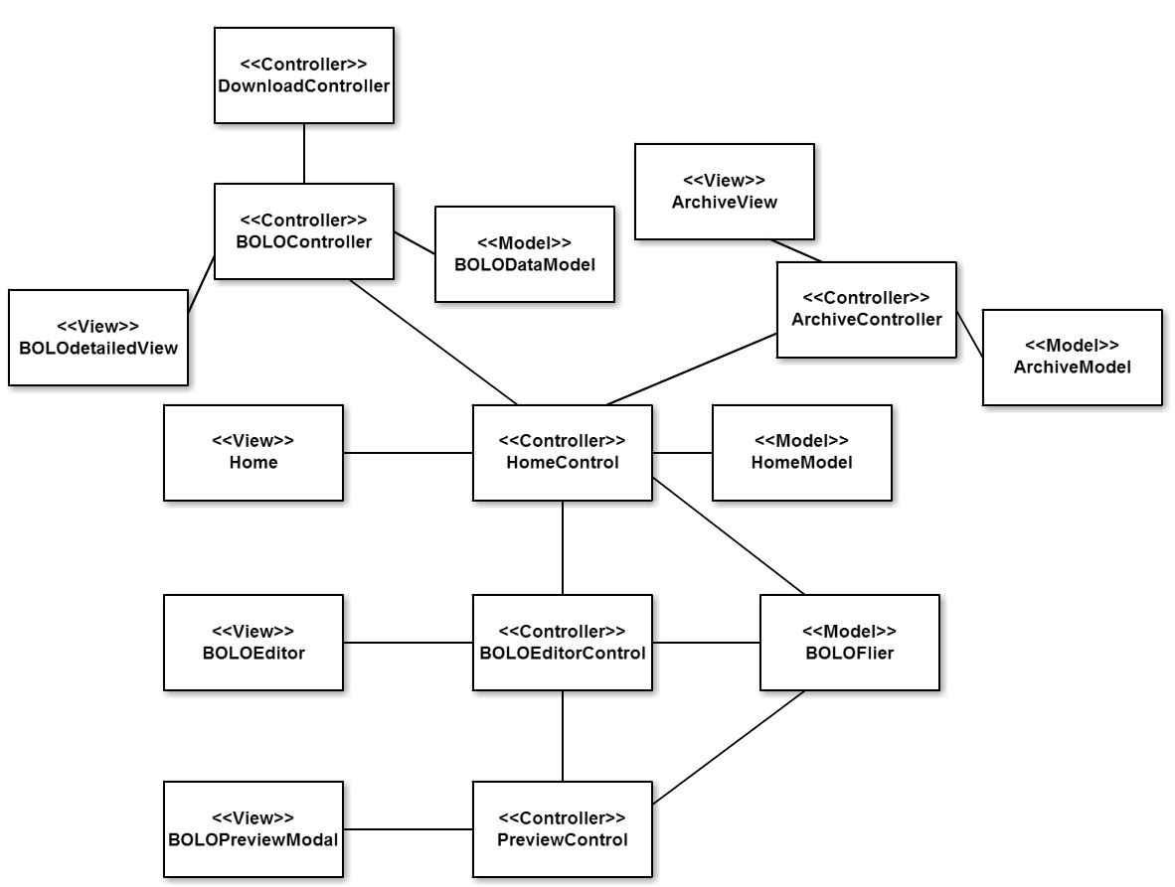
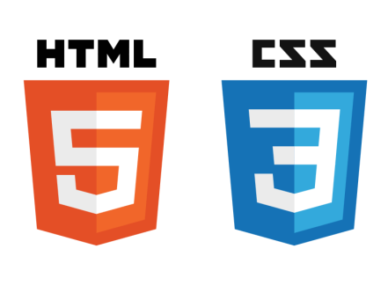


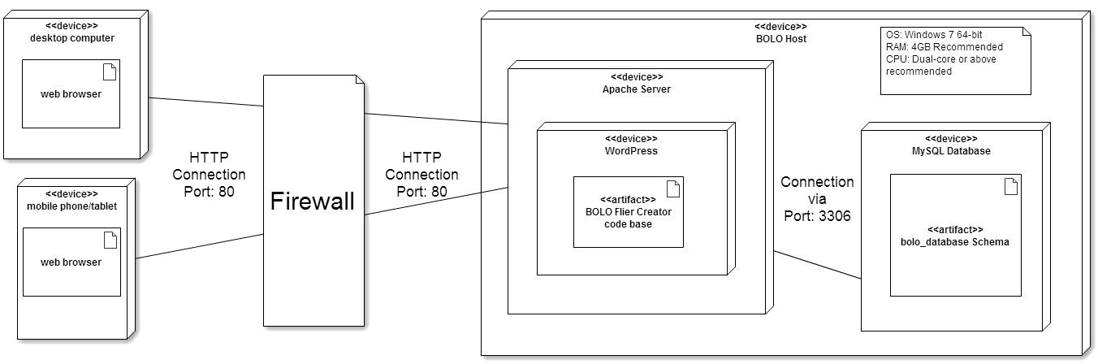






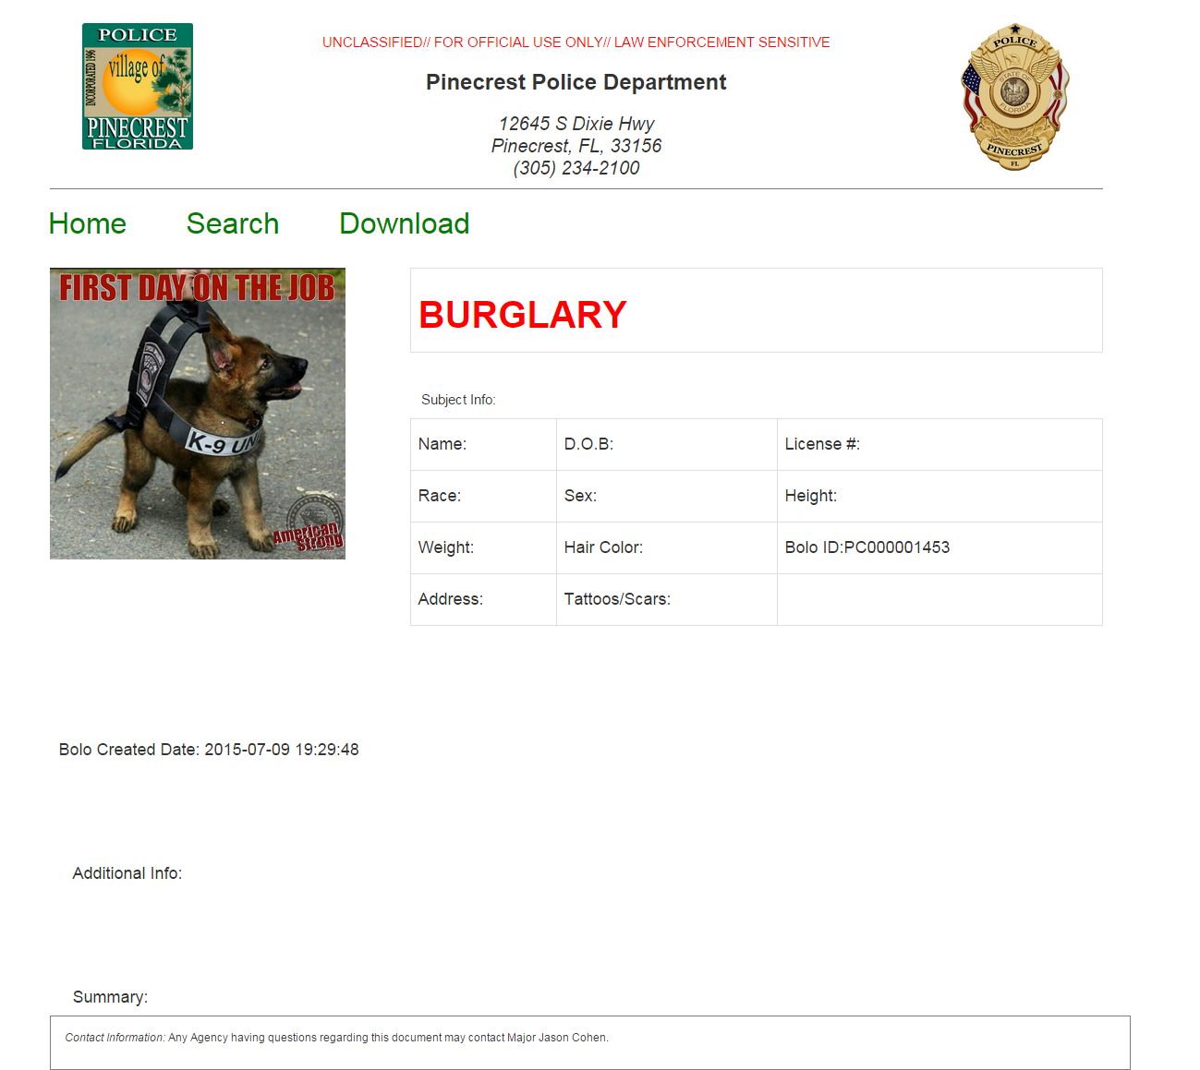
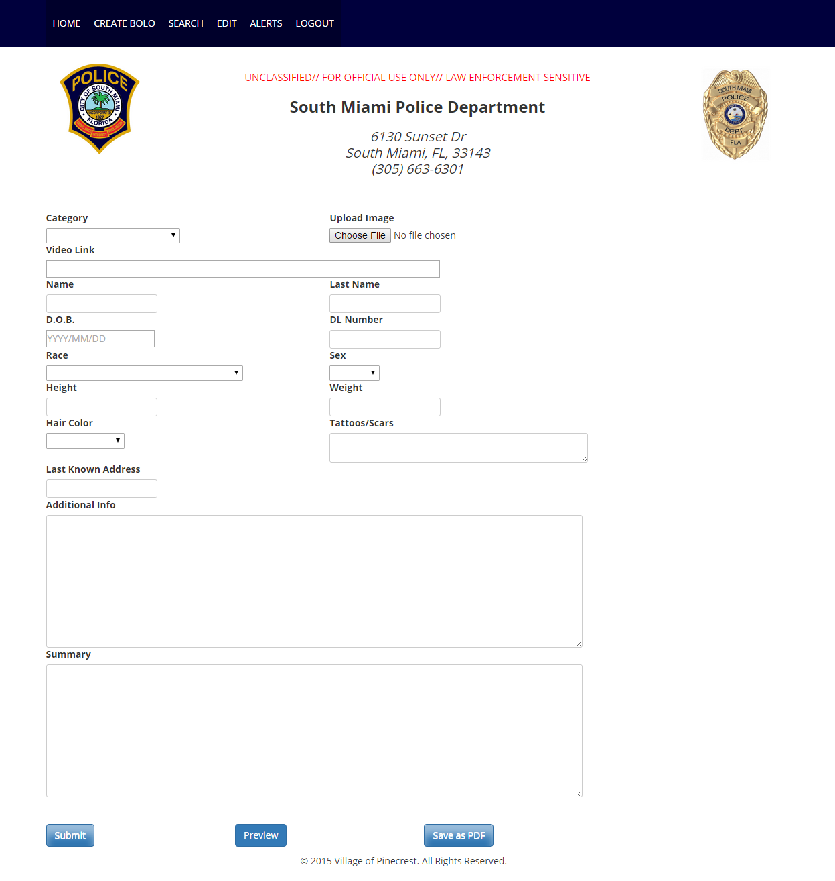
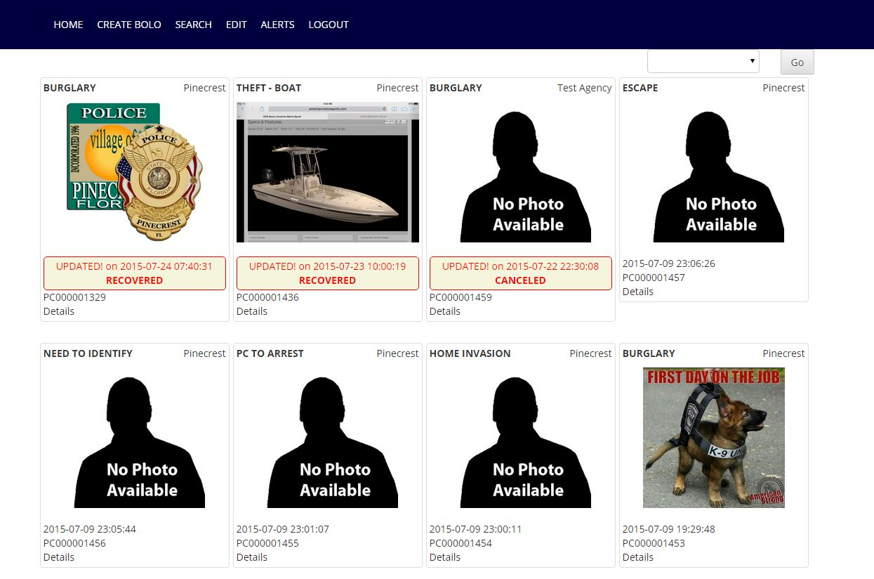
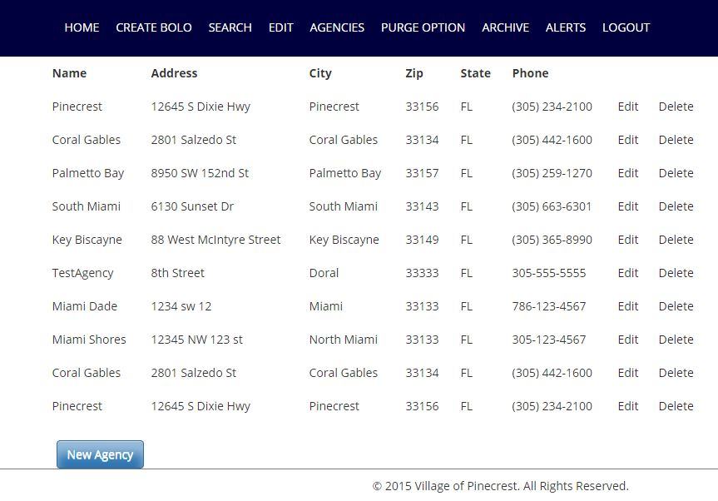
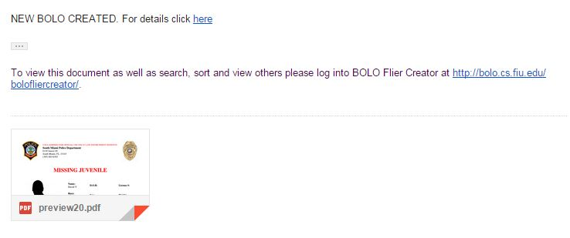
School of Computing & Information Sciences
Senior Project, 2015, Summer
BOLO Flyer Creator
Student: David E. Vizcaino, Florida International University
Mentor: Major Jason Cohen, Pinecrest Police Department
Instructor: Masoud Sadjadi, Florida International University
Problem
Current System
Requirements
Be On the Look Outs (BOLOs) are fliers shareinformational d law enforcement officers in the same, or different, departments. These fliers contain information on persons of interests related to ongoing investigations.
The issue with the current system stems from its response time. Officers responding to a scene do not currently have the capability to generate a BOLO on-site. And must wait until they are back in their office or several days thereafter. Once they generate a BOLO, they have to submit it for approval to their supervisor. After approval, the document is sent via mass email to multiple officers. This creates a system that is unsearchable and decentralized, which makes retrieving previously created BOLOs a hassle, if not entirely unfeasible and may lead to older BOLOs being lost or ignored.
A BOLO is currently distributed via several systems:
Electronically via emails containing PDFs. The PDFs are simply copies of BOLOs created via Microsoft Word and may contains pictures or other information. This is currently the most popular system and the one or software aims to replace.
Police Radio messages may also be sent when an incident has occurred These also contain information on persons of interests and may be considered a BOLO.
Test Messages may be sent to all officers currently on duty thanks through Computer Aided Dispatch (CAD).
BOLO Flyer Creator was designed as a lightweight system that can run on many computers, regardless of whether they are large multimillion dollar machines, or simple, cost-effective systems.
Furthermore, the system was also designed to reduce the time it took from when a crime is reported, to when a BOLO is distributed. This needed to be done in a way that would allow first responders to easily create the BOLOs while allowing input from witness and verification of final documentation (the actual BOLO produced) to reduce the frequency of errors as well as increasing production speed.
Our software would also need to post BOLOs, in real-time, to a central site and allow officers to search for specific BOLOs, as well as allowing Supervisors the ability to remove inappropriate BOLOs and better manage BOLOs created by their departments.
Object Design
Verification
Implementation
Test Case | BOLO 494 - SUNNY
Purpose | To validate the ability to preview BOLOs being created, as they would appear in the system.
Preconditions | User needs to be logged into system and creating a BOLO.
Input | Fill in BOLO with information (images, text, etc.) and then click on the Preview button.
Expected Result | The BOLO is successfully shown in a popup window as it would be displayed on the webpage (not as a PDF). On a mobile device, the BOLO is also shown in a new window after a warning displaying information on the redirect.
Result | PASS
BOLO Flyer Creator was implemented with HTML, JavaScript and Ajax with JQuery for BOLO previewing. Bootstrap was used to assist in the styling of the pages, especially for mobile devices, along with WordPress.
The backend was coded in PHP, with WordPress also providing some backend support.
In order to send emails with the attached BOLOs, PHPMailer, by Marcus Bointon, was used.
The PDFs themselves were created using mPDF.
Lastly, the database used was a mySQL database, which was included in the software stack provided by WAMP.
System Design
Test Case | BOLO 541 - SUNNY
Purpose | To validate the ability to download PDFs of previously created BOLOs
Preconditions | User needs to be logged into system and viewing a BOLO.
Input | Click on the Download link at the top of the BOLO.
Expected Result | The BOLO is successfully downloaded as a PDF that displays all BOLO data shown on the webpage.
Result | PASS
BOLO Flyer Creator uses a simple Client-Server architecture with a Model-View-Controller code base implementation; this allows all application data to be stored on the server and users to interact with the application using a web client. This deployment diagram shows our system distribution.
Summary
BOLO Flyer Creator was successfully implemented with all features requested for this development cycle completed.
Several new features were added by myself and my partner, including:
Previews: A BOLO could be previewed before being finalized.
PDF downloads: A PDF of any BOLO could be downloaded by simply viewing the BOLO and clicking the download link.
Edit from homepage: Any user is now able to edit any of their BOLOs directly from the homepage, navigation to the edit menu is no longer necessary.
And several more features.
Our software can be said to be a drastic improvement over the current manual system and successfully provides a tool to create BOLOs not just faster, but with less effort.
Screenshots
Acknowledgement
The material presented in this poster is based upon the work supported by Major Jason Cohen and started by previous students Icxe Vidal and Danae Perez. I am thankful to the help that I received from my group member Yamila Flietas .
Notes:
1

