Slide 1









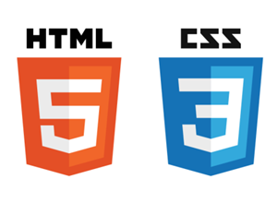

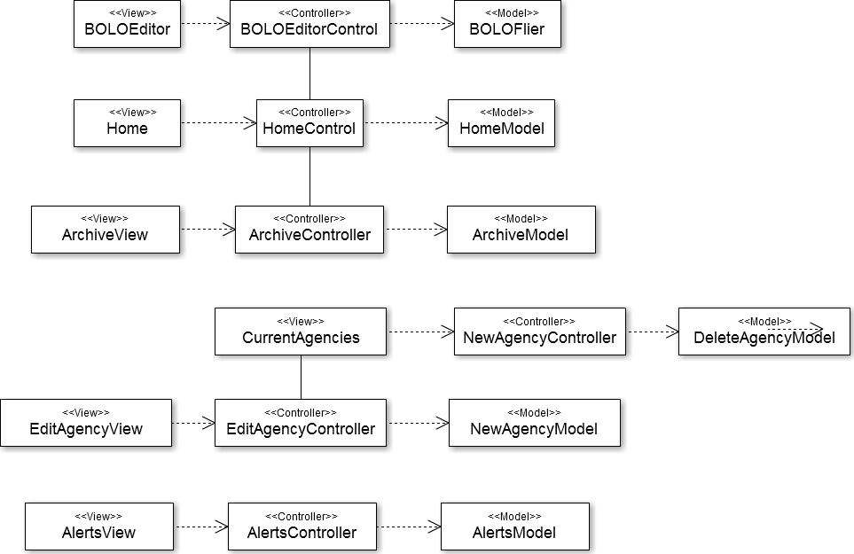
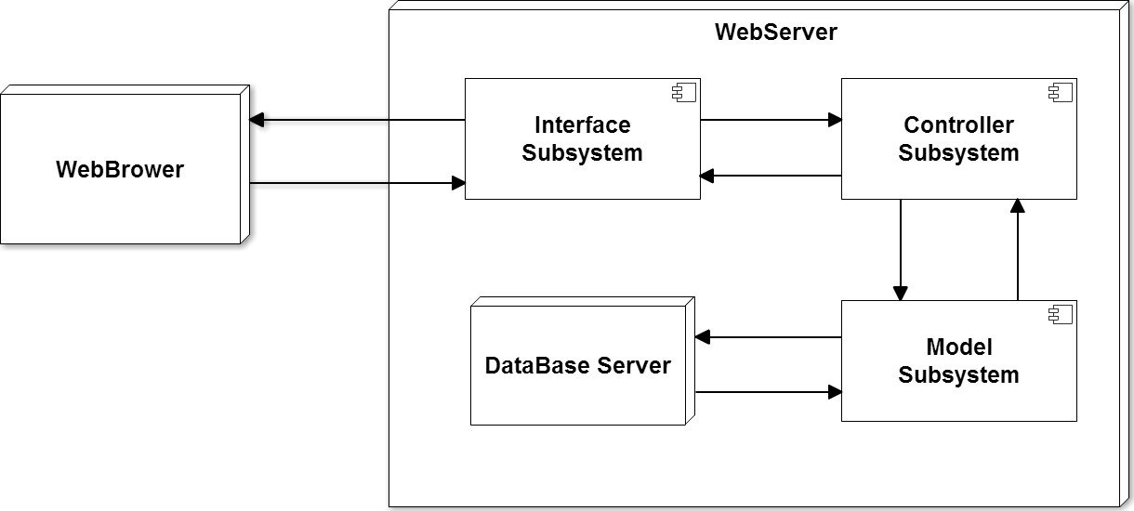
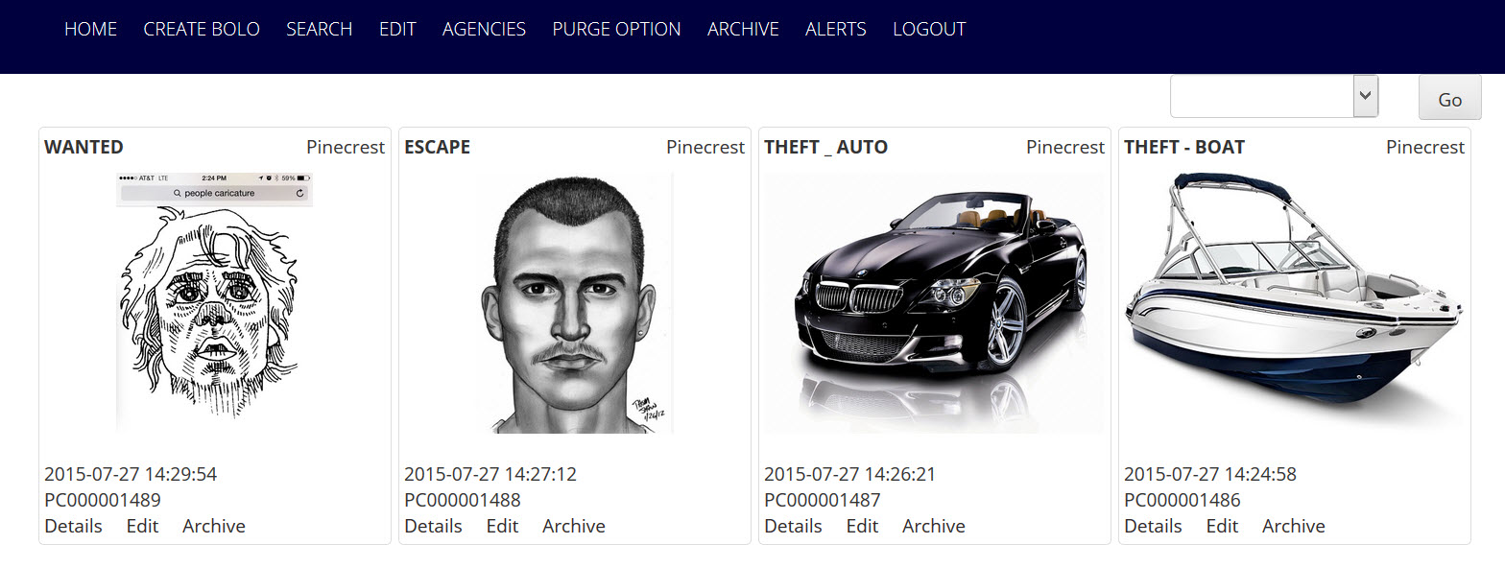
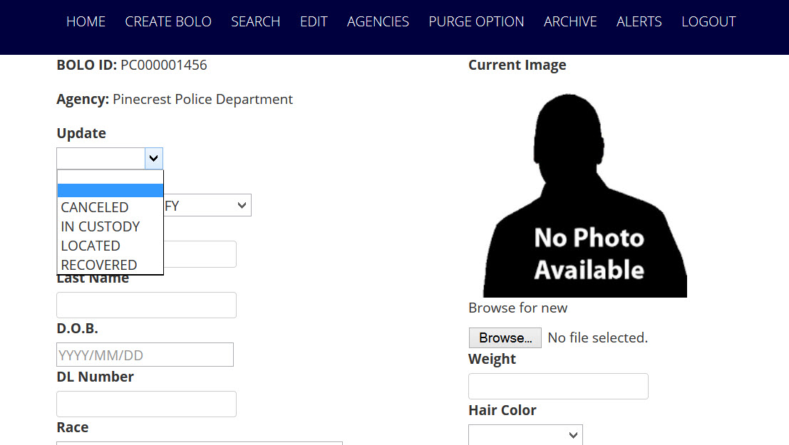
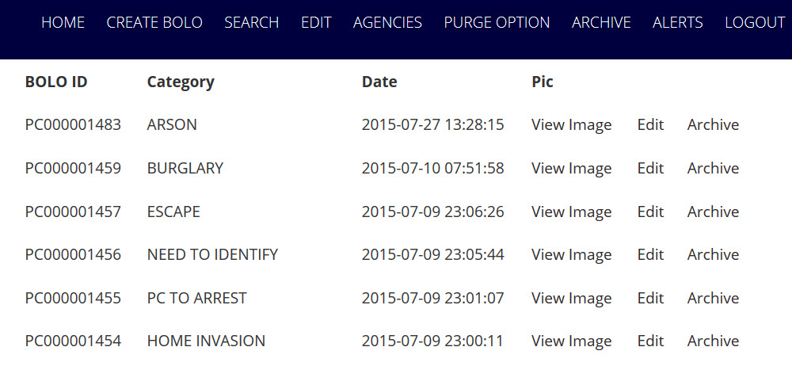
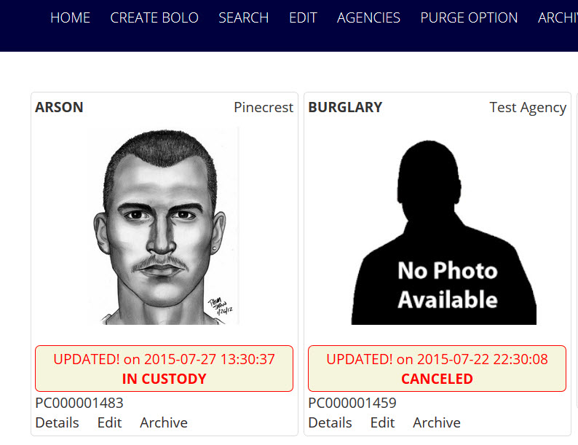
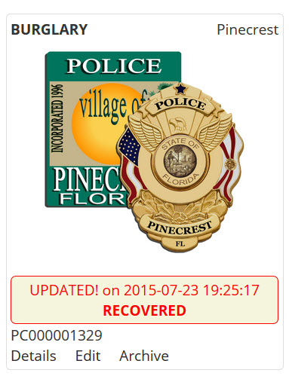
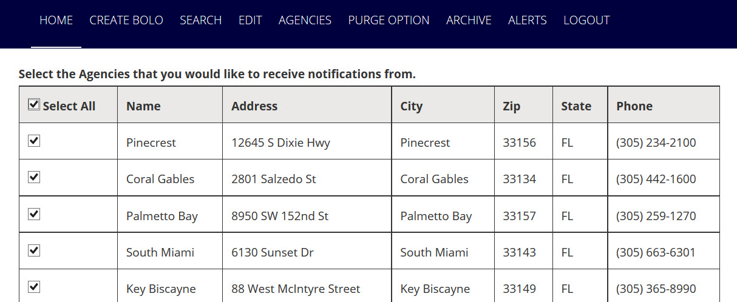
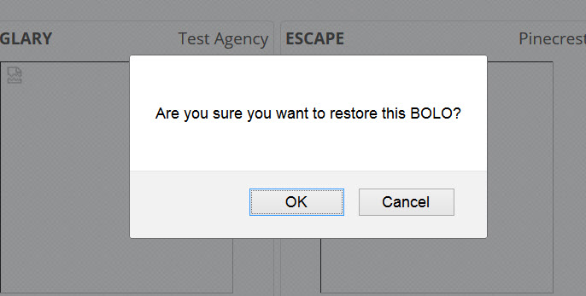
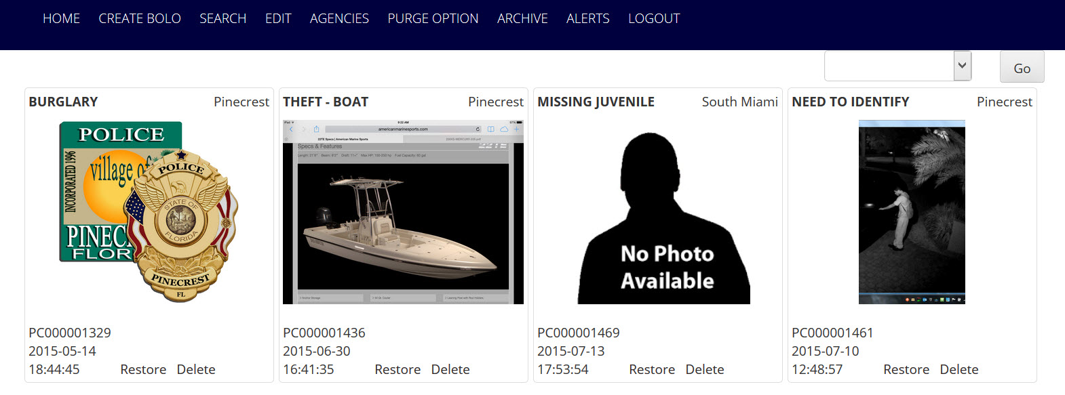
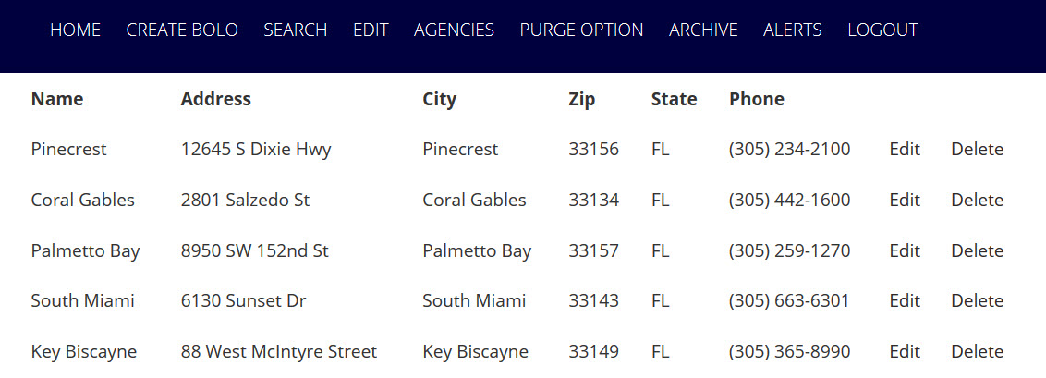
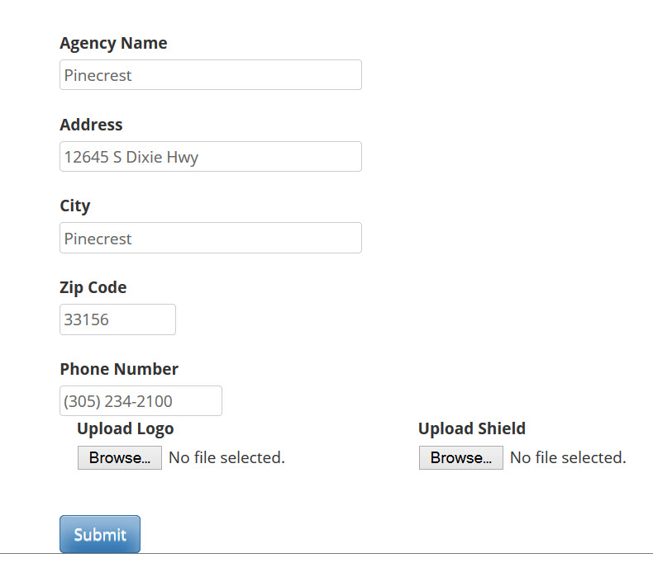
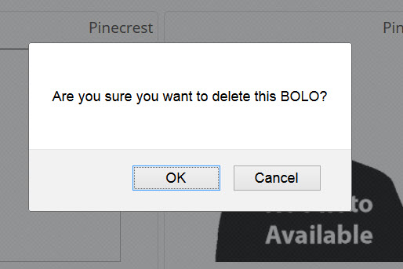
School of Computing & Information Sciences
Senior Project, 2015, Spring
BOLO Flyer Creator
Student: Yamila Fleitas, Florida International University
Mentor: Major Jason Cohen, Pinecrest Police Department
Instructor: Masoud Sadjadi, Florida International University
Problem
Current System
Requirements
The purpose of the BOLO Flier Creator is:
To decrease the amount of time it takes for an officer to take information from an event, such as a crime scene, and turn such information into a usable report, a BOLO.
Future system will allow users to create BOLOs with greater
View new BOLOs and BOLOs pertaining to other departments faster and easier.
Automatically send notifications to all relevant users upon the creation of a BOLO.
A BOLO is distributed in several ways:
Over the police radio: When an incident occurs the responding officer will “BOLO” pertinent information over the police radio for other units to hear.
Via Computer Aided Dispatch (CAD) message: The officer will send a text message via the CAD to other police units that are currently on duty.
A BOLO Flyer (Document) with pertinent information, to include pictures, is created, usually via MS WORD and then converted to PDF and distributed to other officers or agencies via Email or FAX.
The system shall…
Allow to add the Archive button on each BOLO flier
Allow to add the ability to Delete Archived BOLOs
Allow to add the ability to Restore Archived BOLOs
Allow the administrators to edit agency information
Allow the users to filter alerts by agency
Allow to add the 2-step verification of the Archive button
Allow to add the category Recovered to the update drop down.
Allow the user to change the email address
Allow users upon user creation to have by default all agencies selected
System Design
Object Design
The application uses a server- client architecture where the implementation will be on the server side using the Model-View-Controller (MVC) architecture.
Implementation
The front end of the website was implemented using HTML and JavaScript; and Bootstrap to make it mobile friendly, while PHP was used in the back end.
MySQL was selected as our Database Management System.
In order to create the pdf version of the BOLO the open source library mPDF was used.
Verification
Screenshots
Summary
The Bolo Flyer Creator verification was done using dynamic and static test cases. It was done with automated and manual test cases on each piece of functionality once its implementation was done using Selenium Automation Tool.
The objective of our System Tests were to make sure that the system was behaving appropriately, as defined by the requirements provided by our clients.
The goal of the project is to build a BOLO Flier Creator web application that will speed the process of creating a BOLO (Be On the Lookout) flier. The application will help officers serve their communities in a faster, easier, and more efficient way, by replacing the paperless process that is currently in use.
Using this application information is shared in as close to real time as possible as well as preserved via database for use and review at any time.
Acknowledgement
The material presented in this poster is based upon the work supported by Major Jason Cohen and Pinecrest Police Department. I am thankful for the help that I received from my group member David Vizcaino. I would also like to thank Masoud Sadjadi and Juan Caraballo for the feedback provided throughout the semester.

