Slide 1
Collaborative Platform Version 5.0
Team Members
Product Owner
Adrian Alfonso (Developer)
Juan Caraballo (Product Owner)
Jorge Travieso (Developer, Scrum Master)
Spring 2015

Slide 2
Problem
Current students lack a reliable source for answering questions related to their classes or projects.
Students may rely on several internet sources, often unreliable, inaccurate and incomplete.
Difficulty matching the correct mentor to the right question.
Lack of standard way of communication for answering questions.

Slide 3
Problem Solution
Lack of interaction among users of the system
Very difficult to set up meetings
Lack of reporting to measure the utilization of the system
Collaborative Tools
Admin Reports
Utilization Dashboard

Slide 4
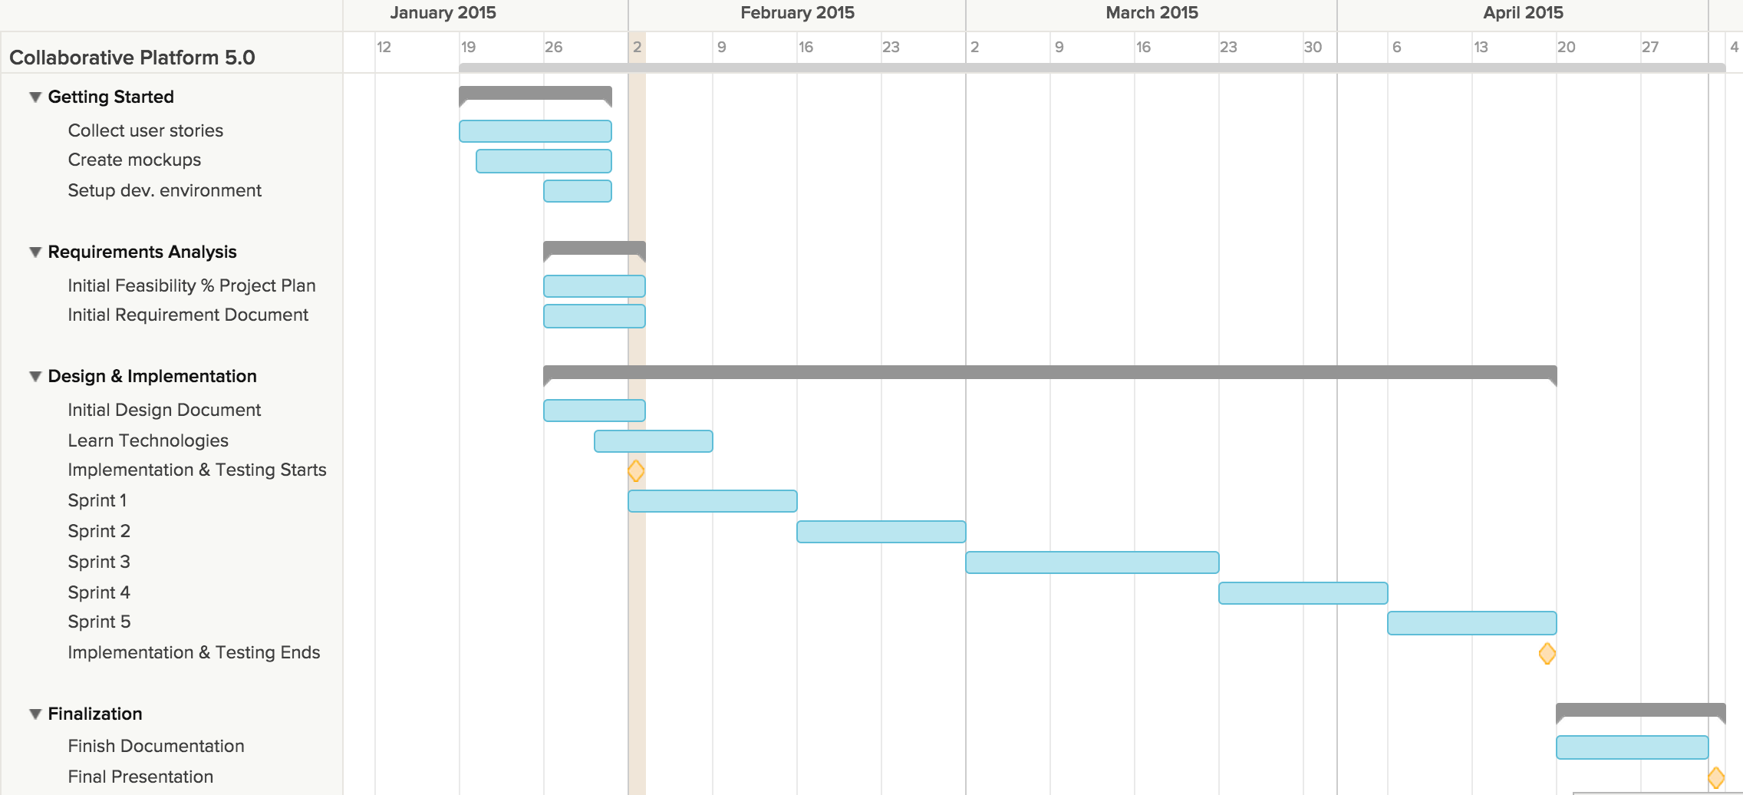
Project plan

Slide 5
User Stories
User Story
Schedule On-Demand Video Conference
Schedule Video Conference Ahead of Time
Schedule Video Conference From a Ticket
Join Video Conference
Screen Sharing During Video Conference
Use Whiteboard
Use Chat Room
Invite More People
Accept/Reject Video Conference Invitation
Cancel Video Conference Meeting

Slide 6
User Stories
User Story
Pull Mentee Reports
Pull Mentor Reports
Pull Ticket Reports
Pull New Tickets (Chart)
Pull Closed Tickets (Chart)
Pull Average Mentor Response Time (Chart)
Pull Average Ticket Duration (Chart)
Pull Tickets Unanswered (Chart)
Pull Tickets Currently Opened (Chart)
Pull Tickets Currently open (Details)
User Story
Pull Tickets Unanswered (Details)
Pull Closed Tickets (Details)
Pull Ticket Duration (Details)
Pull Mentor Response Time (Details)

Slide 7
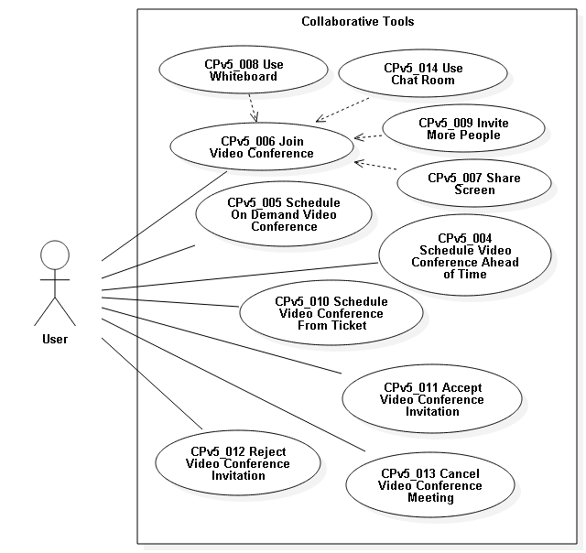
Use Cases

Slide 8
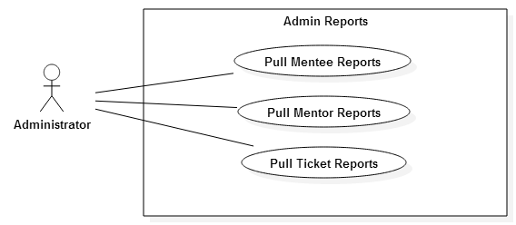
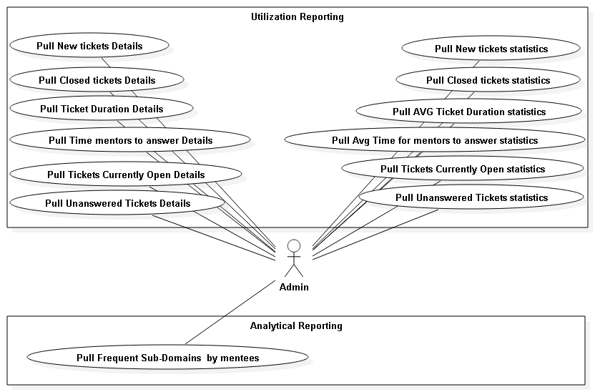
Use Cases

Slide 9
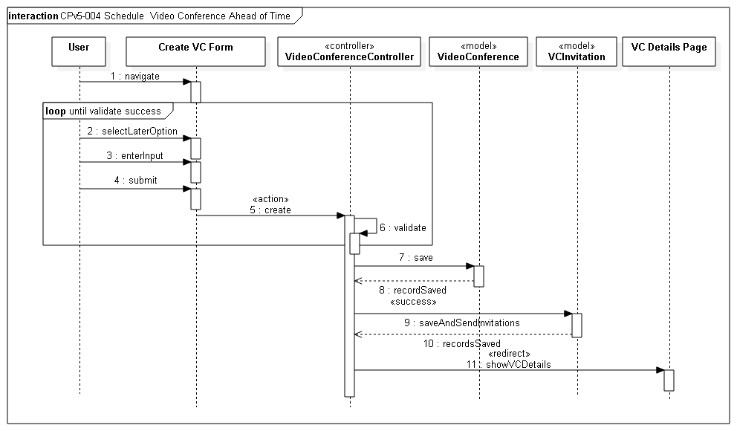
Sequence Diagrams

Slide 10
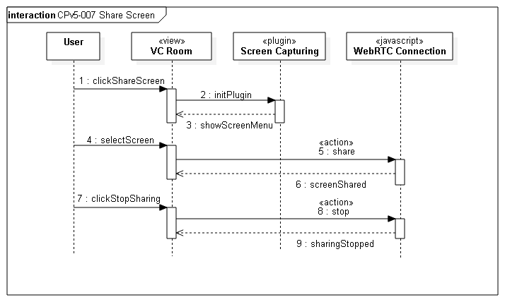
Sequence Diagrams

Slide 11
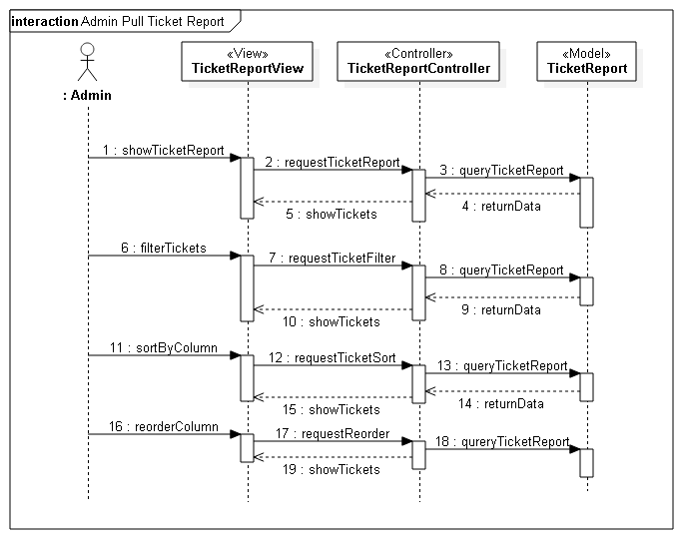
Sequence Diagrams

Slide 12
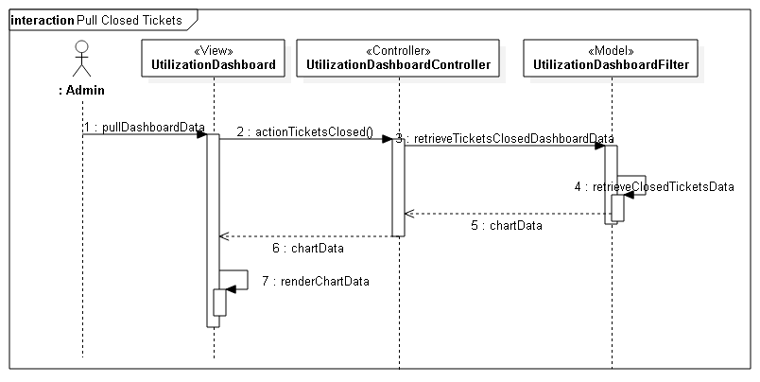
Sequence Diagrams

Slide 13
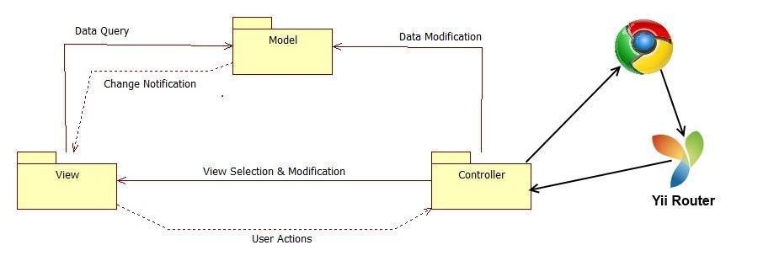
System Decomposition

Slide 14
System Deployment
Minimum Hardware
Minimum Software
Processor | 1.6 GHz
RAM | 256 MB
CPU op-mode(s) | 32-bit
Database Server | MySql 5.5
Web Server | Apache 2.0
Server-side Scripting | PHP 5.5
Operating System | Linux

Slide 15
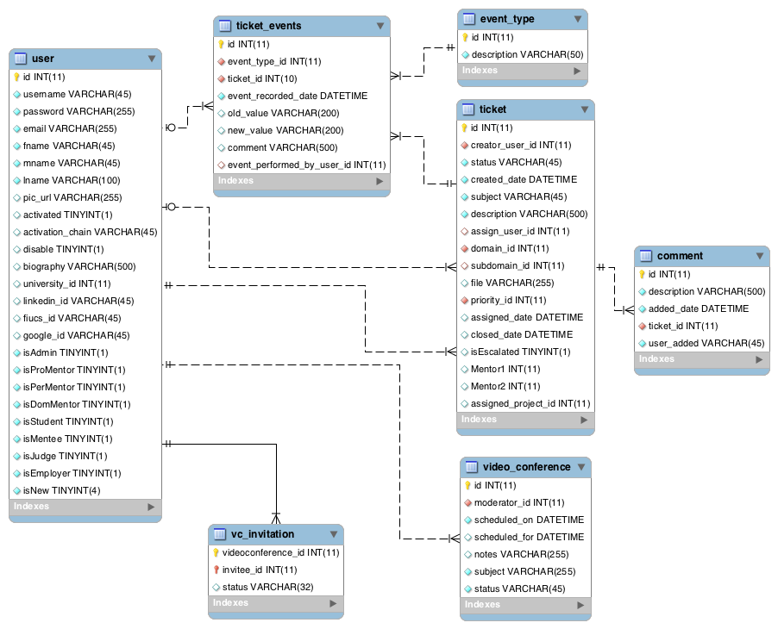
ER Diagram

Slide 16
Security/Privacy
Yii access control rules
Yii Cross-site scripting prevention
Password hashing
Secure registration process

Slide 17
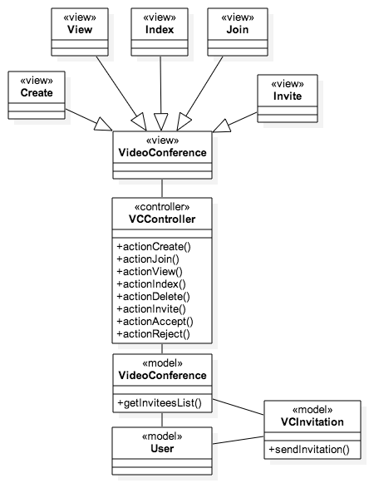
Class Diagram

Slide 18
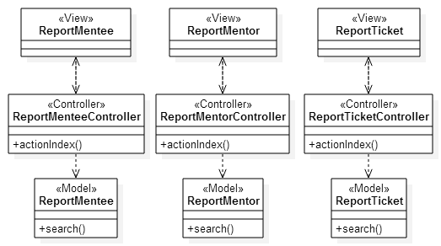
Class Diagram

Slide 19
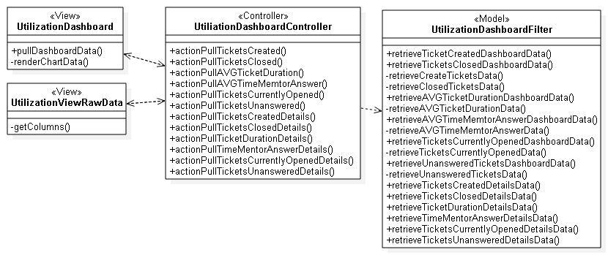
Class Diagram

Slide 20
Join Video Conference algorithm
Invitee:
Navigate to video conference room
Click join button
Wait until Moderator opens room
Share resources (webcam, microphone)
Join the conference
Moderator:
Navigate to video conference room
Click open button
Share resources (webcam, microphone)
Conference starts
Receive invitees connections

Slide 21
Test Cases
Test Case ID | TS011 Video conference scheduled ahead of time
Purpose | Test that video conference can be scheduled ahead of time.
Test Setup | The user should be authenticated and have navigated to the create video conference form.
Input | The user selects the later option, enters the meetings subject, date, time, notes and correct several invitee emails. These emails addresses should already exist on the system.
Expected Output | The invitations have been successfully sent.
Actual Output | The invitations have been successfully sent.
Test Case ID | TS009 Video conference invitation to wrong email
Purpose | Test that an invitation cannot be sent to an email that does not exist on the system.
Test Setup | The user should be authenticated and have navigated to the create video conference form.
Input | The user selects the now option, enters the meetings subject, notes and a wrong invitee email. These email address is not recognized by the system
Expected Output | <wrong email> does not appear in our records <br>
Actual Output | <wrong email> does not appear in our records <br>

Slide 22
Test Cases
Test Case ID | CPv5-TC08
Purpose | Testing Ticket Report accuracy after filtering by Closed tickets.
Test Setup | Set the database with 10 tickets, one of the tickets is closed.
Input | Admin user clicks on the menu report and then clicks on the sub-menu Ticket. The user selects the filter Ticket Status = Closed.
Expected Output | The data for the closed ticket should show.
Actual output | The data for the closed ticket closed shows.
Test Case ID | CPv5-TC06
Purpose | Testing Mentee Report security (only accessible to admin).
Test Setup | Logging into the system as a non-administrator user.
Input | The user inputs in the browser the URL = host + /coplat/index.php/reportMentee
Expected Output | A non-authorized page should appear.
Actual output | A non-authorized page should appear.

Slide 23
Demo
http://cp-dev.cis.fiu.edu/coplat/index.php/site/login

