Slide 1
Collaborative Platform Version 5.0
Team Members
Product Owner
Adrian Alfonso (Developer)
Juan Caraballo (Product Owner)
Jorge Travieso (Developer, Scrum Master)

Slide 2
Problem
Current students lack a reliable source for answering questions related to their classes or capstone projects.
Students may rely on several internet sources, often unreliable, inaccurate and incomplete.
Difficulty matching the correct mentor to the right question.
Lack of standard way of communication for answering questions.

Slide 3
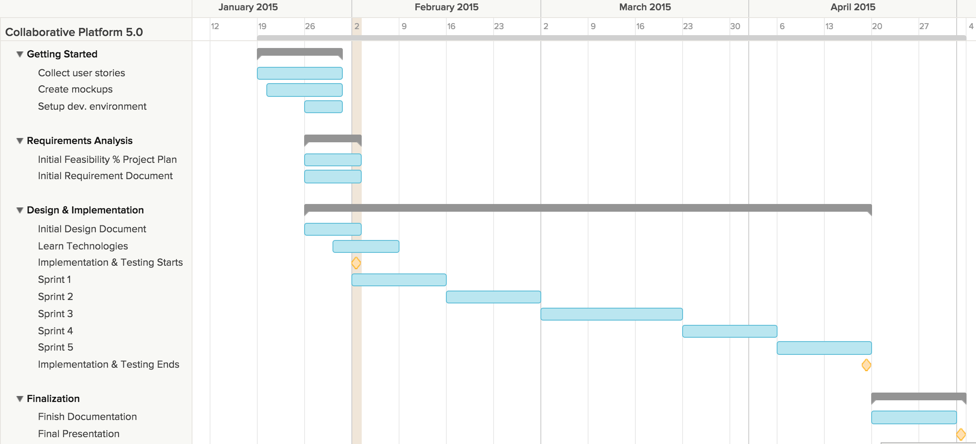
Project plan

Slide 4
User Stories

Slide 5
Use Cases

Slide 6
Sequence Diagrams

Slide 7
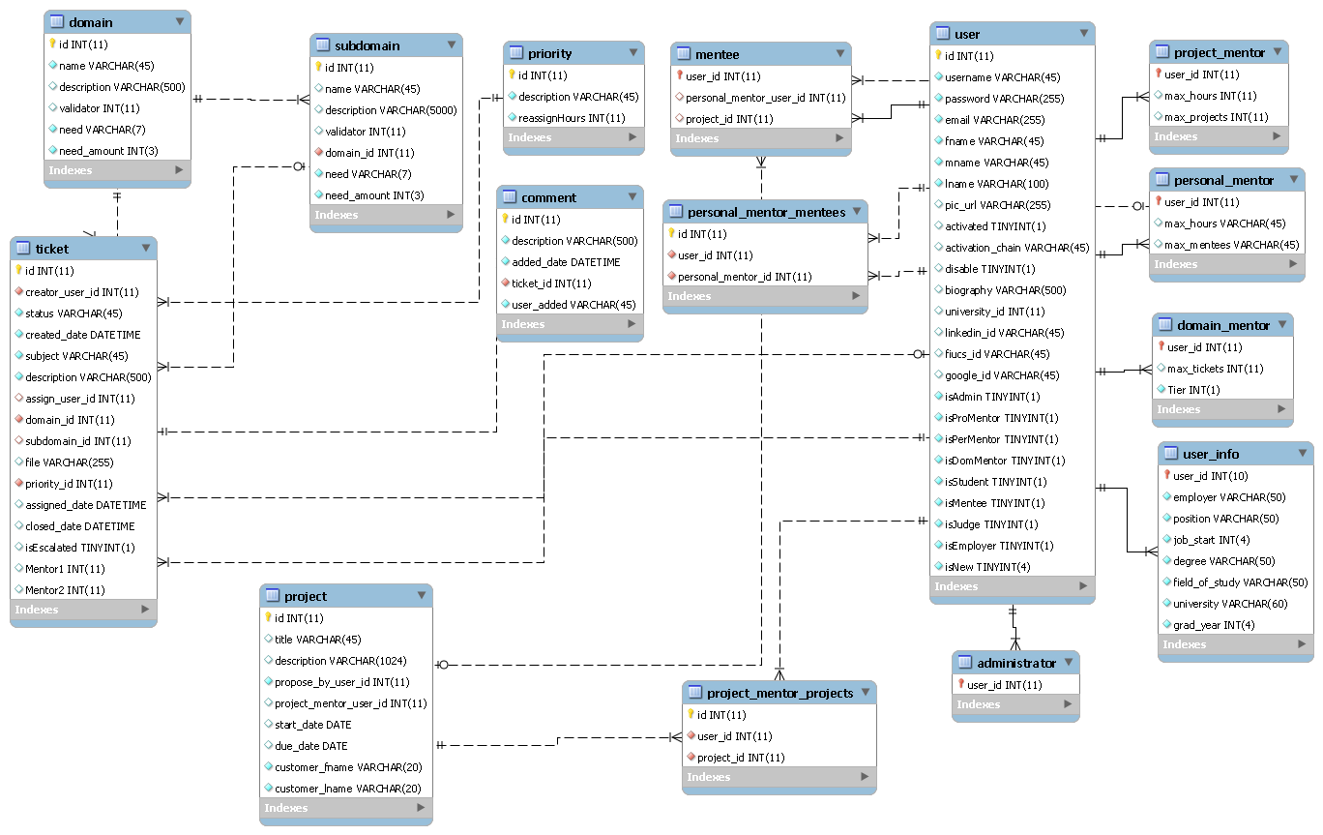
ER Diagram

Slide 8
Security/Privacy

Slide 9
Class Diagram

Slide 10
State Machine

Slide 11
Main Algorithm

Slide 12
Test Cases

