Slide 1
Collaborative Platform Version 5.0
Team Members
Product Owner
Adrian Alfonso (Developer)
Juan Caraballo (Product Owner)
Jorge Travieso (Developer, Scrum Master)

Slide 2
Problem
Current students lack a reliable source for answering questions related to their classes or capstone projects.
Students may rely on several internet sources, often unreliable, inaccurate and incomplete.
Difficulty matching the correct mentor to the right question.
Lack of standard way of communication for answering questions.

Slide 3
Previous Version Limitations
Lack of interaction among users of the system
Very difficult to set up meetings
Lack of reporting to measure the utilization of the system

Slide 4
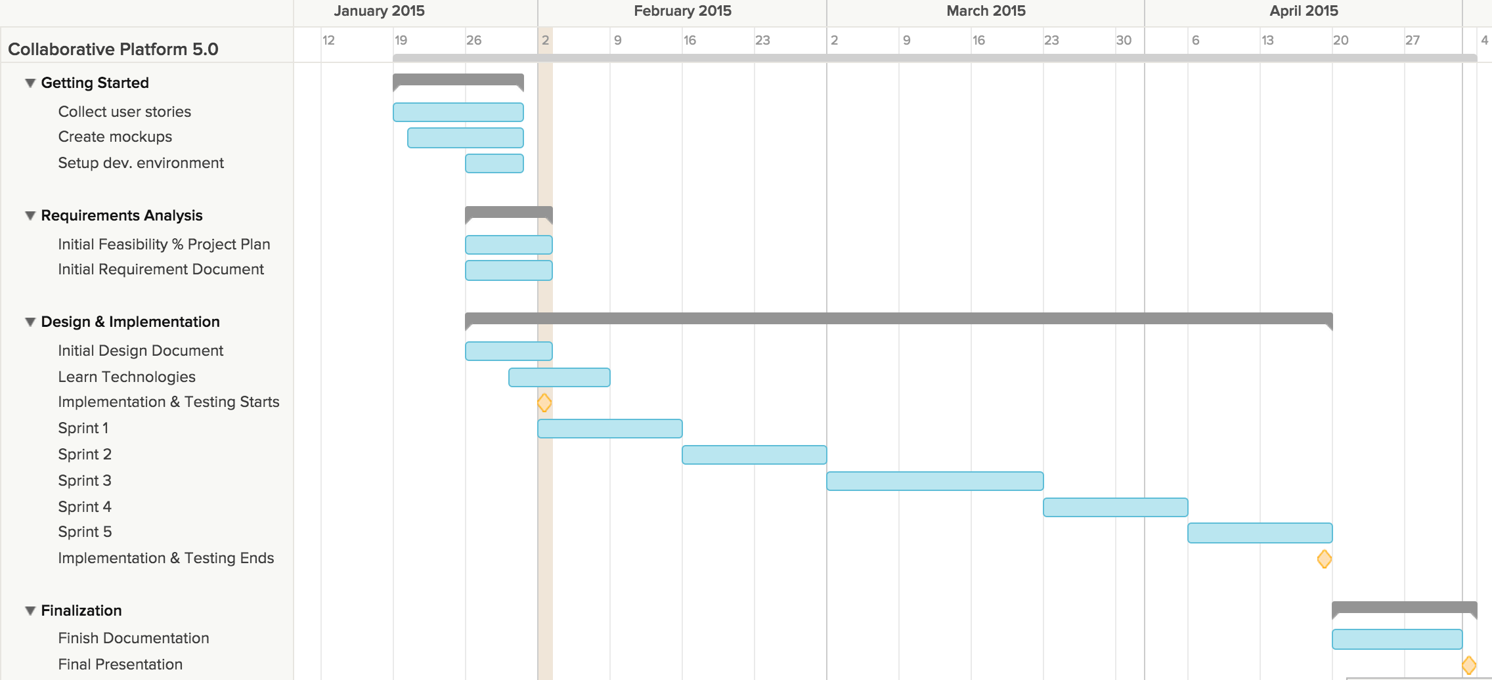
Project plan

Slide 5
User Stories
User Story
Schedule On-Demand Video Conference
Schedule Video Conference Ahead of Time
Schedule Video Conference From a Ticket
Join Video Conference
Screen Sharing During Video Conference
Use Whiteboard
Use Chat Room
Invite More People
Accept/Reject Video Conference Invitation
Cancel Video Conference Meeting

Slide 6
Use Cases

Slide 7
Sequence Diagrams

Slide 8
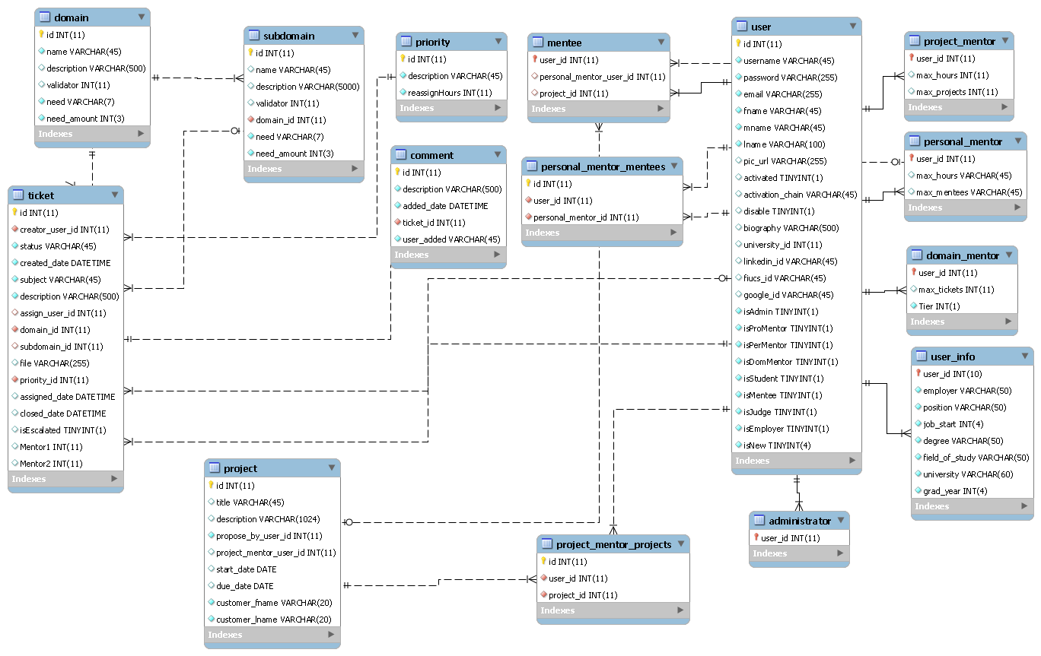
ER Diagram

Slide 9
Security/Privacy

Slide 10
Class Diagram

Slide 11
State Machine

Slide 12
Main Algorithm

Slide 13
Test Cases

