Slide 1










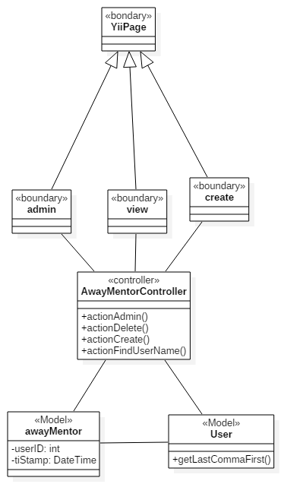
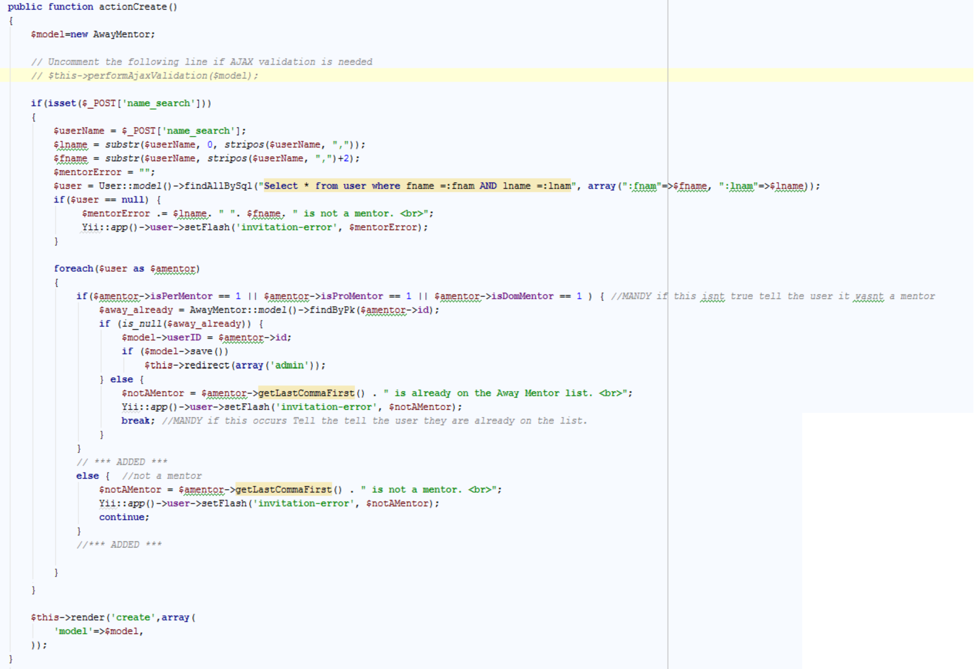
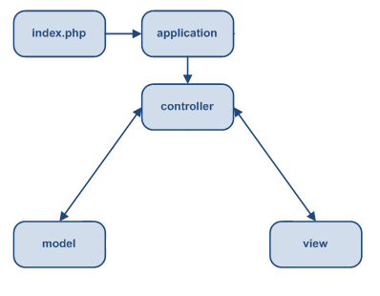
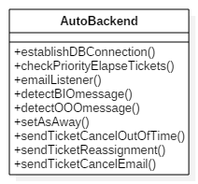
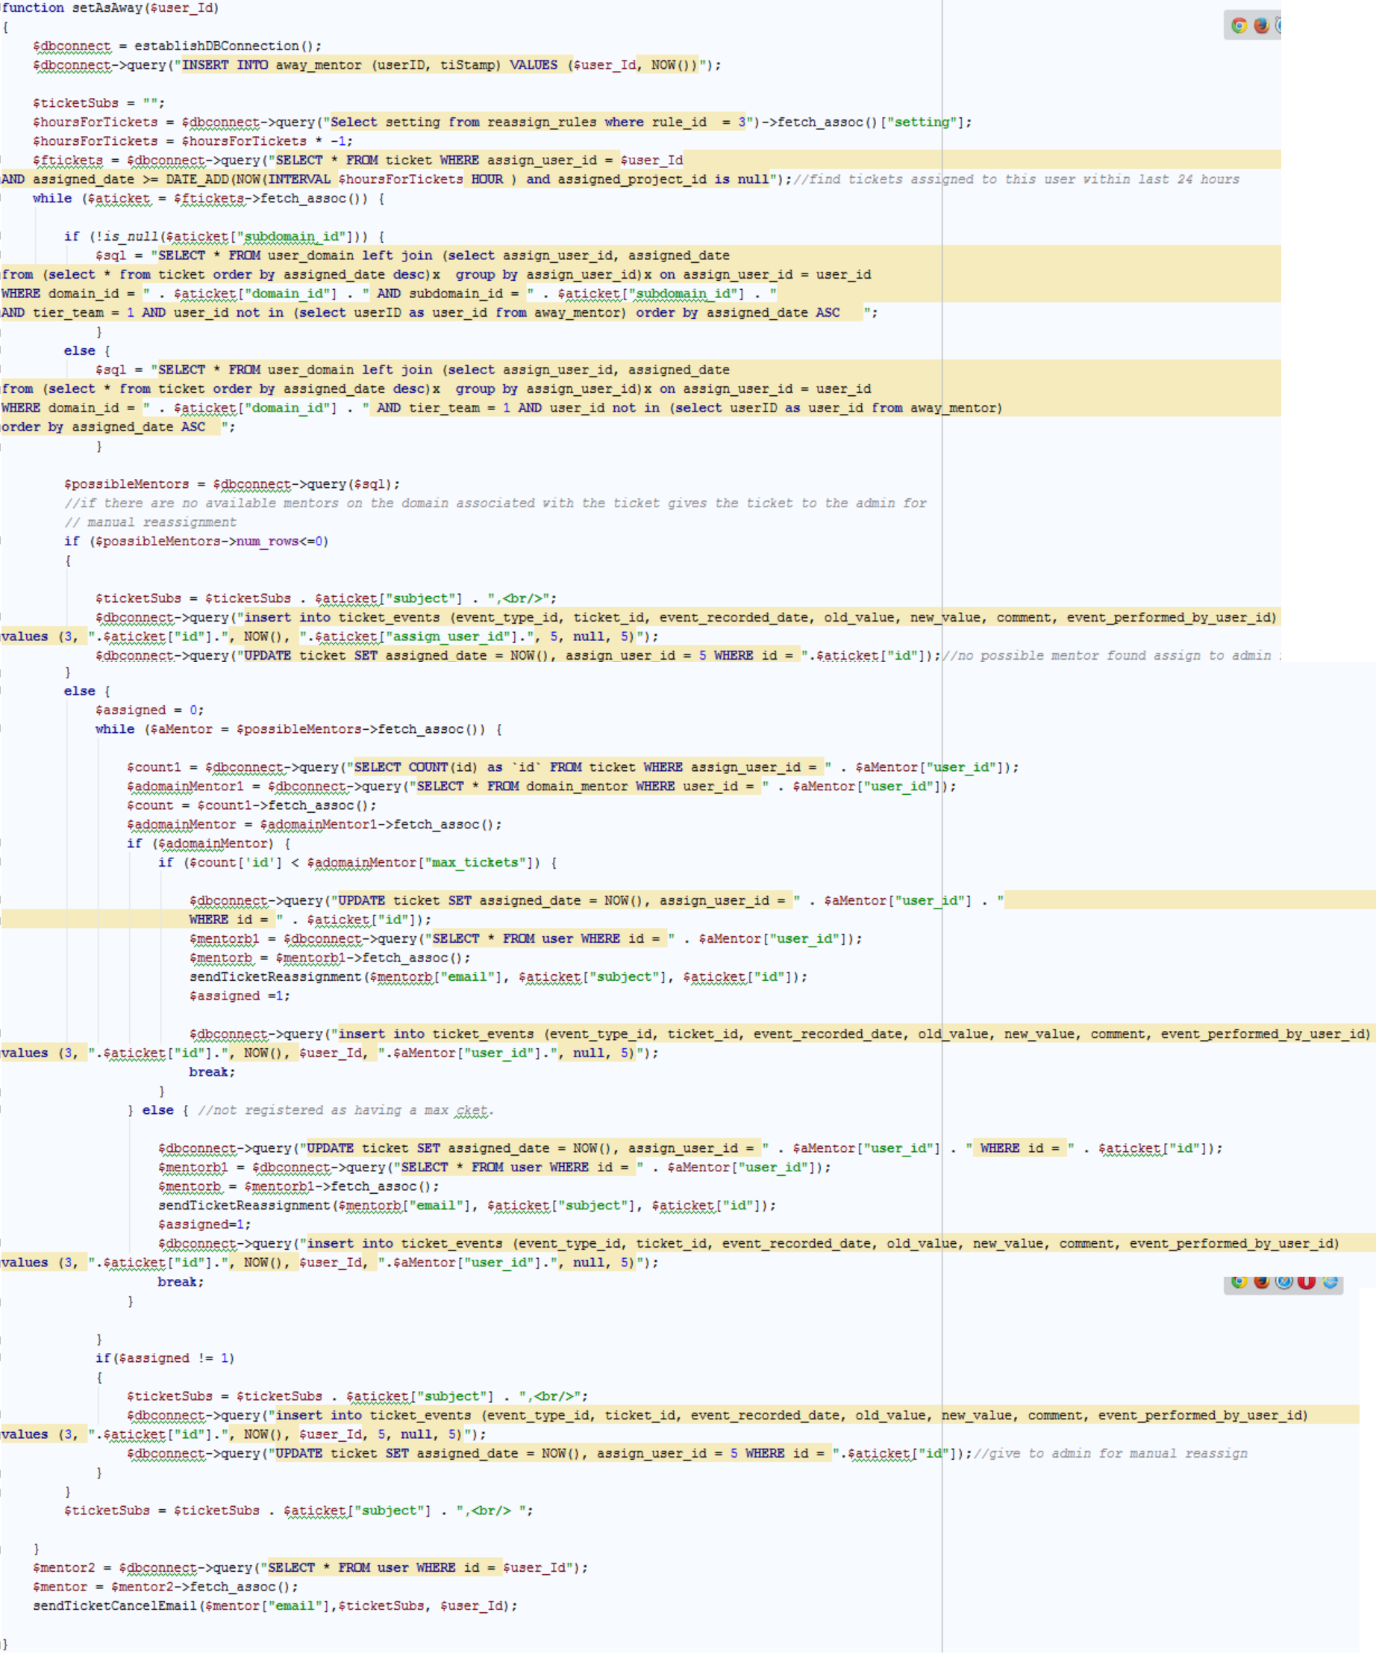
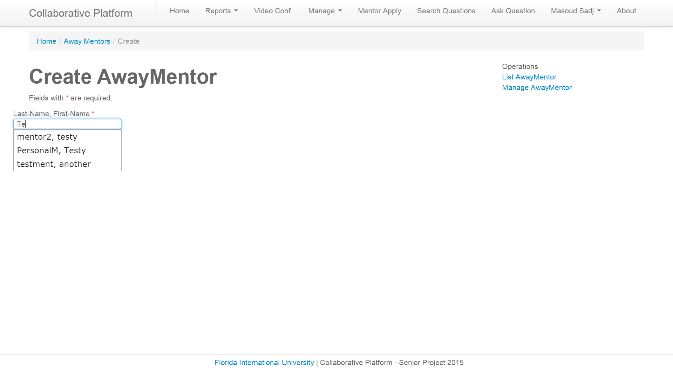
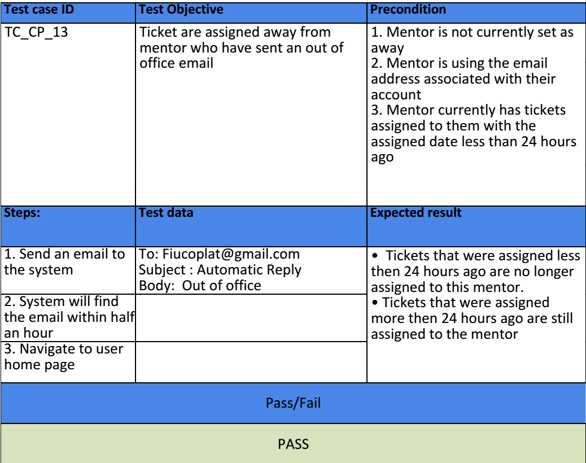
School of Computing & Information Sciences
Senior Project, 2015, Summer
Collaborative Platform
Student: Michael Machin, Florida International University
Mentor: Juan Caraballo, IBM
Instructor: Masoud Sadjadi, Florida International University
Problem
Current System
Requirements
Current students lack a reliable source for answering questions related to their classes or projects. At times students rely on internet sources that are often unreliable, inaccurate and incomplete. In efforts to solve this issue FIU SCIS decided to develop the Collaborative Platform in order to connect students (mentees) with the right experts (mentors).
To improve the interaction between mentors and mentees, a system to keep track of unavailable mentors, as well as a system that will automatically assign a ticket to a new mentor when the need arises will be implemented. This was my task this semester.
The current system consists of a web application that allows mentees to post questions (tickets) that can be solved by a mentor. In the system, administrators can group mentees by project and mentors by domain to better assign the right mentor to a ticket. In addition, administrators have many options to manage registration applications, tickets, projects, etc.
However, the system lacks the ability to automatically determine when tickets should be assigned to a new mentor, thus users are forced to wait unnecessarity for the resolving of their ticket.
To refine the ticket assignment process, we developed the Automated backend, which will:
Upon Receiving and “Out Of Office” email
Prevent the mentor from receiving further questions.
Assign the recent questions assigned to the mentor to a new available mentor
Notify the “Out of Office” mentor of the removed questions and that they are “Out of Office.
Notify the new mentor of the new questions
Notify the “Out of Office” mentor they are considered such both through email and on their home page.
Allow the “Out of Office” mentor to let the system know they are “Back in Office”.
System Design
Object Design
Implementation
The Collaborative Platform is powered by Yii framework which provides a model-view-controller (MVC) design pattern. The model represents data, business logic and rules. The view represents the presentation. Finally, the controller accepts input and provides bridge of communication between models and views.
AwayMentorController.php
AutoBackend.php
Verification
Screenshots
Summary
The Automatic Backend was tested through hands-on question assignments and setting of automated replies on our respective emails. We were able to test all the implemented features.
The Collaborative platform provides a tool for answering students questions; effectively and in a timely manner.
With the implementation of the Automatic Backend we are providing users a more complete system for handling the questions they ask.
The mentee no longer has to wait unnecessarily on mentors who are out of office or are generally taking to long to answer the question.
The mentor can rest assured that if their email is sending out automatic Out of Office replies they no longer will be assigned questions they are unable to answer.
Acknowledgement
I wanted to thank my group member, friends, mentors and my family for the support.
Notes:
‹#›

