Slide 1







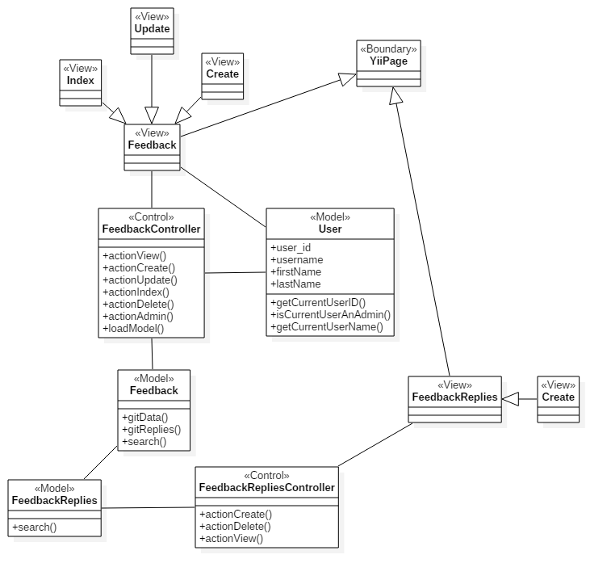
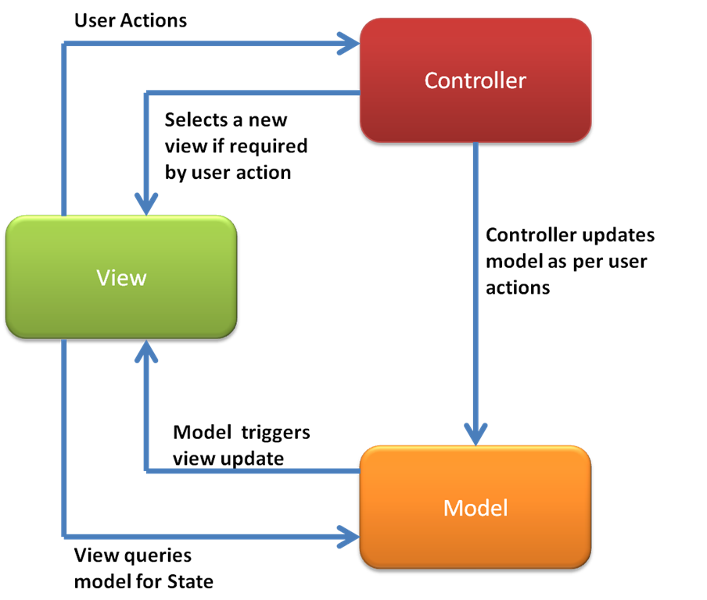
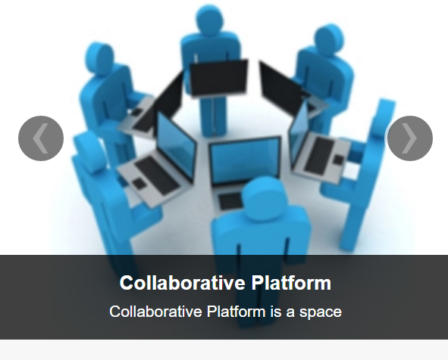
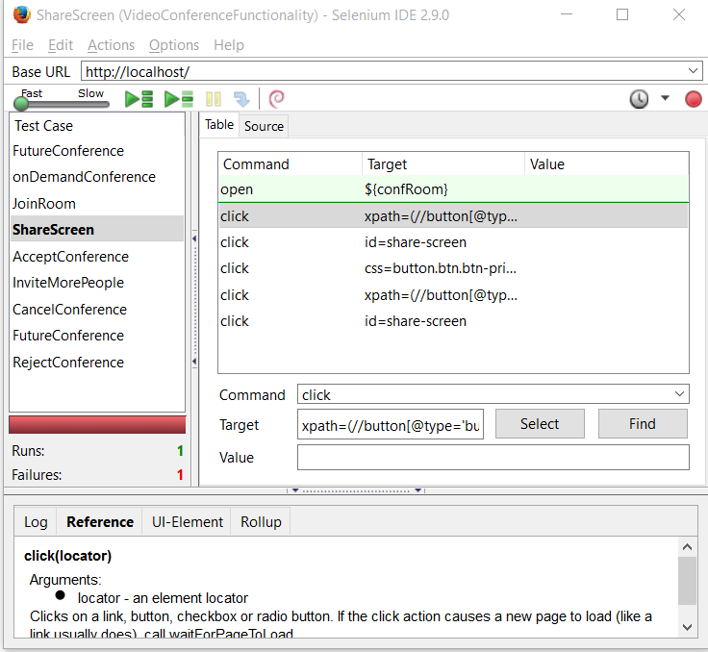
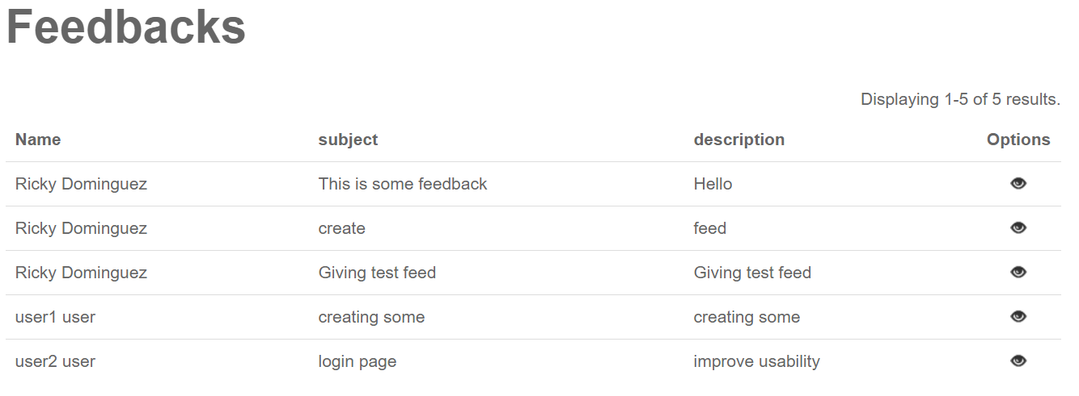
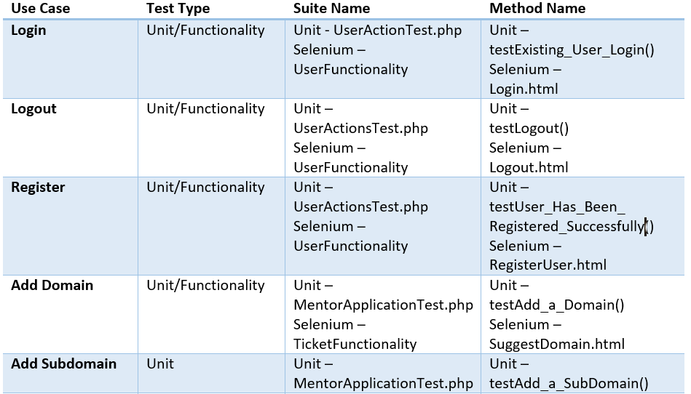
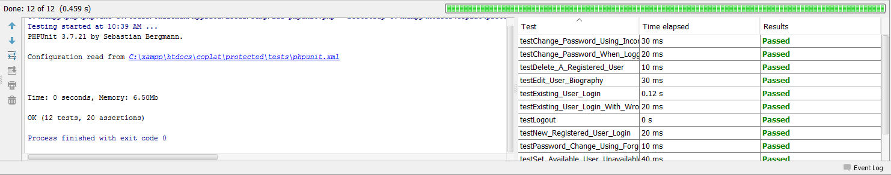
School of Computing & Information Sciences
Senior Project – Fall 2015
Collaborative Platform
Student: Ricardo Dominguez, Florida International University
Mentor: Juan Caraballo, IBM
Instructor: Masoud Sadjadi, Florida International University
Problem Current System Implementation
The system, at the beginning of the semester, lacked proper automatic tests. This needed to be addressed because if the system were to change in the future then it would need some kind of automated code that it could fall back on to make sure that the features were working as intended by the system.
It also lacked a feature that would allow users to give the administrators some kind of feedback they could use in order to better the system as a whole. The system was subject to risk if changed at its core and more than likely, many aspects of it would have to be begun from scratch without many references to go by.
The current system has several suites that cover both functional and unit tests that span the many facets that our system has to offer. There has been a feedback feature added as well that allows users to provide us with insight as to how to better what we currently have.
The test suites make sure that our database is communicating with the system as it should and that the correct tables are being utilized as a whole.
They also check the user end of the application to make sure we have a step by step visual documentation of how our system is supposed to work.
In order to provide a secure experience the system should have Unit and Functionality Tests in the following subsystems –
Tickets
Users
Mentorship
Video Conferencing & Messaging
Reporting
Feedback
As well as other areas not covered by these subsystems crucial to a good user experience.
The system must also support a sub-system that will allow users to give the administrators constructive comments on the application.
System Design Object Design Implementation
Collaborative Platform is designed around the Yii Framework. This Framework uses a Model -> Controller -> View relationship and is mainly programmed in PHP.
Feedback was implemented using the Yii System design of Model -> Controller -> View. Auxiliary methods were created to tailor the system to suit our needs.
The subsystem works by allowing users to create Feedback that is accessible for viewing by other users and administrators.
Restrictions that are present are that while other users can view other feedback they cannot manage the feedback or reply to it. Only the administrator of the system is given these privileges.
Verification Screenshots Summary
The Functionality testing was done using a Firefox plugin called “Selenium IDE”. It allows the user to automate front-end application usage.
The Unit testing was done using PHPUnit and tests our models to make sure that our models pull from correct tables and that the models are coded properly to avoid redundant code.
The Collaborative platform provides a tool for students to ask questions and have them answered in a timely manner.
With the implementation of the Feedback feature we can take a step towards making sure people are satisfied with our products and can air any problems they may have with it.
By writing a series of suites it also ensures that any future changes the application goes through will only better our system rather than hinder it. This full package allows Collaborative Platform to take on any shape it wants to in the future.
Acknowledgement
The material presented in this poster is based upon the work supported by Dr. Masoud Sadjadi and Juan Caraballo. I am thankful to the help that I received from my group members, Frank Hernandez and Christopher Jones.

