Slide 1
Collaborative Platform 5
Team Members
Product Owner
Jorge Travieso
Adrian Alfonso
Juan Caraballo
Spring 2015

Slide 2
Why the Collaborative Platform?
Current students lack a reliable source for answering questions related to their classes or projects.
Students may rely on several internet sources, often unreliable, inaccurate and incomplete.
Difficulty matching the correct mentor to the right question.
Lack of standard way of communication for answering questions.

Slide 3
Problem Solution
Need for
Better interaction among users of the system.
Fast way to set up meetings.
Reports to measure the utilization of the system
The Collaborative Tools
Utilization Dashboard
Admin Reports

Slide 4
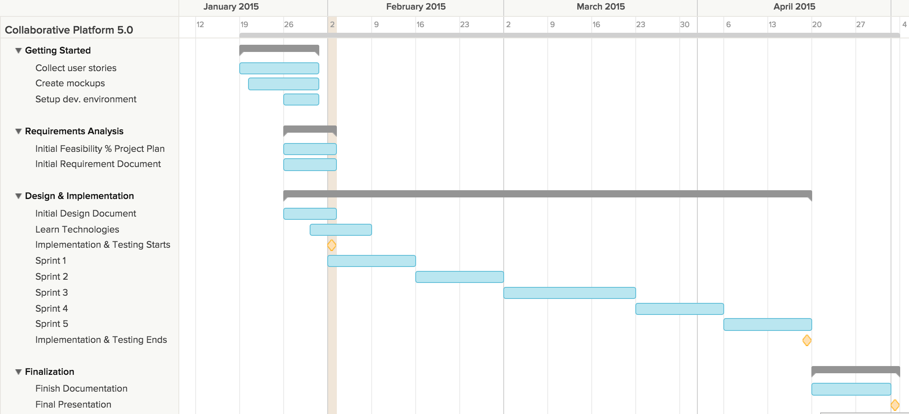
Schedule

Slide 5
Main User Stories
User Story
Schedule On-Demand Video Conference
Schedule Video Conference Ahead of Time
Schedule Video Conference From a Ticket
Join Video Conference
Screen Sharing During Video Conference
Use Whiteboard
Use Chat Room
Invite More People
Accept/Reject Video Conference Invitation
Cancel Video Conference Meeting

Slide 6
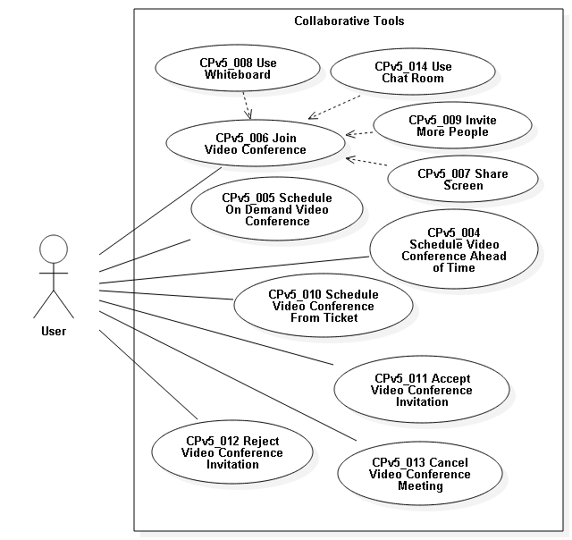
Use Cases

Slide 7
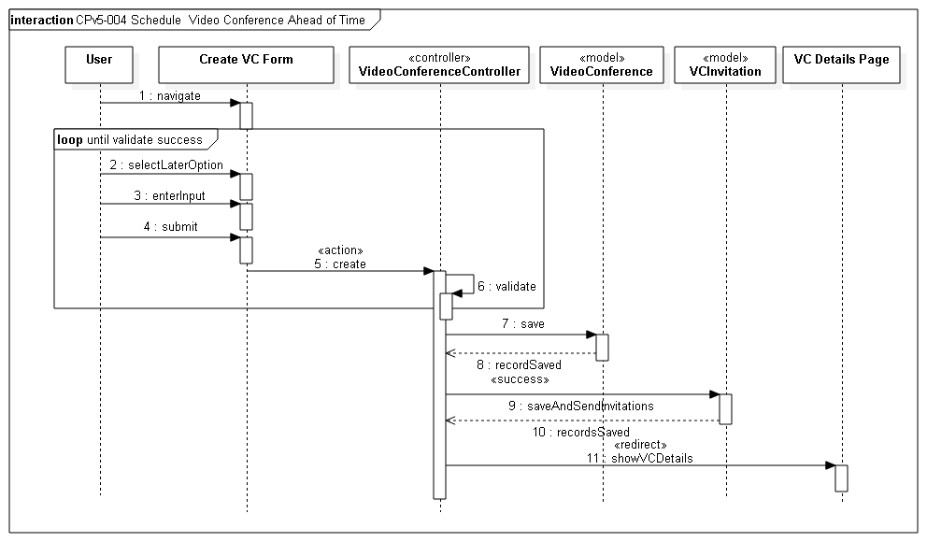
Sequence Diagrams

Slide 8
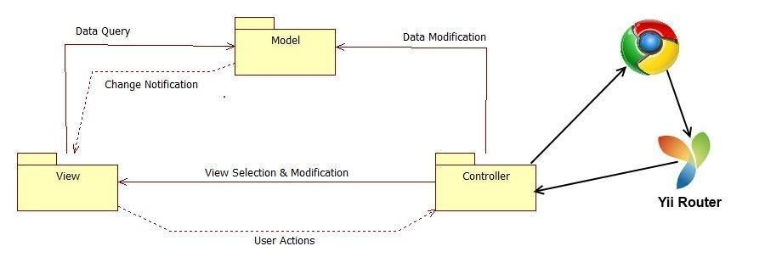
System Decomposition

Slide 9
System Deployment
Minimum Hardware
Minimum Software
Processor | 1.6 GHz
RAM | 256 MB
CPU op-mode(s) | 32-bit
Database Server | MySql 5.5
Web Server | Apache 2.0
Server-side Scripting | PHP 5.5
Operating System | Linux

Slide 10
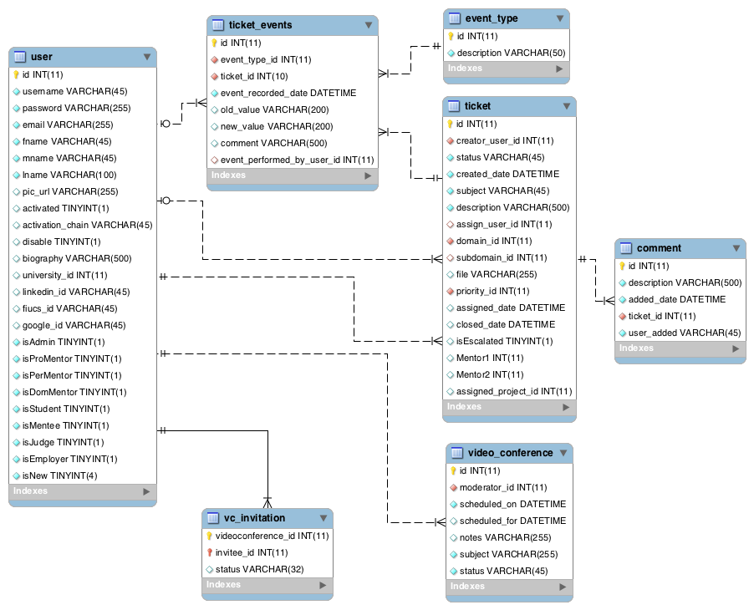
ER Diagram

Slide 11
Security/Privacy
Yii access control rules
Yii cross-site scripting prevention
Password hashing
Secure registration process

Slide 12
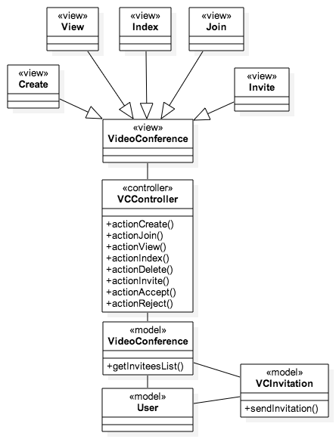
Class Diagram

Slide 13
Join Video Conference Algorithm
Invitee
Moderator
Navigate to video conference room
Click join button
Wait until Moderator opens room
Share resources (webcam, microphone)
Join the conference
Navigate to video conference room
Click open button
Share resources (webcam, microphone)
Conference starts
Receive invitees connections

Slide 14
Sunny Day Test Case
Test Case ID | TS011 Video conference scheduled ahead of time
Purpose | Test that video conference can be scheduled ahead of time.
Test Setup | The user should be authenticated and have navigated to the create video conference form.
Input | The user selects the later option, enters the meetings subject, date, time, notes and correct several invitee emails. These emails addresses should already exist on the system.
Expected Output | The invitations have been successfully sent.
Actual Output | The invitations have been successfully sent.

Slide 15
Rainy Day Test Case
Test Case ID | TS009 Video conference invitation to wrong email
Purpose | Test that an invitation cannot be sent to an email that does not exist on the system.
Test Setup | The user should be authenticated and have navigated to the create video conference form.
Input | The user selects the now option, enters the meetings subject, notes and a wrong invitee email. These email address is not recognized by the system
Expected Output | <wrong email> does not appear in our records <b
Actual Output | <wrong email> does not appear in our records

