Slide 1
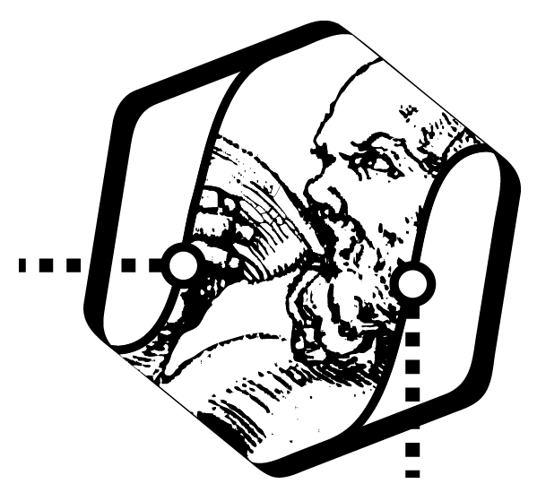


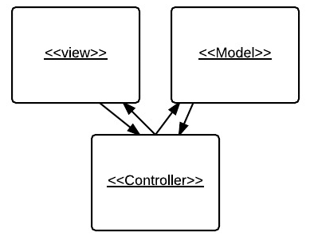
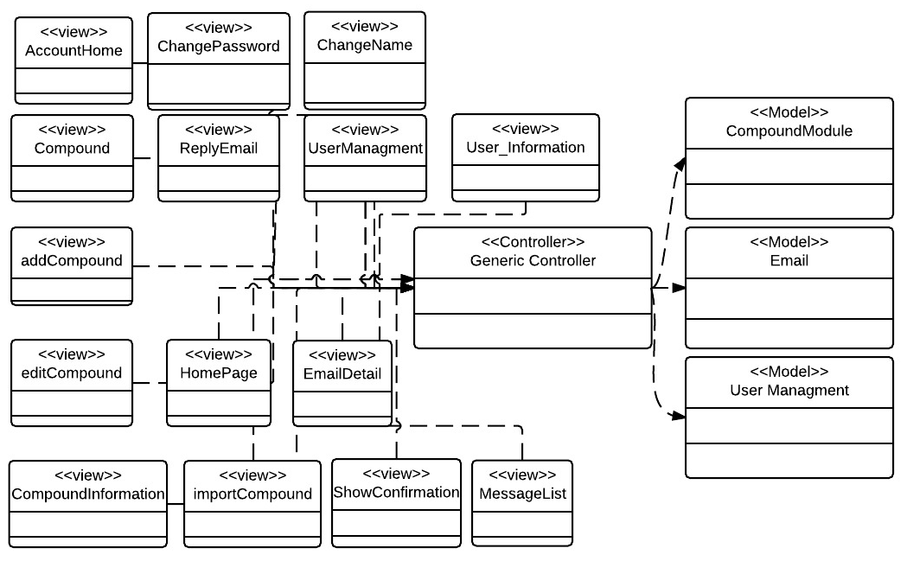
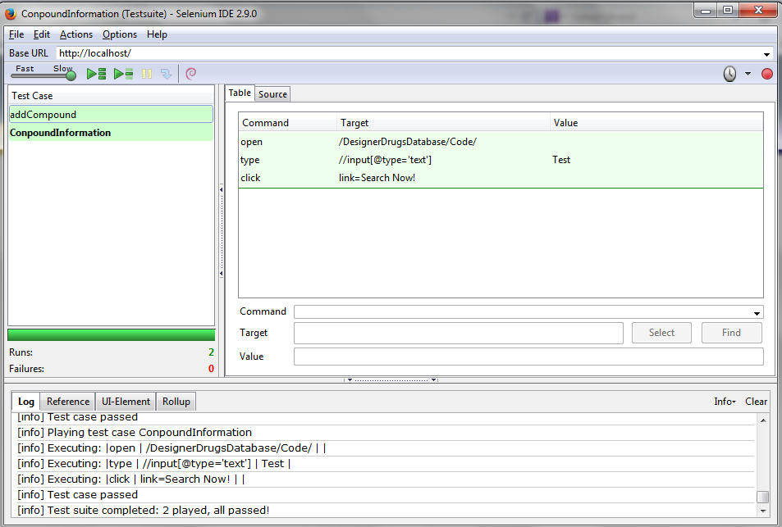
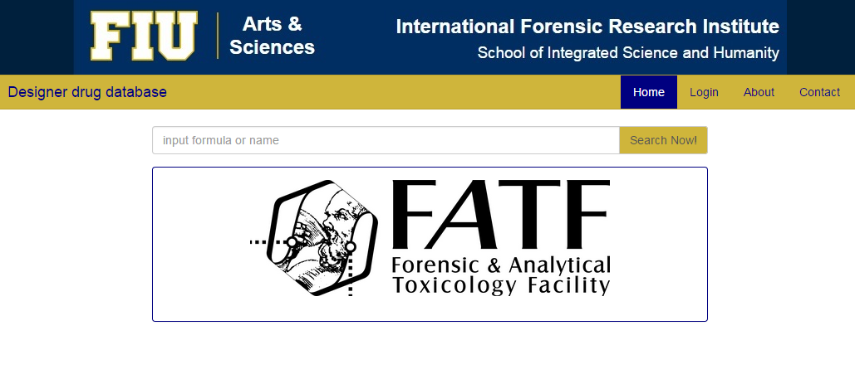
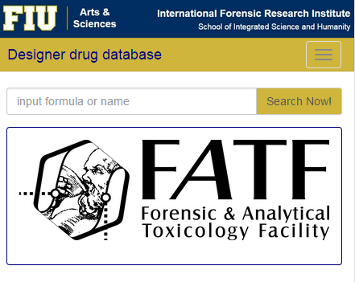
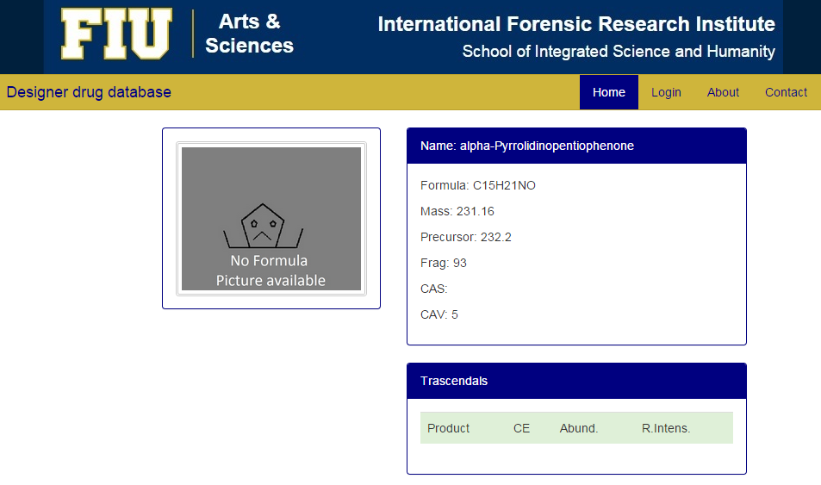
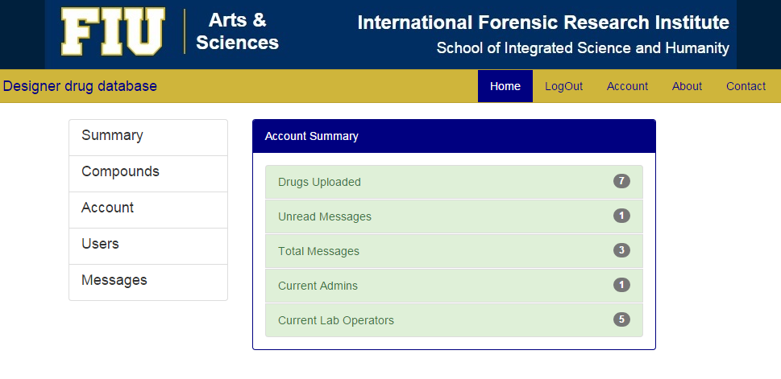
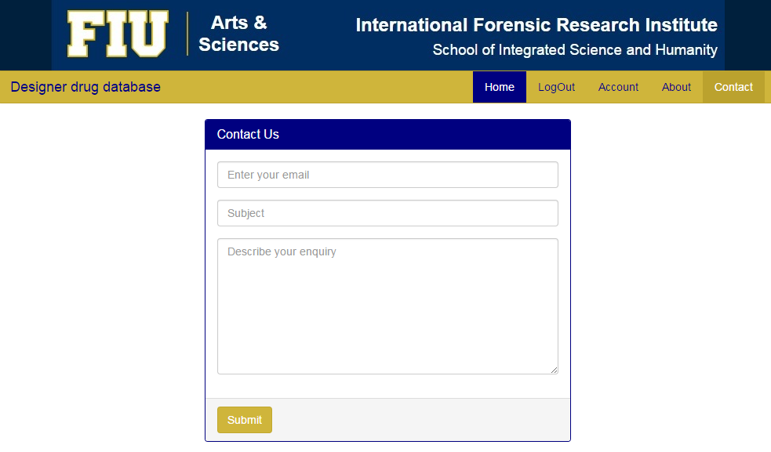
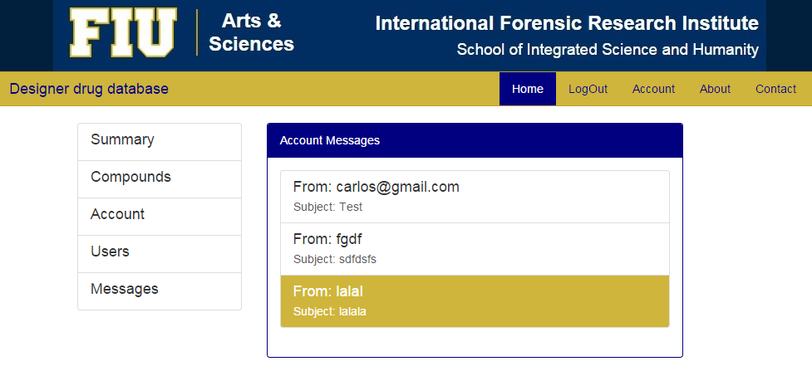
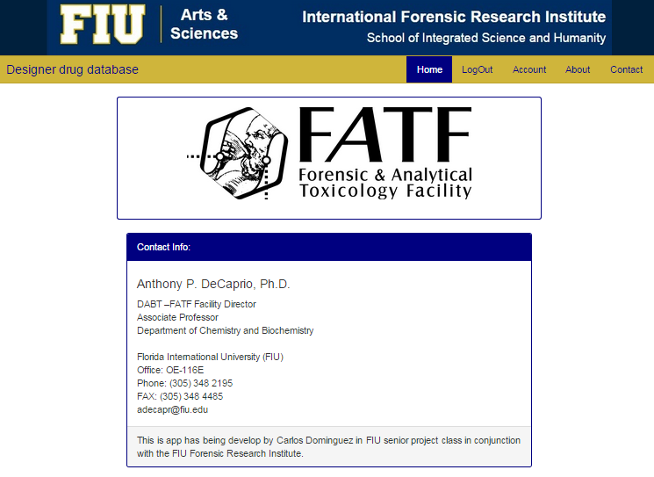
School of Computing & Information Sciences
Senior Project, 2015, Spring
Designer Drug Database
Student: Carlos Dominguez Martinez, Florida International University
Mentor: Dr Luis Arroyo, Professor at Forensic Research Institute At FIU
Instructor: Masoud Sadjadi, Florida International University
Problem
Requirements
System Design
Dr. Arroyo and the team at the Forensic Research Institute produce several reports and useful information from research they perform at the Institute. One of the challenges they have face is sharing the results that yields from their research. The purpose of this project will be to provide the Institute with a software solution that allows them to share the research result with the world of Academia and the Professionals Community
The International Forensic Institute needed a tool to:
Share information with the world of Academia and the Professionals Community.
Manage shared information.
Control the access to the management of this information
In the system there are three types of users: Admins, lab Operator and guest, thus the requirements are:
Admins and lab operator must be able to login with their credentials
Admins and lab Operator must be able to add new compounds
Admins and lab Operator must be able to edit compounds
Admins and lab Operator must be able to delete compounds
Admins must be able to import compounds
Admins and Lab Operators must be able to modify their name.
Admins and Lab Operators must be able to modify their password.
Admins must be able to create new users in the system
Admins must be able to delete users of the system
Admins must be able to modify user roles of the system
Admins and Lab Operators must be able to see summary of the system in a dashboard.
Admins and Lab Operators must be able to read contact emails.
Admins and Lab Operators must be able to delete contact emails.
Admins and Lab Operators must be able to reply contact emails.
Any user of the system must be able to search and visualize the information of a compound.
The system design implements a model view controller
Current System
Object Design
At the time this project started there was no system in place. The Forensic Research institute would share their research information by email upon request, and the information used to be in an excel spread sheet.
Implementation
The Model-View-Controller (MVC) architectural pattern was maintained from past versions using Yii Framework.
HTML, CSS, JavaScript, Bootstrap, angularJS was used in order to implement the front-end.
PHP was used to implement the back end, using:
  MYSQL for the retrieval of jobs from the database, and to create/update the information.
  Prepare Statements to avoid SQL Injections
  Password Encryption to protect password being stolen.
Summary
In this project all the requirements were implemented. However, the client express he wanted to have a native IOS application. This application that can be implemented in a future using what was implemented in the server side
Verification
Test Cases passing
For the verification different test cases were created and Selenium was used to implement the test cases. Some examples of the test cases and their screenshots of their respective verifications are shown.
Name: add new Compound
Participating actor: either an admin or a labOP
Entry condition: User is logged in the system and User is in compound page.
Exit condition: Compound data is added in the system and pop up is shown
Event flow: User click on the add compound button System shows add compound form page User selects the picture of the compound, enters “Test ” in name field, enters “Test” in formula field, enters “Test” in other name field, enters “5” in mass field, enters “5” in fragments field, enters “Test” in Cayman Number, enters “5” in precursor field, enters “6” in CAS field, select “Test51” as compound class and click submit all button. System confirm that compound has been saved with a pop up
Screenshots
Main Page in Computer and small device
One Compound Information
System Dashboard
System Messages contact and inbox
System About Us
Acknowledgement
The material presented in this poster is based upon the work supported by … I am thankful to the help that I received from my group members, … .

