Slide 1

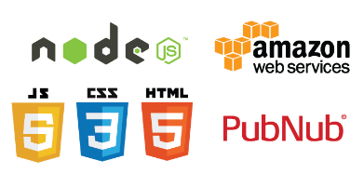
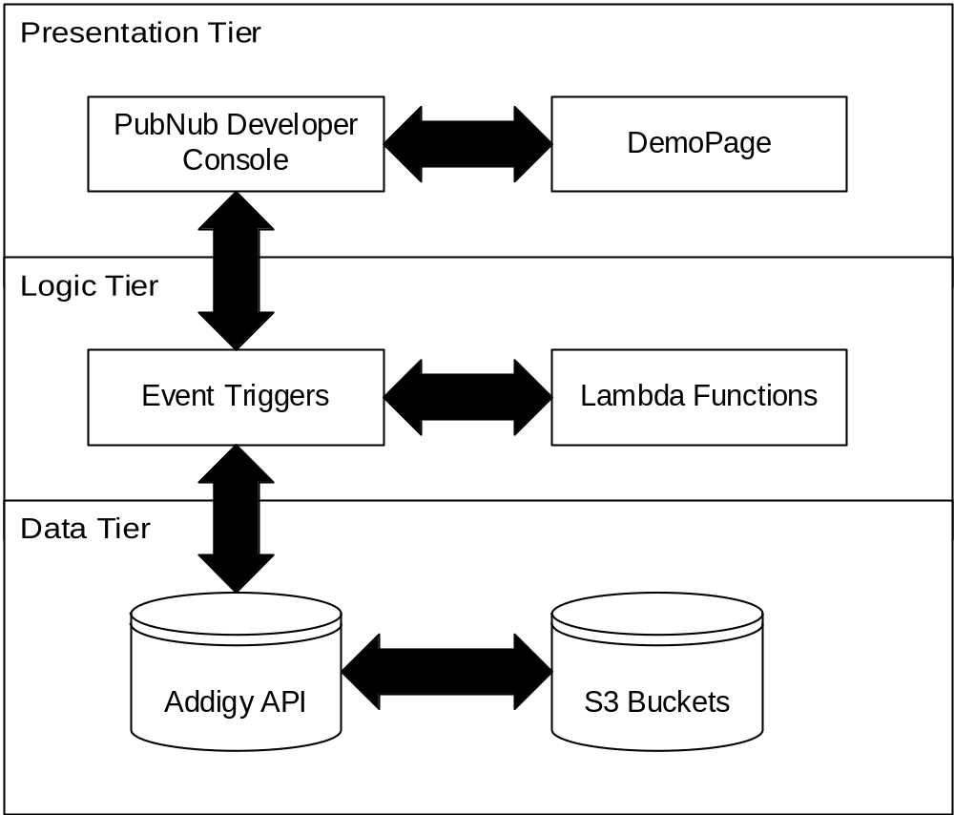
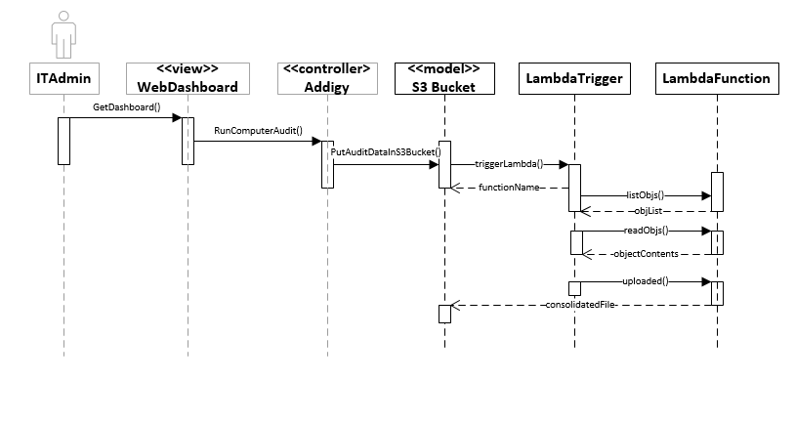
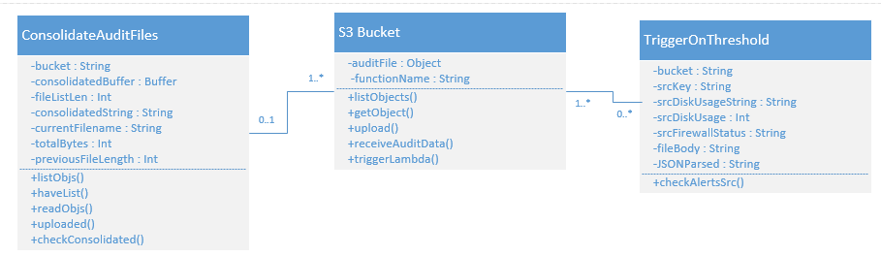
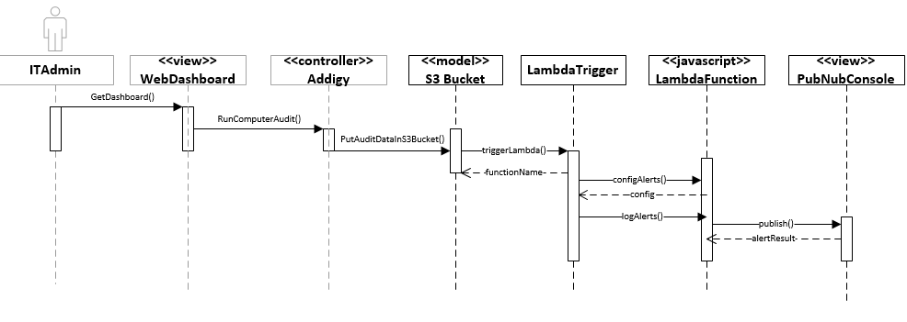

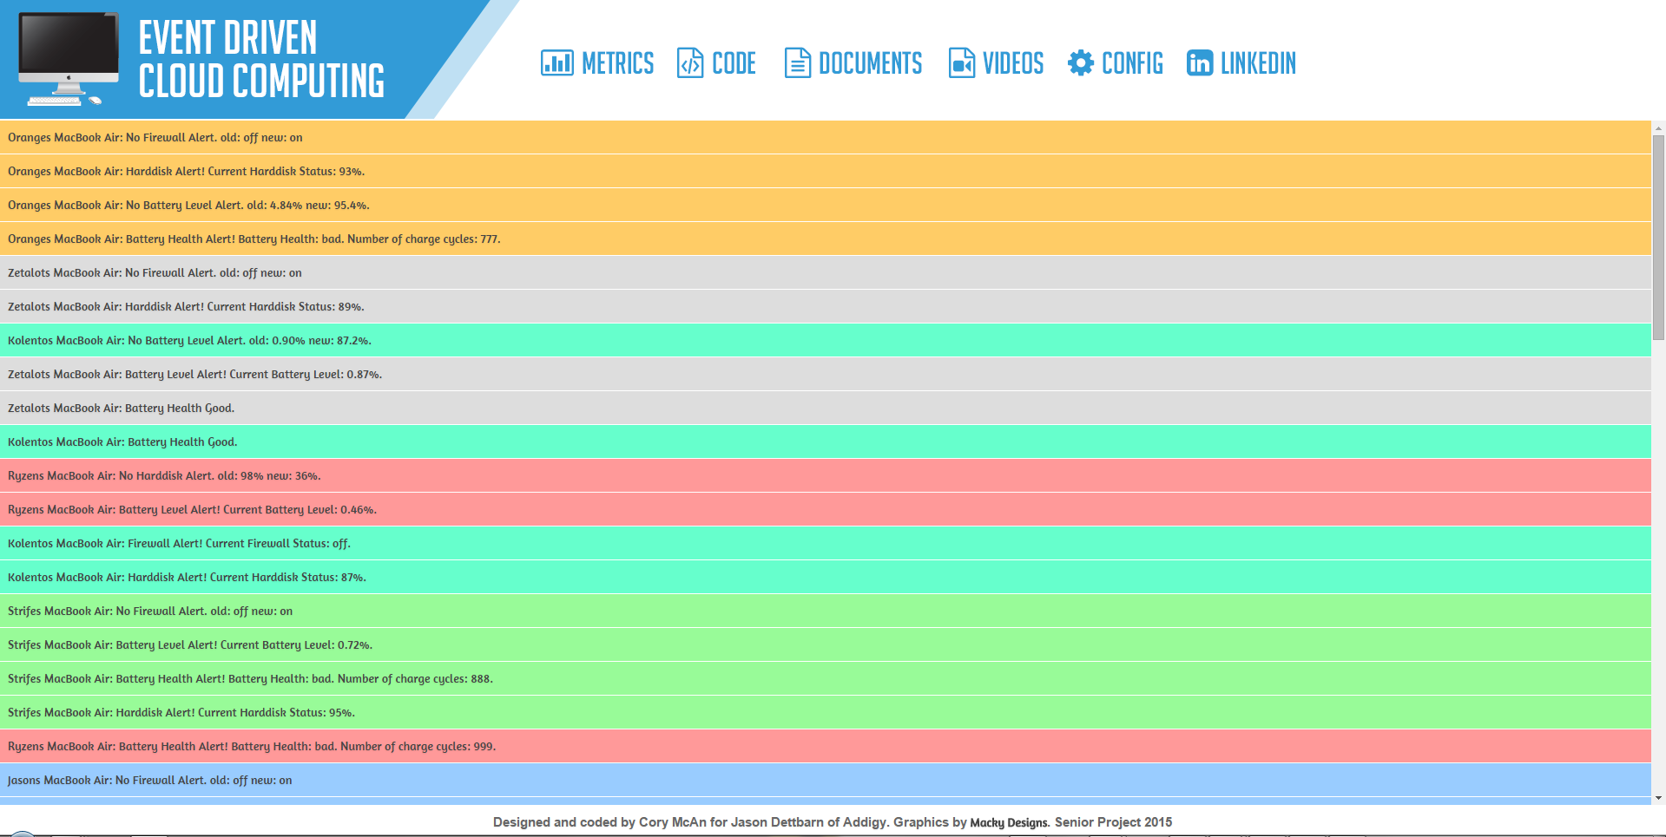
School of Computing & Information Sciences
Senior Project, 2015, Spring
Event Driven Cloud Computing
Student: Cory McAn, Florida International University
Mentor: Jason Dettbarn, Addigy
Instructor: Masoud Sadjadi, Florida International University
Problem
Current System
Requirements
Current IT monitoring systems designed for Mac are few and far in between, many of the systems available lack features or use a server implementation which requires additional cost and complexity to manage.
Large amounts of audit data can be difficult to manage in a server implementation
Security and low cost are essential to having an effective auditing service
Most available IT tools for Mac machines lack information regarding specific machine statics which can hinder productivity in a primarily Mac environment
Currently Addigy has a Web Dashboard with many features that can display audit data to an IT Admin using polling. However, the previous implementation used a remote server to handle processing of audit data.
The back end functionality I have implemented now handles the audit data in real time and sends alert messages to the PubNub console when we get new audit data.
This new back end implementation also leverages AWS Simple Storage Service to handle the audit data using triggers, and only do computation when we get new audit data.
The most important feature of the project is the increased speed and reduced cost of maintaining the service, as it lives in the Amazon cloud, which has significantly smaller costs than the previous implementation.
FUNCTIONAL REQUIREMENTS:
The system shall…
run in the cloud using AWS (Amazon Web Services).
consolidate all audit files per organization into one file.
notify IT Admins when certain thresholds are reached using PubNub.
notify IT Admins only when NEW thresholds are reached.
be equipped to handle large inputs, 10+ audit files uploaded at once with correct alerts
alert on firewall status, harddisk status, battery status, and antivirus logs
have a backend configuration file that allows backend admin to adjust the types of alerts to send messages on
System Design
Implementation
Object Design
This diagram depicts the consolidation of files in the bucket when a new audit is uploaded.
The S3 bucket object stores the audit data in containers called buckets, which can respond to certain events such as a file upload.
The other objects represented here are functions that handle the audit data and perform analysis which will later result in alert messages.
ConsolidateAuditFiles stores the current state of the machine audits in a single file that can be read and checked against future audits. This allows for triggering of alerts, which is handled by TriggerOnThreshold.
It is necessary to maintain the previous state of the audit data as it allows for alerting to occur only when we have new alerts to display, reducing the computation needed to inform IT Admins of relevant alerts on their client machines.
This project is intended to provide the back end functionality for the Web Dashboard for Addigy which would display the audit information and alerts in real time.
The system uses an MVC pattern design, where the primary processing of the audits occurs in the Lambda Functions that respond to event triggers.
I used the following frameworks in the implementation of my project:
Node.js
A web framework for Javascript, used for Lambda Functions.
PubNub
A messaging service that uses data streams to establish communication channels. Used for demo materials.
This diagram depicts the process involved in the multipleRunTester which is used in the demo. Many files are uploaded at once and each are handled as above.
Implementation written in Node.js:
Currently the AWS S3 Bucket requires any Lambda code to be written in Node.js as the Lambda Service was quite new when I started the project. They are adding support for Java as well, but Node.js served very well for efficiency due to its asynchronous nature.
Screenshots
Verification
This application required creating all the test data to cover the user stories requested by my product owner. I created the test data by hand to ensure that I could create two different batches of data for the same machines. This allows me to show the alerts for the two different batches.
I also created an Excel spreadsheet that contains all the relevant alerting information for both batches to allow me to check my answers. Creating this test data assisted greatly in checking that the code was working as expected, and allowed me to fix bugs quickly.
Developer tools in the browser and debugging tools in my IDE assisted me in finding and fixing errors such as:
JSON parsing errors, errors regarding execution of the code in S3, timeout issues, and memory issues.
Summary
All IT companies need a cost effective, fast, and reliable tool to manage the audit data from their Mac machines, that can also provide them real time alerts on set thresholds.
My main contribution to the project was…
Creating all the backend code that alerts on thresholds
Consolidate all the files in the bucket so that we can check the previous status of the machine in interest
Alert on Harddisk, Firewall, Battery and Antivirus statuses
Creating a configuration file for the purpose of modifying how alerts are triggered
Creating large amounts of test data to confirm alerts work properly
Creating log files to test Antivirus alerting
Provide a clean and intuitive interface for demoing the real time alerting
Acknowledgement
The material presented in this poster is based upon the work by Cory McAn. I am thankful to the help that I received from Jason Dettbarn, my mentor.

