Slide 1
Genomic Sequences Final Presentation
Yordan Alvarez – Developer
Yohan Santos – Developer

Slide 2
Problem Definition
Biologists, researchers, and health professionals do not have computational resources to identify sections of the human genome.
There is not currently an automated system that can accelerate this process and produce a proper result.
The current system for processing genomic sequences is being done manually and could take weeks to obtain a result.

Slide 3
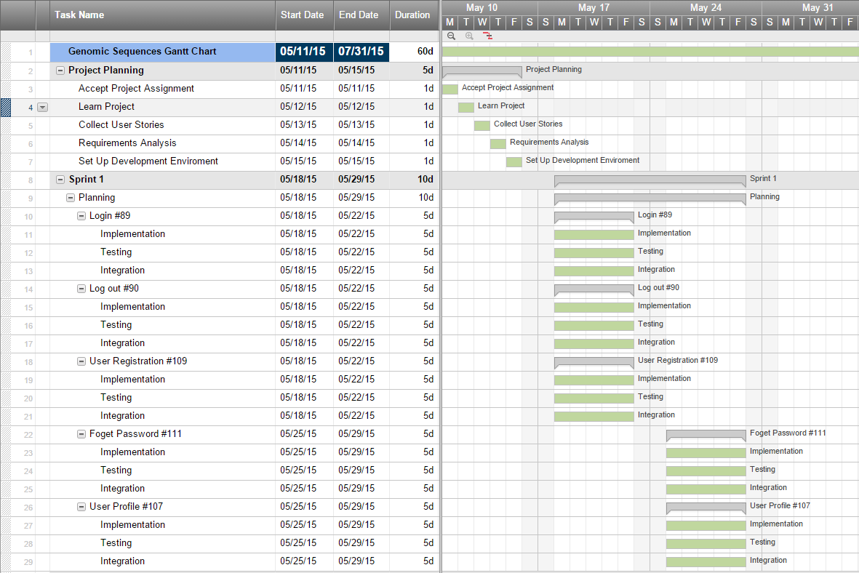
Gantt Chart

Slide 4
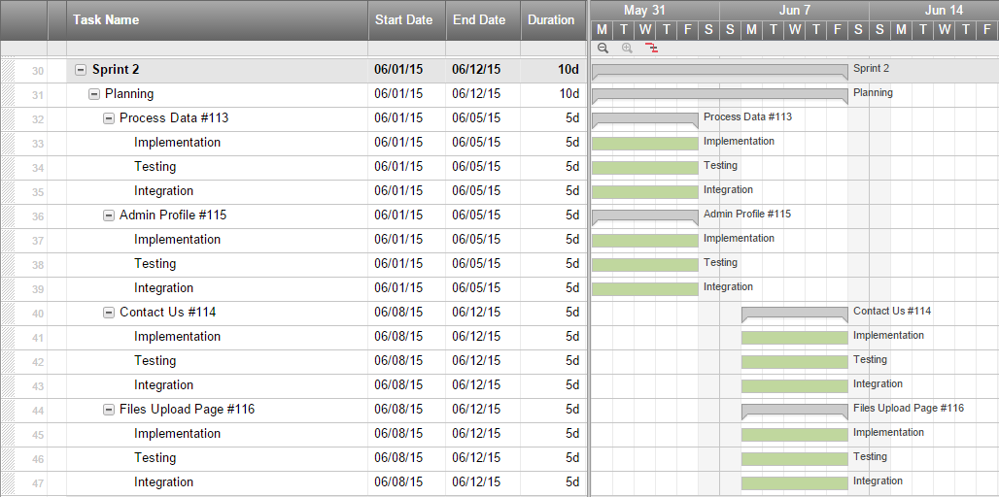
Gantt Chart Continued

Slide 5
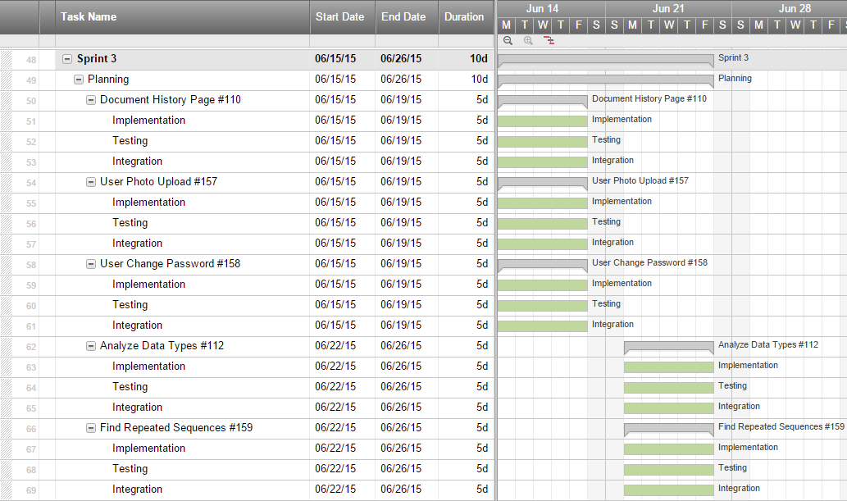
Gantt Chart Continued

Slide 6
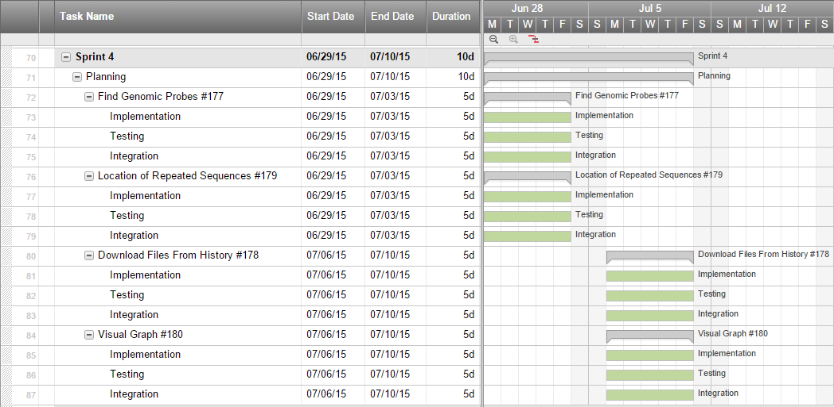
Gantt Chart Continued

Slide 7
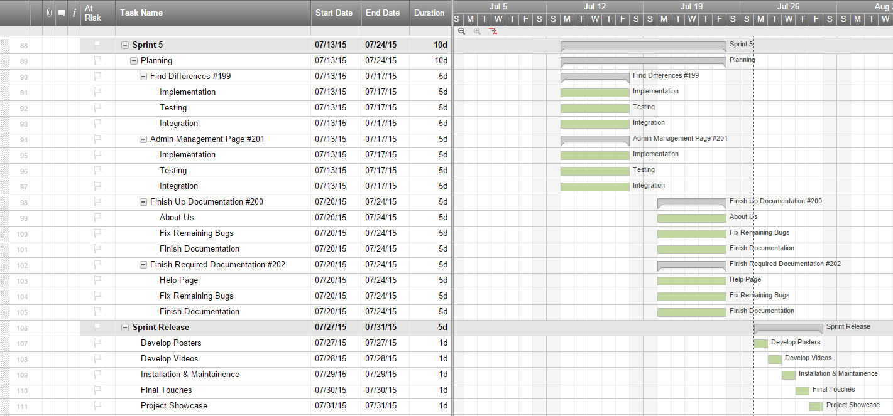
Gantt Chart Continued

Slide 8
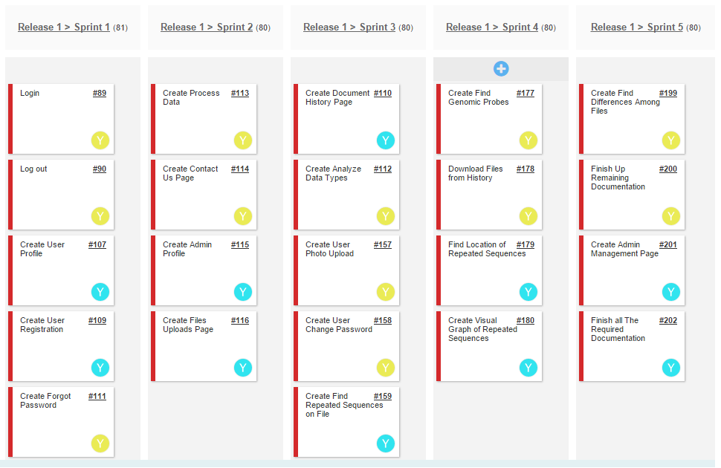
User Stories Implemented

Slide 9
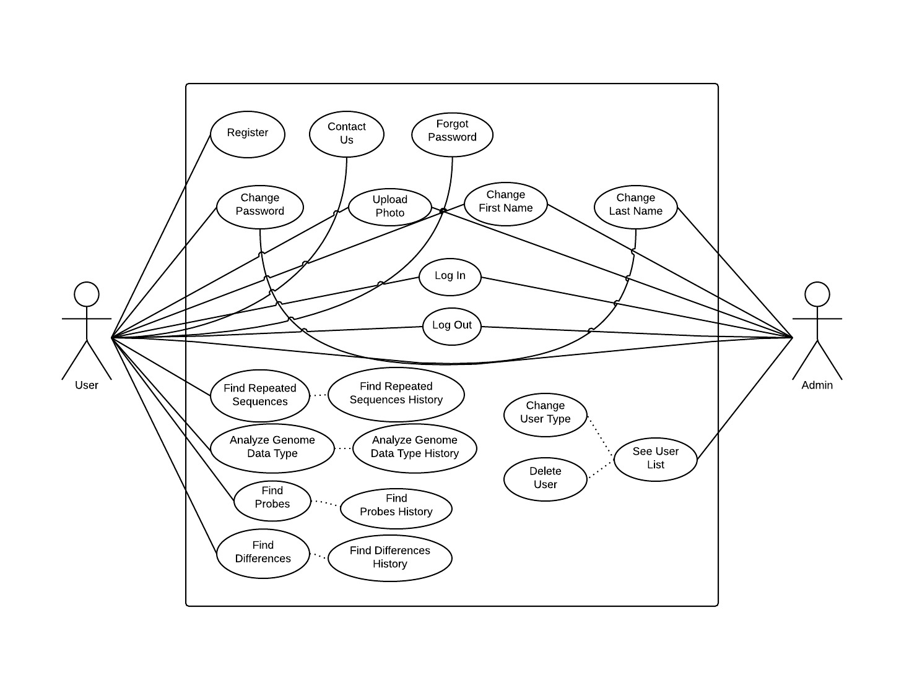
Use Cases Diagram

Slide 10
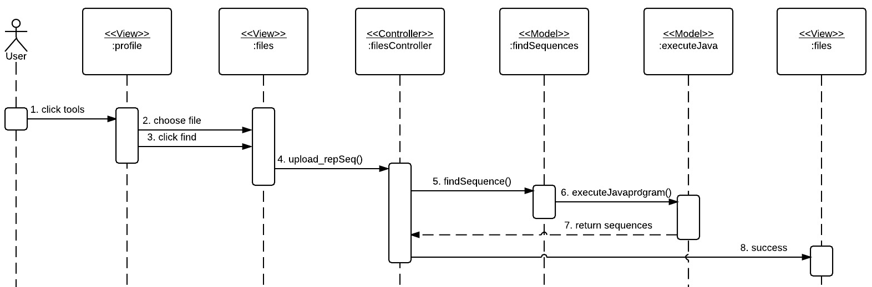
Find Repeated Sequences Sequence Diagram

Slide 11
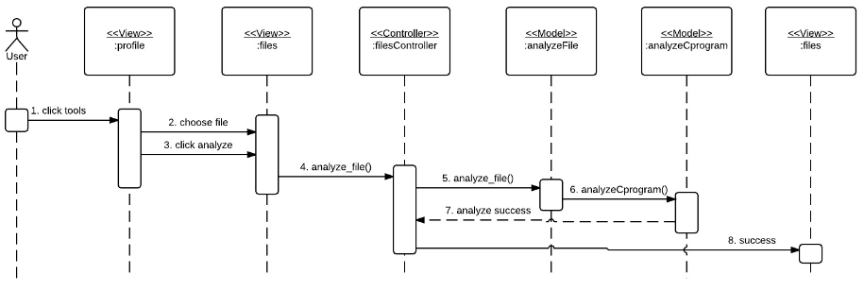
Analyze Data Types Sequence Diagram

Slide 12
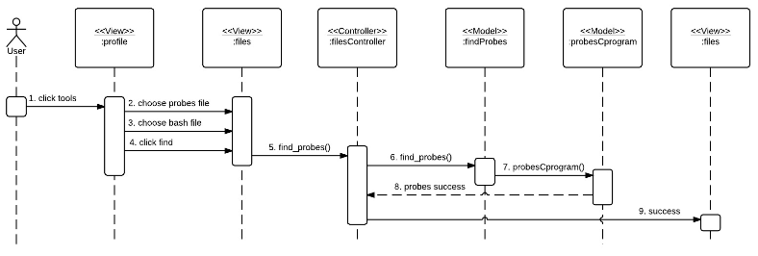
Find Genome Probes Sequence Diagram

Slide 13
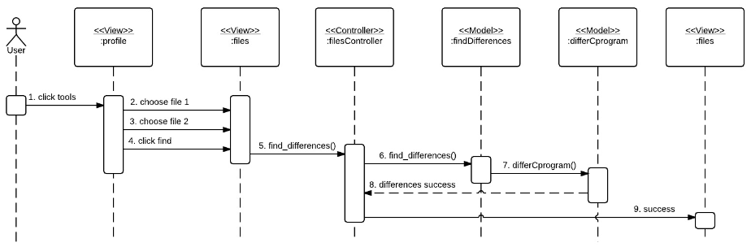
Find Genome Differences Sequence Diagram

Slide 14
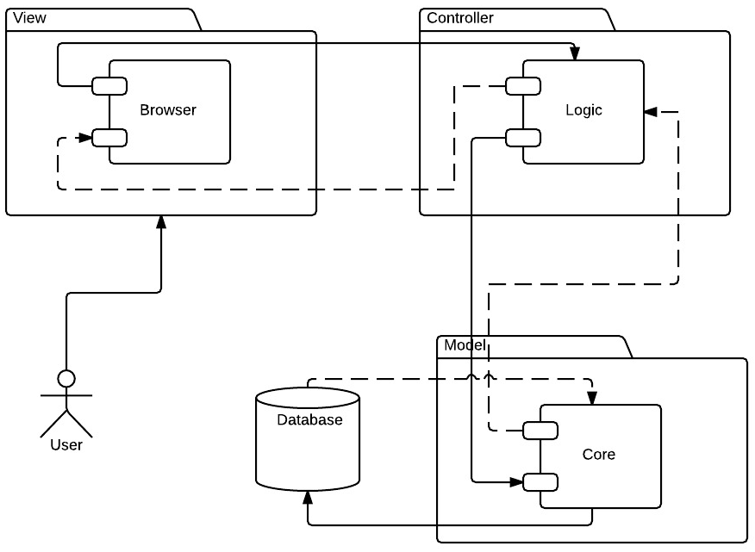
System Design (MVC)

Slide 15
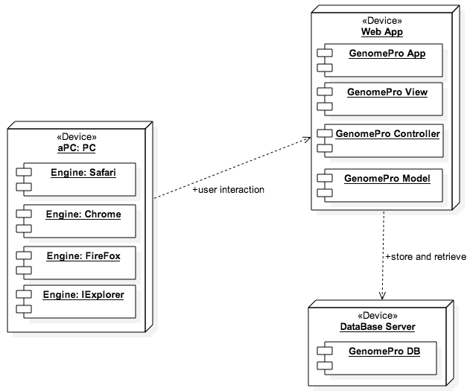
System Deployment

Slide 16
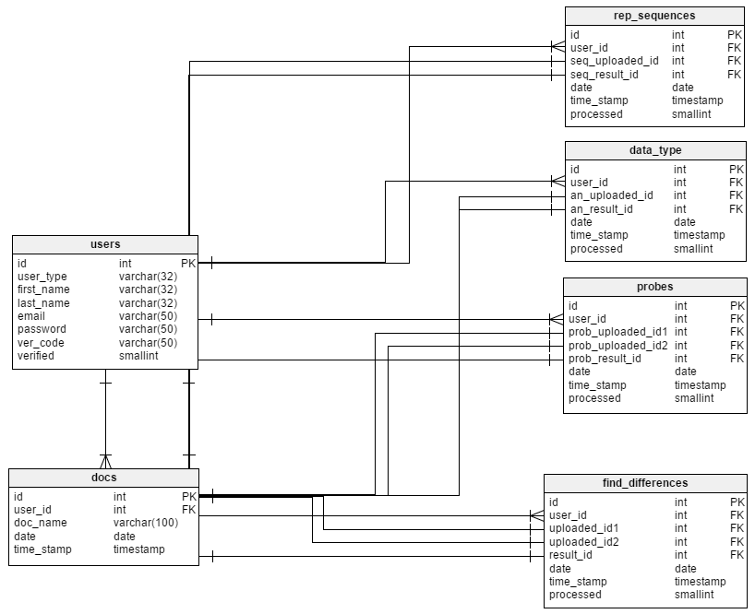
Persistent Data Design

Slide 17
Security/Privacy
Secure Registration Process
Password hashing
Data Validation
Access control rules

Slide 18
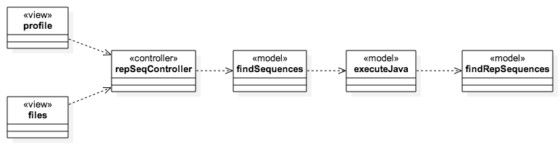
Find Repeated Sequences Minimal Class Diagram

Slide 19
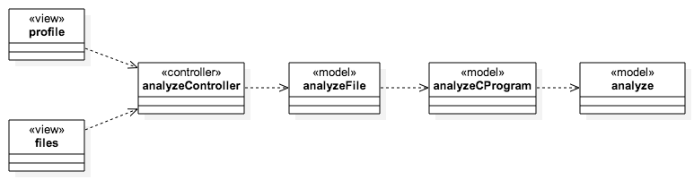
Analyze Data Types Minimal Class Diagram

Slide 20

Find Genome Probes Minimal Class Diagram

Slide 21
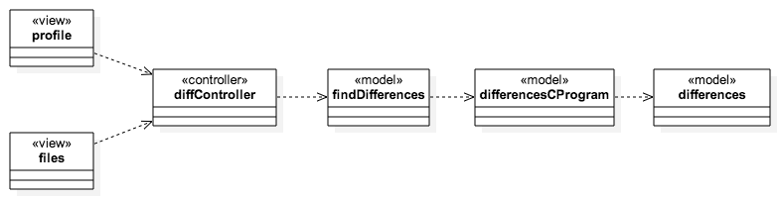
Find Differences Minimal Class Diagram

Slide 22
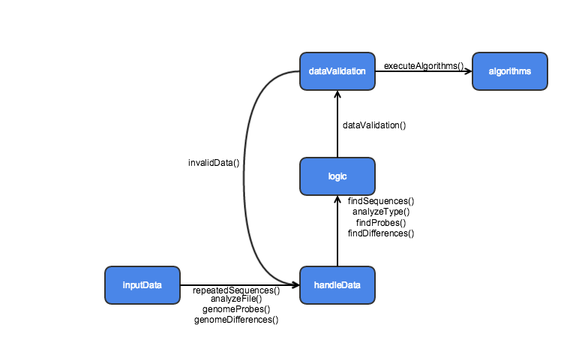
State Machine Diagram

Slide 23
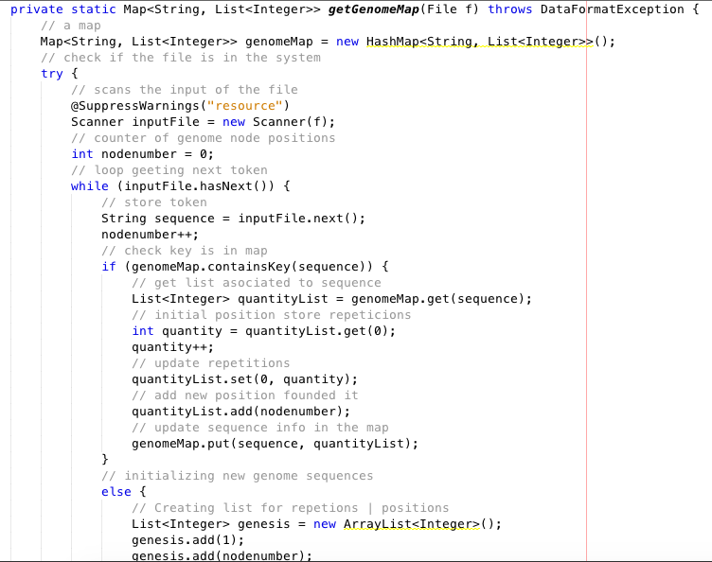
Find Repeated Sequences Main Algorithm

Slide 24
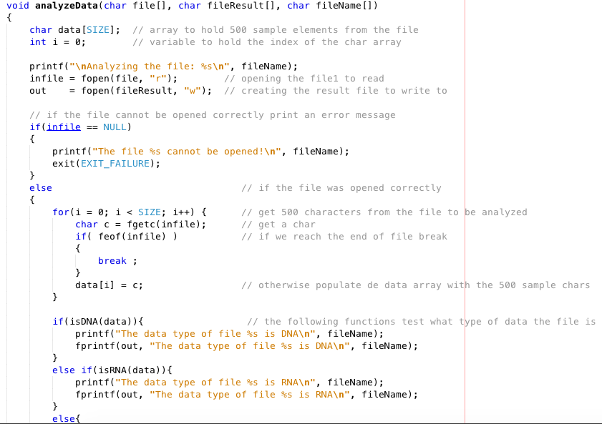
Analyze Data Types Main Algorithm

Slide 25
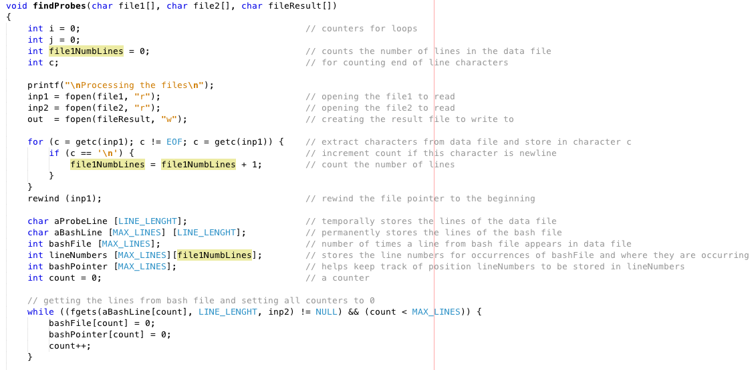
Find Genome Probes Main Algorithm

Slide 26
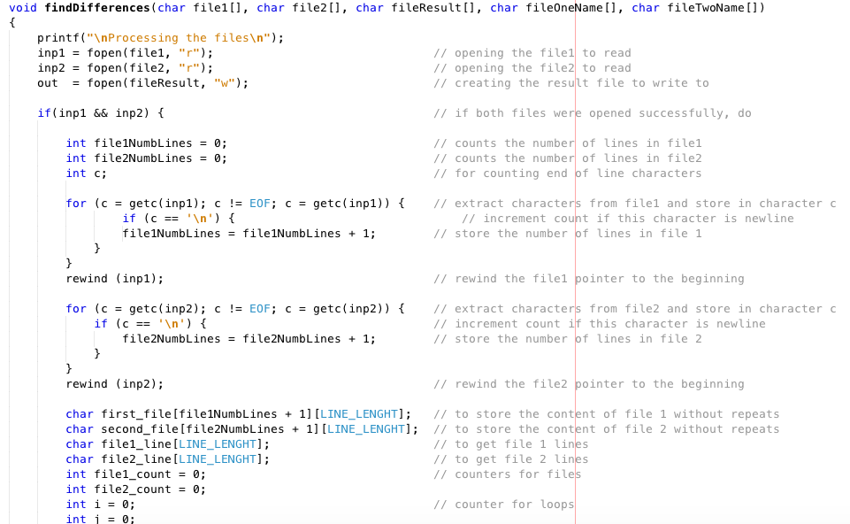
Find Differences Main Algorithm

Slide 27
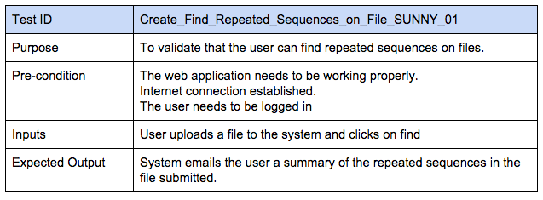
Find Repeated Sequences Sunny Day

Slide 28
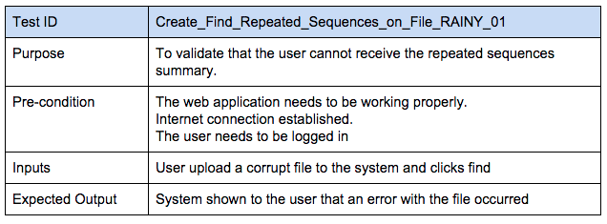
Find Repeated Sequences Rainy Day

Slide 29
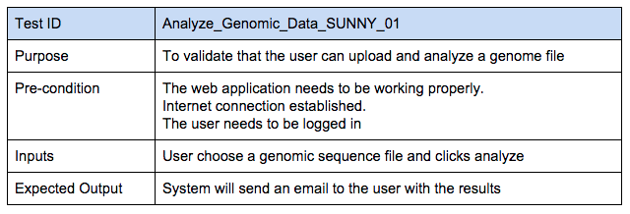
Analyze Data Types Sunny Day

Slide 30
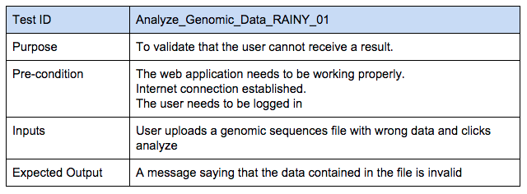
Analyze Data Types Rainy Day

Slide 31
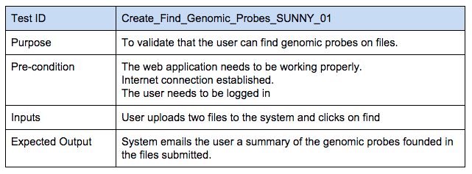
Find Genome Probes Sunny Day

Slide 32
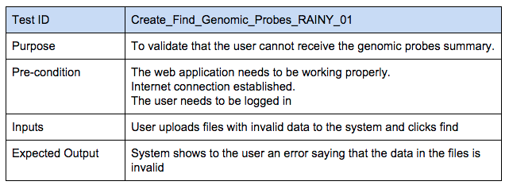
Find Genome Probes Rainy Day

Slide 33
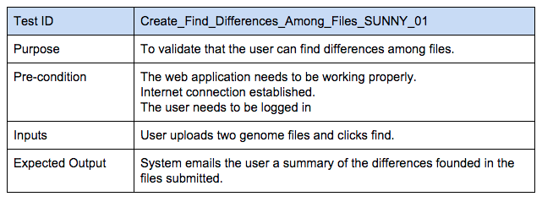
Find Differences Sunny Day

Slide 34
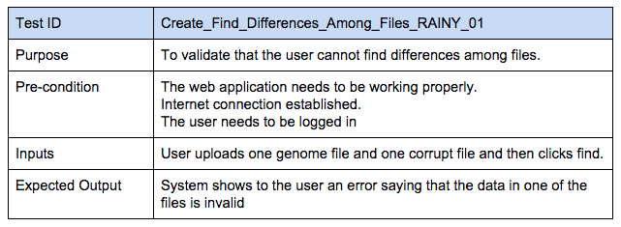
Find Differences Rainy Day

Slide 35
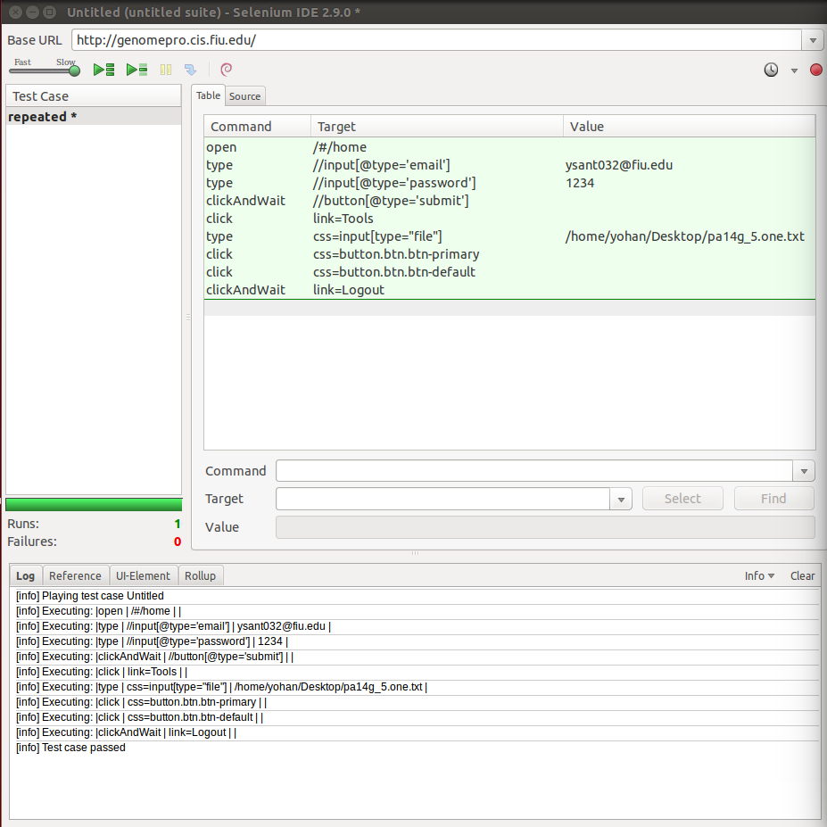
Find Repeated Sequences Automated Test Scripts

Slide 36
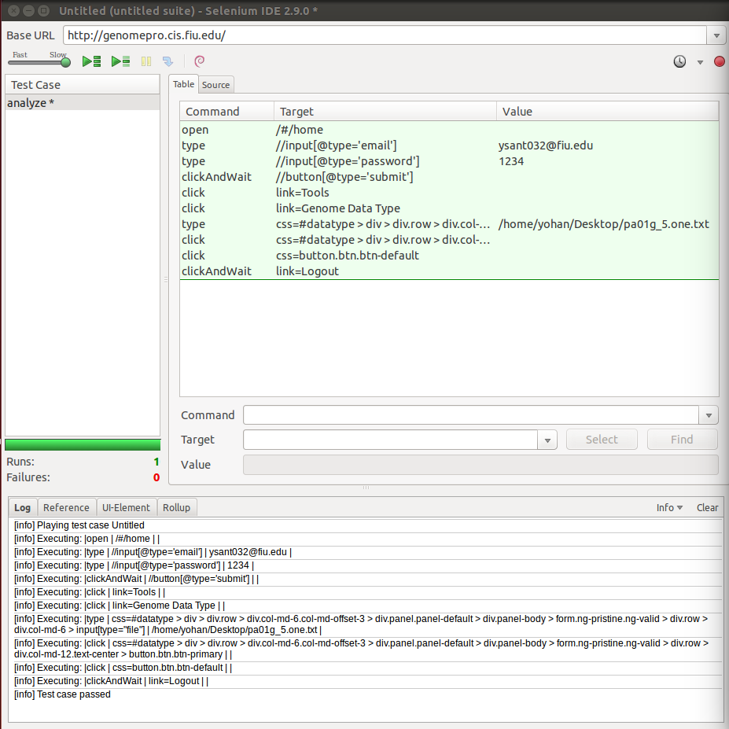
Analyze Data Types Automated Test Scripts

Slide 37
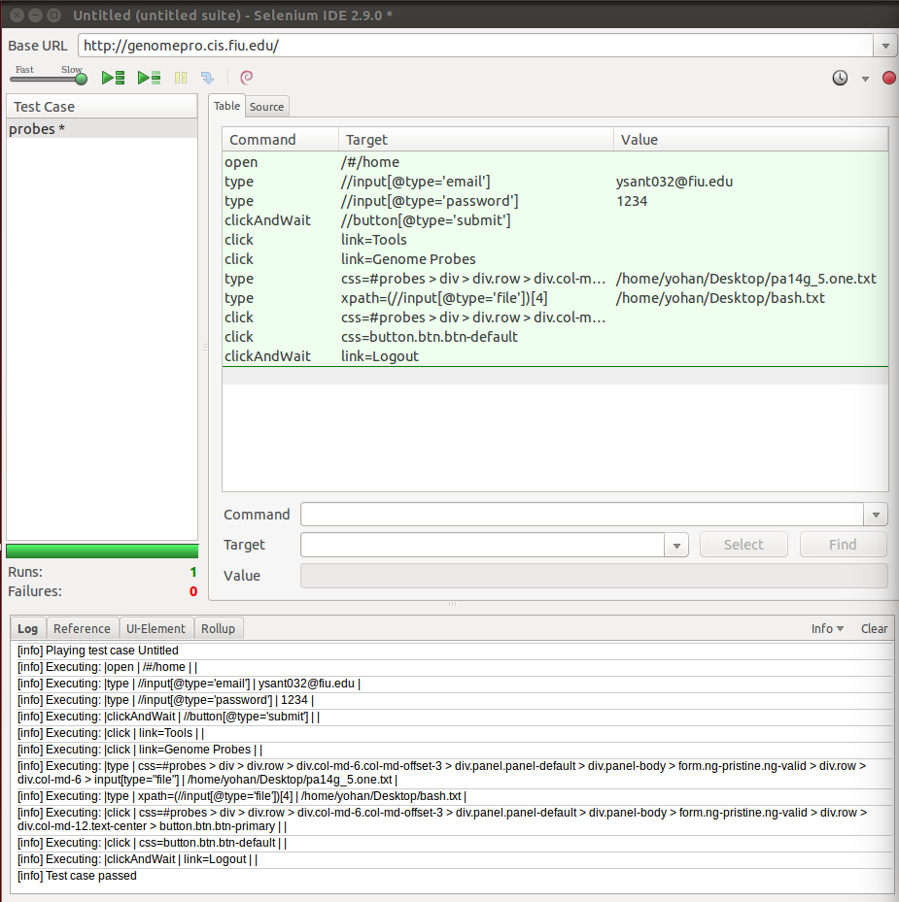
Find Genome Probes Automated Test Scripts

Slide 38
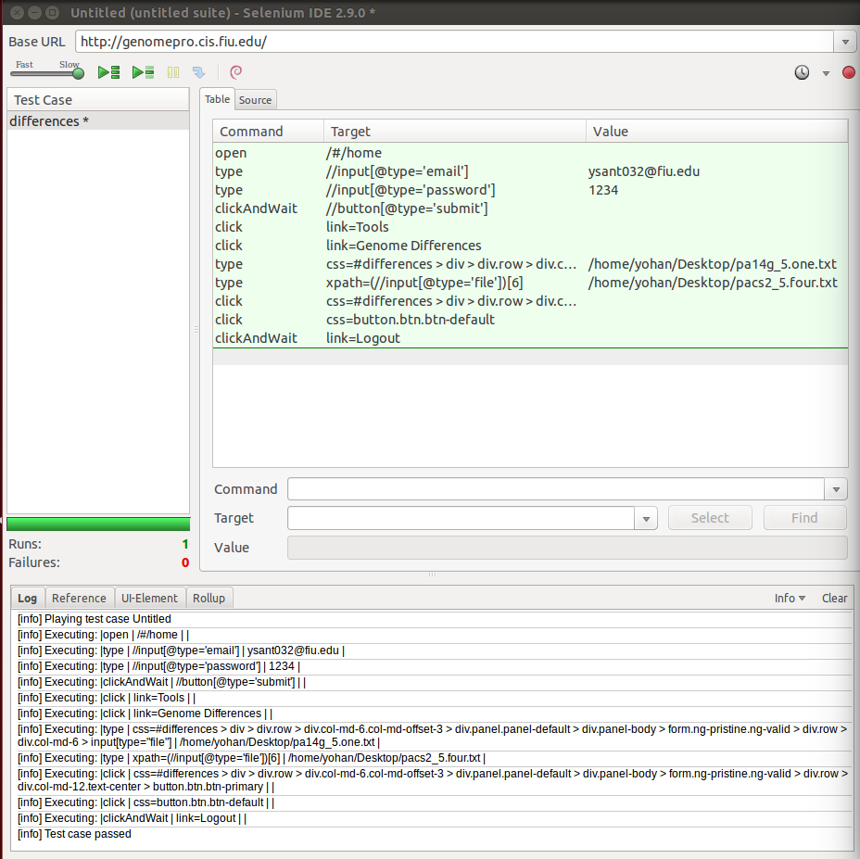
Find Differences Automated Test Scripts

Slide 39
High Level Demo Can Be Found At
https://www.youtube.com/watch?v=SRXHjVs6Eag

