Slide 1
Genomic Sequences
Team Members
Yordan Alvarez, Developer, Tester, and Scrum Master
Yohan Santos, Developer, Tester, and Scrum Master

Slide 2
Problem Definition
Biologists, researchers, and health professionals do not have computational resources to identify sections of the human genome.
There is not currently an automated system that can accelerate this process and produce a proper result.
The current system for processing genomic sequences is being done manually and could take weeks to obtain a result.

Slide 3
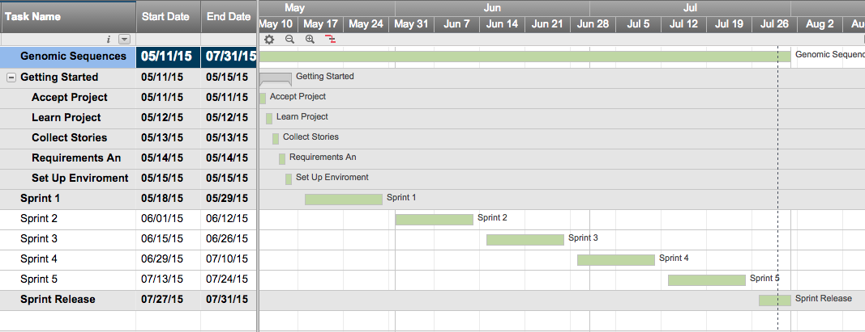
Gantt Chart

Slide 4
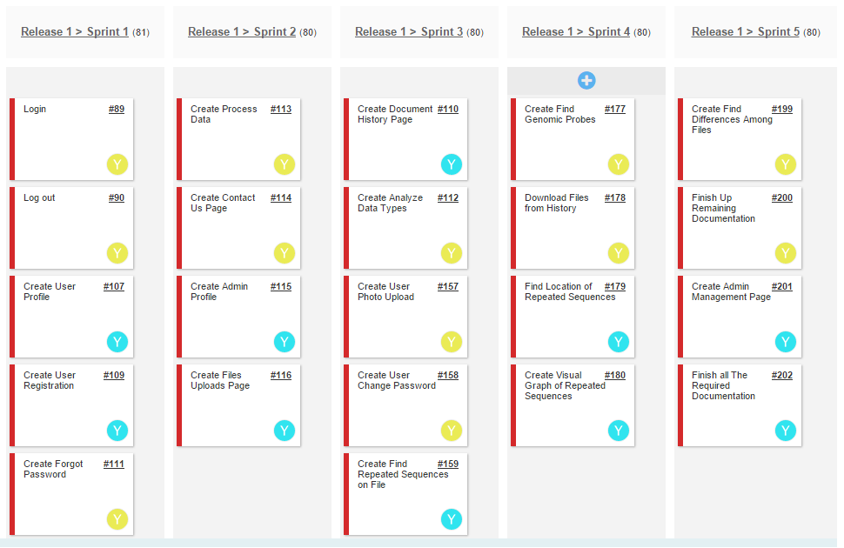
User Stories Implemented

Slide 5
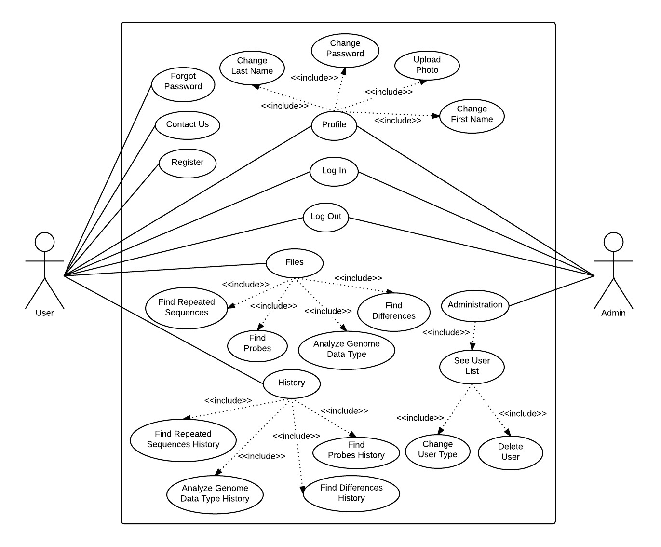
Use Cases Diagram

Slide 6
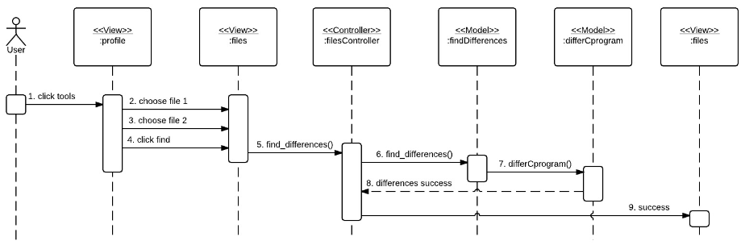
Find Genome Differences Sequence Diagram

Slide 7
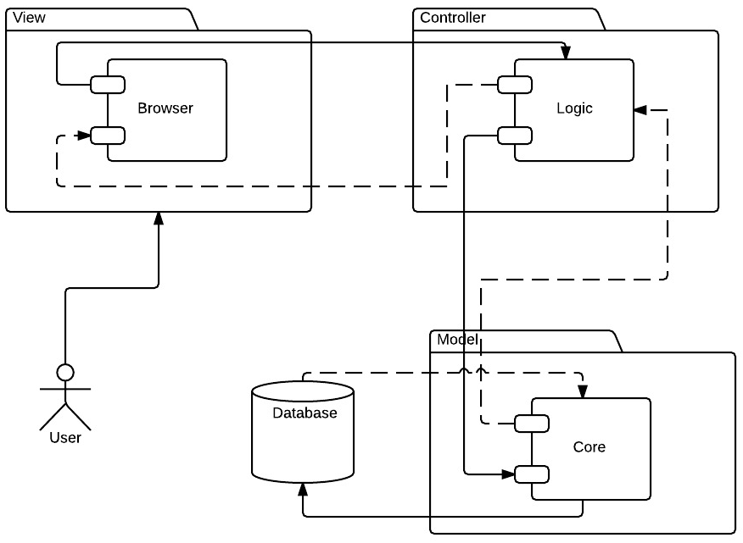
System Design (MVC)

Slide 8
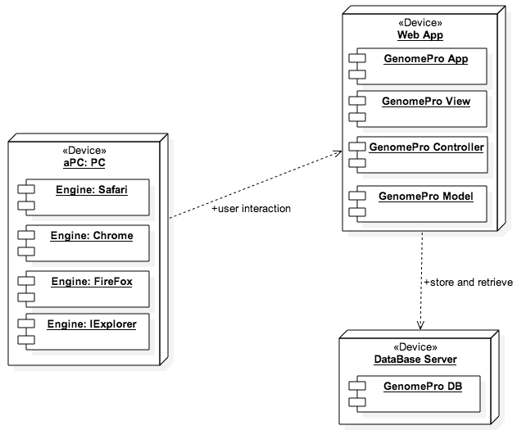
System Deployment

Slide 9
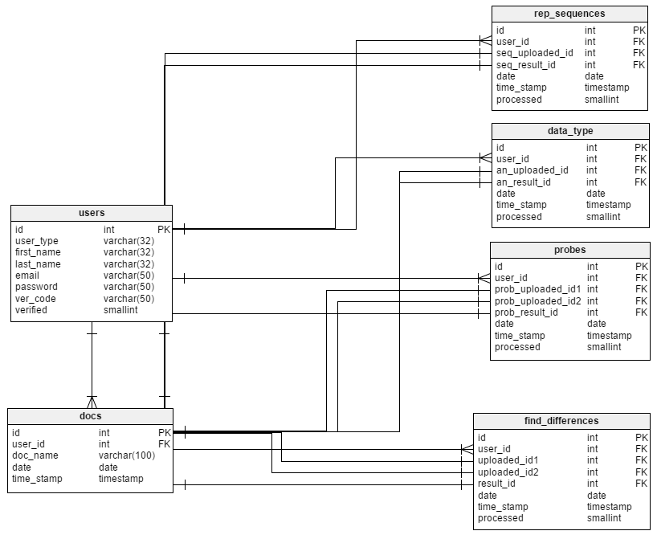
Persistent Data Design

Slide 10
Security/Privacy
Secure Registration Process
Password hashing
Data Validation

Slide 11
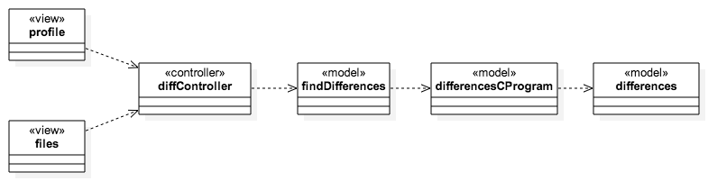
Find Genome Differences Minimal Class Diagram

Slide 12
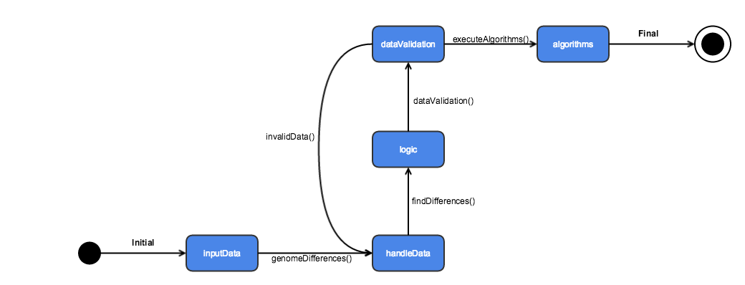
State Machine Diagram

Slide 13
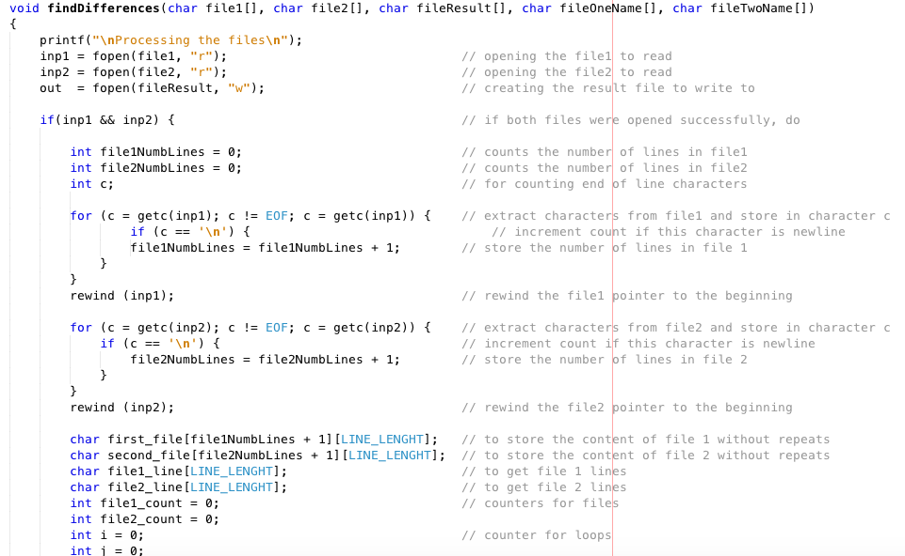
Find Genome Differences Main Algorithm

Slide 14
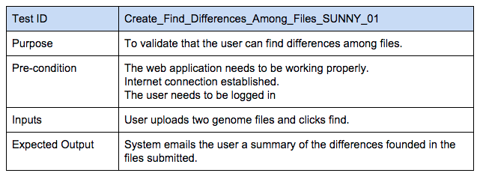
Find Genome Differences Sunny Day

Slide 15
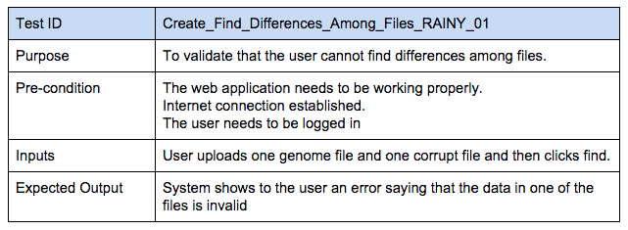
Find Genome Differences Rainy Day

Slide 16
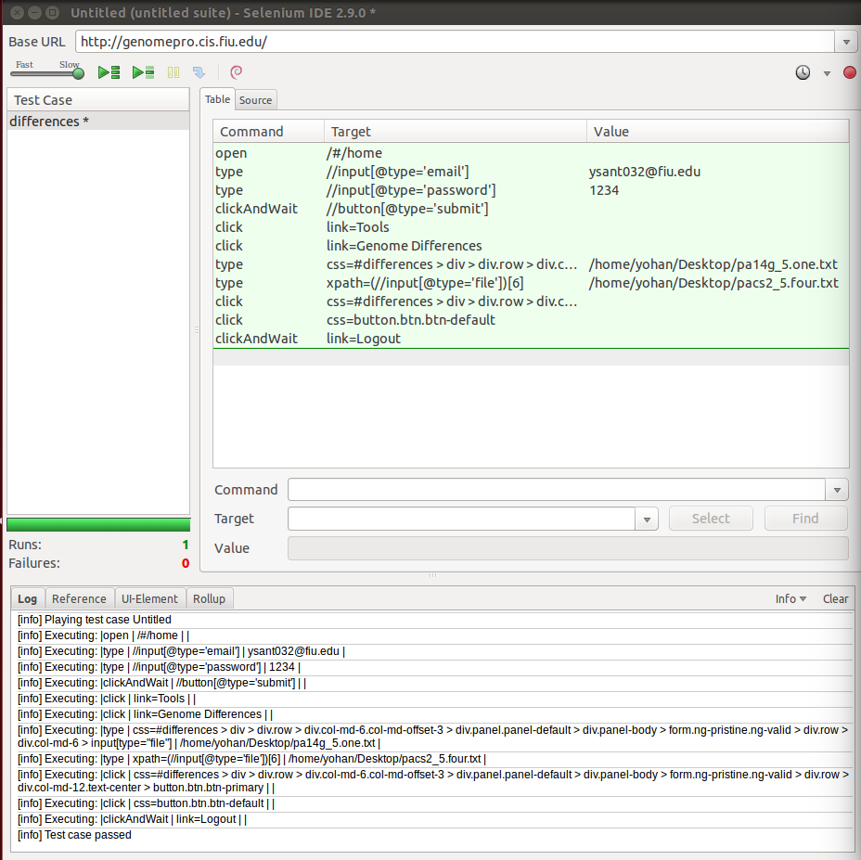
Find Genome Differences Automated Test Scripts

Slide 17
Thank You and Good Luck!

