Slide 1










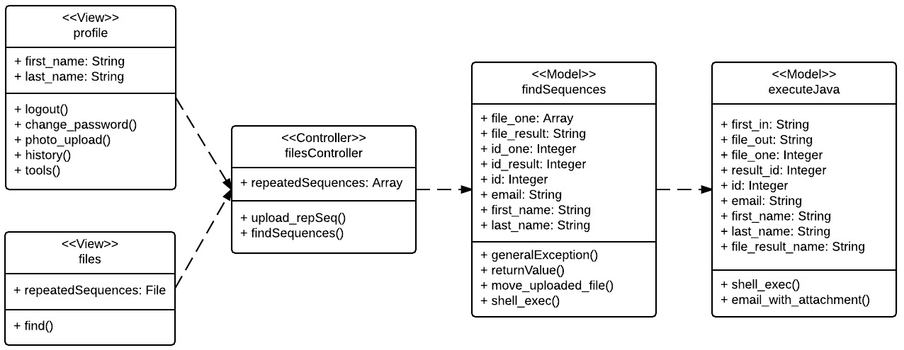
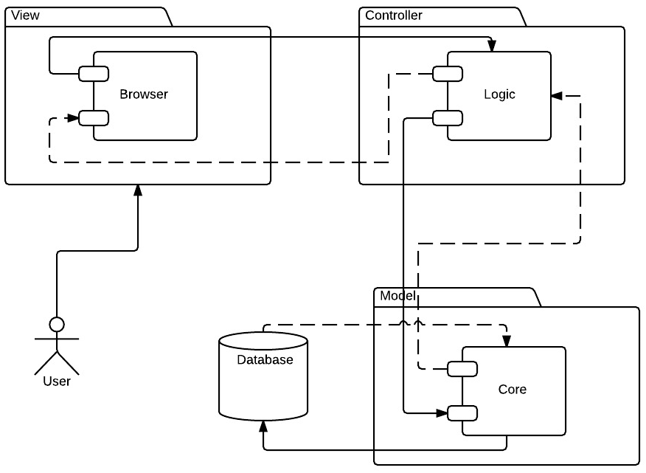
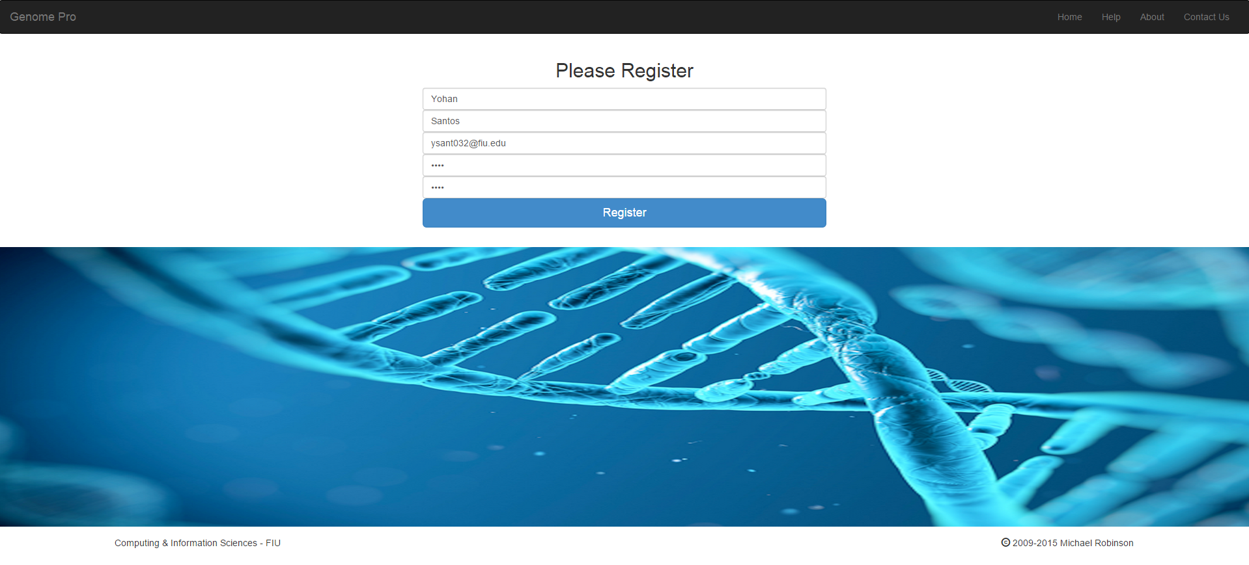
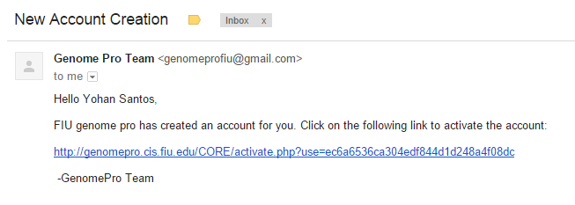
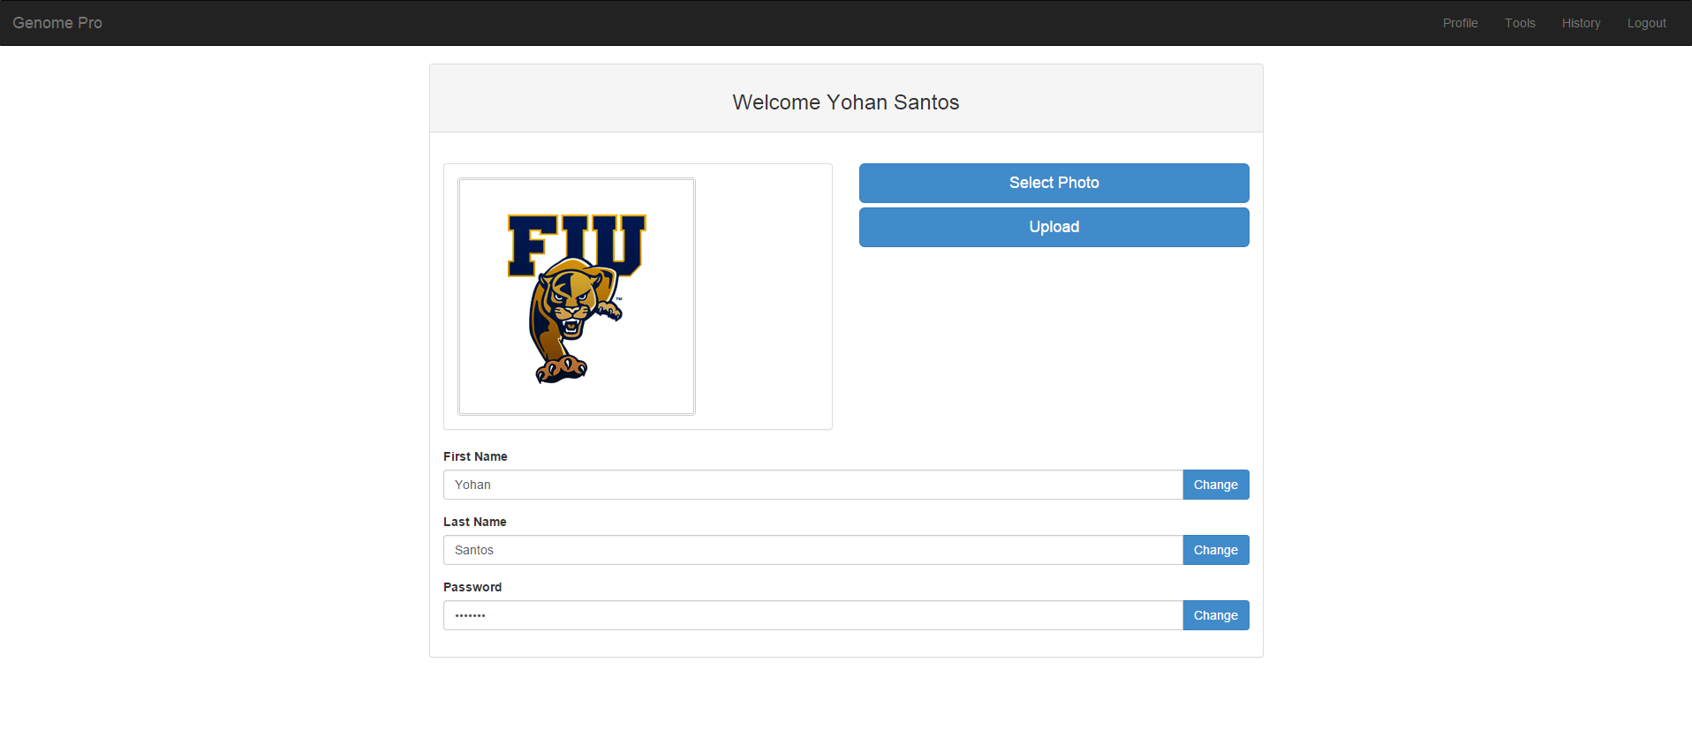
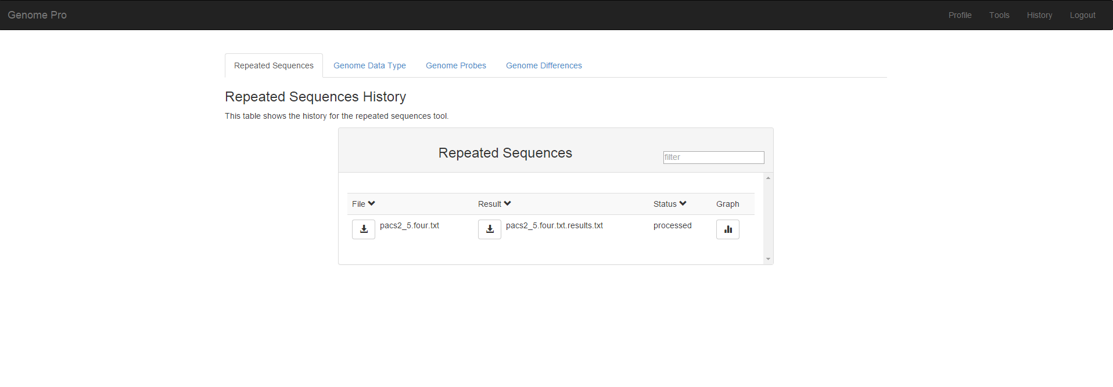
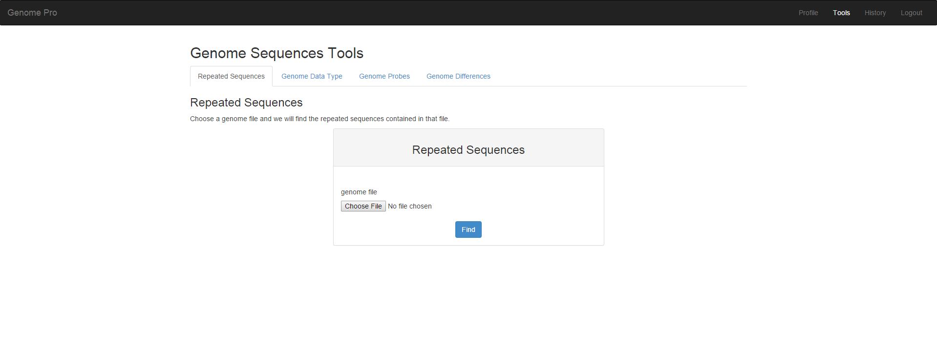
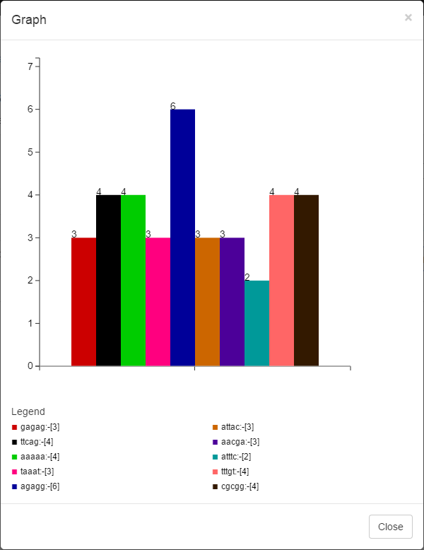
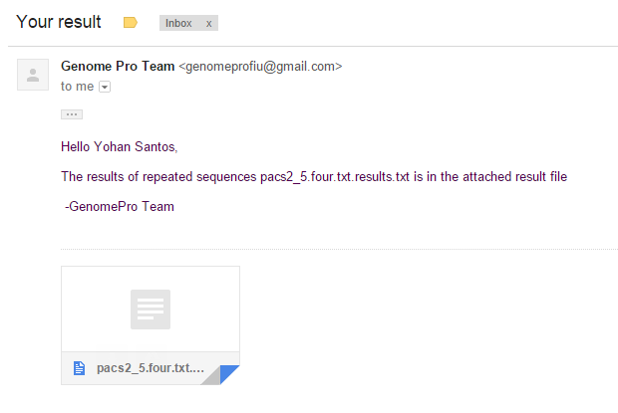
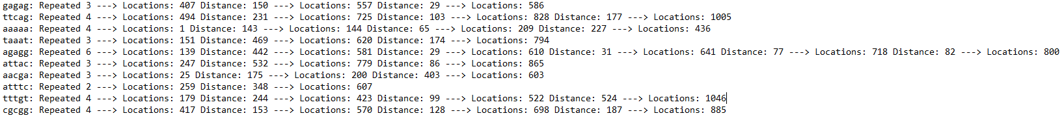
School of Computing & Information Sciences
Senior Project, 2015, Summer
Genomic Sequences
Student: Yohan Santos, Florida International University
Mentor: Michael Robinson, Florida International University
Instructor: Masoud Sadjadi, Florida International University
Problem
Requirements
Identification:
Biologists do not have the proficiency to identify computationally the portions of the genome that are significant to biologic disease processes.
The reason of this problem is that there is not currently an automated system that can accelerate this process and produce a proper result.
Our goal is:
To make possible a new framework that allow us to develop new applications to further study genome data.
To provide a web application where you can submit raw DNA, RNA or Protein data, to execute a variety of genome applications.
The system should allow the user to:
Create Account
Send Email With Account Confirmation
Find Repeated Sequences
Find Locations/Positions
Find Distances
Show Graph of Repeated Sequences
Receive Emails with Results Alert
See History of Genome Files
The system should allow the admin to:
See All Users Register On The System
Change User Types
Delete User From The System
Current System
The current system is holding back many health professionals and researchers studying the area of bioinformatics as they encounter the problem of obtaining a fast and accurate result while processing Gigabytes of genomic data.
In addition, the current system for processing genomic sequences is being done manually and this process could take days and even weeks to obtain an accurate result that can be error free.
Object Design
Screenshots
Find Repeated Sequences Class Diagram
System Design
How To Register At Genome Pro
MVC
Registration Page
Email with confirmation Alerts
Verification
Unit testing:
Performed for each component before being integrated into the system.
Integration Testing:
Established that the backend was working as expected with the frontend. We validated that the functionalities where accomplished using the use cases already defined.
Automatic and Manual Testing:
The system was extensible tested by imitating the role of the regular, registered and admin user as well. All the features of the client application were tested to ensure proper behavior.
Implementation
Profile Page
This Web Application was implemented using Bootstraps with Angular JS that allow to generate HTML5, CSS, and JavaScript providing a responsive design suitable to any platform. The data access is managed through PHP connecting to PostgreSQL. The algorithms to compute genome processing where implemented using Java and C given their power to process arithmetic operations.
How To See Repeated Sequences Results
Summary
See Repeated Sequences History Page
How To Find Repeated Sequences
From now on Biologist and Researchers can take advantage of this first version of the Genome Pro Application. They can find that the system could now provide them with tools and functionalities like Find Repeated Sequences, Types, Probes, and Differences. Also they could create profiles, receive email notifications and keep track of their genome files as well.
This first version sets the roots for future development and continue improvement of the actual system.
Find Repeated Sequences Page
Repeated Sequences Graph Results
Email with Result Alerts
Repeated Sequences Document Results
Acknowledgement
The material presented in this poster is based upon the requirements specified by Michael Robinson. Special thanks to my Family, my Team Partner: Jordan Alvarez, our Product Owner: Michael Robinson, and our Professor: Masoud Sadjadi.

