Slide 1







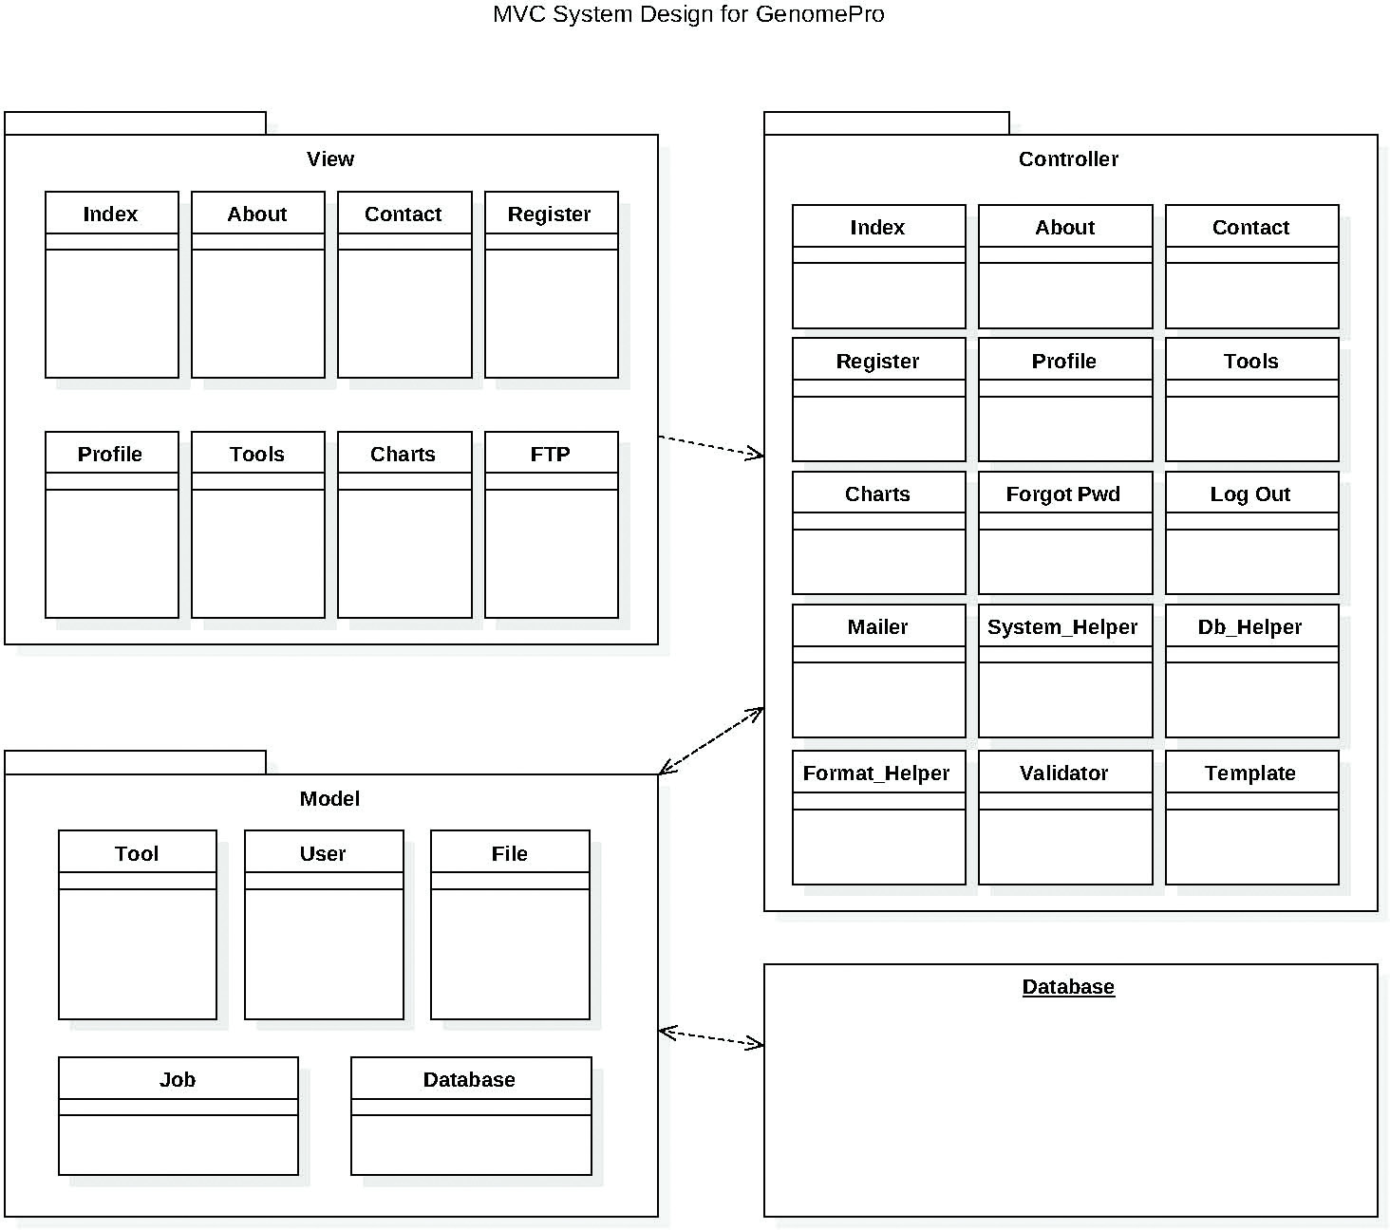
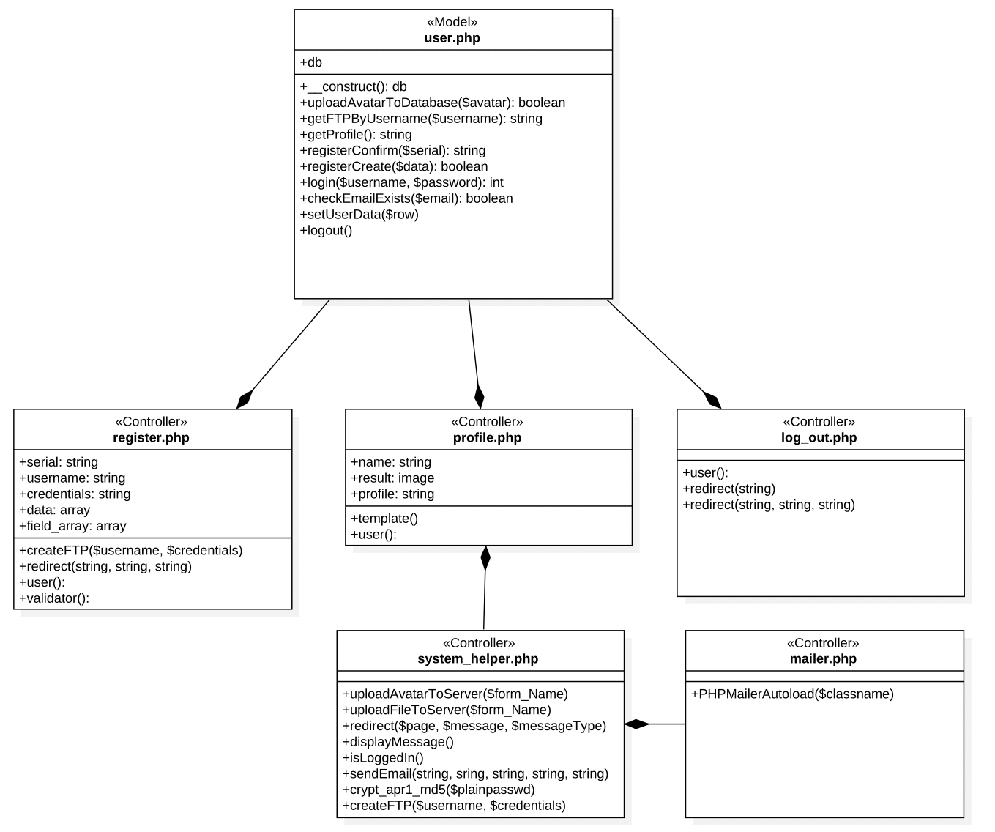
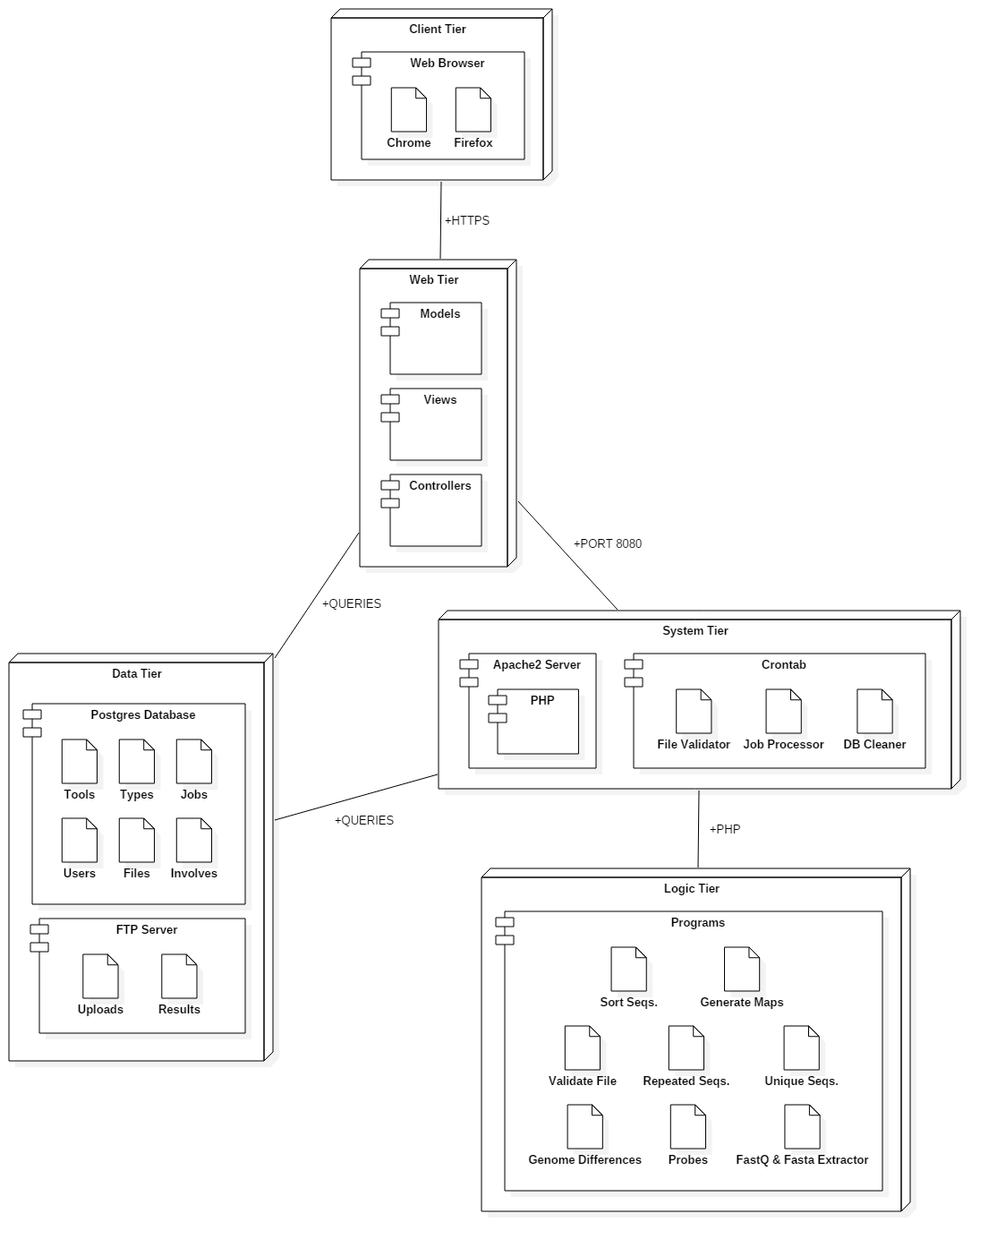
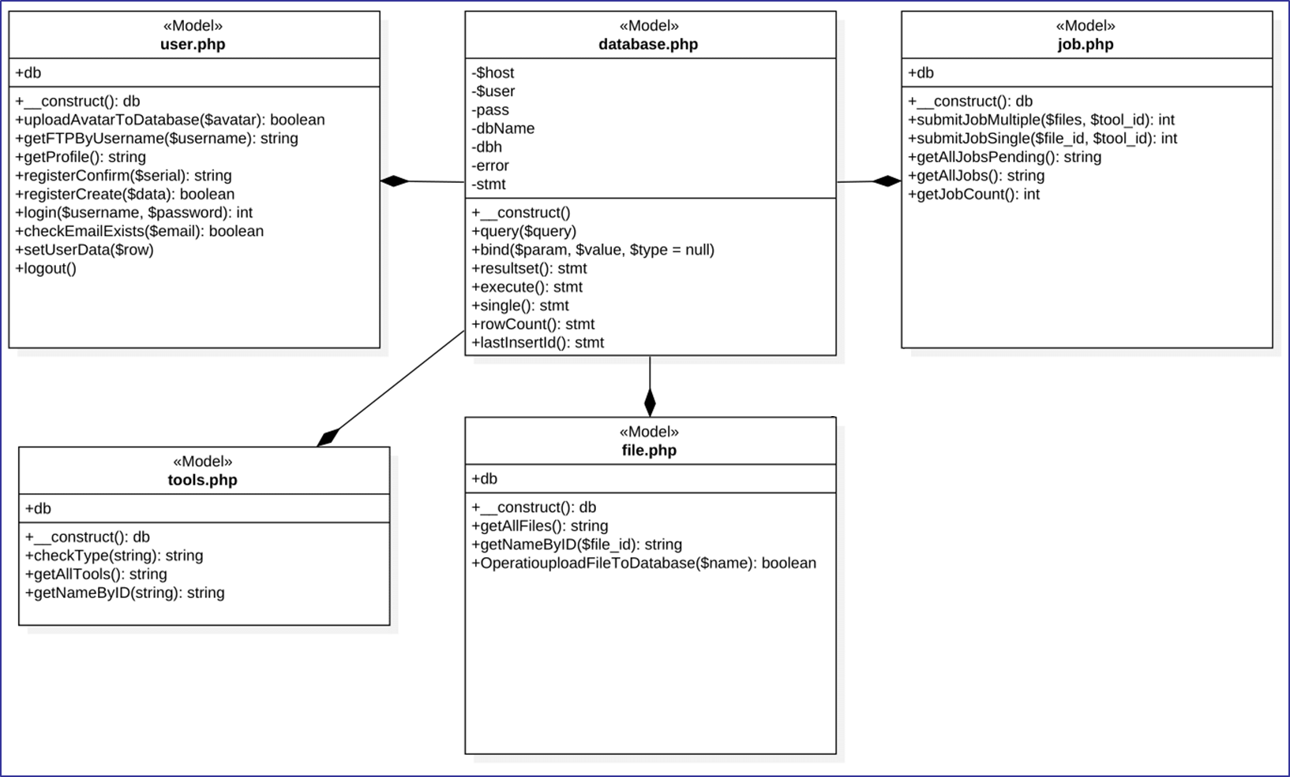
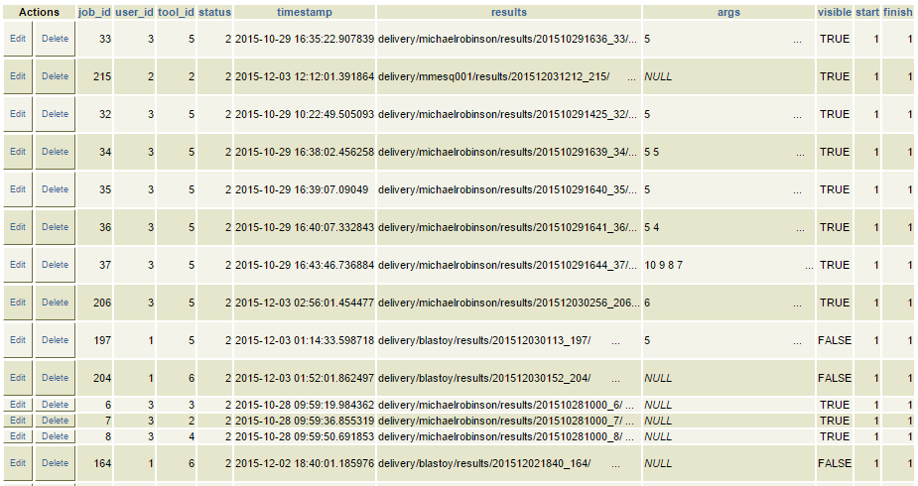
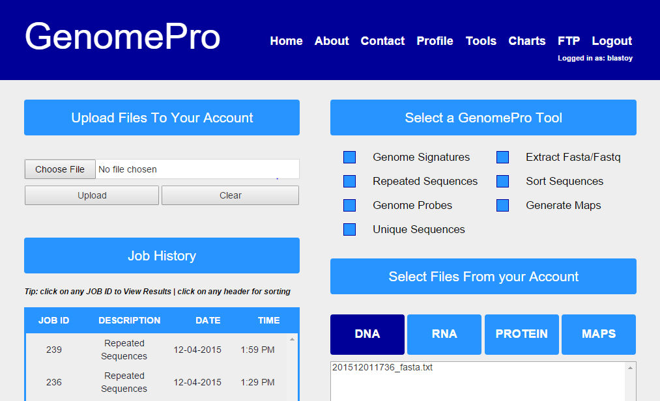
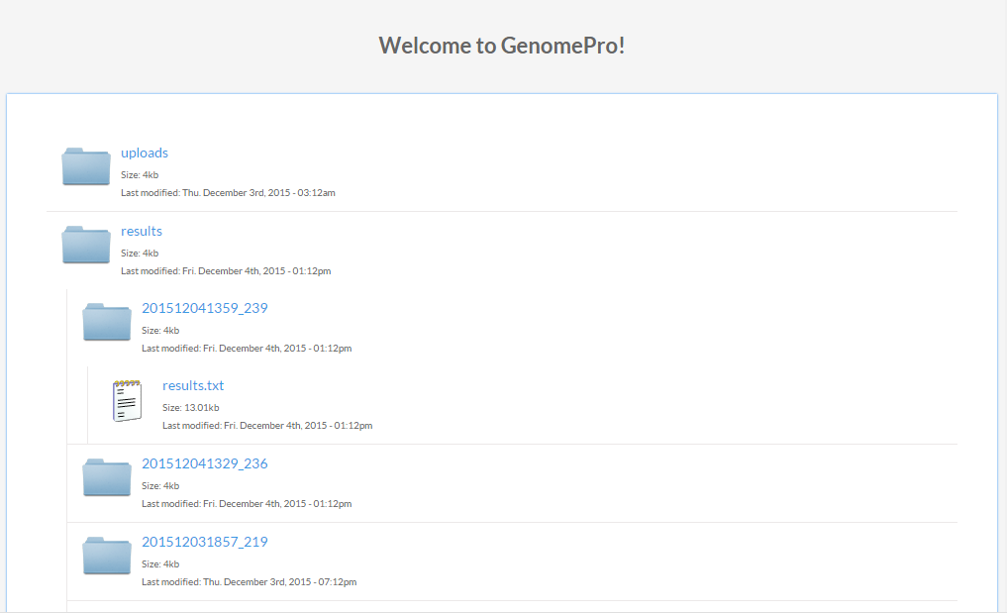
GenomePro 2.0
Student: Guido Ruiz, Florida International University
Mentor: Michael Robinson, Florida International University
Instructor: Masoud Sadjadi, Florida International University
School of Computing & Information Sciences
Senior Project, 2015, Fall
Problem
Many Biomedical Researchers today struggle as they perform the necessary steps to find patterns within their genomic data. Using programs like Excel to perform arithmetic calculations, issues arise with the file size of genome data, as well as the effort and complicated procedures required to make genome files readable.
We are developing a sophisticated web framework that can perform calculations on genomes automatically, removing the complicated tasks that are usually done by hand and allowing users to find breakthroughs faster.
Current System
With new readily available tools, GenomePro 2.0 offers even more jobs that can be done on uploaded genomic data, increasing the total amount of tools to seven, all done through the use of a web service. Jobs submitted by users are now stored in queue, which are processed every minute by the system if no other job is taking place using Linux/Unix CRON (easily converted into distributed systems in later versions). The current system is also totally modular, and user’s results are now stored safely using Apache Authentication (FTP) to be accessed anywhere.
Requirements
C Program: File Validator
Tool: Genome Signatures
Tool: Unique Sequences
Tool: Genome Probes
Tool: Extract Sequences
Tool: Sort Sequences
Tool: Create Maps
Tool: Generate Charts
Queue jobs in a FCFS (FIFO) fashion.
FTP results with encryption.
Automate the execution of jobs.
Save results securely.
Allow multiple jobs and chaining.
System Design (MVC)
Object Design
Implementation
All programs that perform calculations on genomes to produce results are done in ANSI C. Using a web service, the user can submit multiple jobs on multiple files. Every minute, new jobs are selected from the database and are processed by their respective ANSI C programs through the use of a PHP script. Adding new jobs to the database after a user has submitted them are also procedures done in PHP. The ease of use and design of the site was done very successfully by Mardoqueu Mesquita, my team partner for this project.
Screenshots
Verification
Unit, integration, and validation testing was done to make sure all the elements of GenomePro 2.0 worked as intended. For unit testing, Selenium was used extensively. These include testing to see if the user can log in, register, etc. However, for other cases, such as the ANSI C programs built, manual unit testing was done to make sure they worked by themselves, integrating them later onto the system. As each C program was added onto the system, integration testing was done manually and automatically using Selenium by submitting ‘dummy’ jobs to the system and seeing if the results were as expected.
Both malicious and ordinary users were tested, making sure the system was ready for SQL injection, uploading malicious files, etc.
Once all seven tools worked, we looked at the system and performed validation testing to make sure the system still performed and achieved what was originally intended. By checking the time it took for each program to run, as well as noting how many steps is required to submit a job, we made sure GenomePro was dependable and easy to pick up and use right away. GenomePro understands that its audience is Biomedical Researchers that want their results quickly and efficiently, which confirms the necessary emphasis put on validation.
Summary
GenomePro 2.0 is a sophisticated web service that hopes to be as useful to a Biomedical Researcher as a scientific calculator is to a mathematician. It provides the ease of use and accessibility to a task that would otherwise be very tedious and time consuming. With extras such as charts generation from the data uploaded, Biomedical Researchers can see exactly where repeats in genome data happen, and compare side by side different subsequences of bases found in data types such as DNA, RNA, and Protein. All the result files are stored securely, and can be downloaded anytime, anywhere.
With GenomePro 2.0, our team hopes that Biomedical Researchers make more exciting breakthroughs to help find cures for many diseases affecting the world today, using our very secure and easy to use software as an assistant to get there. We also hope that GenomePro 3.0 releases many more tools to come, and that it becomes a branding tool as it entices more and more users.
Acknowledgement
The material presented in this poster is based upon the work supported by Michael Robinson. I am thankful to the help that I received from my group member Mardoqueu Mesquita.

