Slide 1
Genomic Sequences
Yordan Alvarez – Developer, Tester, and Scrum Master
Yohan Santos – Developer, Tester, and Scrum Master

Slide 2
Problem Definition

Slide 3
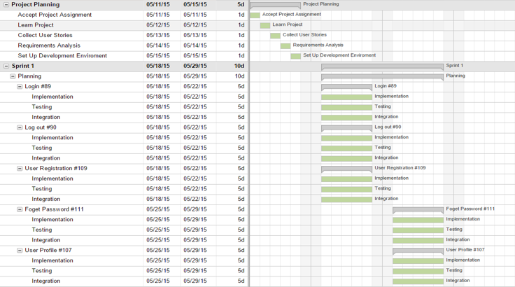

Gantt Chart

Slide 4
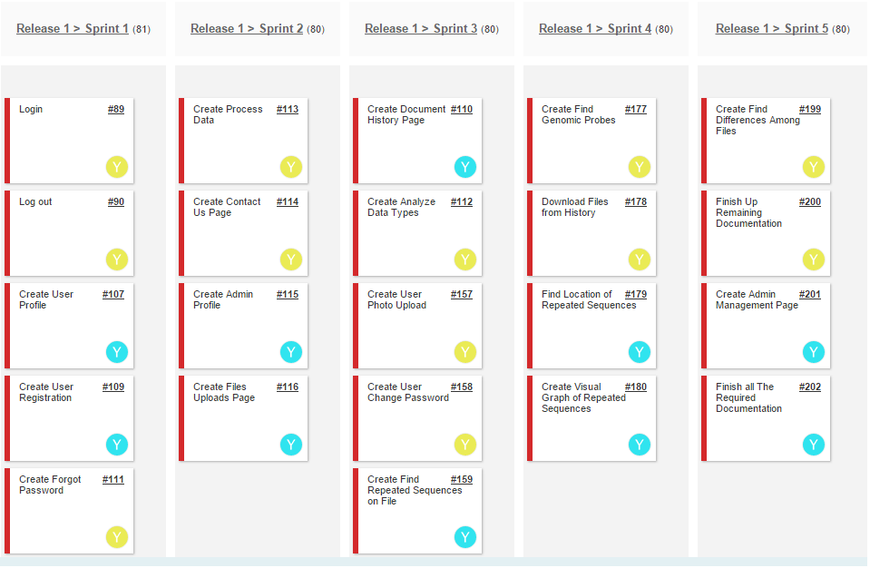
User Stories Implemented

Slide 5
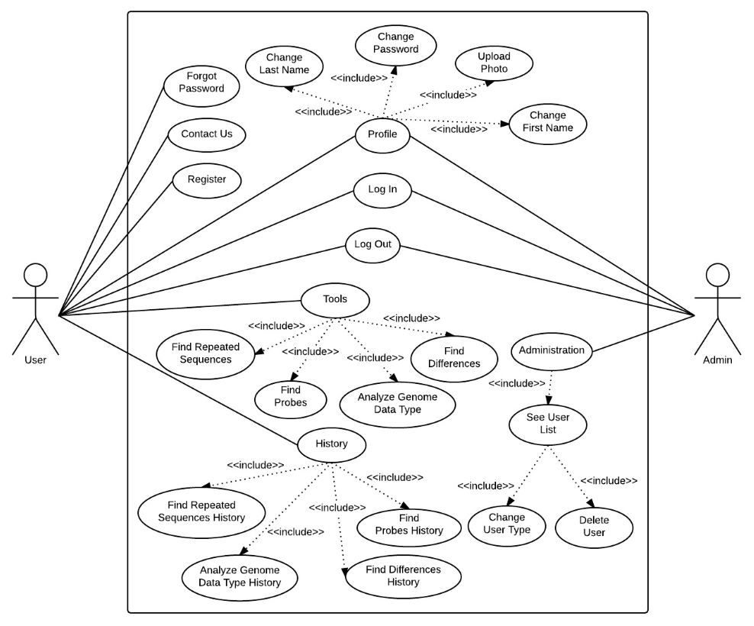
Use Cases Diagram

Slide 6
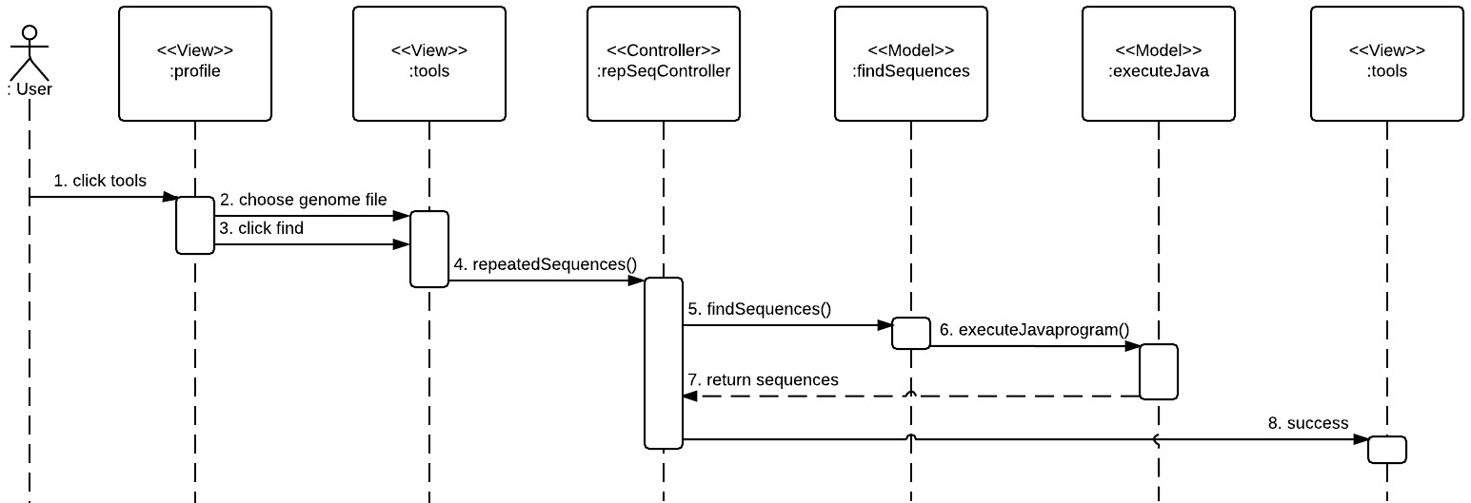
Find Repeated Sequences Sequence Diagram

Slide 7
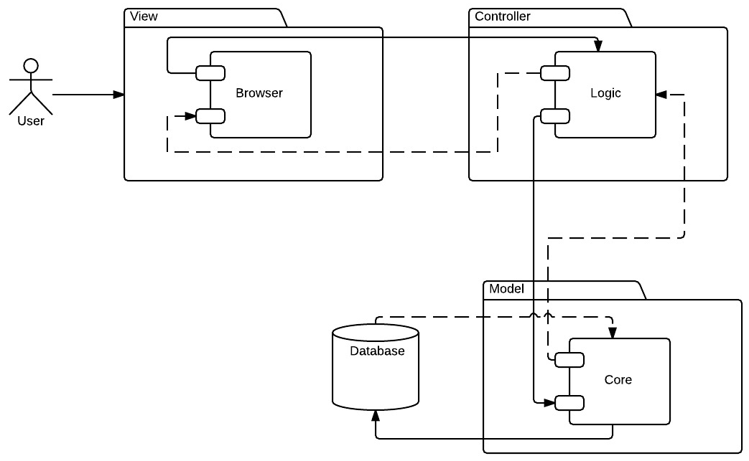
System Design (MVC)

Slide 8
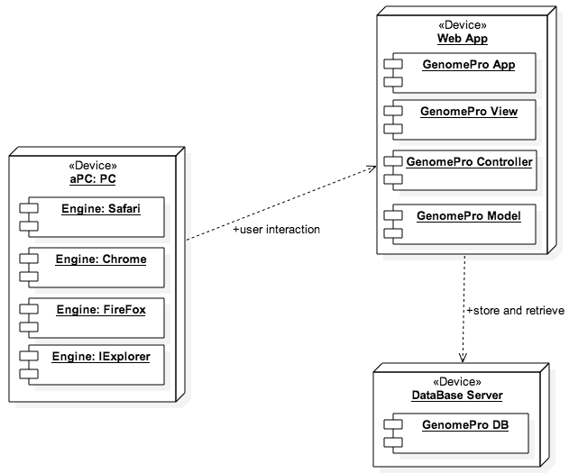
System Deployment

Slide 9
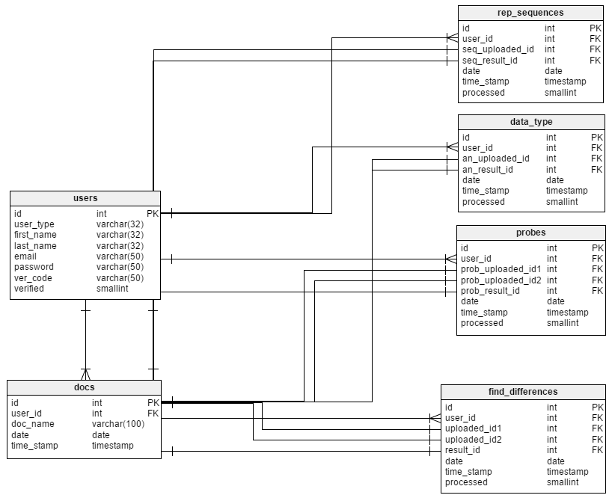
Persistent Data Design

Slide 10



Security/Privacy

Slide 11
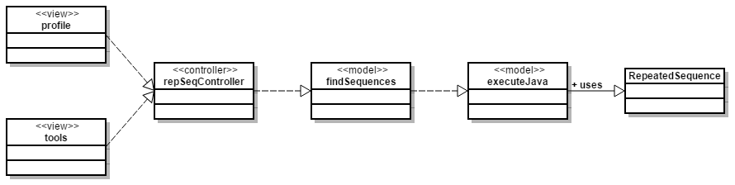
Find Repeated Sequences Minimal Class Diagram

Slide 12
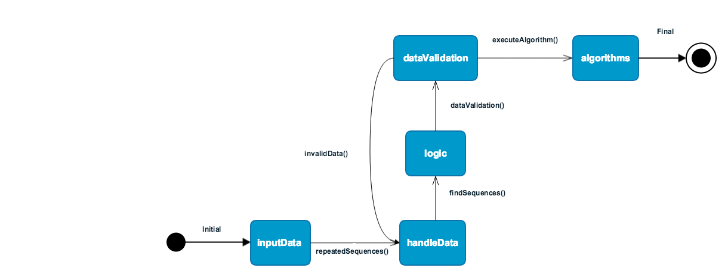
State Machine Diagram

Slide 13
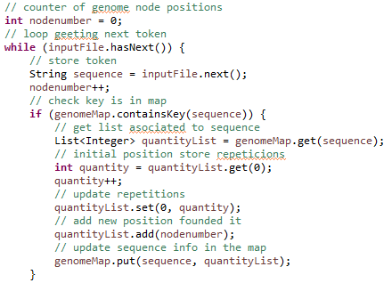
Main Algorithm used to Find Repeated Sequences

Slide 14
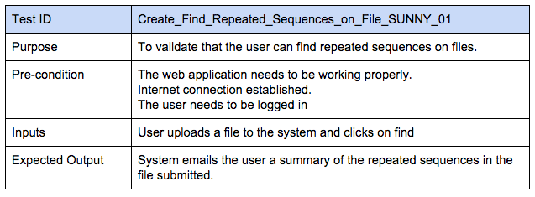
Find Repeated Sequences Sunny Day

Slide 15
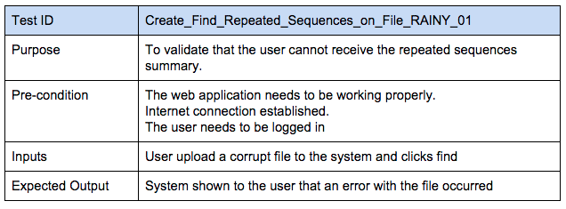
Find Repeated Sequences Rainy Day

Slide 16
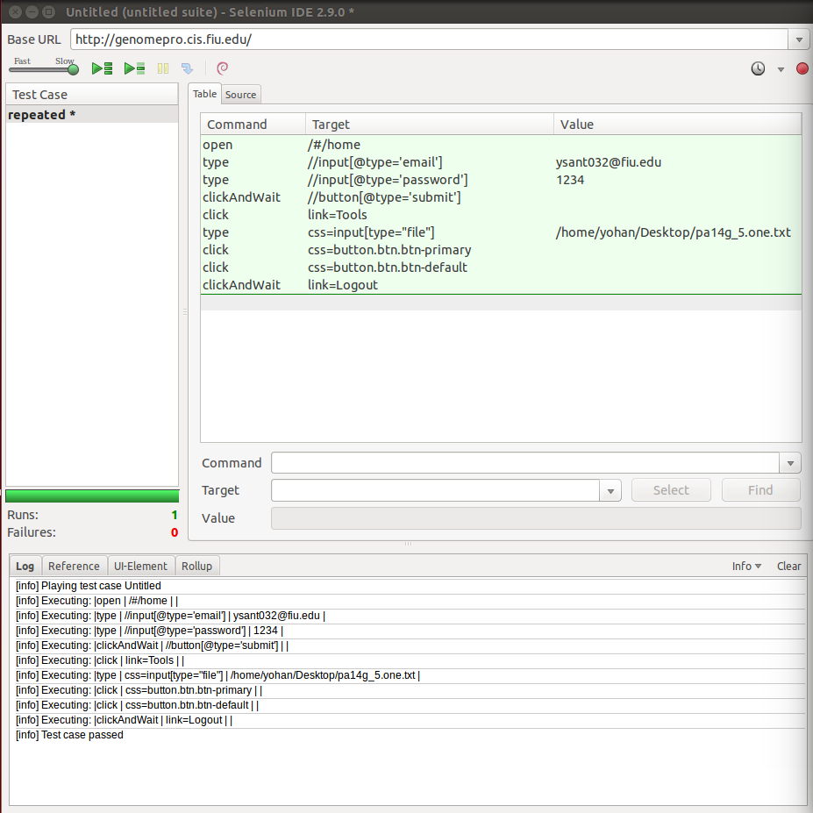
Find Repeated Sequences Automated Test Scripts

Slide 17
Thanks!

