Slide 1











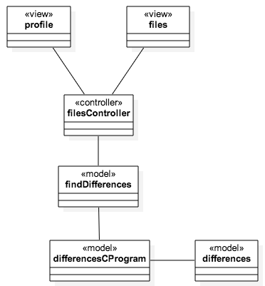
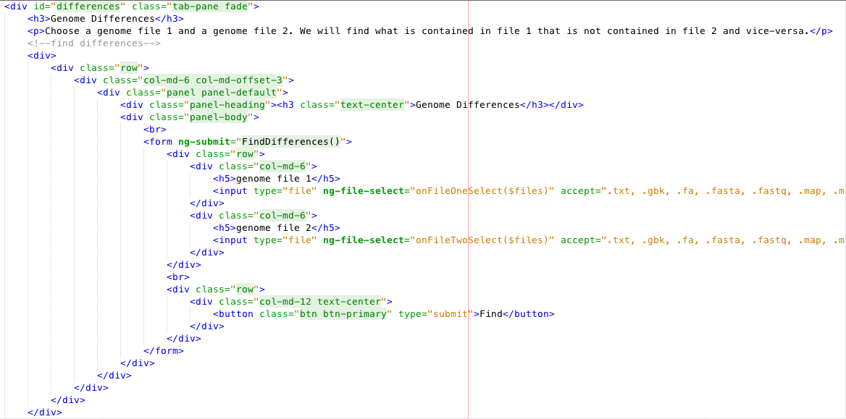
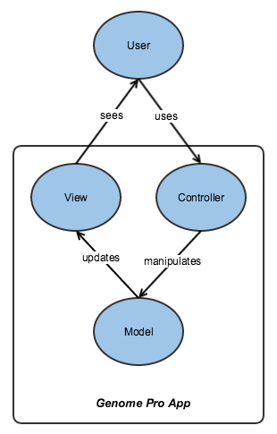
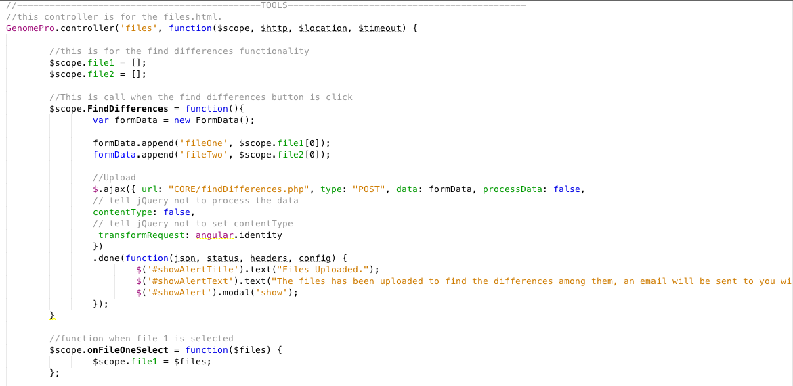
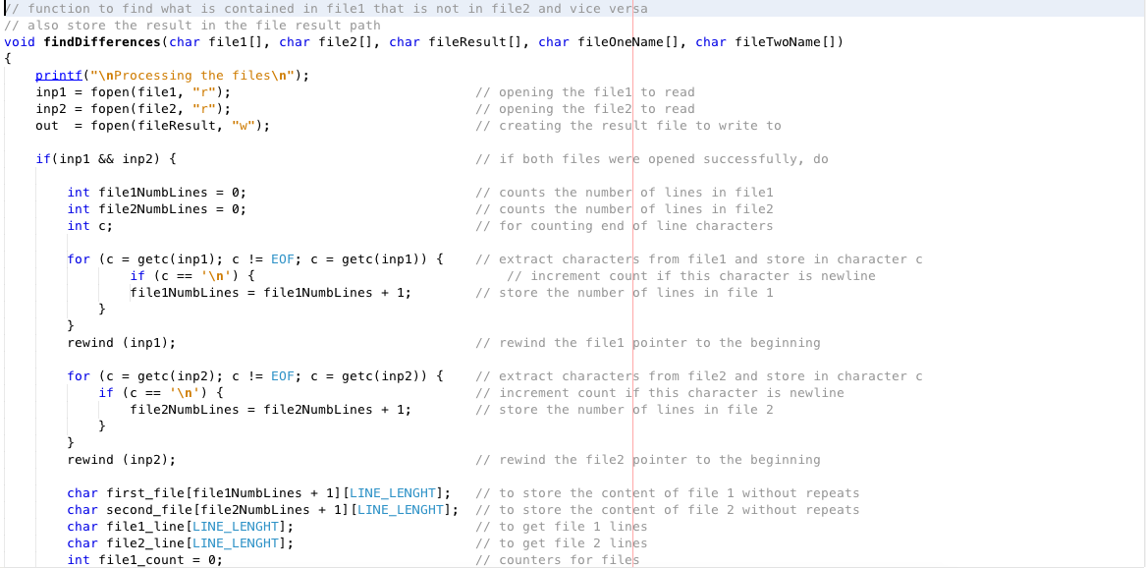
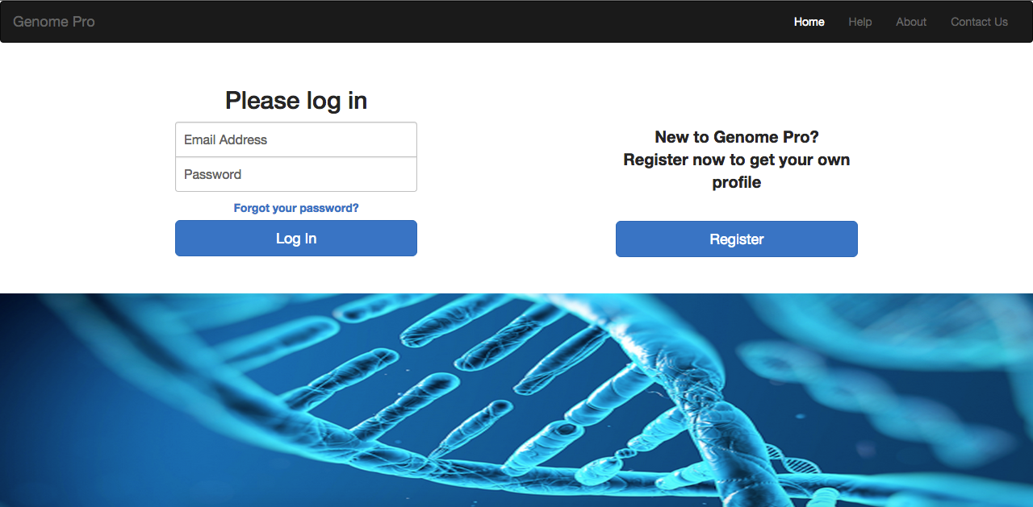
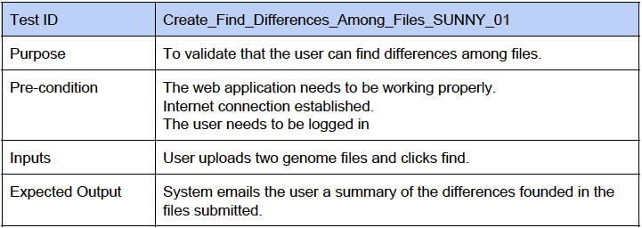
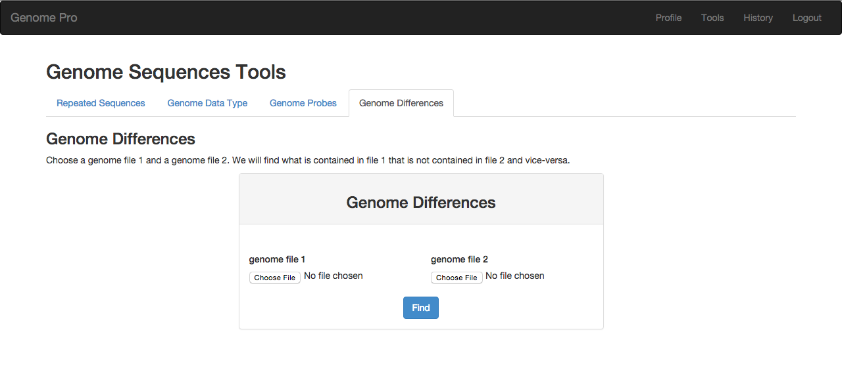
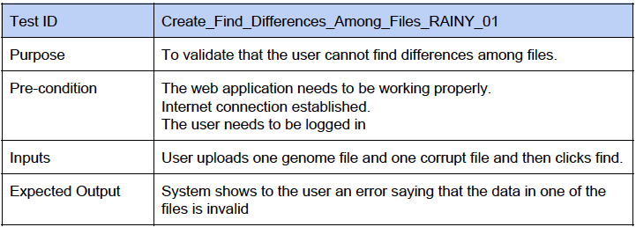
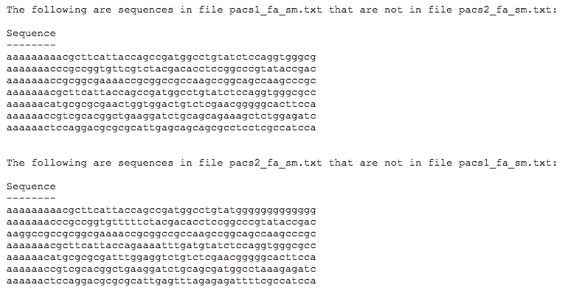
School of Computing & Information Sciences
Senior Project, 2015, Summer
Genomic Sequences
Student: Yordan Alvarez, Florida International University
Mentor: Michael Robinson, Florida International University
Instructor: Masoud Sadjadi, Florida International University
Problem
Current System
Requirements
Out of the 3.2 billion nucleotides in the human genome, over 95 percent is unknown. The recently completed five-year project named Encyclopedia of DNA Elements (ENCODE) concluded that about 80 percent of the human genome is active and it is not just junk DNA as it was previously called.
Nowadays, biologists, researchers, and health professionals do not have the resources to identify computationally the sections of the human genome that are significant to study and prevent biologic disease processes due to the increasing production of genomic data.
The current system is holding back many health professionals and researchers studying the area of bioinformatics as they encounter the problem of obtaining a fast and accurate result while processing Gigabytes of genomic data.
The reason to this problem is that there is not currently an automated system that can accelerate this process and produce a proper result. In addition, the current system for processing genomic sequences is being done manually and this process could take days and even weeks to obtain an accurate result that can be error free.
To provide users with a solution to study the human genome, we developed the Genomic Sequences Tools, which will allow users to:
Find repeated sub-sequences with their location and distances among them
Graphical representation of repeated sub-sequences
Analyze the contents of genomic data
Find signatures of any length
Find exact sub-sequences present in multiple genome
System Design
Object Design
Implementation
The Genomic Sequences application provides a model-view-controller (MVC) design pattern. The model represents data, business logic and rules. The view represents the presentation. Finally, the controller accepts input and provides a bridge of communication between models and views.
Find Differences Object Design Diagram
files.html
filesController.js
differences.c
Verification
Screenshots
Summary
The Genomic Sequences Tools were tested carefully through hands-on team meetings. We were able to test all the implemented features of the application and verify that they were working as expected.
Genome Pro is a web application that helps health professionals, researchers, biologists, and anyone else with a desire to help to discover treatments for diseases. Genome Pro provides to the users the facility to quickly obtain a result file through email after uploading data to be processed.
In addition, the tasks of the Genome Pro web application is to process genomic data files with algorithms that searches, analyzes, and compares such files. It is important to note that Genome Pro will help to accelerate the process of obtaining fast and accurate results needed during a medical or research examination.
Acknowledgement
I would like to thank my mentor, group member, friends, and specially my family for the support through all these years. Special thanks to the love of my life and mother of my son Yesenia Guzman

