Slide 1





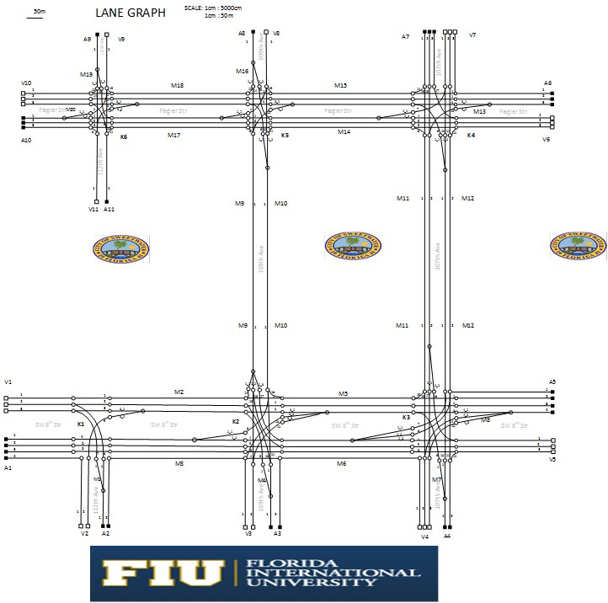
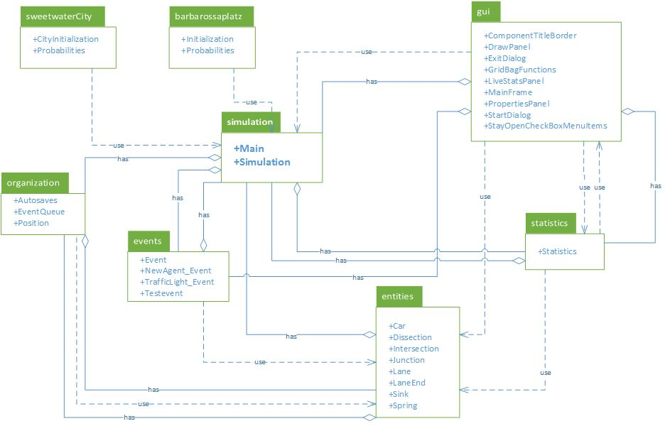





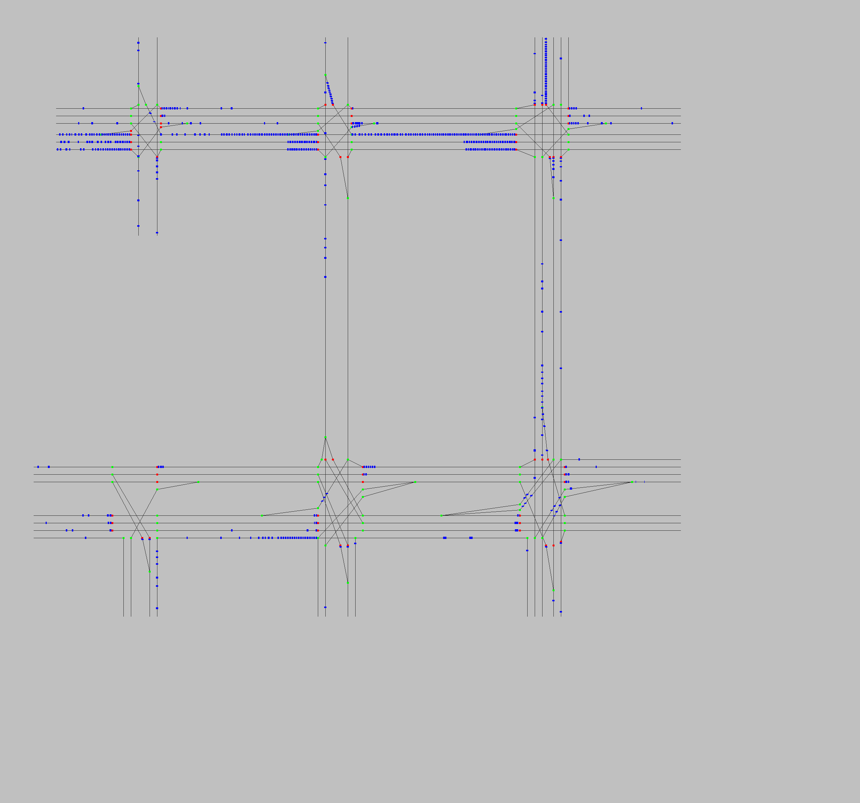
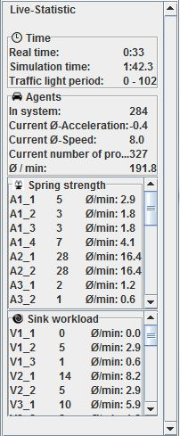
School of Computing & Information Sciences
Senior Project, 2015, Summer
University City Traffic Simulator (UCTS)
Student: Daniel Costa e Sa, Florida International University
Mentor: Gerald Inberg, Dr. Oliver Ulrich, Charaf Azzouzi
Instructor: Masoud Sadjadi, Florida International University
Problem
Current System
Requirements
Congestion on the roads and highways is a major problem in Miami-Dade County, and given the county’s rapidly growing population, it’s a hurdle that isn’t going away. In the city of Sweetwater this is a big dilemma since the city is positioned between two large consumer areas (Dolphin Mall and International Mall) and FIU a 50,000 plus state university. Continual growth in this area causes more and more congestion as an increasing number of drivers compete, in an unorganized way, for a limited set of resources. To better understand this continual growth in traffic and the parameters that relieve or aggravate congestion is the reason for developing the model.
Current System is built and modeled on the basis of the busiest part of city Cologne(Germany), Barbarossaplatz. The model includes the design of road positions, traffic lines, and traffic lights based on Barbarossaplatz area. The system visualizes traffic of the region in an agent-based simulation. In addition, it produces statistics about objects involved in simulating traffic conditions, so that conclusion about improving traffic flow can be made by user.
The overall requirement of the project is to elaborate the design and implement a UniversityCity/Sweetwater Traffic Simulator for research purposes. This will require that a subset of the Sweetwater region to have it’s highways and roads measured and transposed onto a scale so that coordinates and other information can be gathered. After which this information will be used to build a model that properly reflects the mapped region. Once the model has been built, the Graphic User Interface will need to be updated to display all necessary metrics when the simulator is running and will require added functionality such as being able to export an image of the model.
Model Design
System Design
Implementation
The following is the Sweetwater’s major roads Lane Graph.
The below Package Diagram displays each of the component necessary for the correct functioning of the Simulator. This diagram includes components such as entities, GUI, simulation, statistics, events, organization and their relationship to each other.
The system was implemented using Java in NetBeans IDE, Java’s Swing library for the user interface. Microsoft’s Visio was used for designing the visual parts of the model and Excel was used for data collection.
Figure 1.1: Model Lane Graph
Figure 1.2: Package Diagram
Figure 1.3: A sample of the frameworks, tools, and software used to implement the system.
Verification
Summary
The system was verified by developing a set of unit test with NetBeans’ JUnit in order to verify the functionality of the system. Manual system tests where also performed as adequate for UI testing purposes.
This project allows us to observe Sweetwater’s traffic simulation for SW 8th Str and Flagler Str. Careful observation of the Sweetwater model may encourage important traffic improvements as well as provide knowledge about traffic to the City infrastructure.
Agent-based traffic simulation system can be applied to any city area model troubled by traffic congestions.
Figure 1.4: A visual representation of the working simulation taken using the export function added to the GUI
Figure 1.5: Screenshot of UI, representing the live stats panel
Acknowledgement
The material presented in this poster is based upon the work supported by FIU. I am thankful to the help that I received from my group members: Artiom Tiurin and development guidance from Charaf Azzouzi

