Slide 1




Touch and Mid–Air Framework
Visualizer
Team Member: Richard A Lopez
Developer, Scrum Master

Slide 2
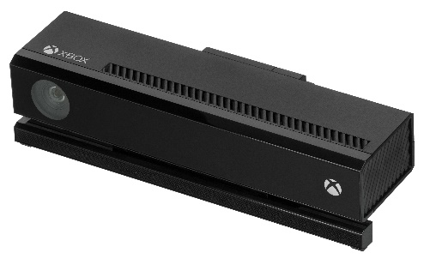
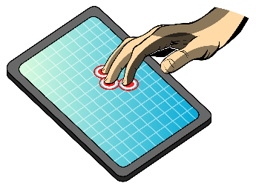
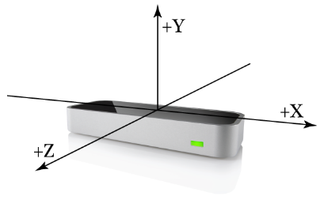
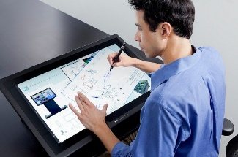
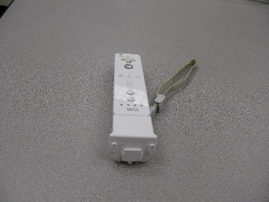
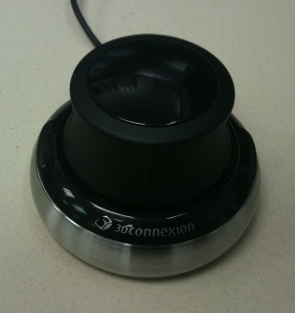
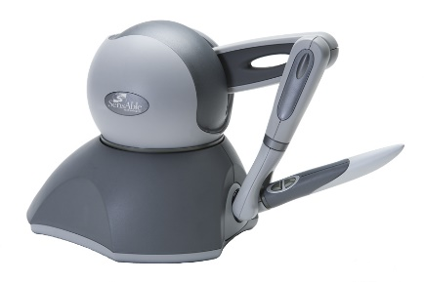
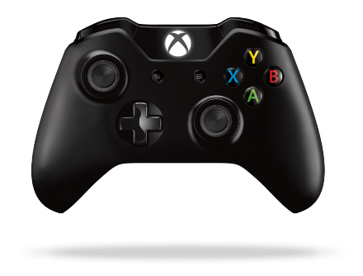
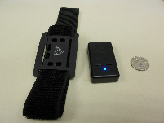
Problem Definition
Explosion of input devices
Cumbersome to code for more than one device
Provide a Modern Code Base (Parallel and Modular System)
Provide a tool for Researchers and Users
Promote Diversity via HCI

Slide 3
Existing Systems
Virtual Reality Peripheral Network
Online only
Setup of Servers
Interruption to service
Still not general enough for non VR peripherals

Slide 4
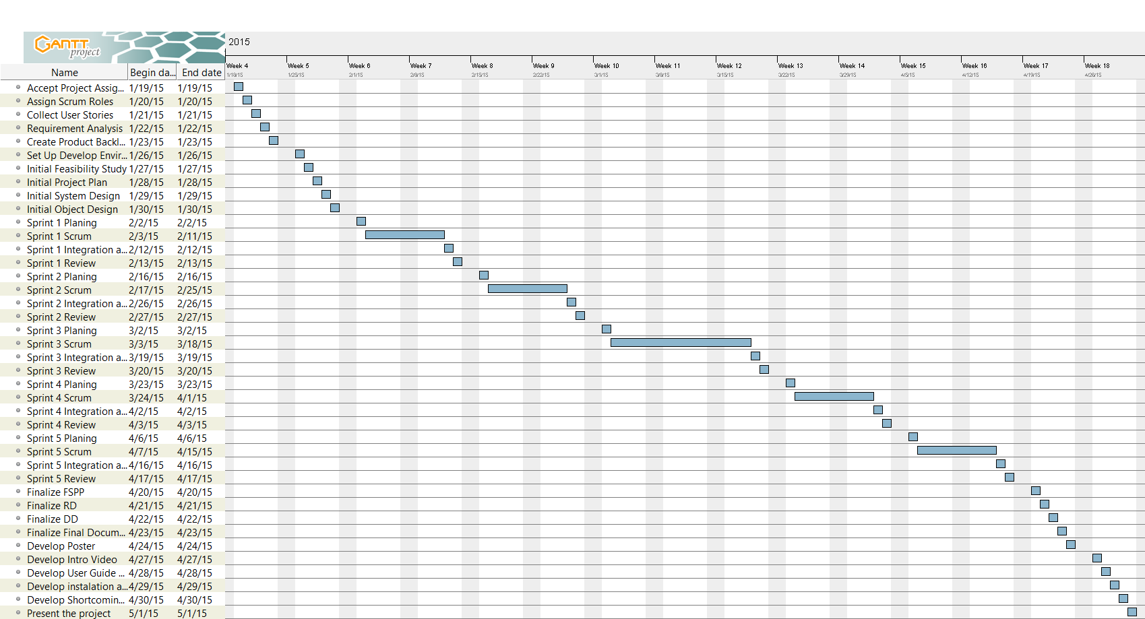
Project Schedule

Slide 5
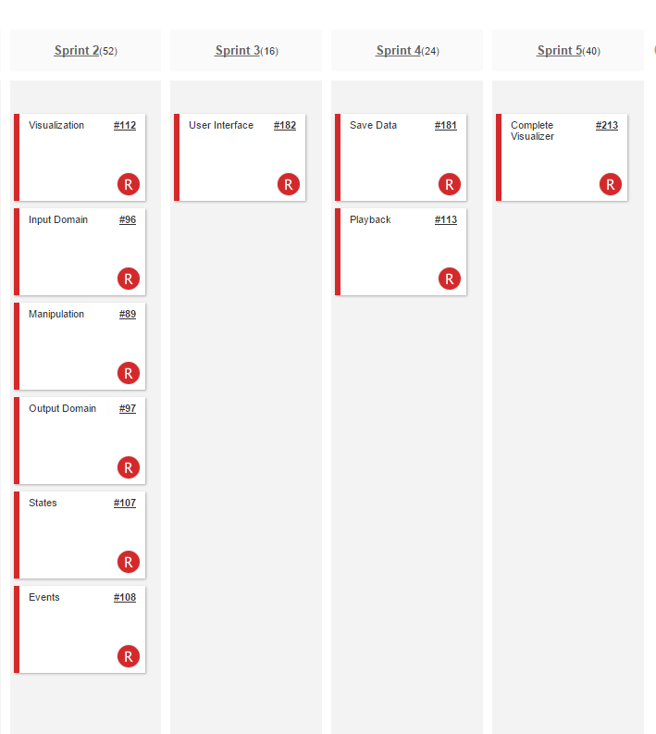
Implemented User Stories

Slide 6
Use cases
TAMUC01 The system shall subscribe to a windows service to receive touch events.
TAMUC02 The system shall allow a user to touch the screen with one or more fingers (Max 10) and draw on the screen.
TAMUC03 The system shall define the states of a touch event.
TAMUC04 The system shall use the X and Y coordinates and map them to a function.
TAMUC05 The system shall record input.
TAMUC06 The system shall replay the touch action in the order the action happened.
TAMUC07 The system shall allow for input to be saved to a file.
TAMUC08 The system shall read recorded input files and replay them.
TAMUC09 The system shall allow various sizes of touch visualization.
TAMUC10 The system shall allow the user to clear the screen and replay data at will.
TAMUC11 The system shall display all the information from the program to a debug monitor.

Slide 7
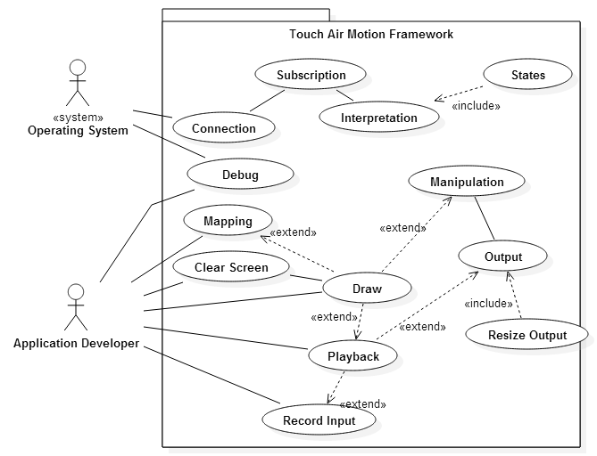
Use Case Diagram

Slide 8
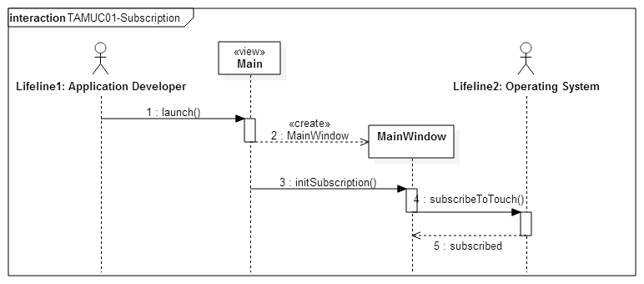
Sequence Diagram

Slide 9
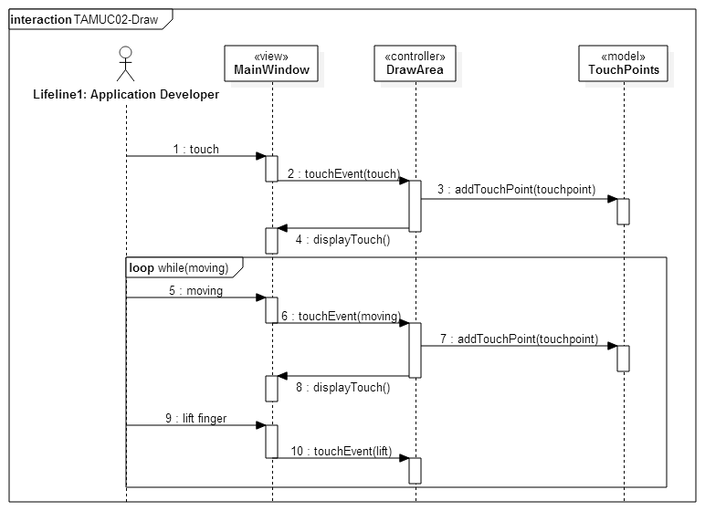
Sequence Diagram

Slide 10
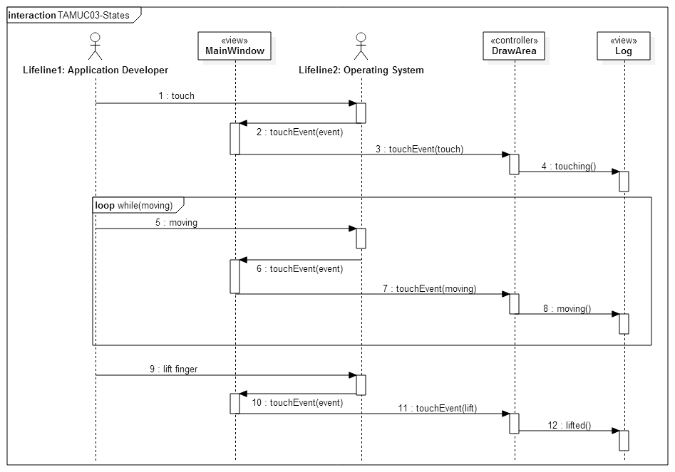
Sequence Diagram

Slide 11
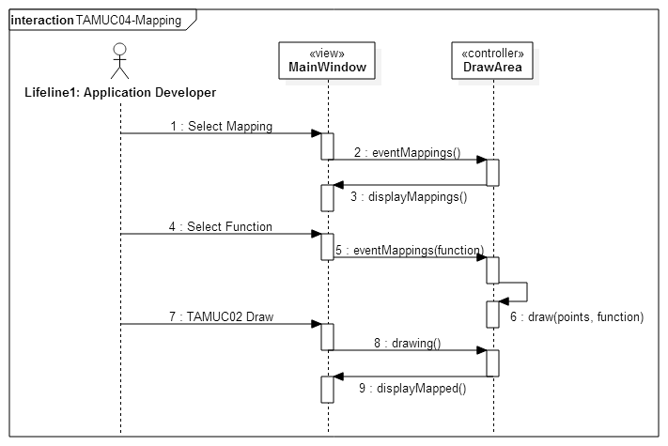
Sequence Diagram

Slide 12
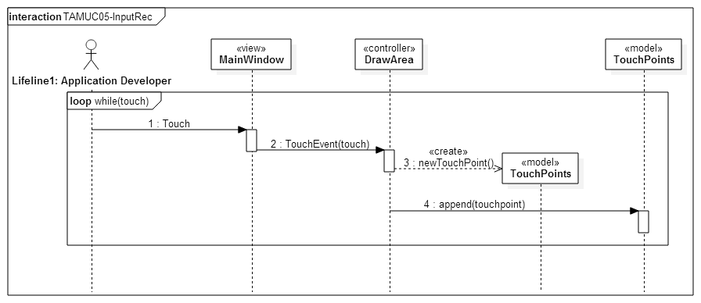
Sequence Diagram

Slide 13
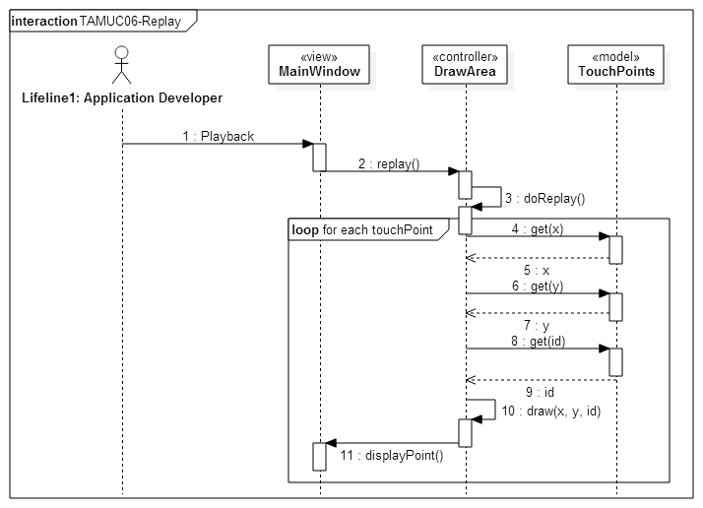
Sequence Diagram

Slide 14
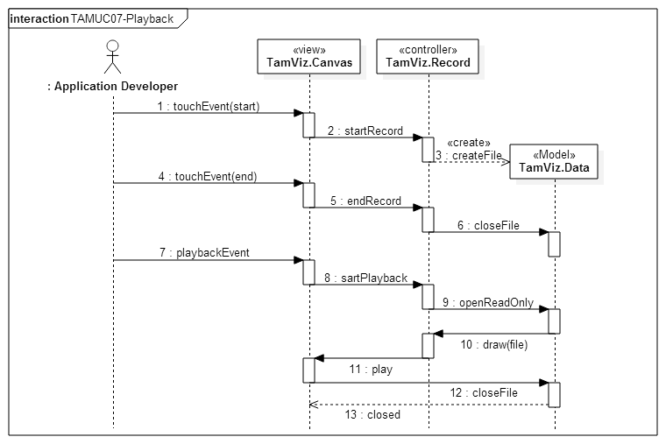
Sequence Diagram

Slide 15
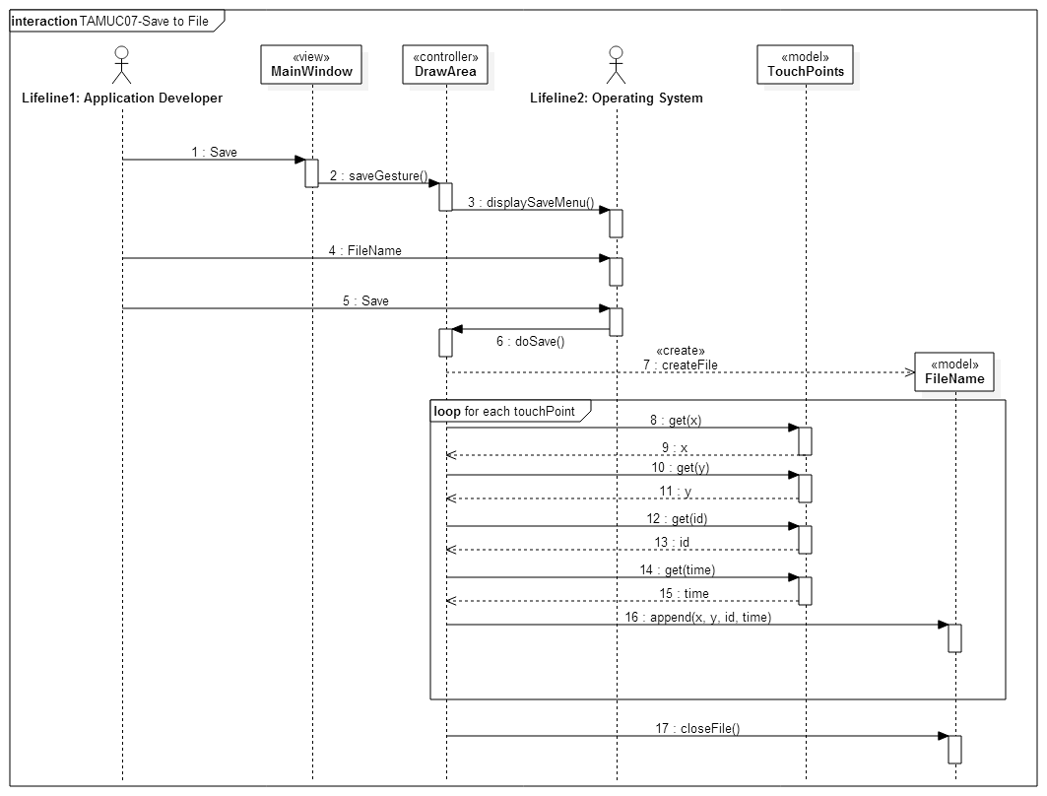
Sequence Diagram

Slide 16
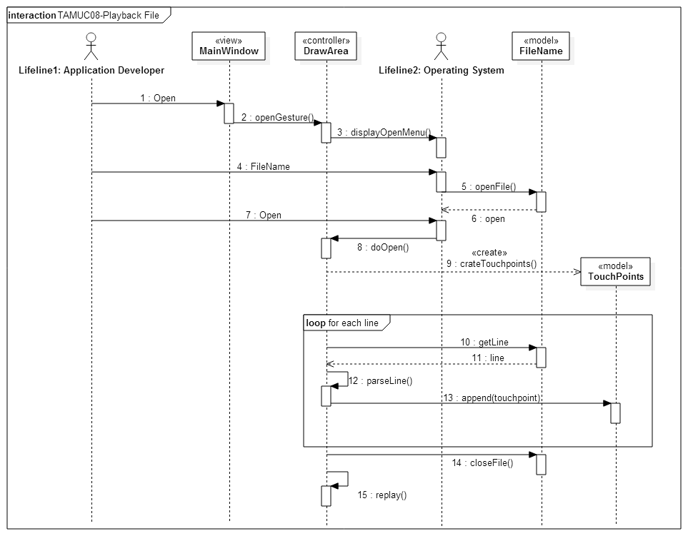
Sequence Diagram

Slide 17
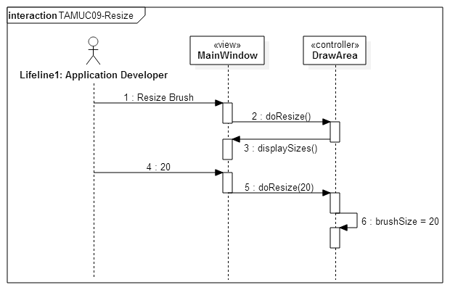
Sequence Diagram

Slide 18
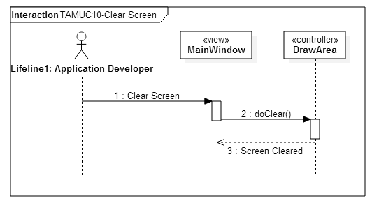
Sequence Diagram

Slide 19
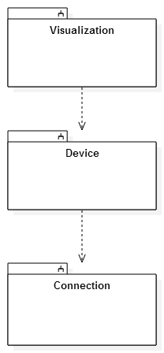
System Decomposition
Service Oriented Architecture
OS input Messages
All messages trough Connection
Model View Controller
Visualization – View
Device – Controller
Connection - Model

Slide 20
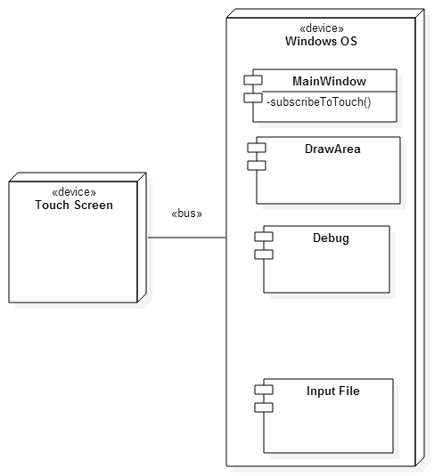
System Deployment
Hardware:
Touch screen capable computer
Multi touch screen capable computer
1 GB of RAM
512 MB Video card
Software:
Windows Operating System 8.1 or greater
Visual Studio 2013 or greater
Qt plugin for Visual studio 5.4 or greater

Slide 21
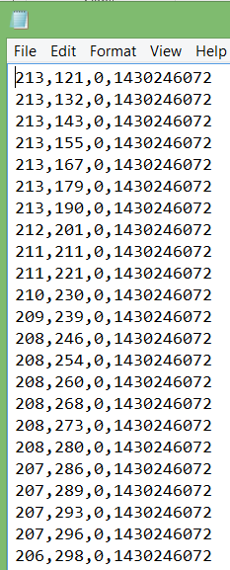
Persistent Data
Save to File
List of Touch Points
X coordinate
Y coordinate
ID
Time Stamp

Slide 22
Security and Privacy
The TAM visualizer and the TAM framework do not utilize any form of registered user, no private data is kept and the framework is aimed towards developers as well as the open source community, therefore there is no privacy or security implementation.

Slide 23
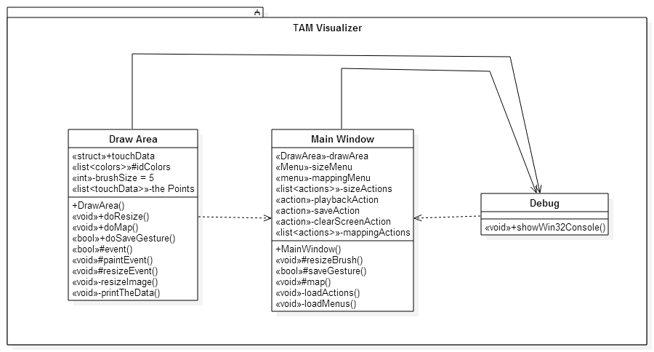
Detailed Design
Static View

Slide 24
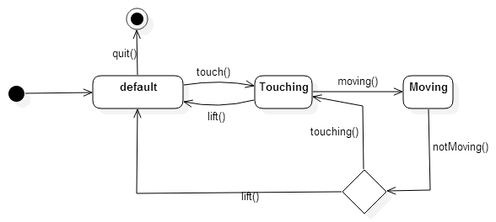
Detailed Design
Dynamic View

Slide 25
Test Cases
Use Case TAMUC02-Touch
Test Case ID | TAM1_SysT_testTouch_SD1
Purpose | To validate result of a touch event
Test Setup | Start app (“TAM Visualizer”) Int x = 50 Int y = 50
Input(s) | Event(touchEvent(x,y));
Expected Result | Red Circle drawn on the screen at 50,50
Test Case ID | TAM1_SysT_testTouch_RD1
Purpose | To validate result of a touch event
Test Setup | Start app (“TAM Visualizer”) Int x = 50 Int y = -50
Input(s) | Event(touchEvent(x,y));
Expected Result | No red circle is drawn

Slide 26
Test Cases
Use Case TAMUC05-Save
Test Case ID | TAM2_SysT_testSave_SD1
Purpose | To validate the result of the save function
Test Setup | Start app (“TAM Visualizer”) Int x = 50 Int y = 50
Input(s) | Event(touchEvent(x,y));
Expected Result | touchpoint.x = 50 touchpoint.y = 50
Test Case ID | TAM2_SysT_testSave_RD1
Purpose | To validate the result of the save function
Test Setup | Start app (“TAM Visualizer”) Int x = 50 Int y = -50
Input(s) | Event(touchEvent(x,y));
Expected Result | touchpoint.x = 50 touchpoint.y = -50

Slide 27
Test Cases
Use Case TAMUC06-Replay
Test Case ID | TAM3_SysT_testReplay_SD1
Purpose | To validate the correct replay of a touch event
Test Setup | Start app (“TAM Visualizer”) Int x = 50 Int y = 50 Event(touchEvent(x,y));
Input(s) | action(playBack)
Expected Result | Screen cleared. Red Circle drawn on the screen at 50,50
Test Case ID | TAM3_SysT_testReplay_RD1
Purpose | To validate the correct replay of a touch event
Test Setup | Start app (“TAM Visualizer”) Int x = 50 Int y = -50 Event(touchEvent(x,y));
Input(s) | action(playBack)
Expected Result | Screen cleared. No Red Circle drawn on the screen

Slide 28
Test Cases
Use Case TAMUC07-Save to File
Test Case ID | TAM4_SysT_testSaveToFile_SD1
Purpose | To validate the result of the save function
Test Setup | Start app (“TAM Visualizer”) Int x = 50 Int y = 50 Event(touchEvent(x,y));
Input(s) | action(save) textField.setText(“testFile1”)
Expected Result | testFile1 is created on the default directory, the contents are (50, 50, 0, time)
Test Case ID | TAM4_SysT_testSaveToFile_RD1
Purpose | To validate the result of the save function
Test Setup | Start app (“TAM Visualizer”) Int x = 25 Int y = 32 No touch event
Input(s) | action(save) textField.setText(“testFile3”)
Expected Result | testFile3 is created on the default directory, the contents are empty

Slide 29
Test Cases
Use Case TAMUC08-Open File
Test Case ID | TAM5_SysT_testOpenFile_SD1
Purpose | To validate the opening of a saved file
Test Setup | Start app (“TAM Visualizer”) File touchFile1 exist. touchFile1 contains the touch point “50, 50, 0, time)
Input(s) | Action(open) textField.setText(“touchFile1”)
Expected Result | Red circle is drawn at 50,50
Test Case ID | TAM5_SysT_testOpenFile_RD1
Purpose | To validate the opening of a saved file
Test Setup | Start app (“TAM Visualizer”) File touchFile3 does not exist.
Input(s) | Action(open) textField.setText(“touchFile3”)
Expected Result | No red circle is opened

Slide 30
Test Cases
Use Case TAMUC09-Resize Brush
Test Case ID | TAM6_SysT_testResize_SD1
Purpose | To validate the change of brush size
Test Setup | Start app (“TAM Visualizer”)
Input(s) | Action(BrushSize) Action(50)
Expected Result | Debug monitor displays “BRUSH SIZE: 50”
Test Case ID | TAM6_SysT_testResize_RD1
Purpose | To validate the change of brush size
Test Setup | Start app (“TAM Visualizer”)
Input(s) | Action(BrushSize) No size selected
Expected Result | no displayed size on the debug monitor

Slide 31
Test Cases
Use Case TAMUC04-Map
Test Case ID | TAM7_SysT_testMap_SD1
Purpose | To validate the change of the map function
Test Setup | Start app (“TAM Visualizer”)
Input(s) | Action(Map) Action(Map 2)
Expected Result | Debug monitor displays “MAPPING FUNCTION SELECTED IS 2”
Test Case ID | TAM7_SysT_testMap_RD1
Purpose | To validate the change of the map function
Test Setup | Start app (“TAM Visualizer”)
Input(s) | Action(Map) No map selected
Expected Result | no displayed map on the debug monitor

Slide 32
Test Cases
Use Case TAMUC010-Clear Screen
Test Case ID | TAM8_SysT_testClearScreen_SD1
Purpose | To validate the clear screen function
Test Setup | Start app (“TAM Visualizer”) Int x = 50 Int y = 50 Event(touchEvent(x,y)); Red circle appears at 50,50
Input(s) | Action(ClearScreen)
Expected Result | Screen is cleared, no circle at 50,50
Test Case ID | TAM8_SysT_testClearScreen_RD1
Purpose | To validate the clear screen function
Test Setup | Start app (“TAM Visualizer”) No touch event
Input(s) | Action(ClearScreen)
Expected Result | Screen remains cleared

Slide 33
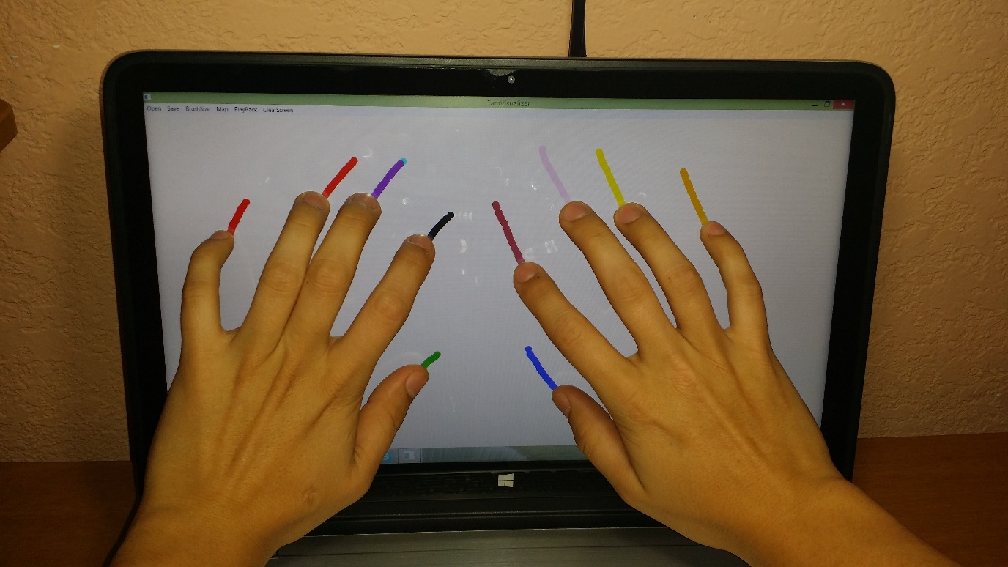
Demo

