Slide 1
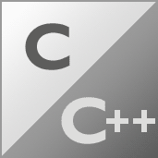






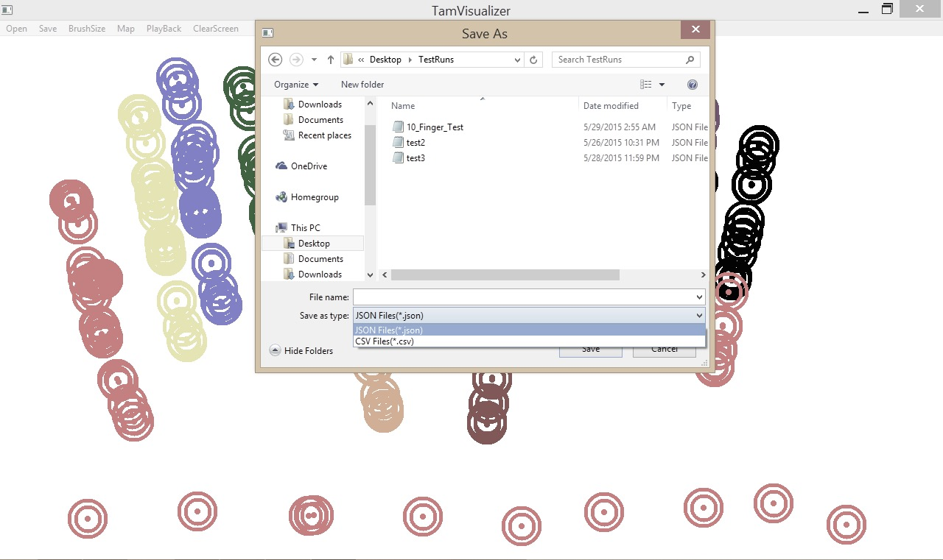
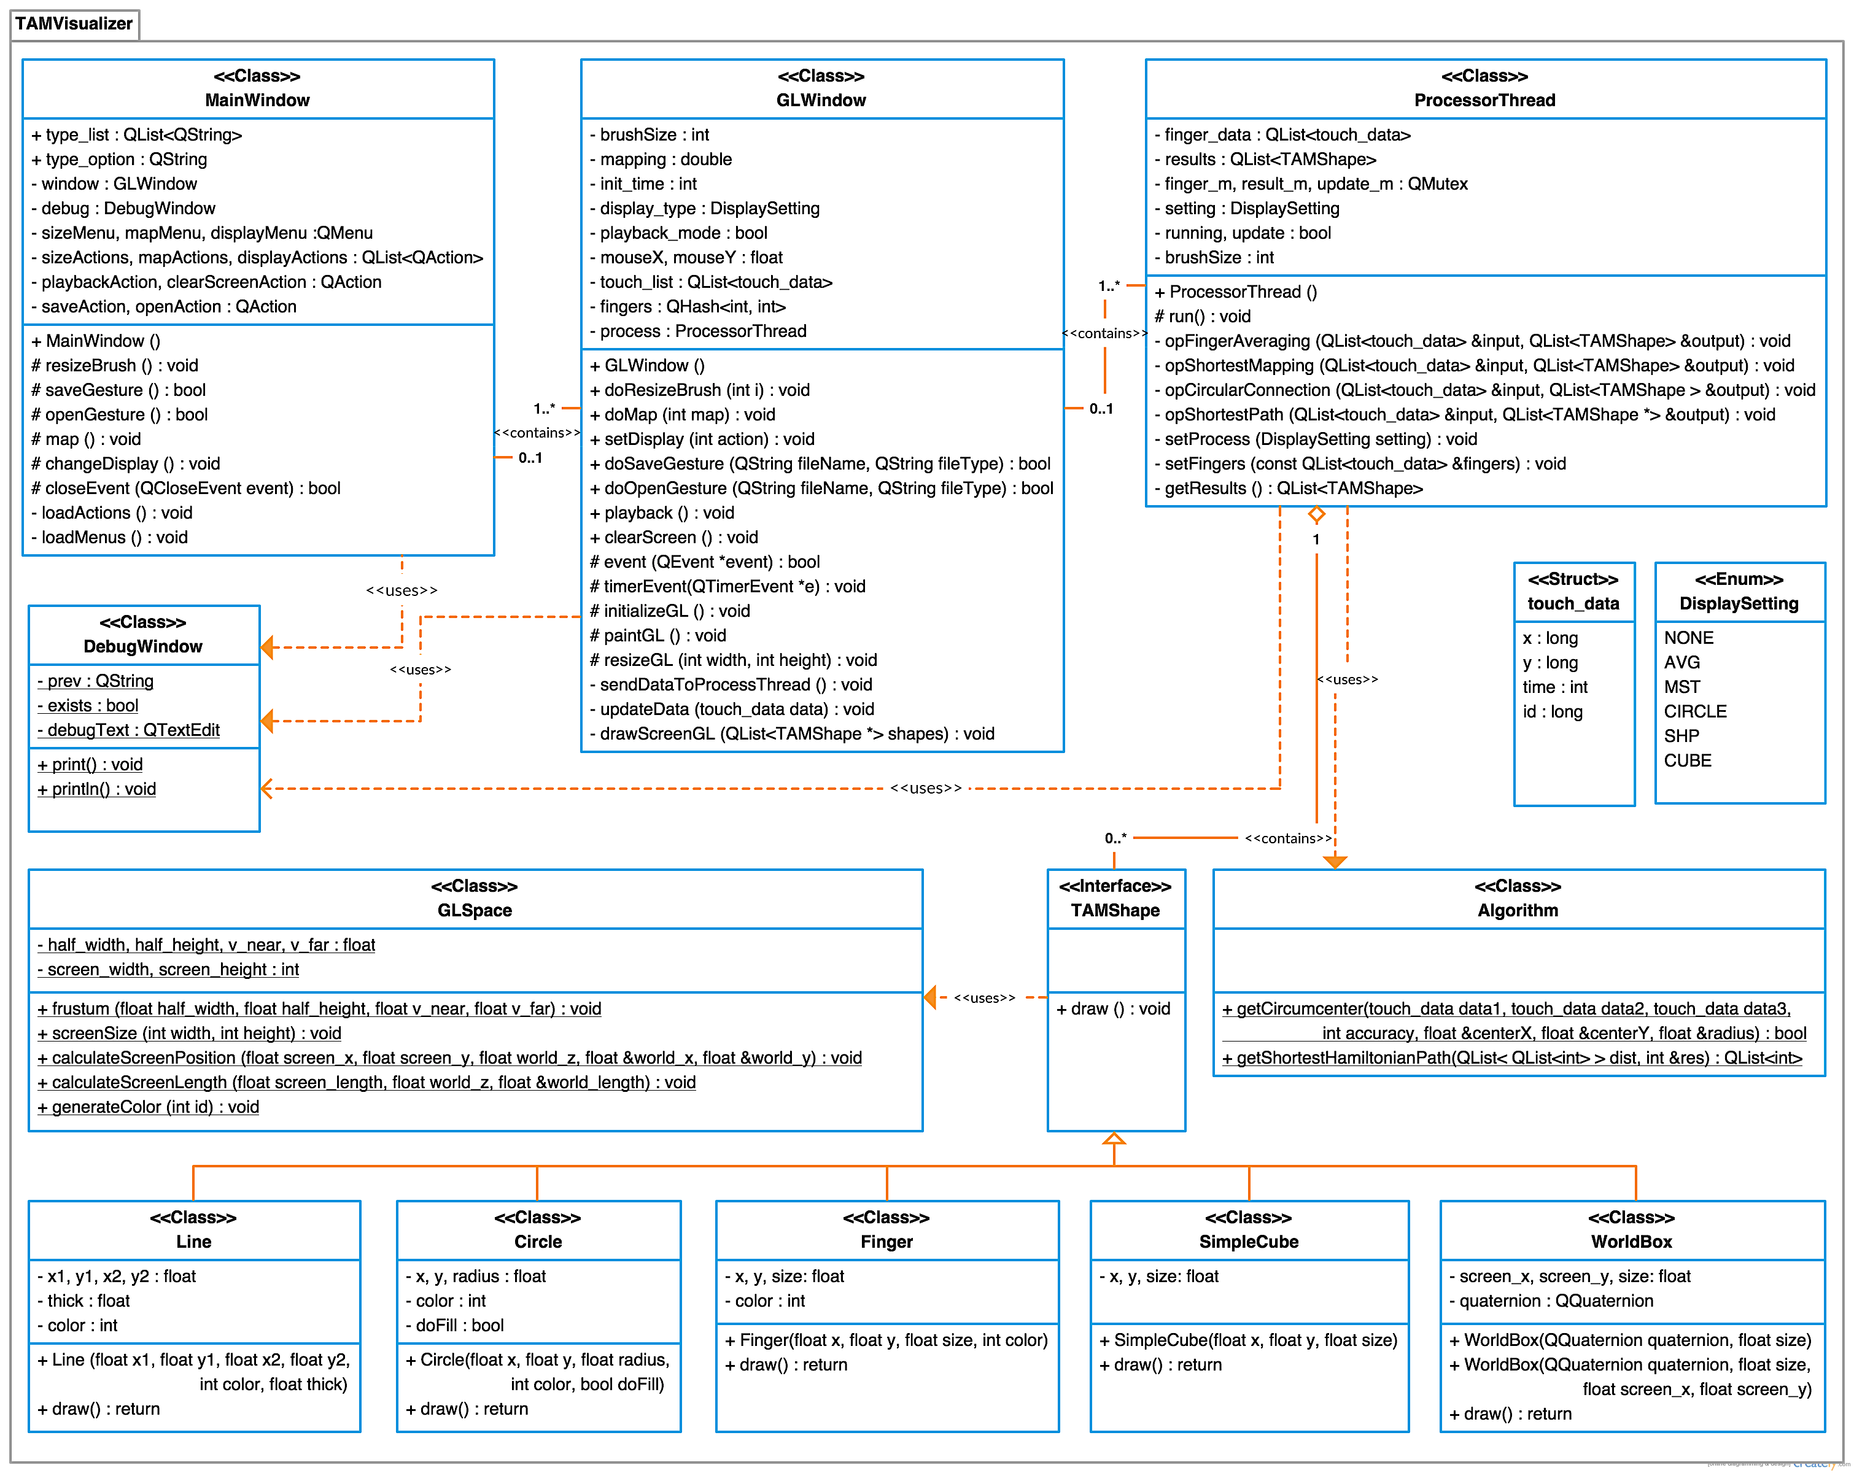
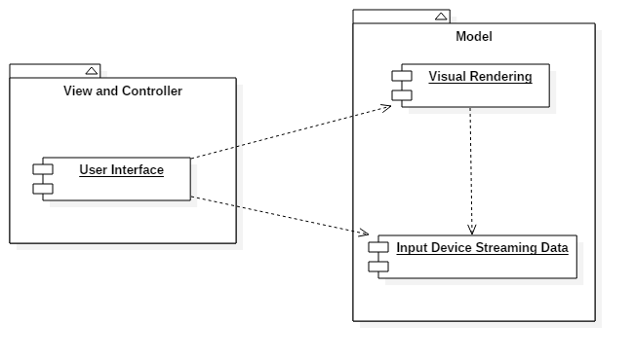
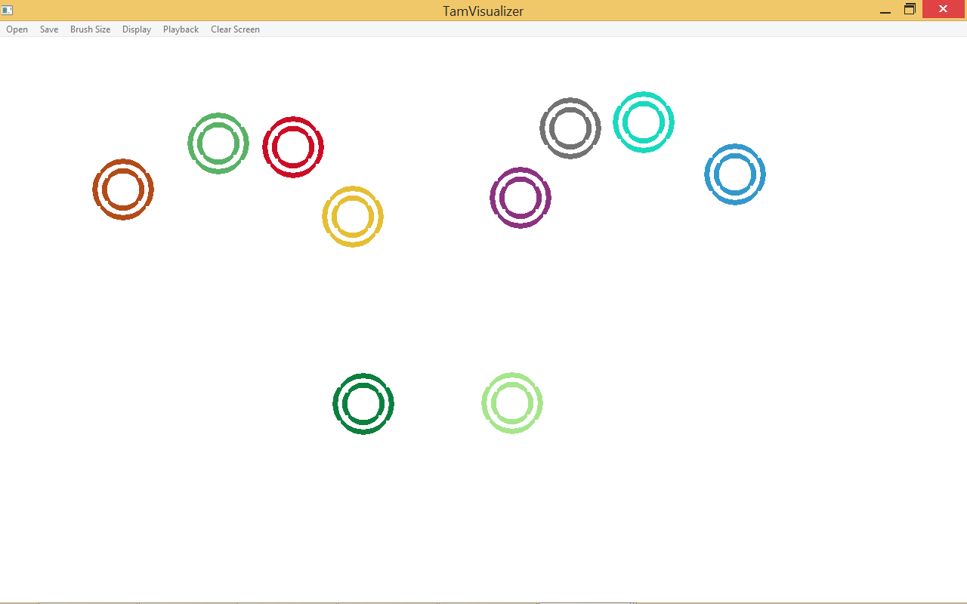
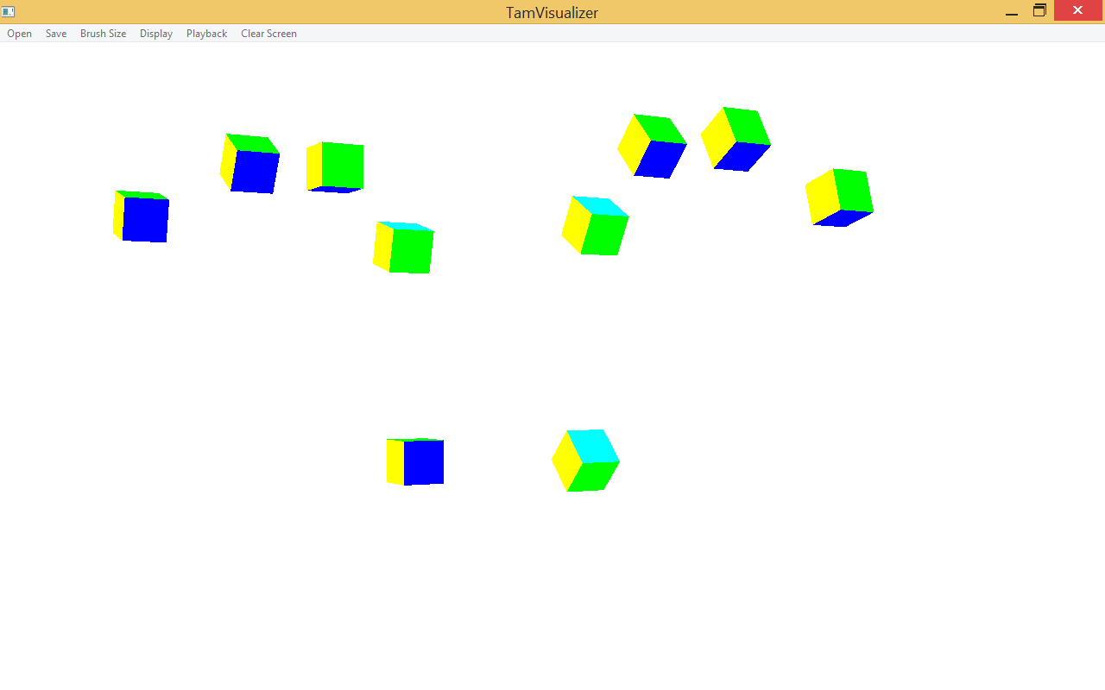
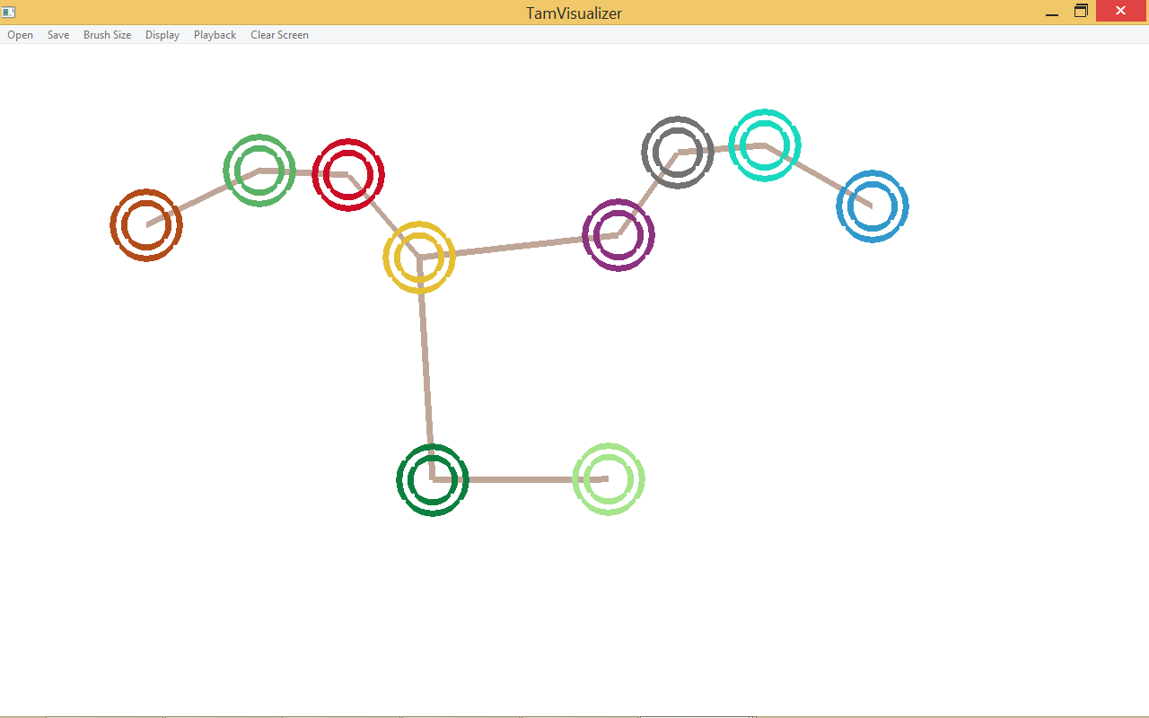
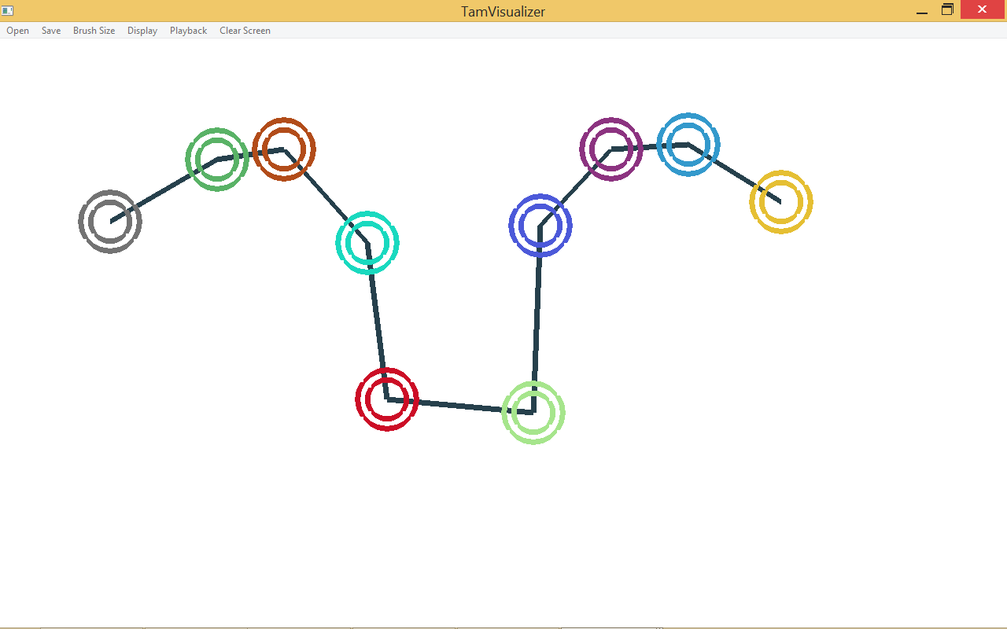
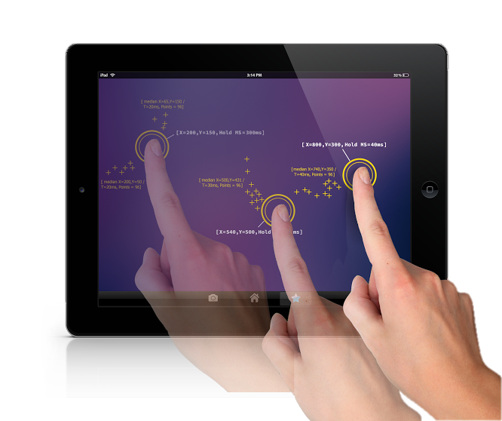
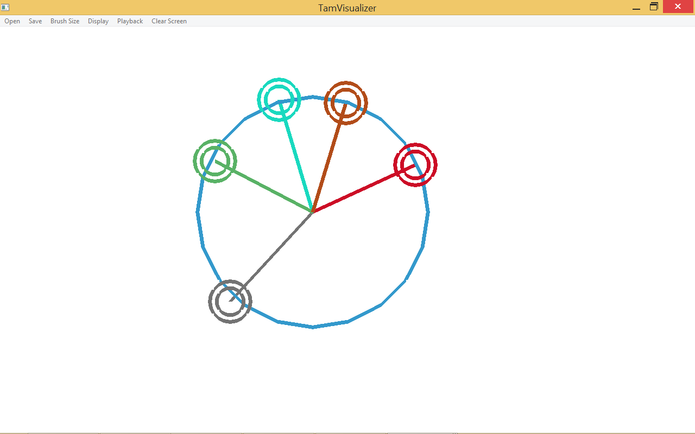
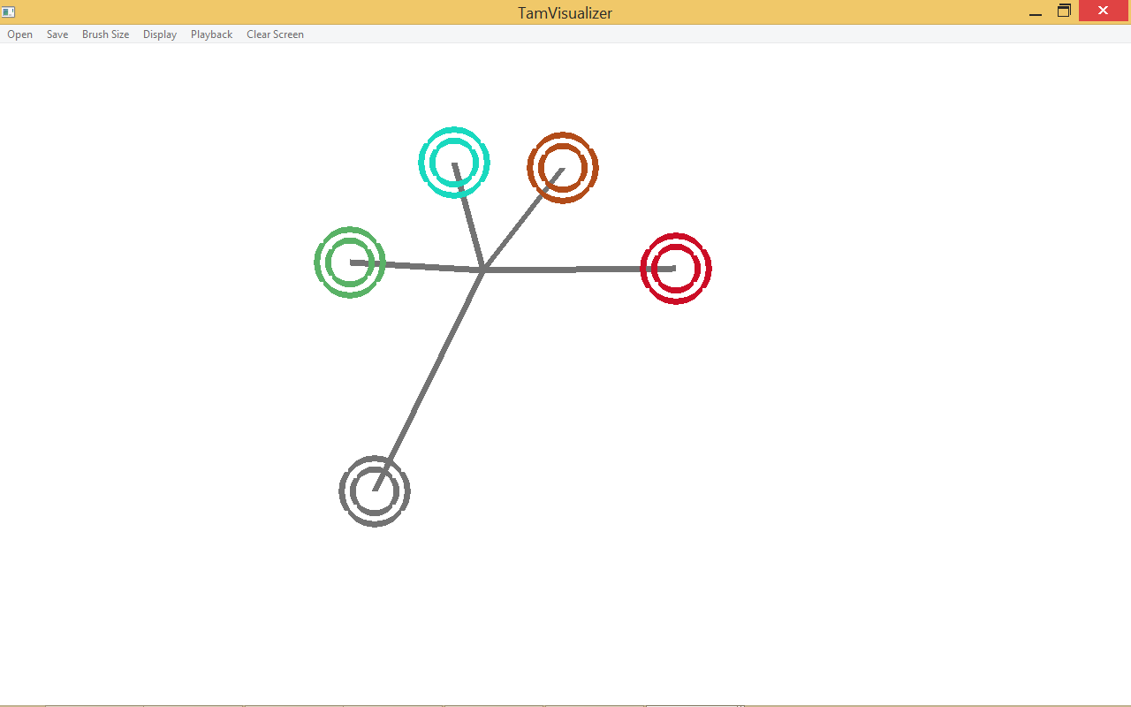
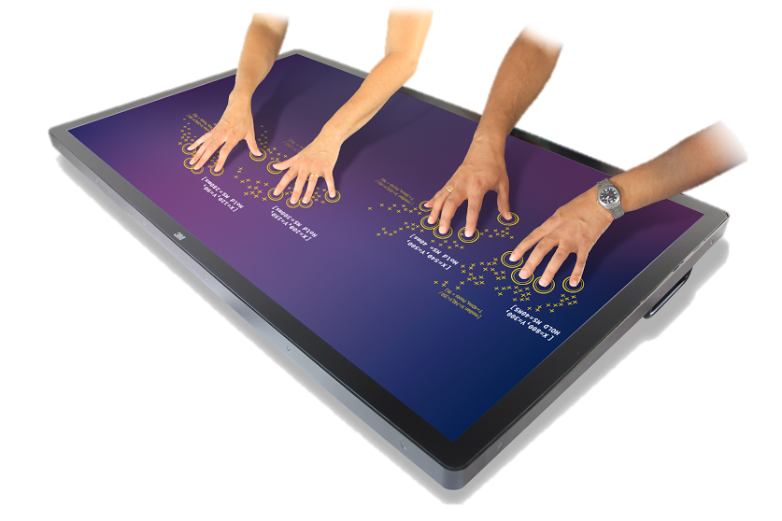
School of Computing & Information Sciences
Senior Project, 2015, Summer
TAMGeF: Touch and Mid-Air Gesture Framework
Student: Steven Ignetti, Florida International University
Mentor: Francisco R. Ortega, Ph.D.
Sponsored By: Naphtali Rishe, Ph.D. and Francisco R. Ortega, Ph.D.
Instructor: Masoud Sadjadi, Ph.D
Problem
Current System
Requirements
Currently, games and applications are being developed with the constraint of the operating system’s most immediate input devices, such as the mouse on a PC or a touch screen on a tablet. Developing an application outside of the familiar devices adds an extra challenge to the application, as developing code for another input device or paying for framework licenses can hurt the growth of the application.
Choosing a framework to provide the code for such capabilities become an extra challenge. Most professional frameworks on input device handling only focus on a select few, and even those that broaden the scope choose to constrain themselves to the popular input devices. These are the problems that TAMGeF hopes to solve for all developers looking to redefine the immersive experience of the modern day applications.
The current (or rather previous) system was a simpler multi-touch screen visualizer. The visualizer gave visual feedback of touch event through the means of “finger painting”. The touch events is recorded and can be saved as a CSV file for later replay. The current visualizer also had some customization features such as changing brush sizes and modifying the way the view mapped to screen.
The new multi-touch visualizer should allow developers working with TAMGeF to:
See feedback from the touch screen be displayed on screen
Allow gestures or touch patterns to be recorded and stored in a readable format, such as JSON
Assign the calculations that should be computed based on the data received by the touch screen, and be visually or textually represented to the user.
Allow easily codeable customizability to how the data is visually displayed
The new visualizer should also help the team developers of the next iteration to expand the capabilities of the TAM into three-dimensional input devices, such as gyroscopes and leap motion, using the OpenGL implementation.
System Design
Object Design
Implementation
The multi-touch visualizer was developed using the Model-View-Controller architecture pattern. In this application, the Controller is the touch screen monitor/device that the user can touch to interact with the View. The Model is the processor-thread, which takes those touch inputs and calculates the proper shapes needed to be drawn to the view for the user to see. Finally, the View is the OpenGL window that displays to the user the outcomes of the touch events recently made.
void ProcessorThread::run() {
while (running) {
. . .
// Draw finger-shapes for the touch-screen data recorded
foreach (touch_data data, current_data) {
current_result << new Finger(data.x, data.y, brushSize, data.id);
}
. . .
// Draw based on the display setting chosen by the user
switch (setting) {
case AVG: // O(N)
operationFingerAveraging(current_data, current_result); break;
case CIRCLE: // O(N^3)
/* Function to calculate for the "Finger Averaging" Display Setting */
void ProcessorThread::operationFingerAveraging
(const QList<touch_data> &input, QList<TAMShape *> &output){
if (input.size() < 2) return;
int avgX = 0, avgY = 0, count = input.size();
foreach (touch_data data, input) {
avgX += data.x; avgY += data.y;
}
avgX /= count; avgY /= count;
foreach(touch_data data, input){
output << new Line(data.x, data.y, avgX, avgY, 60);
}
}
/* Draw the list of TAMShapes to the screen*/
void GLWindow::drawScreenGL(QList<TAMShape *> shapes) {
foreach (TAMShape* shape, shapes) {
shape->draw();
}
}
Verification
Screenshots
Summary
Testing the application went about in two-steps, a Bottom-up approach with unit testing on the most basic methods, and then a manual-based user interface testing approach to test the menu buttons and features that could not be tested through hard-coded method calls.
For the more complicated testing of algorithms used in the software, a rundown of some of the basic cases were made to test the algorithm, followed by a randomly, manually pre-computed, test case to test it’s validity.
In summary, the multi-touch visualizer for TAMGeF has been polished to be a responsive and customizable interface. The display can not only change the finger’s look, but it can also display the connectivity of these fingers. A separate thread handles calculating the finger connectivity to keep the UI responsive. A new export file type was created to add a more universal file format. Lastly, OpenGL is now integrated into the system so that future iterations of the visualizer can integrate with 3D-based input devices without losing the 2D environment displayed currently to the user.
Acknowledgement
The material presented in this poster is based upon the work supported by Francisco Ortega. I am thankful to the help that I received from my group member, Alfredo Zellek.

