Slide 1

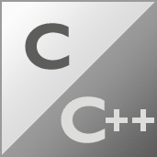

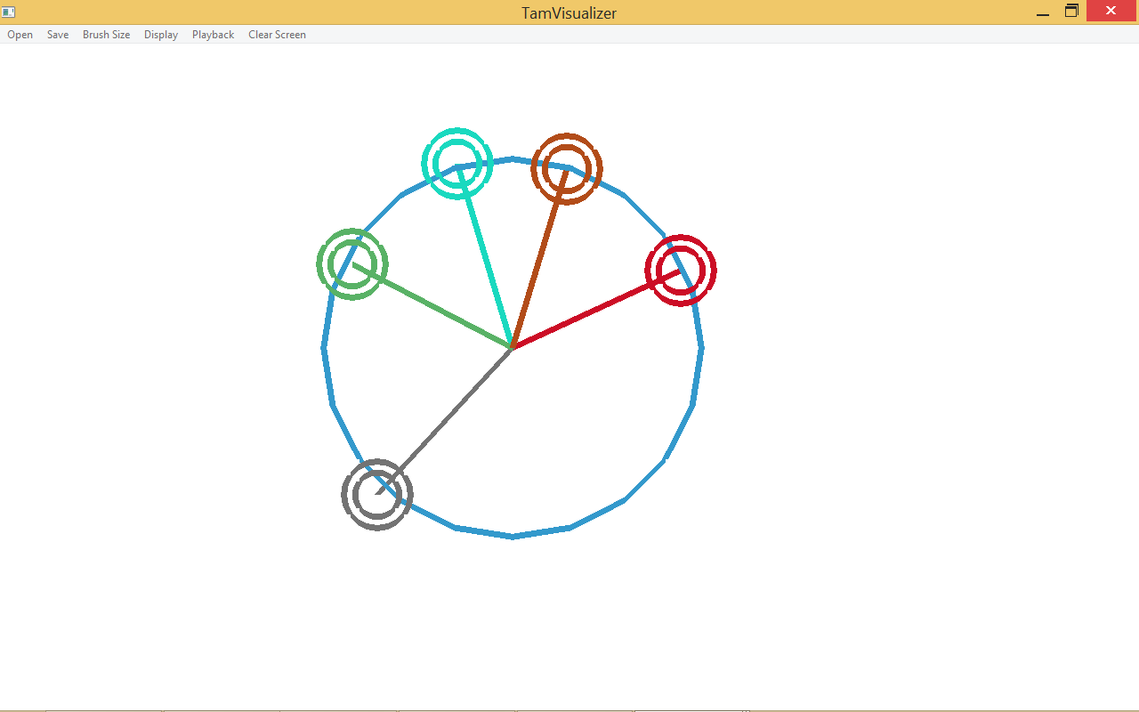
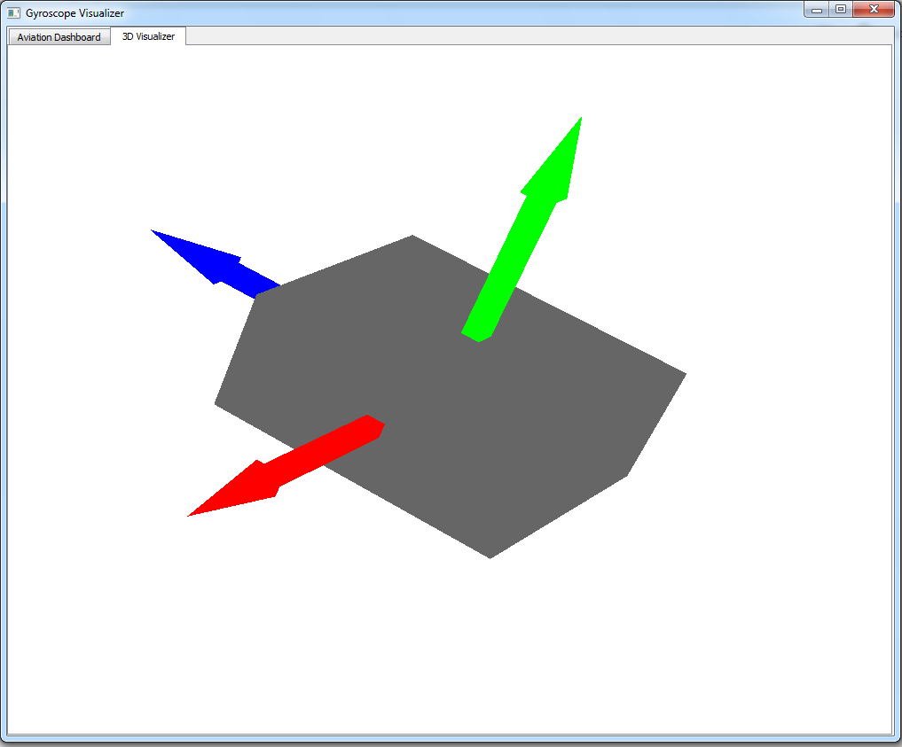
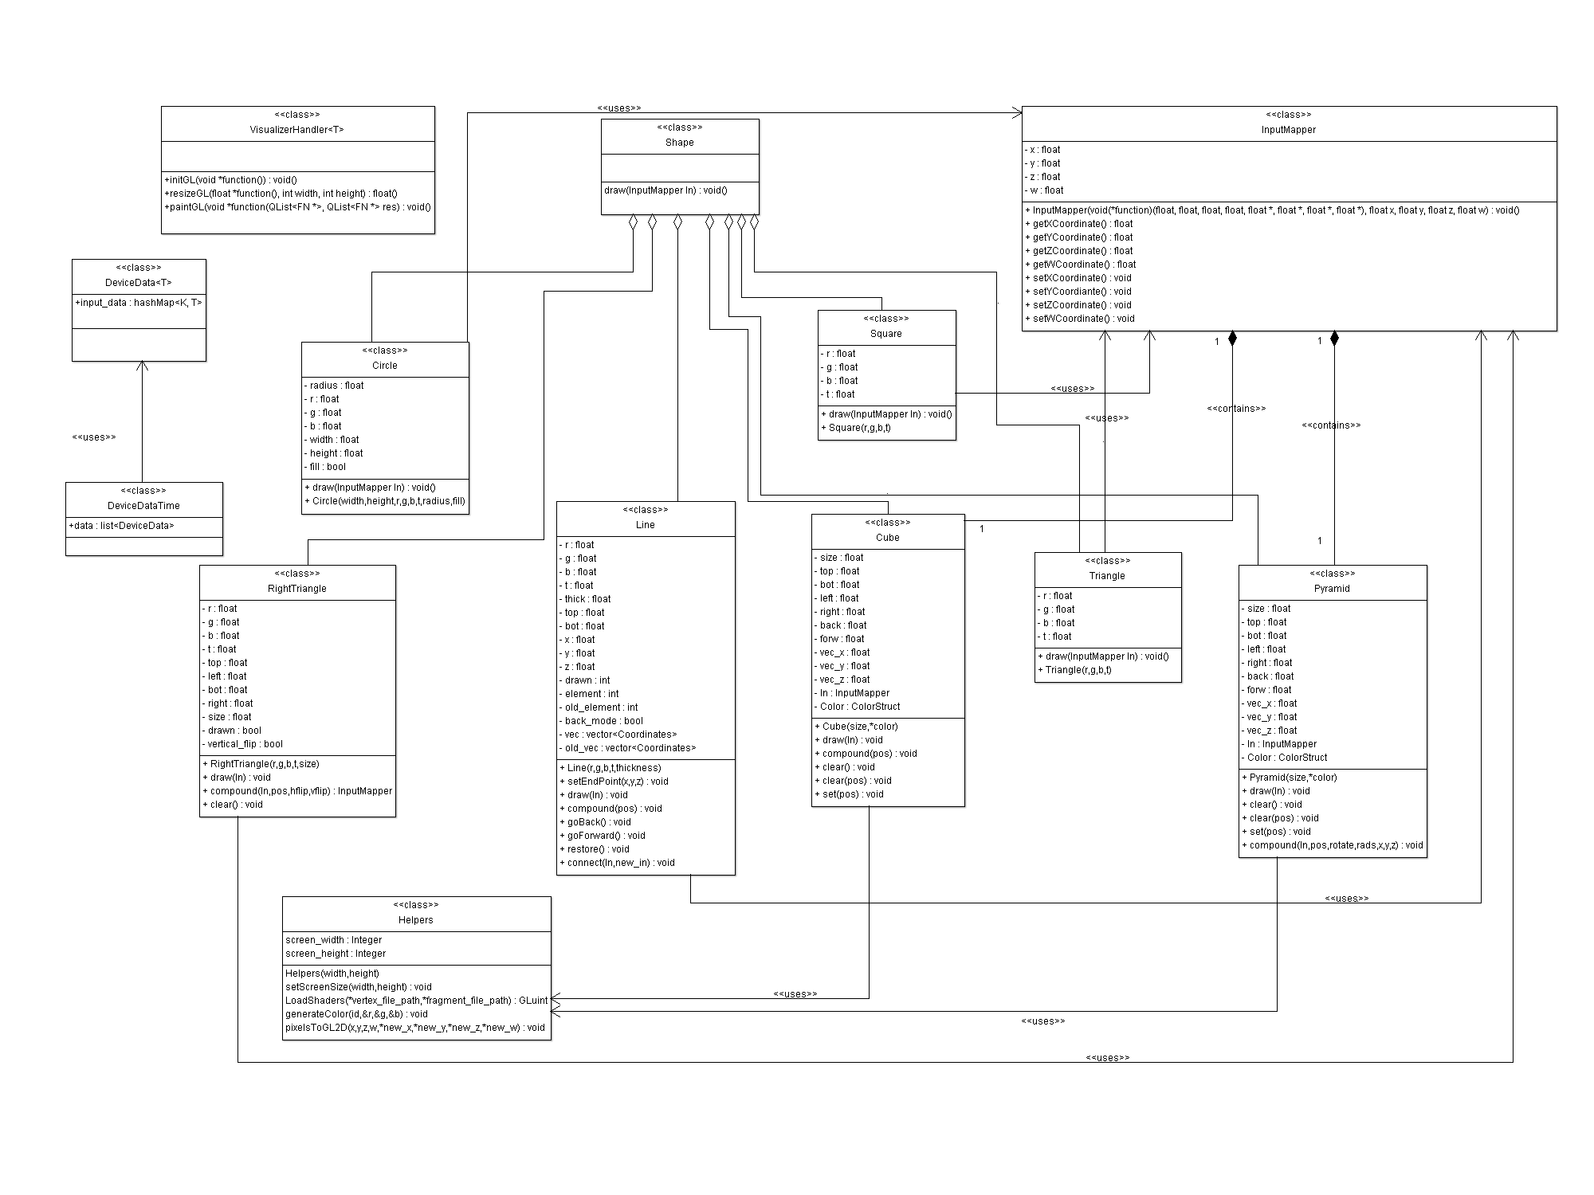
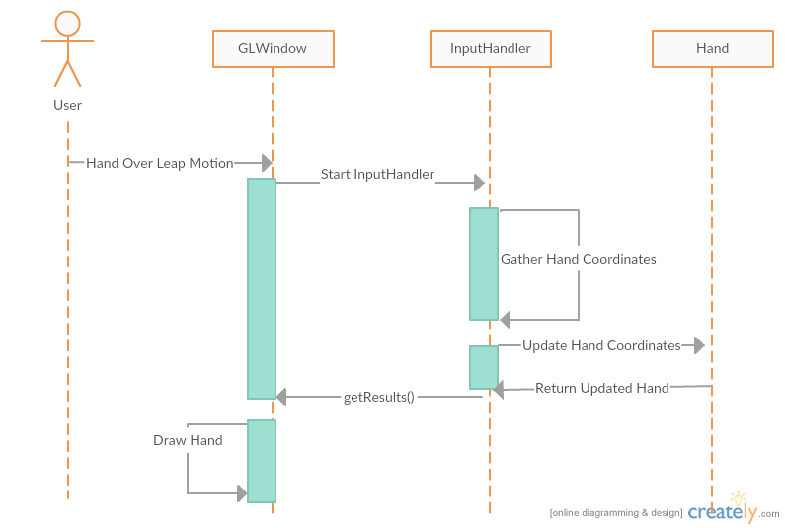
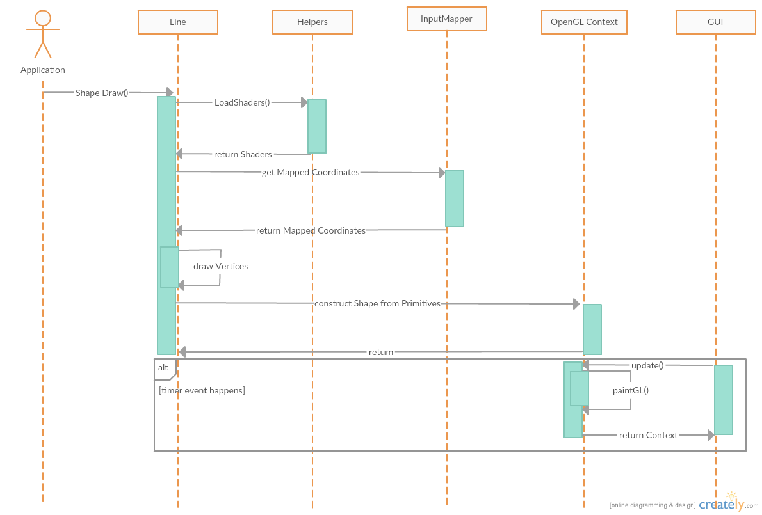
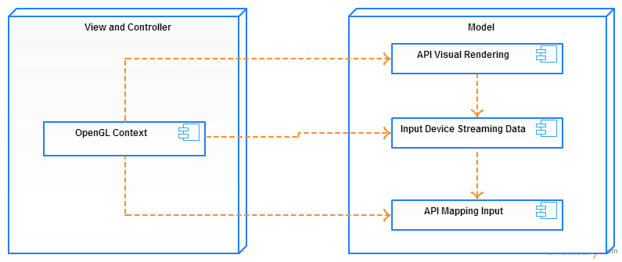
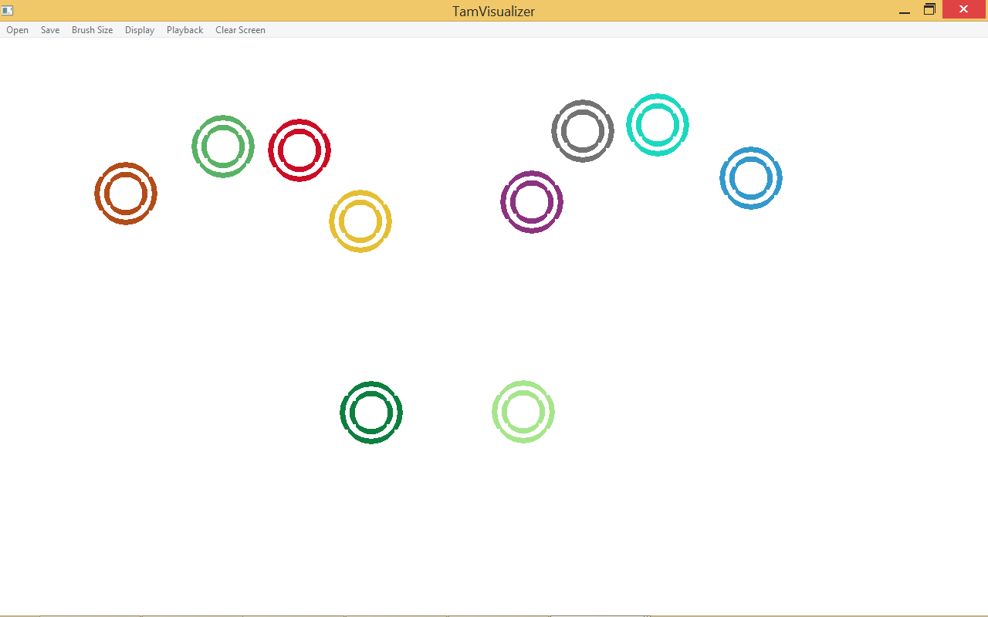
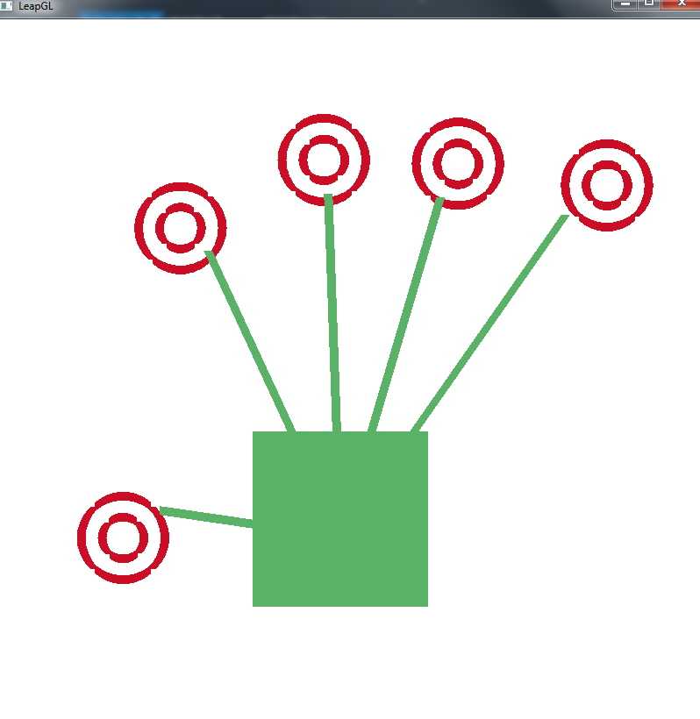
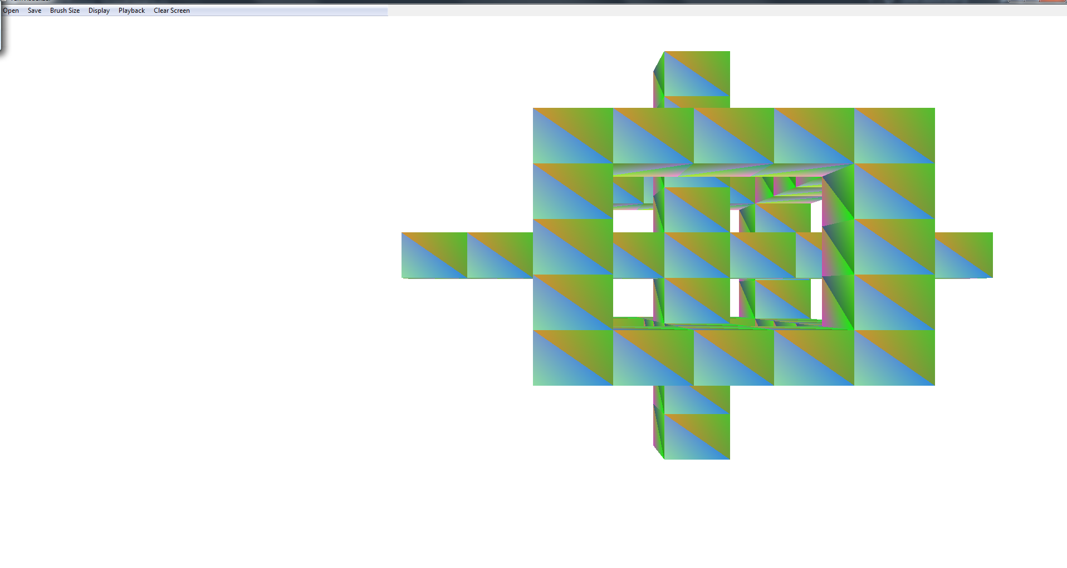
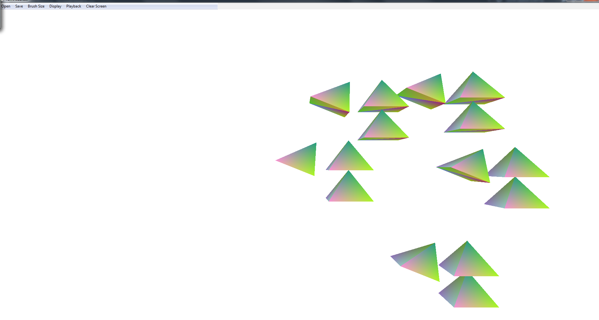
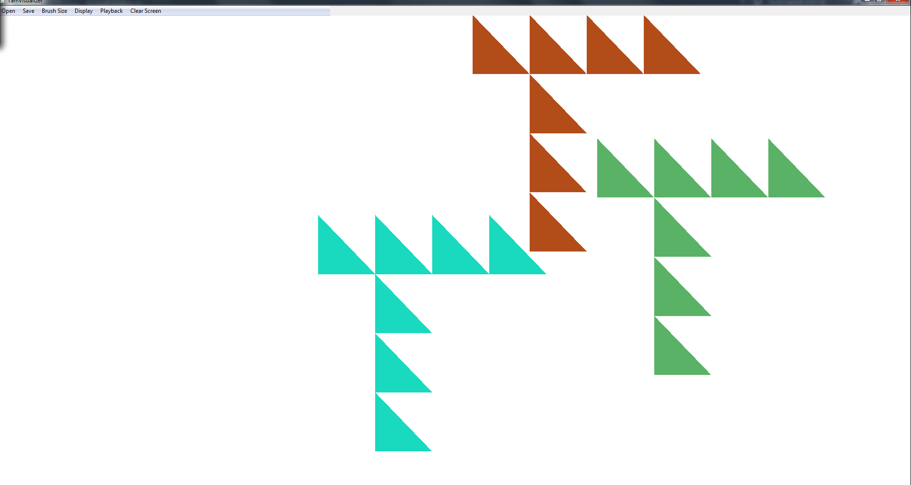
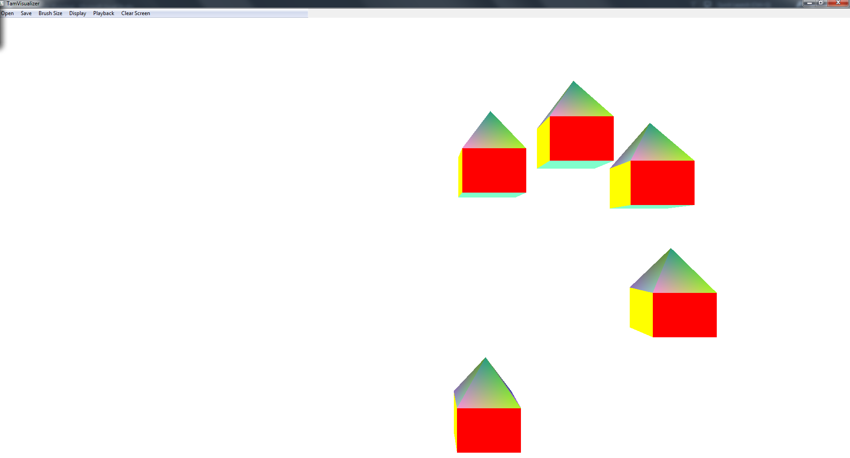
School of Computing & Information Sciences
Senior Project, 2015, Fall
TAMGeF: Touch and Mid-Air Gesture Framework
Student: Alberto Carrillo, Florida International University
Mentor: Francisco R. Ortega, Ph.D.
Sponsored By: Naphtali Rishe, Ph.D. and Francisco R. Ortega, Ph.D.
Instructor: Masoud Sadjadi, Ph.D
Problem
Current System
Requirements
Many Developers are constrained to programming for point and click or touch applications. Developing an application that uses other input devices can prove to be a challenging task since there are few frameworks designed for this purpose.
As such, our goals are to:
Develop a framework to help developers work with multiple Input Devices
The framework that must help developers to easily visualize any kind of input data
Divide the framework in two main parts: the API and Visualizers
For this project we have given special priority to the API that will act as our drawing library. However, we have also expanded the number of visualizers the framework has.
The current TAMGeF system provides the developer with 2 visualizers and no API. The multi-touch visualizer and the gyroscope visualizer which are mainly designed for input device debugging purposes.
The new system will introduce an API so that any developer can easily visualize the input for any kind of input device. The new System will also introduce a LeapMotion visualizer.
The new TAMGeF API should allow developers to:
Easily create an OpenGL Context on the Graphical User Interface of their choice.
Easily map their input device coordinates to their desired coordinate system.
Easily render primitive shapes.
Compound the primitive shapes so that a developer can construct any shape of their choice.
The new LeapMotion Visualizer should provide the following functionality:
Track and draw a hand by processing the input data from the LeapMotion with the API
System Design
Object Design
Implementation
The system was designed to use the Model-View-Controller Architecture pattern. The user can view and change the visualization data through the OpenGL context, while the input device data is streamed through the model portion of the code, which will then render the visual display using the API.
Verification
Screenshots
Summary
The application was developed using a Bottom-up approach. First classes were developed and tested separately from the rest of the system. Then the classes were integrated with the other already tested classes. Unit-testing was used to test all functionality not related to rendering.
Rendering was tested using a manual-based approach.
In summary, the TAM Visualization system has been greatly improved by successfully developing the API which is a major step towards a generalized input-device framework.
This expansion will allow developers to visualize the input data given by any kind of input device by simply using the TAM API
This work also extends the visualization system to LeapMotion by demonstrating how the TAM API uses the input coordinates of the LeapMotion, maps them to its own coordinate system, and draws shapes to construct the LeapMotion hand.
Future work may include expanding the API to provide more shapes such as a sphere and increasing the number of visualizers.
Code Sample
TAM API Circle Drawing example:
TAM::InputMapper newInput(&Helpers::mapper, x[i], y[i], 0.5f, 0.0f);
TAM::Circle newCircle(screen_width,screen_height, 0.10f, r, g, b, 1.0f, false);
TAM::Circle newInnerCircle(screen_width, screen_height, 0.05f, r, g, b, 1.0f, false);
newCircle.draw(newInput);
newInnerCircle.draw(newInput);
Acknowledgement
The material presented in this poster is based upon the work supported by Dr. Francisco Ortega.

