Slide 1
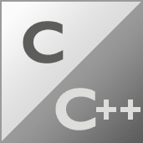






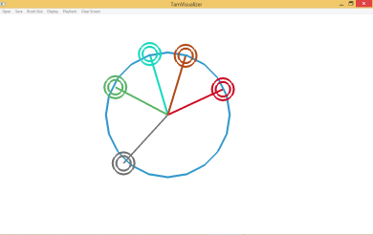
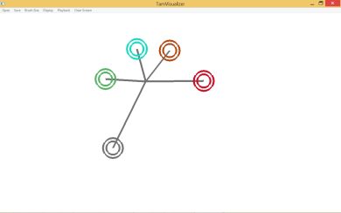
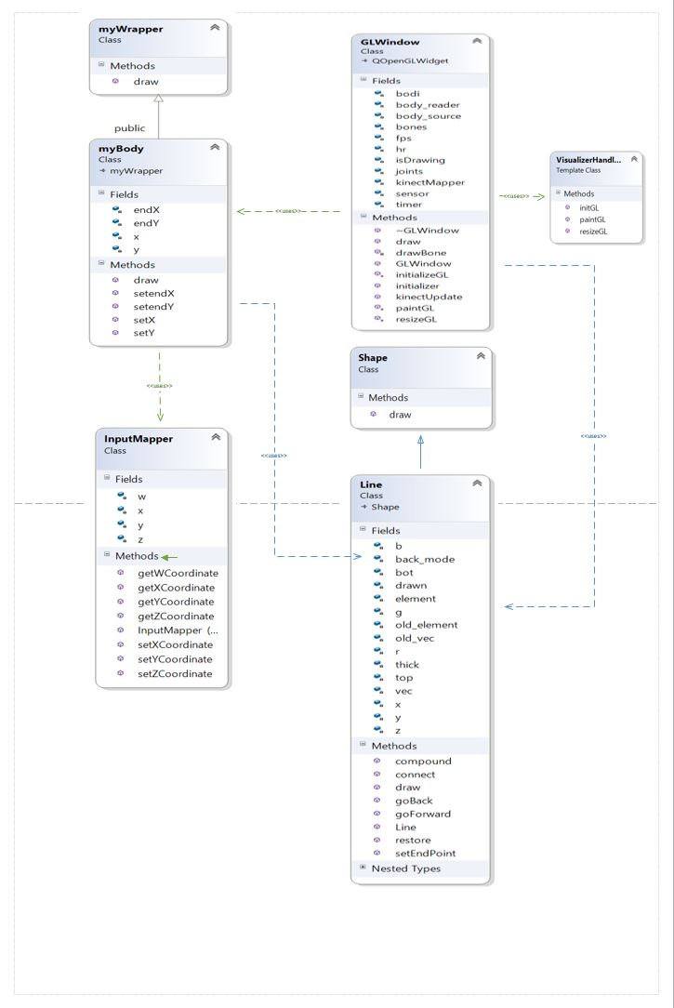
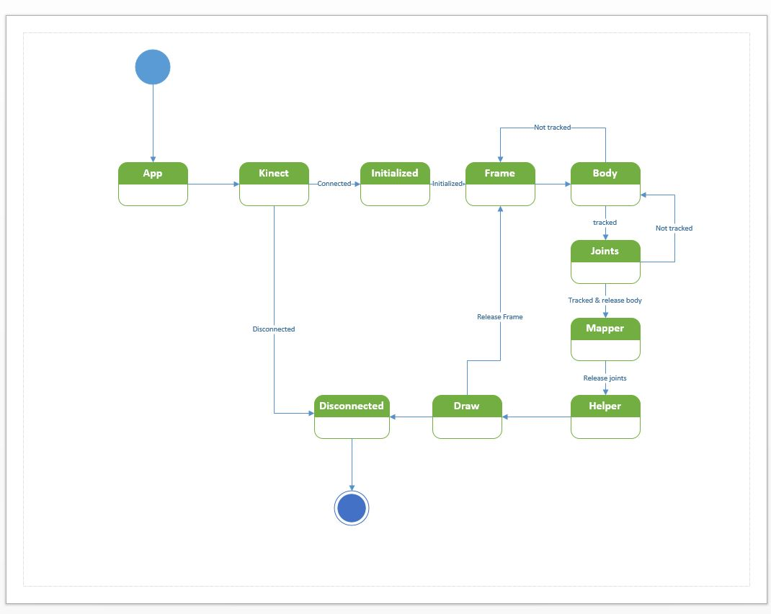
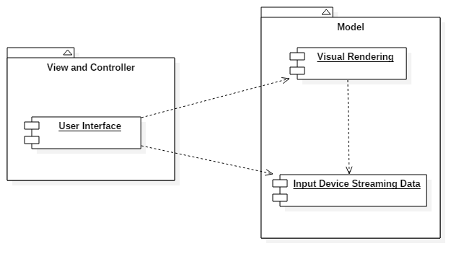
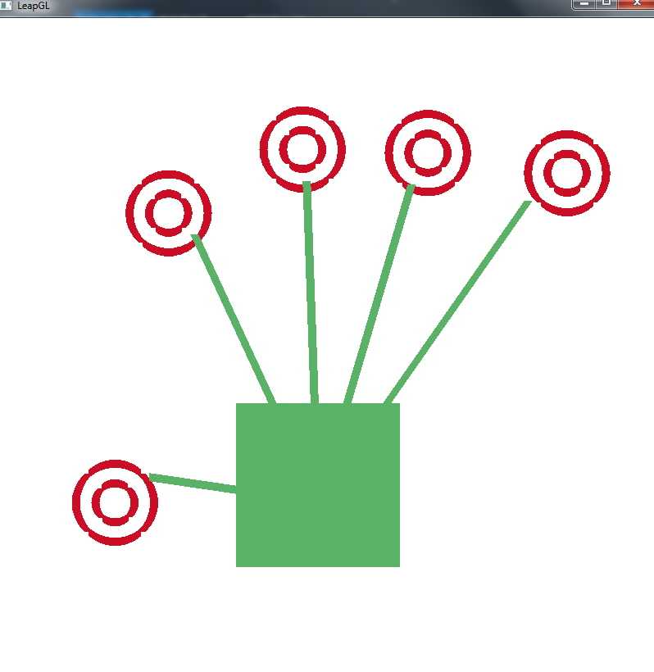
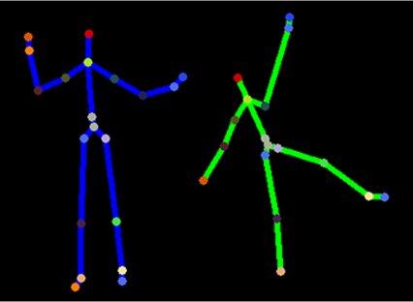
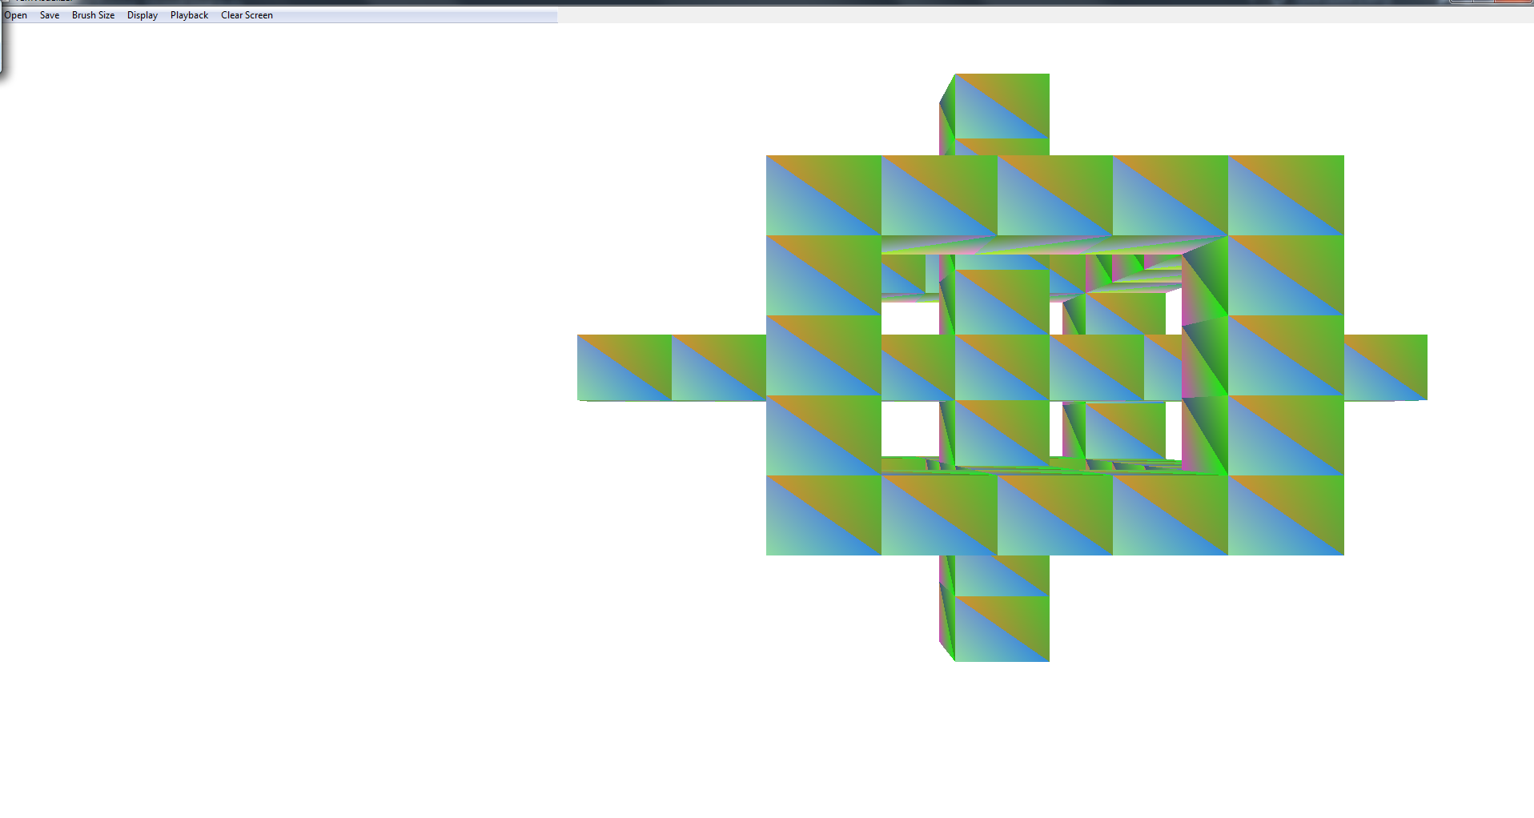
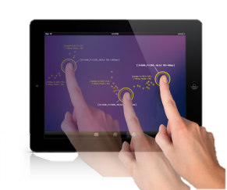
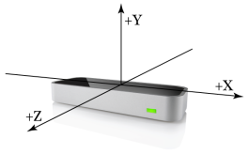
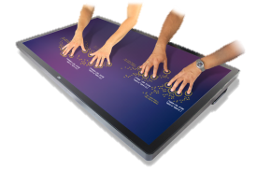

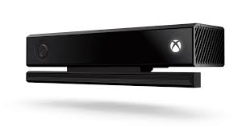
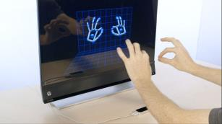
School of Computing & Information Sciences
Senior Project, 2015, Summer
TAMGeF: Touch and Mid-Air Gesture Framework
Student: David Escobar, Florida International University
Mentor: Francisco R. Ortega, Ph.D.
Sponsored By: Naphtali Rishe, Ph.D. and Francisco R. Ortega, Ph.D.
Instructor: Masoud Sadjadi, Ph.D
Problem
Current System
Requirements
Currently, games and applications are being developed with the constraint of the operating system’s most immediate input devices, such as the mouse on a PC or a touch screen on a tablet. Developing an application outside of the familiar devices adds an extra challenge to the application, as developing code for another input device or paying for framework licenses can hurt the growth of the application.
Choosing a framework to provide the code for such capabilities become an extra challenge. Most professional frameworks on input device handling only focus on a select few, and even those that broaden the scope choose to constrain themselves to the popular input devices. These are the problems that TAMGeF hopes to solve for all developers looking to redefine the immersive experience of the modern day applications.
The current system was a simpler multi-touch screen visualizer. The visualizer gave visual feedback of touch event through the means of “finger painting”. The current visualizer also had some customization features such as changing brush sizes and modifying the way the view mapped to screen.
The new system will introduce an API so that any developer can easily visualize the input for any kind of input device.
The new API should allow developers working with TAMGeF to:
See feedback from the device be displayed on screen
Assign the calculations that should be computed based on the data received by the device, and be visually or textually represented to the user.
Allow easily codeable customizability to how the data is visually displayed
Easily render primitive shapes.
Compound the primitive shapes so that a developer can construct any shape of their choice.
System Design
Object Design
Implementation
The system was developed using the Model-View-Controller architecture pattern. In this application, the Controller is the input device in use to interact with the View. The Model is the processor-thread, which pull the data from the input device, create the shape based on the parameters obtained from the input device then map to OpenGL units needed to drawn to the view for the user to see. Finally, the View is the OpenGL window that displays to the user the outcomes of the input events recently made.
Verification
Screenshots
Summary
We use a botton-up integration approach, the classes were created and tested, then paired with the already tested classes to avoid introduction of new bugs, and finally all tested subsystems were integrated into the project.
The whole system was tested using unit testing to verify the accuracy of data manipulation such as mapping coordinates, translation from cm/mm to pixels, .
In summary, the TAMGeF visualizer had been upgraded with an API of its own. The API will allow developers not only interact with the multi-touch, but with any device supported by the system he is developing for, it will allow the creation of shapes in 2D and 3D. The API is also integrated into the system so that future iterations of the visualizer can iterate with 3D-based input devices without losing the 2D environment displayed currently to the user.
Acknowledgement
The material presented in this poster is based upon the work supported by Francisco Ortega. I am thankful to the help that I received from my group member, Alberto Carrillo.

