Slide 1




Touch and Mid–Air Framework
Visualizer
Team Member: Richard A Lopez
Developer, Scrum Master
Mentor: Francisco Ortega

Slide 2
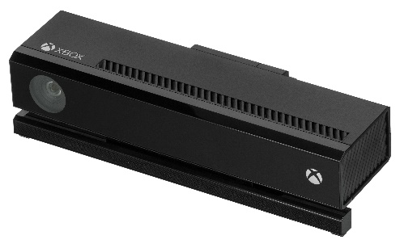
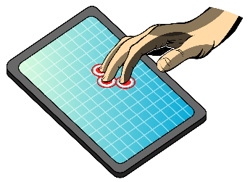
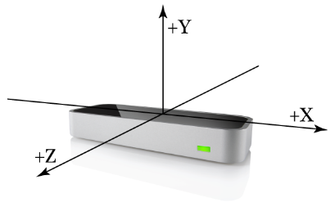
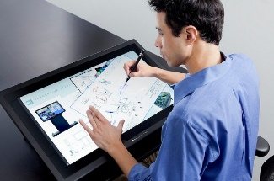
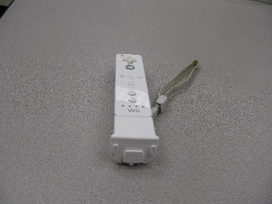
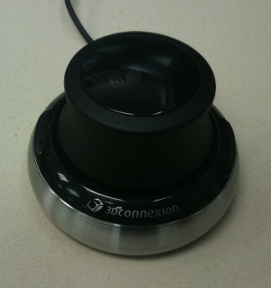
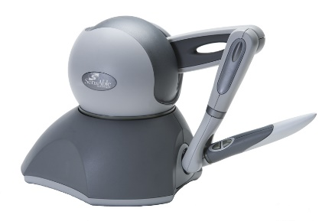
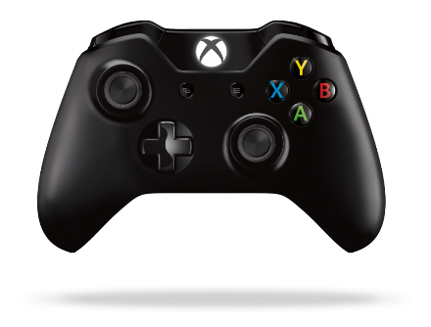
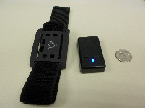
Problem Definition
Explosion of input devices
Cumbersome to code for more than one device
Provide a Modern Code Base (Parallel and Modular System)
Provide a tool for Researchers and Users
Promote Diversity via HCI

Slide 3
Existing Systems
Virtual Reality Peripheral Network
Online only
Setup of Servers
Interruption to service
Still not general enough for non VR peripherals

Slide 4
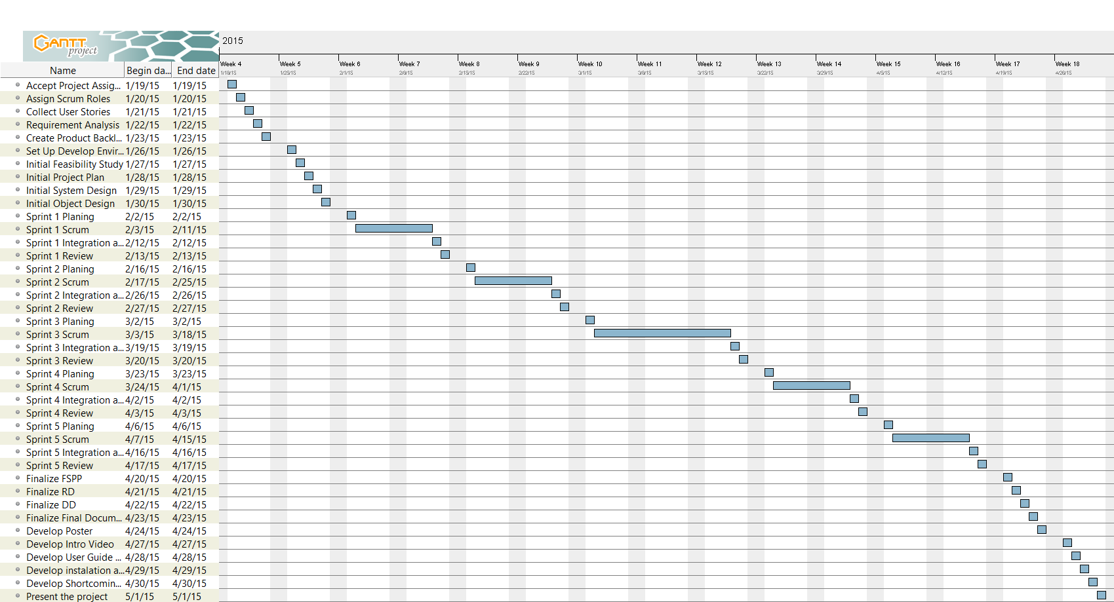
Project Schedule

Slide 5
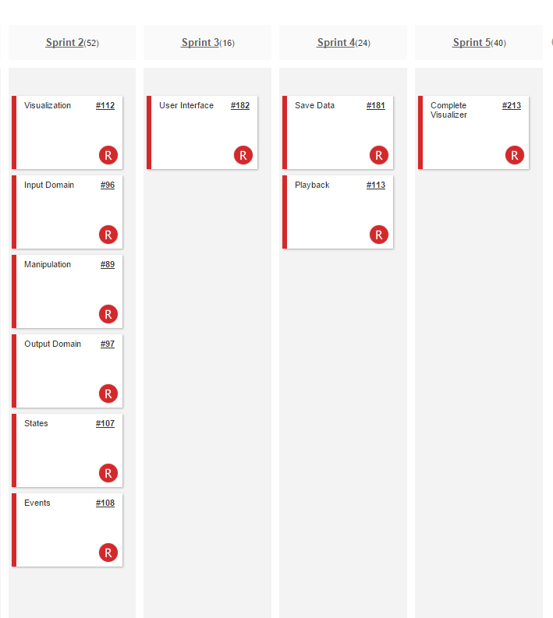
Implemented User Stories

Slide 6
Use cases
TAMUC01 The system shall subscribe to a windows service to receive touch events.
TAMUC02 The system shall allow a user to touch the screen with one or more fingers (Max 10) and draw on the screen.
TAMUC03 The system shall define the states of a touch event.
TAMUC04 The system shall use the X and Y coordinates and map them to a function.
TAMUC05 The system shall record input.
TAMUC06 The system shall replay the touch action in the order the action happened.
TAMUC07 The system shall allow for input to be saved to a file.
TAMUC08 The system shall read recorded input files and replay them.
TAMUC09 The system shall allow various sizes of touch visualization.
TAMUC10 The system shall allow the user to clear the screen and replay data at will.
TAMUC11 The system shall display all the information from the program to a debug monitor.

Slide 7
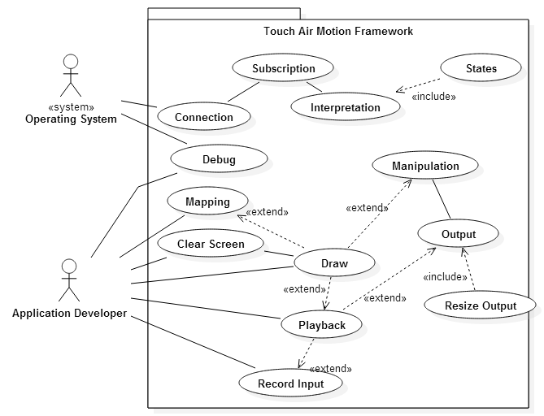
Use Case Diagram

Slide 8
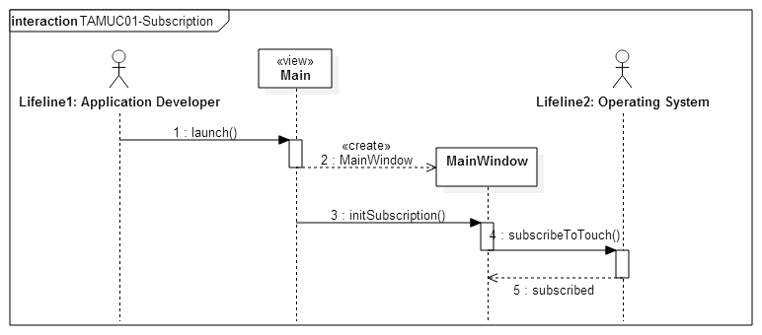
Sequence Diagram

Slide 9
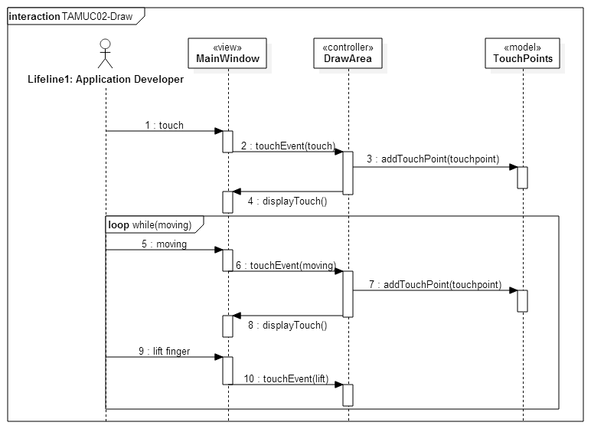
Sequence Diagram

Slide 10
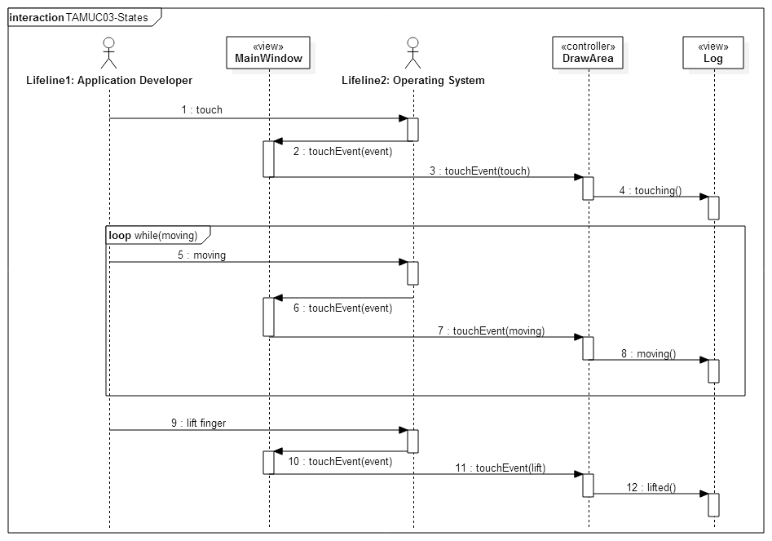
Sequence Diagram

Slide 11
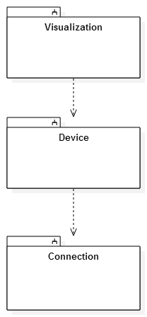
System Decomposition
Service Oriented Architecture
OS input Messages
All messages trough Connection
Model View Controller
Visualization – View
Device – Controller
Connection - Model

Slide 12
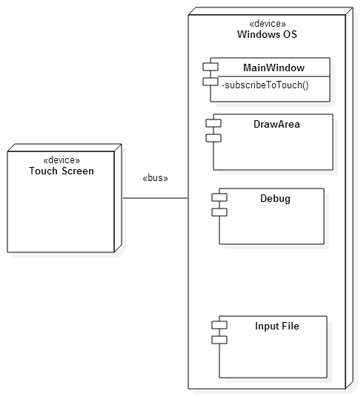
System Deployment
Hardware:
Touch screen capable computer
Multi touch screen capable computer
1 GB of RAM
512 MB Video card
Software:
Windows Operating System 8.1 or greater
Visual Studio 2013 or greater
Qt plugin for Visual studio 5.4 or greater

Slide 13
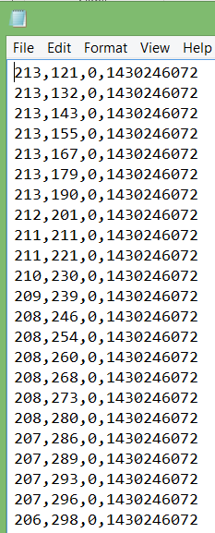
Persistent Data
Save to File
List of Touch Points
X coordinate
Y coordinate
ID
Time Stamp

Slide 14
Security and Privacy
The TAM visualizer and the TAM framework do not utilize any form of registered user, no private data is kept and the framework is aimed towards developers as well as the open source community, therefore there is no privacy or security implementation.

Slide 15
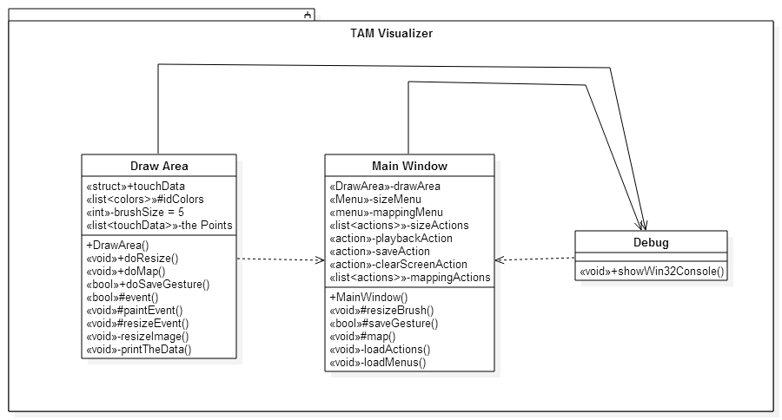
Detailed Design
Static View

Slide 16
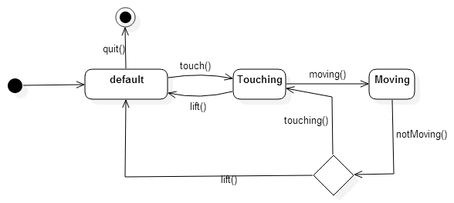
Detailed Design
Dynamic View

Slide 17
Test Cases
Use Case TAMUC02-Touch
Test Case ID | TAM1_SysT_testTouch_SD1
Purpose | To validate result of a touch event
Test Setup | Start app (“TAM Visualizer”) Int x = 50 Int y = 50
Input(s) | Event(touchEvent(x,y));
Expected Result | Red Circle drawn on the screen at 50,50
Test Case ID | TAM1_SysT_testTouch_RD1
Purpose | To validate result of a touch event
Test Setup | Start app (“TAM Visualizer”) Int x = 50 Int y = -50
Input(s) | Event(touchEvent(x,y));
Expected Result | No red circle is drawn

Slide 18
Test Cases
Use Case TAMUC05-Save
Test Case ID | TAM2_SysT_testSave_SD1
Purpose | To validate the result of the save function
Test Setup | Start app (“TAM Visualizer”) Int x = 50 Int y = 50
Input(s) | Event(touchEvent(x,y));
Expected Result | touchpoint.x = 50 touchpoint.y = 50
Test Case ID | TAM2_SysT_testSave_RD1
Purpose | To validate the result of the save function
Test Setup | Start app (“TAM Visualizer”) Int x = 50 Int y = -50
Input(s) | Event(touchEvent(x,y));
Expected Result | touchpoint.x = 50 touchpoint.y = -50

Slide 19
Test Cases
Use Case TAMUC06-Replay
Test Case ID | TAM3_SysT_testReplay_SD1
Purpose | To validate the correct replay of a touch event
Test Setup | Start app (“TAM Visualizer”) Int x = 50 Int y = 50 Event(touchEvent(x,y));
Input(s) | action(playBack)
Expected Result | Screen cleared. Red Circle drawn on the screen at 50,50
Test Case ID | TAM3_SysT_testReplay_RD1
Purpose | To validate the correct replay of a touch event
Test Setup | Start app (“TAM Visualizer”) Int x = 50 Int y = -50 Event(touchEvent(x,y));
Input(s) | action(playBack)
Expected Result | Screen cleared. No Red Circle drawn on the screen

Slide 20

Questions?

