Slide 1

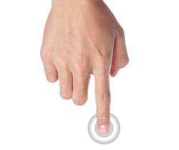

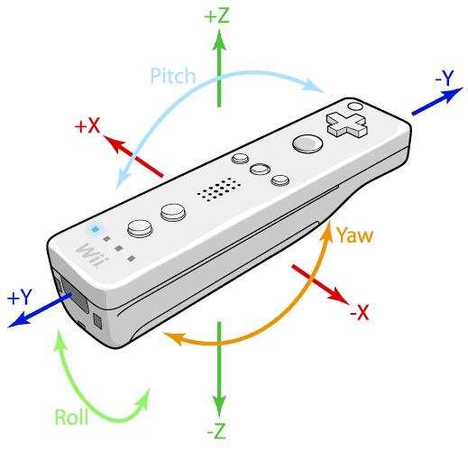
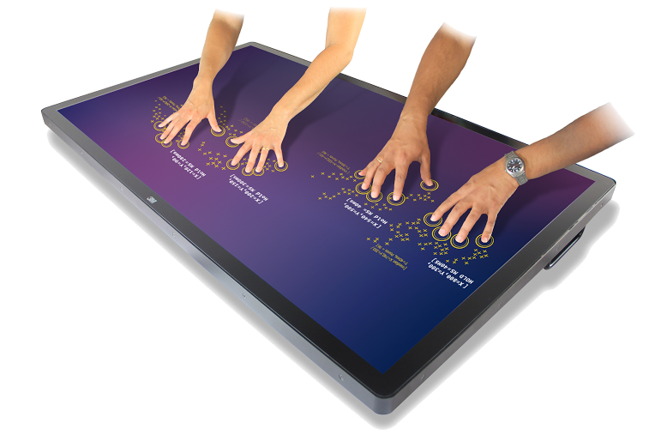
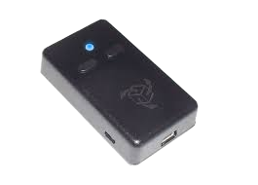
TAMGeF: T uch mid-Air Motion
Gesture Framework
Team Developers: Steven Ignetti, Alfredo Zellek
Mentor: Francisco R. Ortega, Ph.D.
Sponsored By: Naphtali Rishe, Ph.D. and Francisco R. Ortega
Instructor: Masoud Sadjadi, Ph.D

Slide 2

The TAMGeF Framework
Framework for developing applications with input devices outside of mouse and keyboard
Will introduce wide range of input-devices
Multi-Touch
Gyroscope
Leap Motion, and more
Notes:
Framework for developing applications with input devices outside of mouse and keyboard
will introduce wide range of input-devices, such as Multi-touch, Gyroscope, Leap Motion, and more

Slide 3
Current System and Limitations
Provides a simple “finger-painting” visualizer
Record and playback functionality
Limited to touch-screen devices
Lacks data analysis or algorithmic visualization
Notes:
Current system provides a simple “finger-painting” visualizer and playback functionality.
Video or Screenshot of TAM

Slide 4
Our Solution
Expand device-compatibility with framework (i.e. Gyroscope)
Introduce both 2D and 3D visualization
Algorithmic visualization

Slide 5

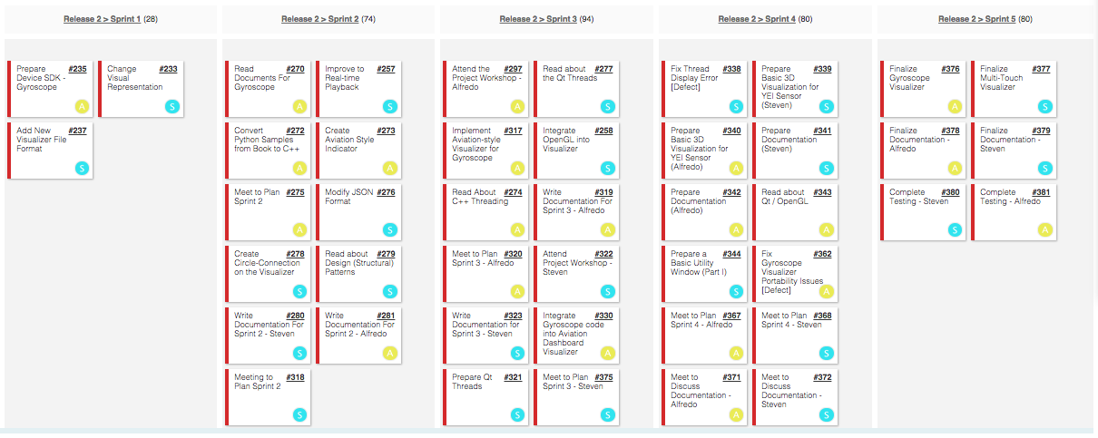
Project Management

Slide 6
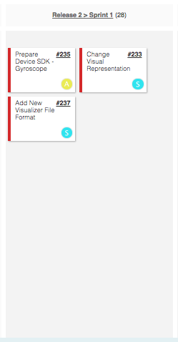
Sprint 1
Major User Stories:
Set up development environment and began familiarization with API
Modified Multi-Touch Visualizer “finger-painting”
Painting replaced with finger tracking
Added JSON File format to Visualizer

Slide 7
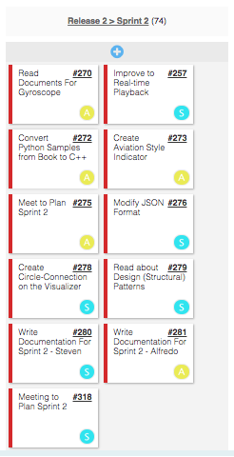
Sprint 2
Major User Stories:
Gyroscope code converted from python to C++
Introduced text-based Aviation-Style indicator
Circle-Connections for visualizer
Real-time playback improved

Slide 8
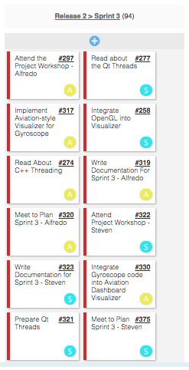
Sprint 3
Major User Stories:
2D visual Aviation-Style Dashboard introduced
Attitude, Heading, and Acceleration Gauges
Gyroscope connected to Aviation-style Dashboard
OpenGL integrated into Multi-Touch visualizer

Slide 9
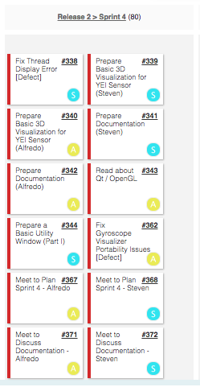
Sprint 4
Major User Stories:
Developed 3D on-screen gyroscope visualization
large collab between Steven and Alfredo
Fixed threading issue in Multi-Touch Visualizer
Fixed portability issue with Gyroscope Visualizer

Slide 10
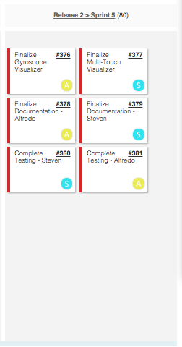
Sprint 5
Major User Stories:
Wrapped up both Visualizers
Refactored code
Bug fixes
Wrapped up documentation
Complete system testing

Slide 11

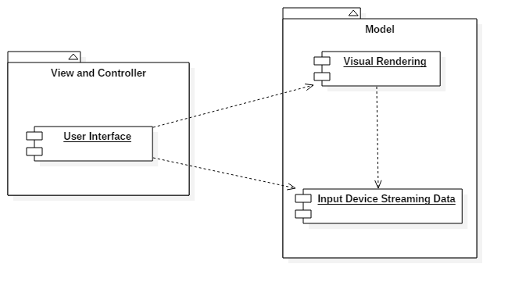
System Design: Architectural Patterns
Model-View-Controller
User interface acts as both the view and controller
Model system deals with
Incoming input data
Visual Rendering

Slide 12
System Design: Hardware and Software Requirements
Hardware:
Macbook Pro, Early 2011
Acer 21” Touch Screen Display
Mini-Display to VGA Adapter
VGA to HDMI Adapter
YEI 3-space Gyroscope Sensor with Wireless Dongle
Multi-touch Dell Laptop
Software:
Windows 7/8.1 (OS)
Visual Studio 2013 (IDE)
C++ Programming Language
Qt Framework
OpenGL Framework
YEI 3-space sensor API

Slide 13
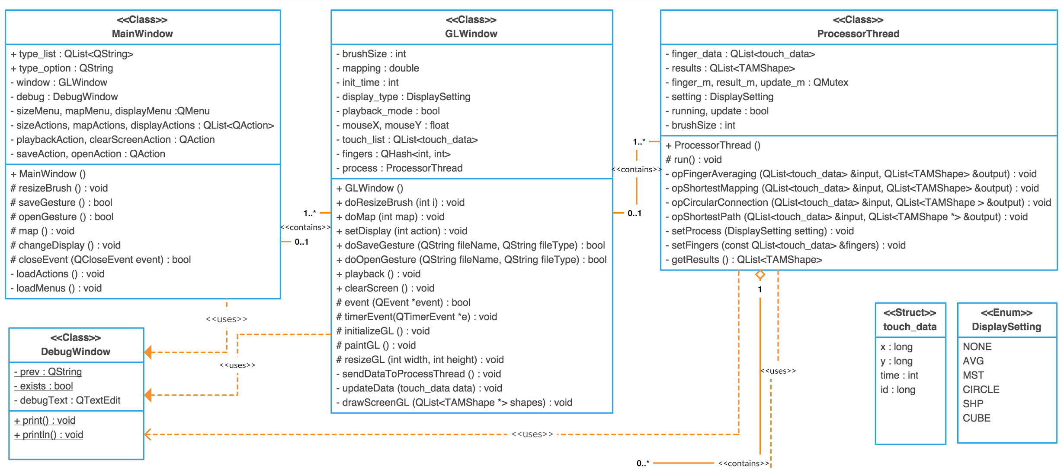
Multi-touch Visualizer Class Diagram

Slide 14
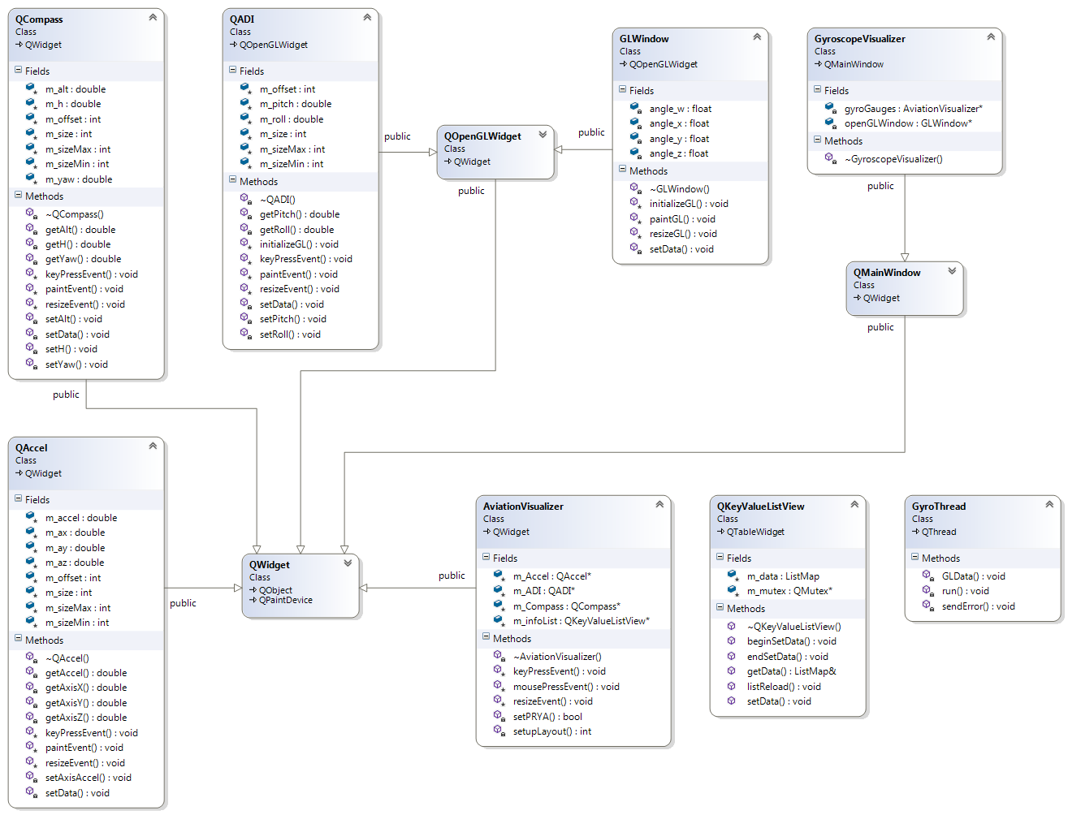
Gyroscope Visualizer Class Diagram

Slide 15

Algorithm
Quaternion, Euler Angles, and Rotation Matrices
Circumcenter calculation
Minimum-Spanning Tree
Shortest Hamiltonian Path Algorithms

Slide 16
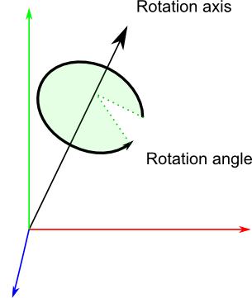
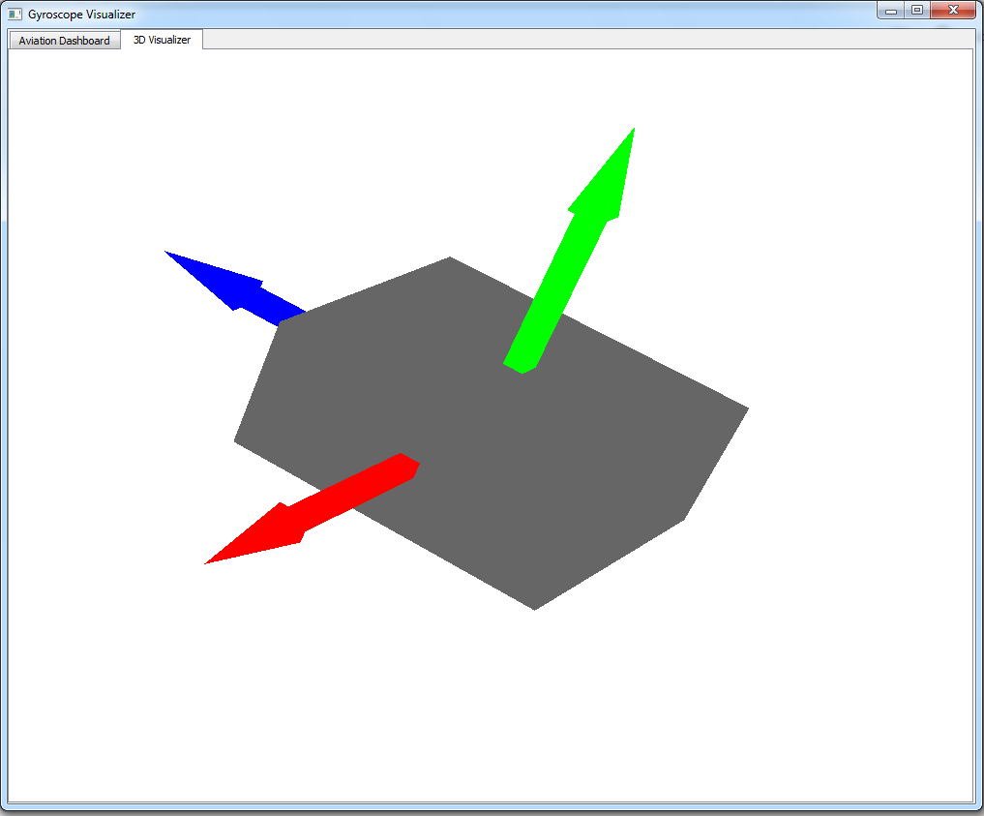
Quaternions, Euler Angles, and Rotation Matrices
Manipulating and filtering incoming gyroscope data into quaternions or axis-angle
Filtering done by Kalman filter
Methods for dealing with quaternion data
converting to Euler Angles
converting to Rotation Matrices
Mapping quaternion to on-screen rotations

Slide 17
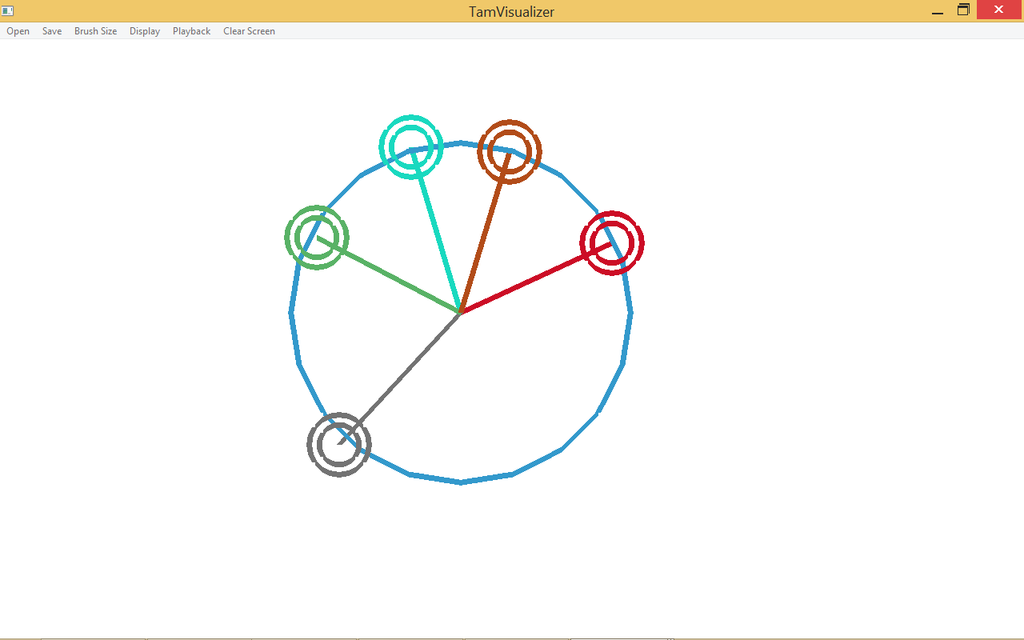


Circumcenter
Algorithm:
For each pair of 3 unique vertices
Compute circumcenter given three points using formula
Compute radius of circumscribed circle by summing the distance between each point and the circumcenter, and divide by three (averaging for float precision)
Sum up circumcenter and radius
Average circumcenter and radius

Slide 18
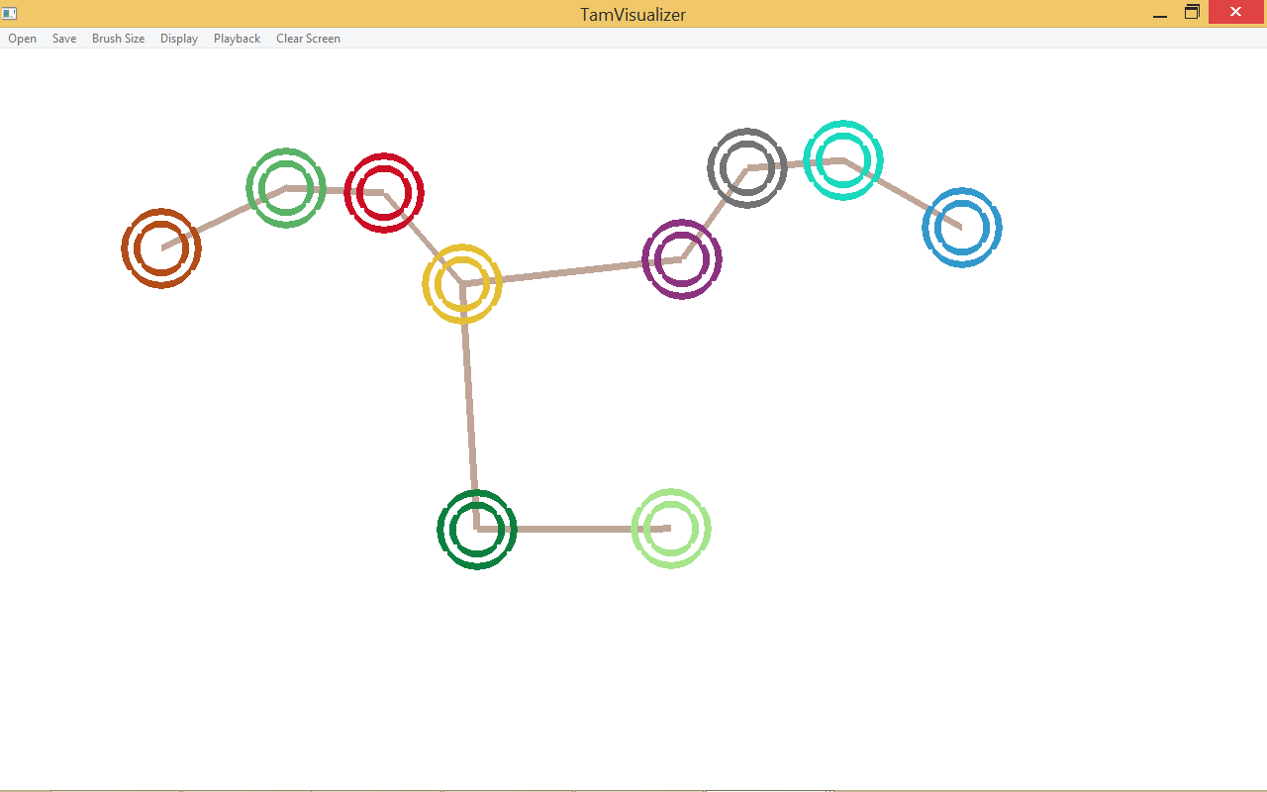
Minimum Spanning Tree
Algorithm:
Mark all vertices unselected
while there exists unselected vertices
for each unselected vertices
for each selected vertices
Get distance between the two vertices
Save the two vertices if distance is the minimum
Given the saved two vertices, draw line connection and mark unselected vertex as selected

Slide 19
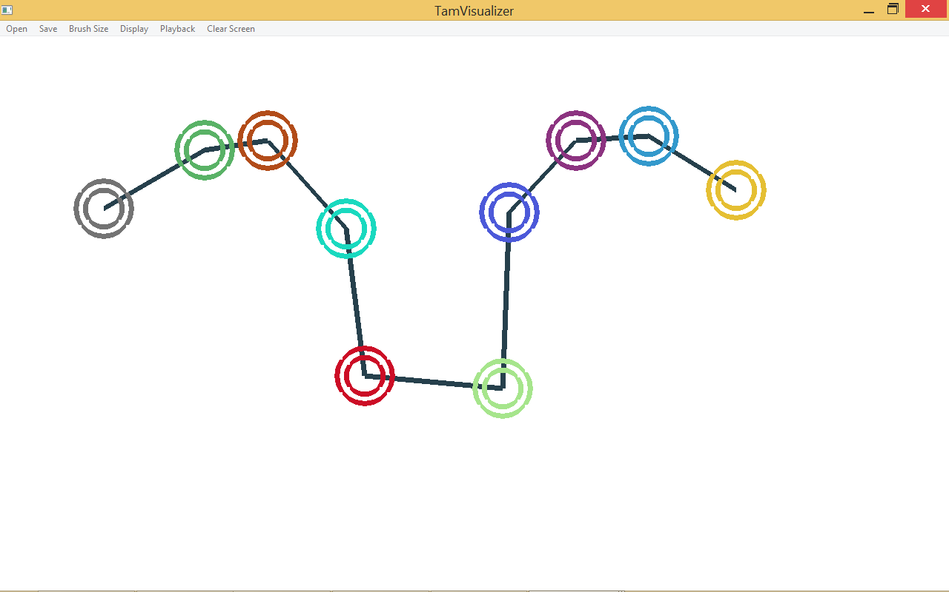
Shortest Hamiltonian Path (S.H.P)
Bellman, Held, and Karp's Dynamic Programming Solution to the S.H.P. Algorithm was implemented
Reliable due to 10 vertices max. input size
S.H.P. Algorithm provided by Google Source Code to assure that it works:
https://sites.google.com/site/indy256/algo/shortest_hamiltonian_path
Algorithm’s Implementation:
Take set of N vertices, create NxN array and assign distance between vertex i and vertex j for its ith row and jth column (but diagonals set to zero)
Send array to Google’s S.H.P. Algorithm, which returns index order of vertices traversal
Draw line in the order of the path traversal

Slide 20

System Testing
Bottom-up approach
Classes were developed separately
Classes were then tested by pairing with already tested classes
Integrate classes into project upon successful testing
Unit Testing
Done for complicated algorithmic tasks

Slide 21

FIN

