Slide 1
TAMGeF: Touch mid-Air Motion Gesture Framework
Team Developers: Alberto Carrillo, David Escobar
Mentor: Francisco R. Ortega, Ph.D.
Sponsored by: Naphtali Rishe, Ph.D. and Francisco R. Ortega Ph.D.
Instructor: Masoud Sadjadi, Ph.D.

Slide 2
The TAMGeF Framework
It is a framework for developing applications with varied input device
We will introduce a wide range of input devices:
Multi-touch
Gyroscope
LeapMotion
Kinect
Game Controller, and more

Slide 3
Current System
Composed of two visualizers: Gyroscope Visualizer and Multi-touch Visualizer
The Multi-touch Visualizer has the following features:
Fingertip Visualization
Algorithmic Visualization
Recording
Playback
The Gyroscope Visualizer has the following features:
Provides a 3D Visualization of the device
Accelerometer
Compass
Pitch indicator
The TAMGeF frame is currently limited to these two devices and lacks an API that will act as an easy to use graphics library.

Slide 4
Our Solution
Expanded the device-compatibility of the framework by introducing the LeapMotion and Kinect
Introduced the first iteration of the TAMGeF API which will act as an easy to use graphics library for device visualization.

Slide 5
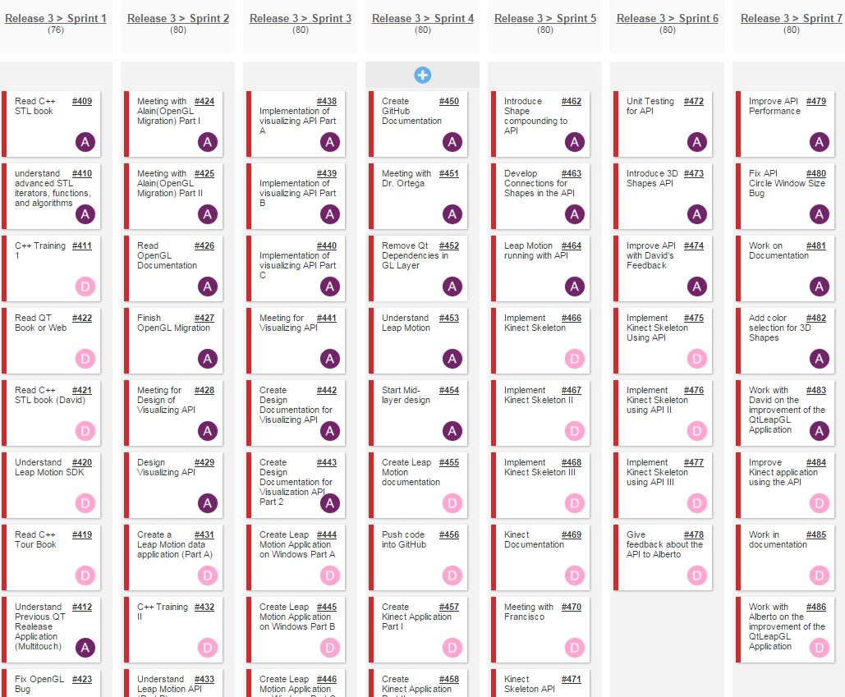
Project Management

Slide 6
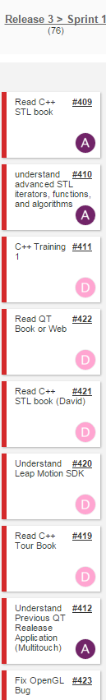
Sprint 1
Major Goals:
Setup Development Environment
Get familiarized with C++
Study previous release
Bug fixing

Slide 7
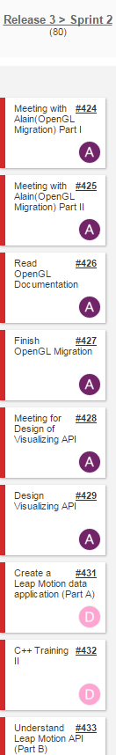
Sprint 2
Major Goals:
Started Design of API
Migrate to OpenGL with programmable pipeline
Create LeapMotion data application

Slide 8
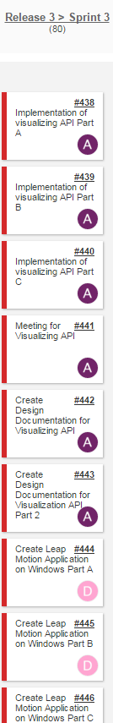
Sprint 3
Major Goals:
Started implementation of the API
Create a windows LeapMotion application

Slide 9
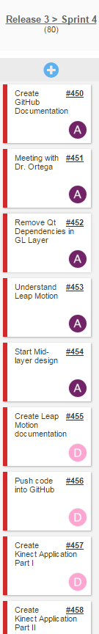
Sprint 4
Major Goals:
Started API Mid-layer design
Remove API Qt dependencies
Start Kinect Application

Slide 10
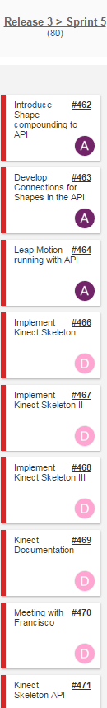
Sprint 5
Major Goals:
Introduce Shape Compounding
Develop LeapMotion Application that runs with API
Implement the kinect skeleton application

Slide 11
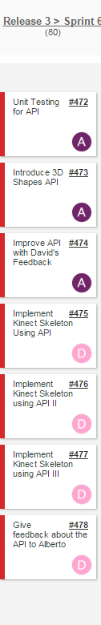
Sprint 6
Major Goals:
Introduce 3DShapes to the API
Finish Skeleton implementation

Slide 12
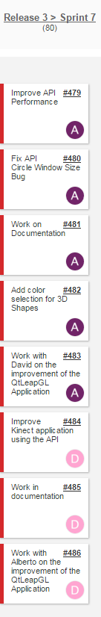
Sprint 7
Major Goals:
Improved performance of API
Fixed Circle Size bug
Improved LeapMotion Application
Finger tracking introduced
Improved Kinect Application
Skeleton size corrected

Slide 13
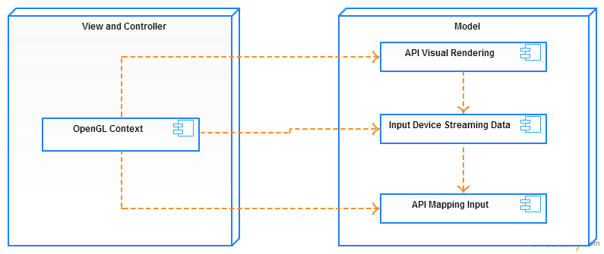
System Design: Architectural Patterns

Slide 14
Software and Hardware Requirements
Hardware:
Multi-touch Monitor
LeapMotion Device
Kinect Device
Software:
Windows 7
Qt Framework
OpenGL Framework
C++ Programming Language
Kinect SDK
LeapMotion SDK
GLM API

Slide 15
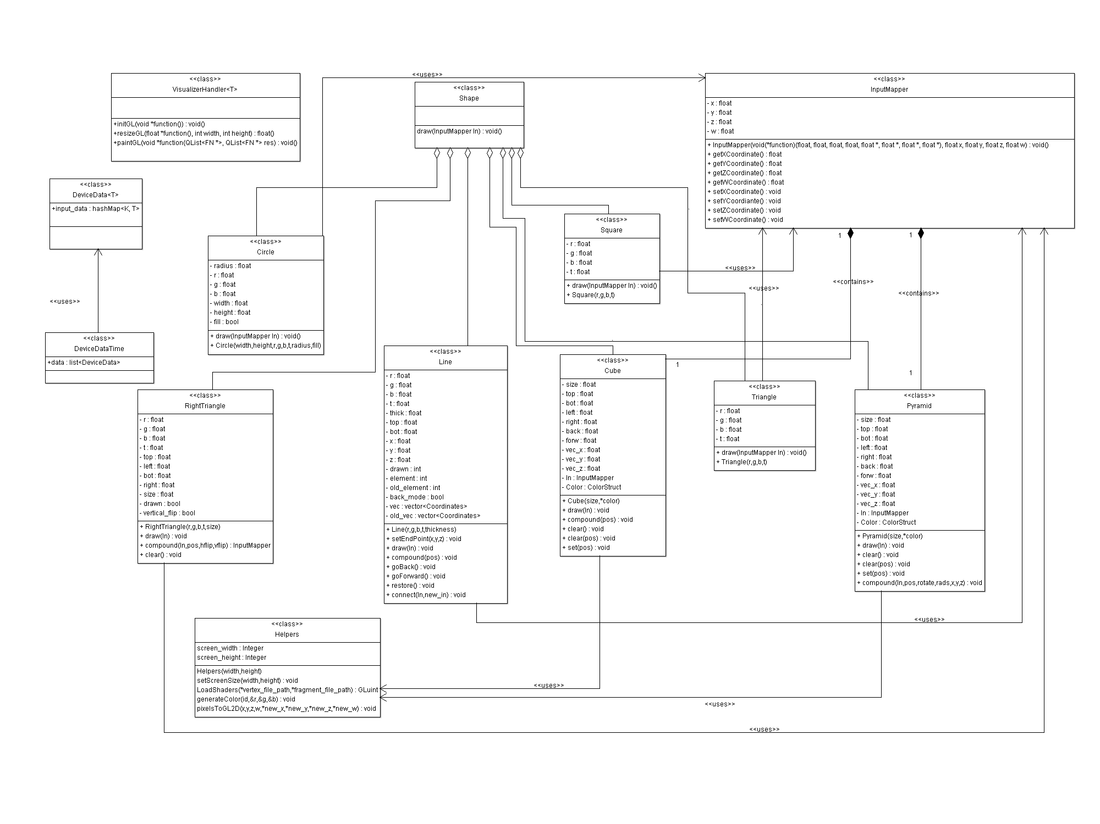
API Class Diagram

Slide 16
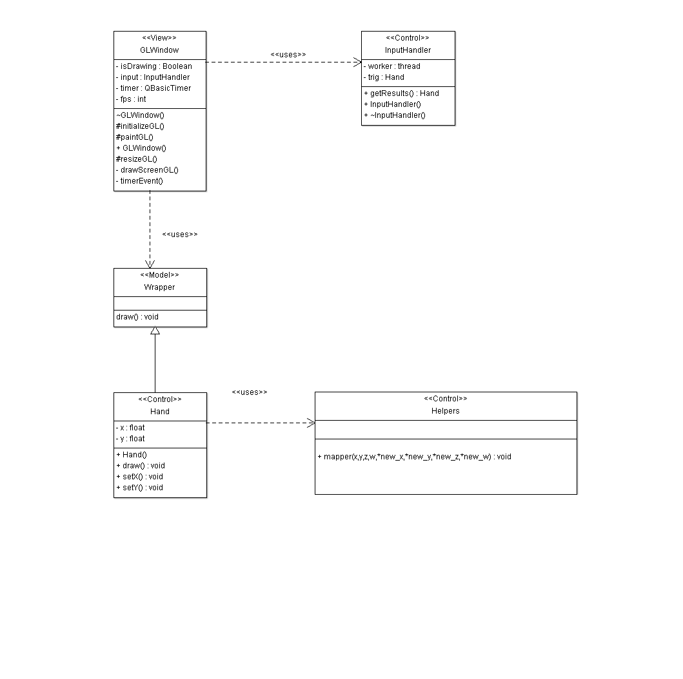
LeapMotion Visualizer Class Diagram

Slide 17
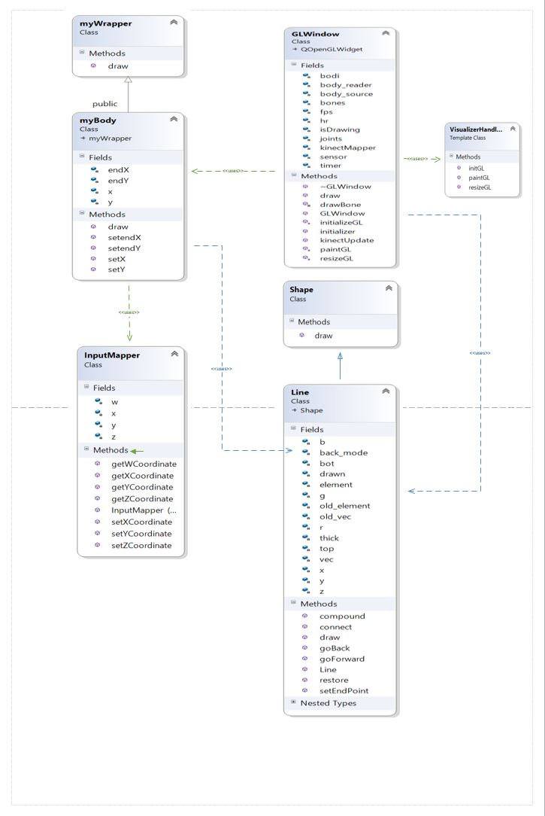
Kinect Visualizer Class Diagram

Slide 18
API Features
Coordinate Mapping
Primitive Shapes drawing
Shape Compounding
Shape Color Selection
Shape Resizing
Automatic OpenGL Context Creation

Slide 19
LeapMotion Visualizer Features
Currently the LeapMotion Visualizer uses the TAMGeF API to provide the following features:
Finger position tracking and drawing
Palm position tracking and drawing

Slide 20
Kinect Visualizer Features
Currently the Kinect Visualizer uses the TAMGeF API to provide the following features:
Bone position tracking and drawing
Implement API’S Shape compounding to draw a human skeleton

Slide 21
System Testing
Bottom-up Approach
Classes were developed separately
Classes were then tested by pairing with already tested classes
Classes were integrated into project after successful testing
Unit testing
Done for all non-rendering functionality of the API

