Slide 1
SaaS Integration Library
Adam Merille – Team Member, Scrum Master
Brian Dosal – Product Owner
Orlando Garcia - Consultant
Steve Restreppo – Consultant

Slide 2
Problem Definition
Brightgauge integrates datasources with visualizations
Want the ability to test third-party APIs data before integration
Need to view the data in a formatted way to discern business value

Slide 3
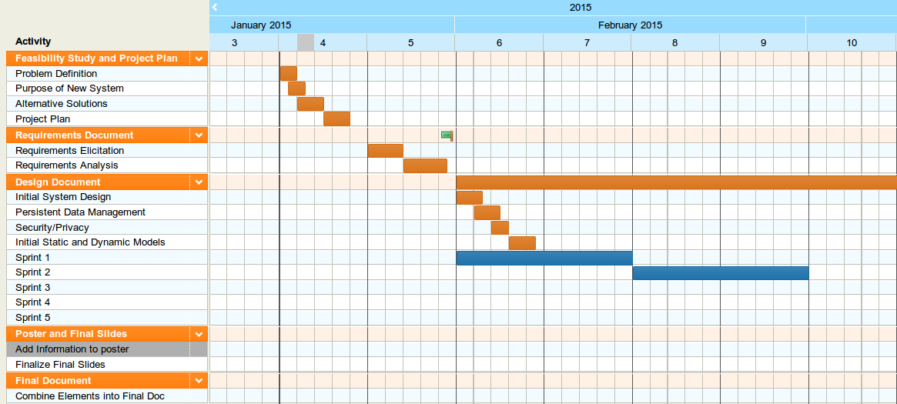
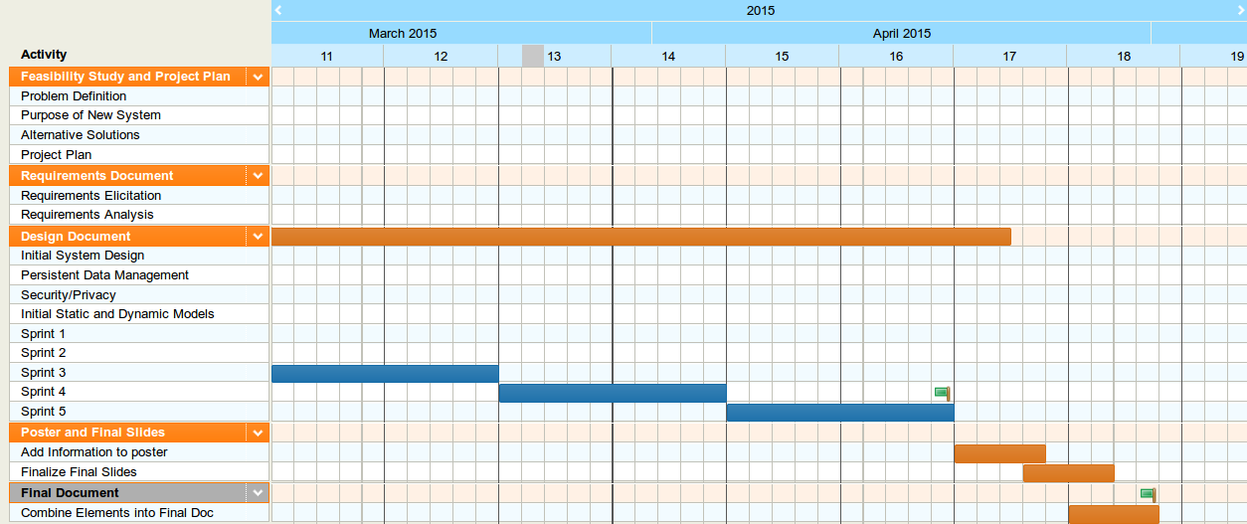
Project Management

Slide 4
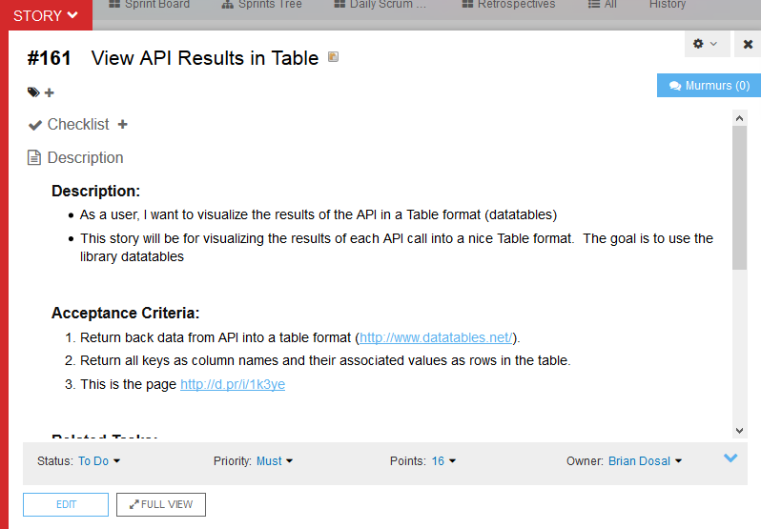
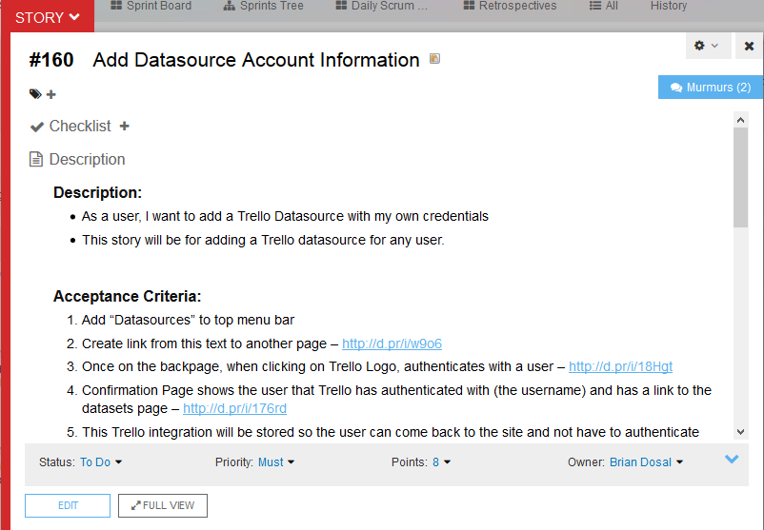
User Stories

Slide 5
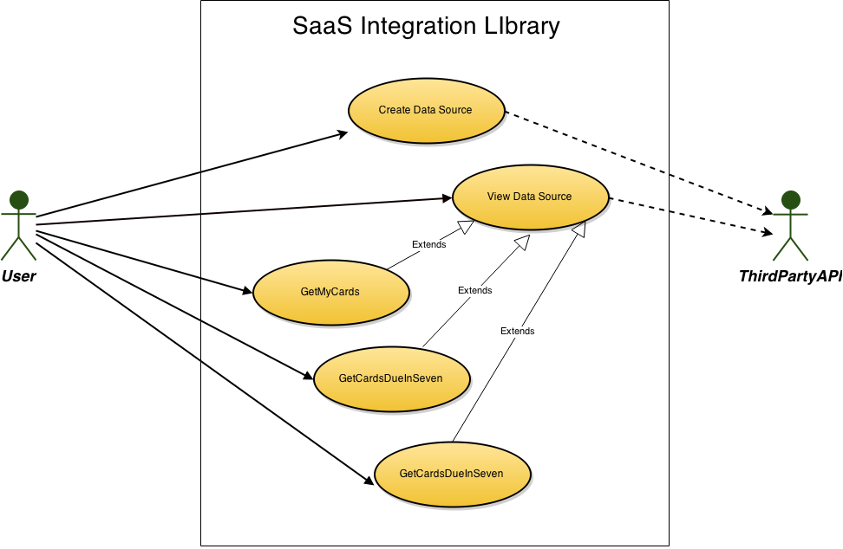
Use Case Diagram

Slide 6
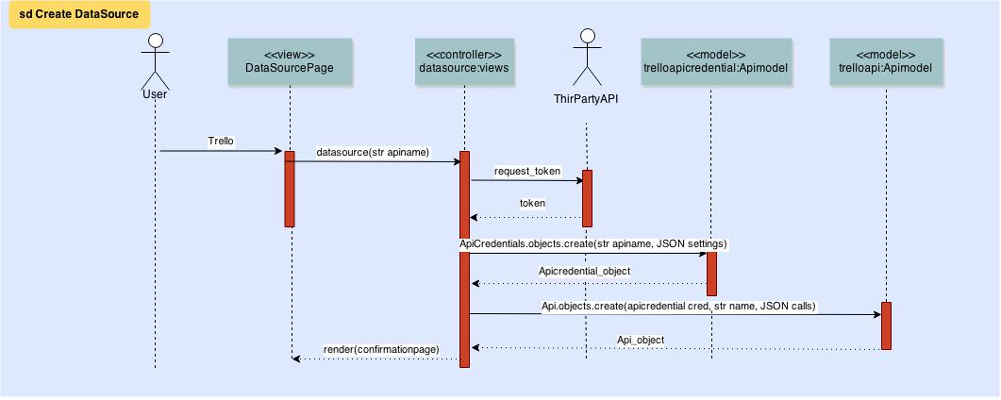
Sequence Diagram – Create Datasource

Slide 7
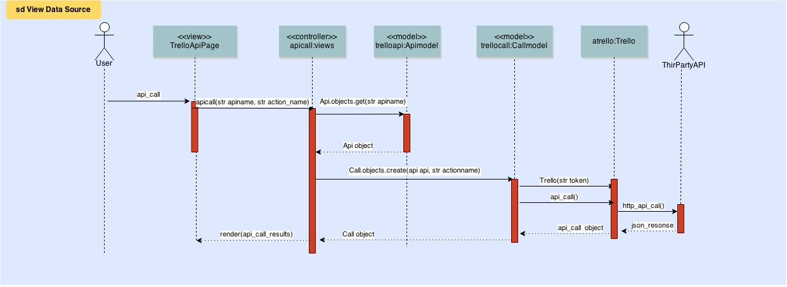
Sequence Diagram – View Datasource

Slide 8
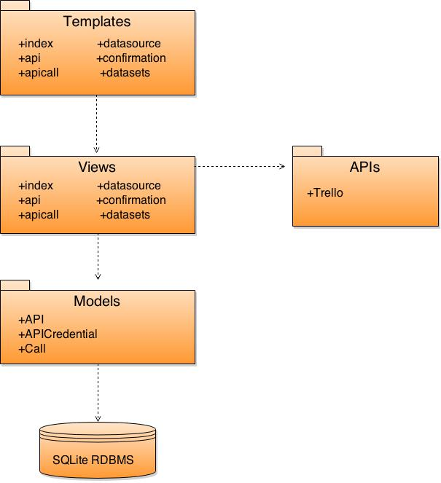
System Decomposition
Architecture:
Model-View-Template
Pipe and Filter

Slide 9
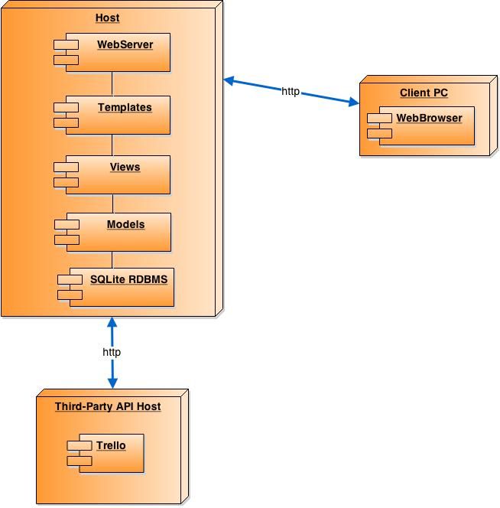
System Deployment

Slide 10
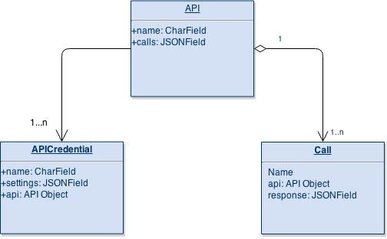
Persistent Data Design

Slide 11
Security and Privacy
Security:
Cross site scripting
Cross site request forgery
SQL injection
Session security
Privacy:
Password protection for database
Authentication handled by Trello

Slide 12
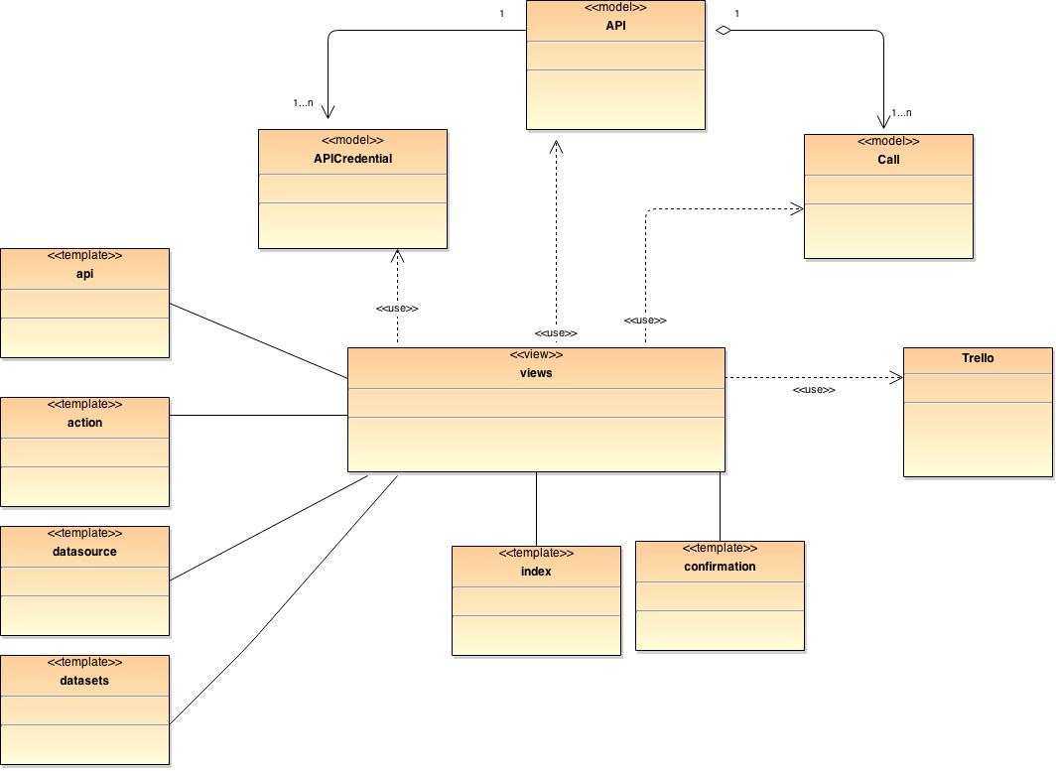
Minimal Class Diagram
Design Patterns:
Abstract Factory
Attempt at keeping API views separate from logic of calls
Command
Templates creating commands
Commands carried out by views

Slide 13
Test Case Sunny Day
Test Case ID: | SIL_Test1_Sunny_Day
Purpose: | To validate that the addition of a new account from Trello redirects the user to the proper page and adds the required information to the database.
Preconditions: | The user is on the Datasource page of the application.
Inputs: | Select Trello datasource button. Select Login Username: siluser Password: 123456 Select Allow
Expected Output: | The system redirects the user to a confirmation page, lets the user know that the account has been added, displays the username “siluser”, and contains a link to the datasets. The credential information for this account has been added to the database.
Actual Output: | Same as expected.

Slide 14
Test Case Rainy Day
Test Case ID: | SIL_Test1_Rainy_Day
Purpose: | To validate that if a user changes his/her mind mid addition of a datasource the system handles it appropriately.
Preconditions: | The user is on the Datasource page of the application.
Inputs: | Select Trello datasource button. Select Login Username: siluser Password: 123456 Select Deny
Expected Output: | The system should not redirect the user to a confirmation page nor should it save any information in the database
Actual Output: | Same as expected.

Slide 15
Demo
http://131.94.128.118:5555/SIL/

Slide 16
Thank You!

