Slide 1













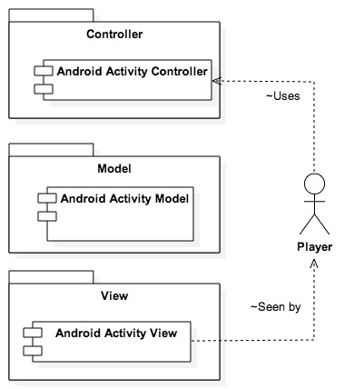
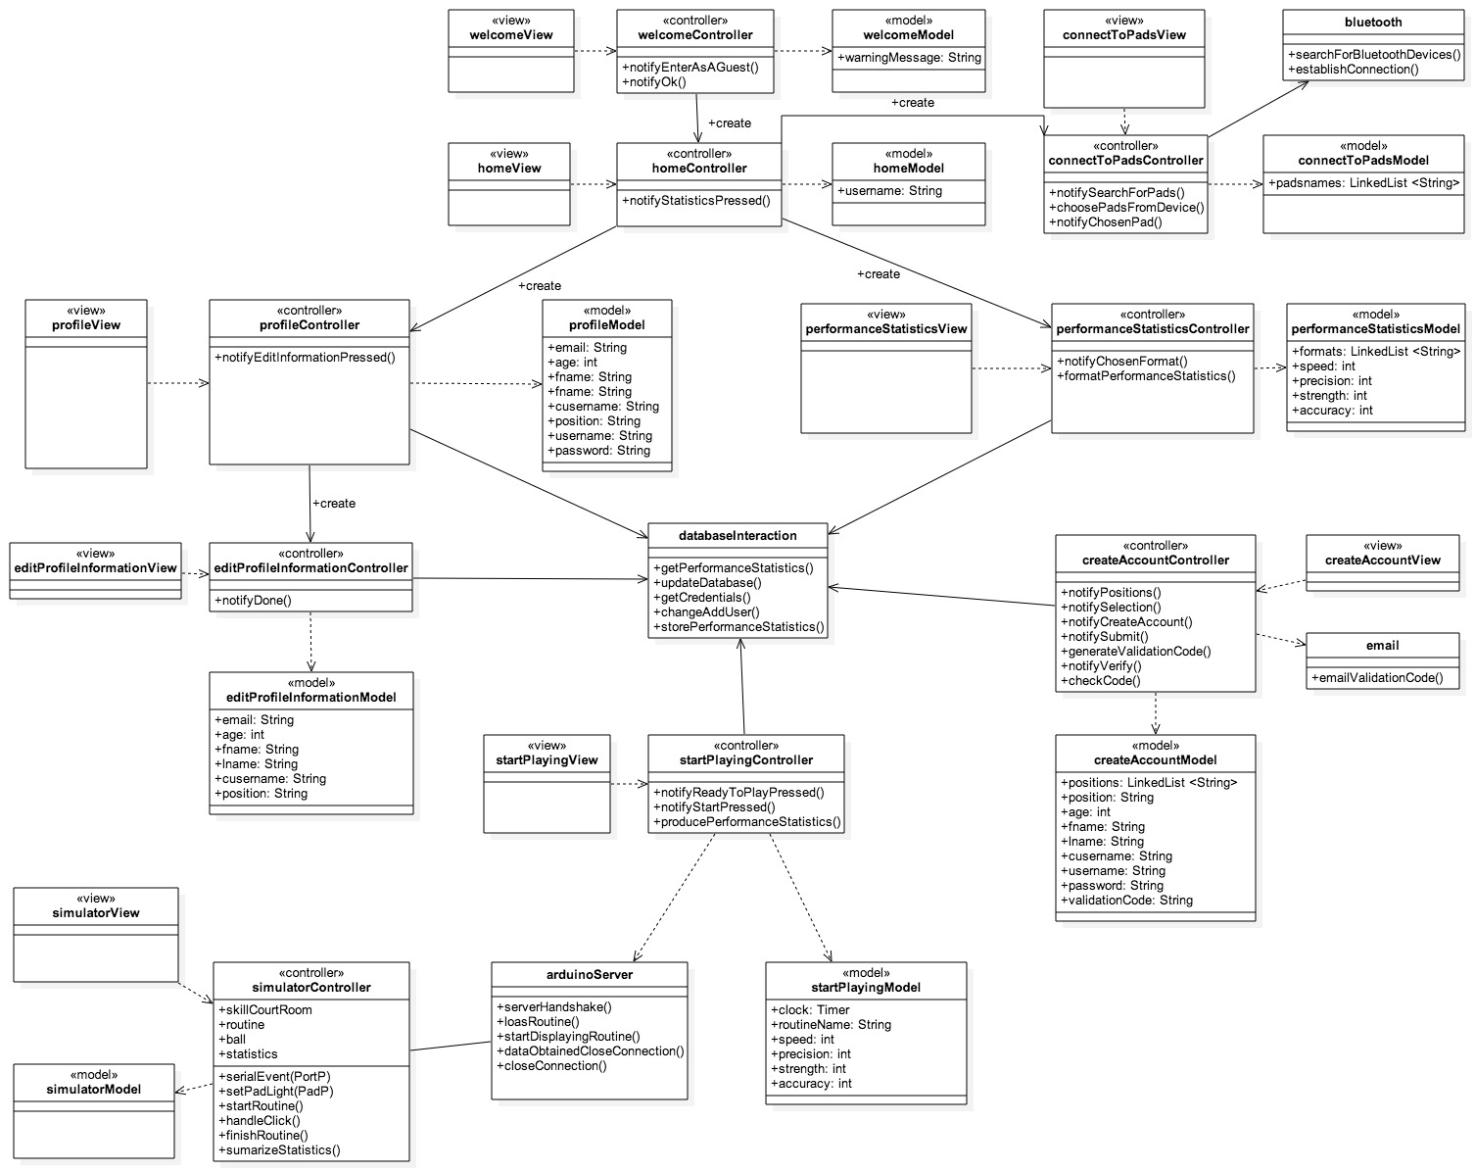
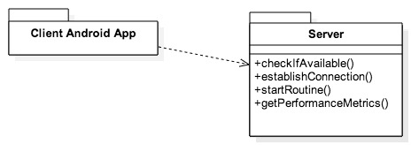
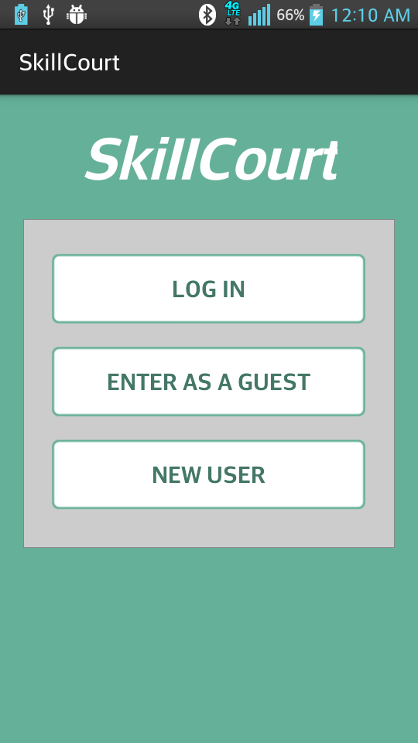
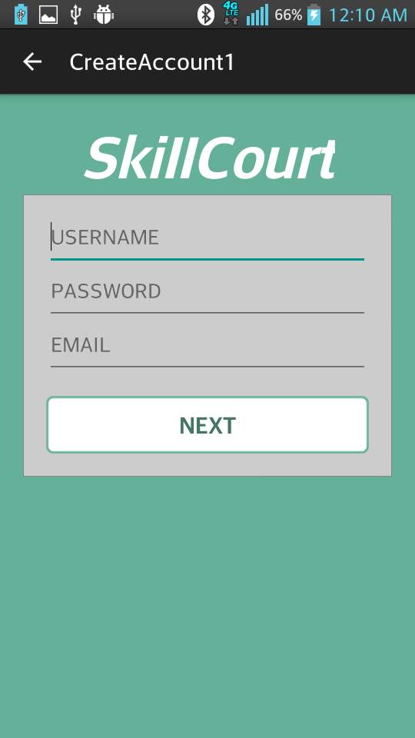
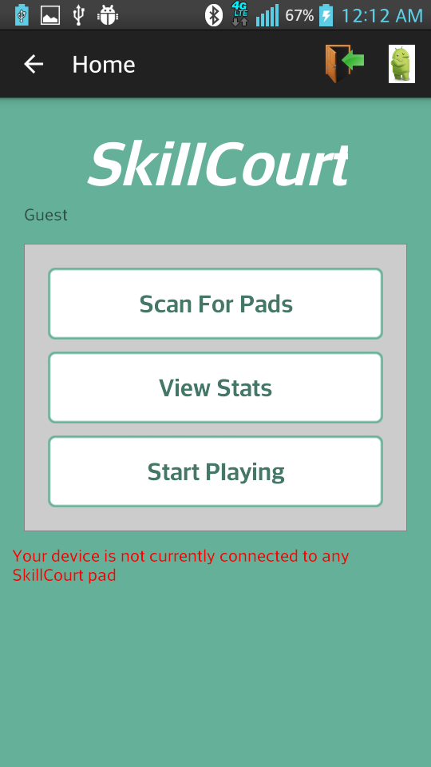
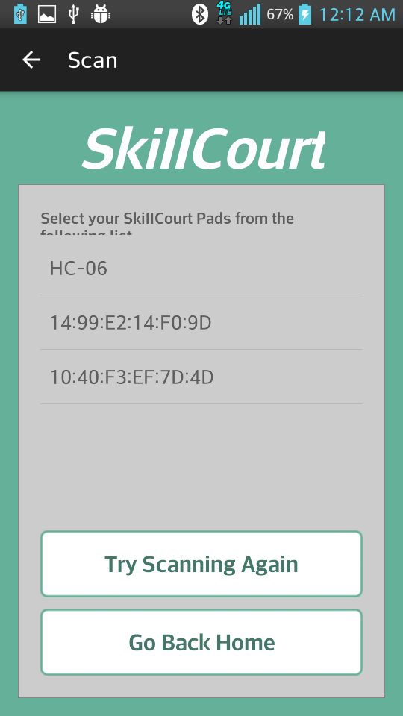
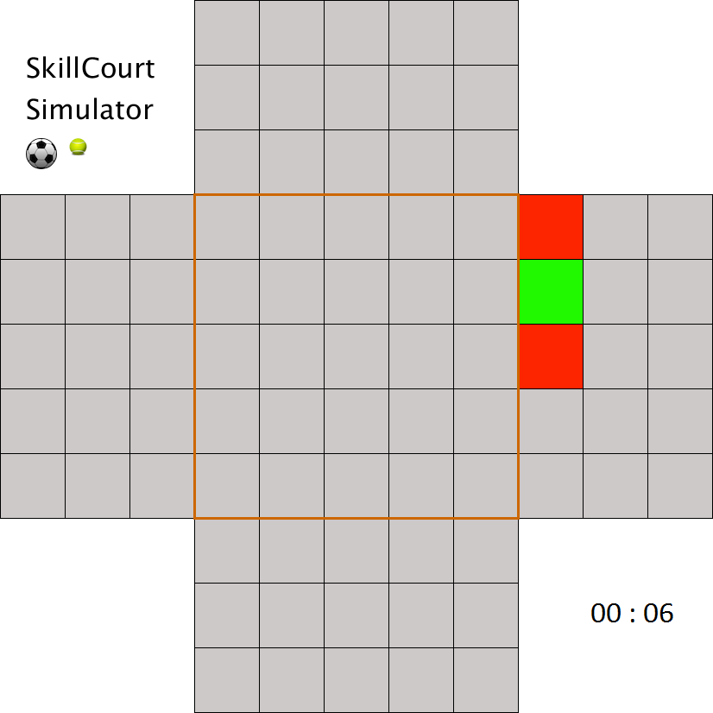
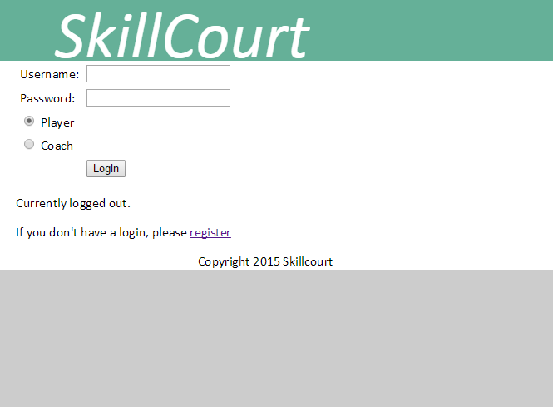
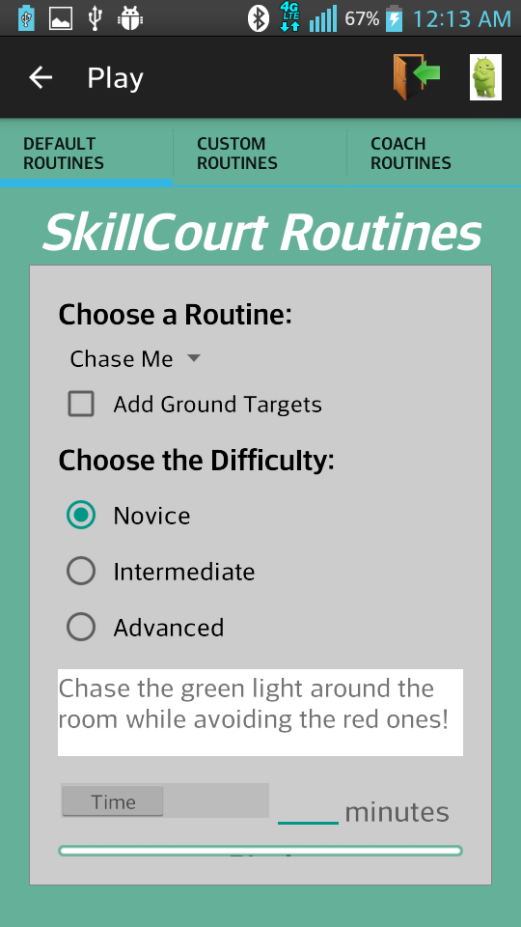
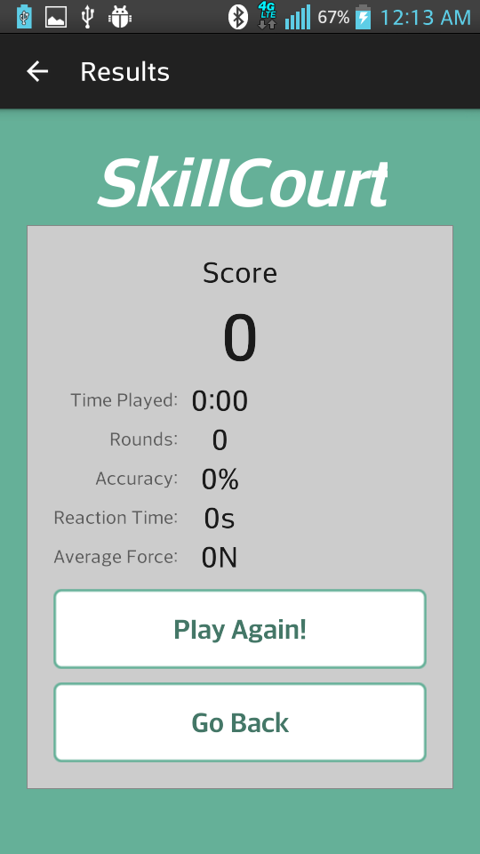
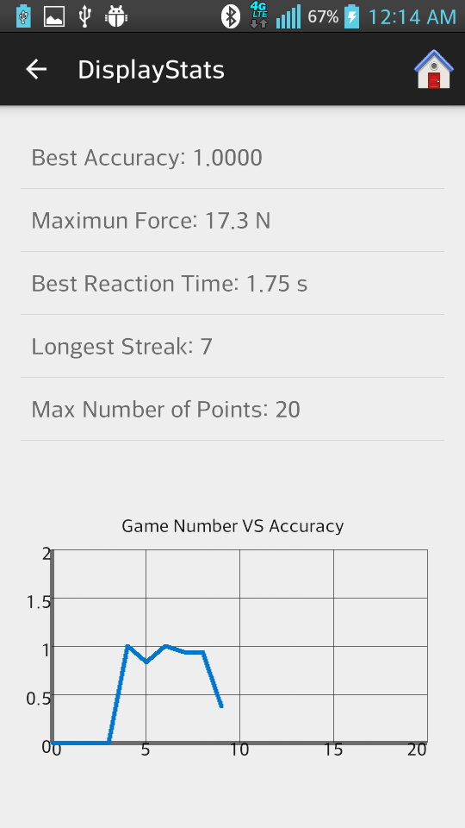
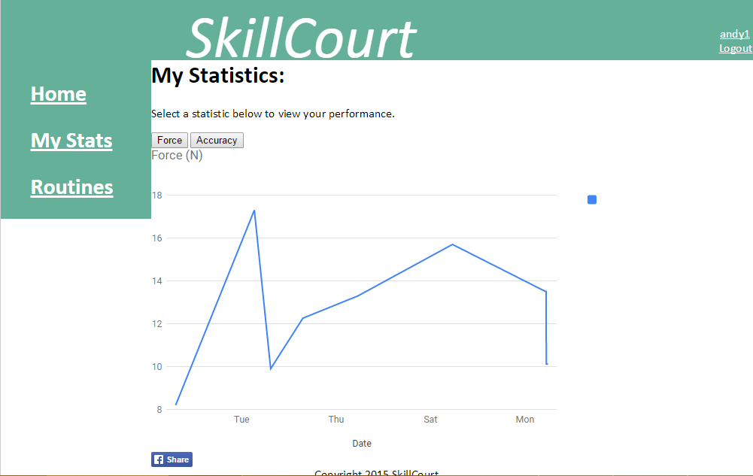
School of Computing & Information Sciences
Senior Project, 2015, Spring
SkillCourt
Student: Matthew Santiago, Florida International University
Mentor: Jaime Borras & Guðmundur “Gummi” Traustason
Instructor: Masoud Sadjadi, Florida International University
Problem
Current System
Requirements
While the efficiency of many things today continues to climb at rates unparalleled by any other era, it would seem as though sports training for the “average joe” has plateaued many years ago. These methods are quite primitive, even for professional athletes, involving countless repetitive actions with little outside of gameplay to show progress.
Games like soccer or football which require a large field are may become a major setback for individuals and even low-budget teams.
Furthermore, the techniques needed for furthering one’s abilities as an athlete are not only hard to learn, but aren’t the most obvious. A lack of direction may cause progress to plateau for anyone.
Although the issue may seem dire, there have not been many attempts to address it. Companies such as Axon Sports, have tried to develop a system to improve brain efficiency through the use of touch technology, but no customizable interactive training system is currently commercially available for users.
This project required the team to plan, design and develop 4 major separate sub systems, each an integral component to the overall system. These systems were the Mobile App, the Web Site, the Simulator, and the Database. The Mobile App, Web Site both required a connection to the database and the Simulator required a connection via Bluetooth to the Mobile App.
Authentication protocols were developed for the Web Site and the Mobile App. Finally, the system was to be user friendly and create an environment in which players can improve their skills and a coaches can maintain and support their players throughout.
Proposed System
SkillCourt is our attempt at solving this issue. Aimed initially as Soccer, SkillCourt provides a customizable “game” with which players and their coaches can interact with. The System uses pressure pads which illuminate to produce smart targets aimed at improving a player’s capabilities and skills.
System Design
Object Design
Implementation
MVC Architecture
The system was developed in an interactive, Agile/Scrum process using Mingle, a ThoughtWorks web-based agile application. The first few development iterations encompassed creating the mobile application and UI.
Once the client approved of the interface, development began on the back end of the system starting with data and logic.
After that, the website became a top priority for me. This started with UI development and quickly moved into parallel functionality between the App and the Website.
Then, the differentiation process began when the Simulator began development and we began working on the Coach functionalities web-side. HTML5, PHP, and JavaScript were main components for the Website while Java and XML was the primary utility for the Application. The Simulator was composed with Python and an Arduino using C/C++.
Client-Server architecture:
Verification
Screenshots
Unit testing was performed for each component before being integrated into the system. Then integration tests were performed to ensure proper interaction between each component. Finally system testing was applied to ensure the system behaved in the proper manner.
These tests were performed before the end of each sprint and any bugs were either fixed on point or assigned to the defect backlog.
Summary
This project was a great experience as it allowed me to further my knowledge in the process of Software Development. It also introduced me to many new tools and languages which were previously unknown to me. Integrating this application combined so much of my knowledge with a lot of research to push me beyond my comfort zone and into the place that I needed to be for my Career.
Acknowledgement
The material presented in this poster is based upon the work supported by Jaime Borras and Gummi Traustason
I am thankful to the help that I received from my group member Andy Martinez.

