Slide 1

Senior project final presentation
fall2015
Mentors:
Team members:
Instructor:
Gummi Traustason & Jaime Borras
Will Rodriguez & Sergio Saucedo
Masoud Sadjadi

Slide 2
PROBLEM DEFINITION
Project Scope:
Team focused sport
Lack of an interactive training facility
Lack of qualified training staff
One coach per team
Specific Problems to Tackle:
Enhance the website’s usability and design limitations
Implement a MVC architectural design pattern in the system
Coach users search functionality presents drawbacks to the user

Slide 3
CURRENT SYSTEM
LIMITATIONS
Mobile application requires:
Arduino-Micro Controller connected via serial port to desktop Simulator for communication
SkillCourt 2.0 Website lacks:
Usability aspect of the subsystems
Lack of clear objective of the website for first-time users
Ambiguous steps to play/and or create routines.

Slide 4
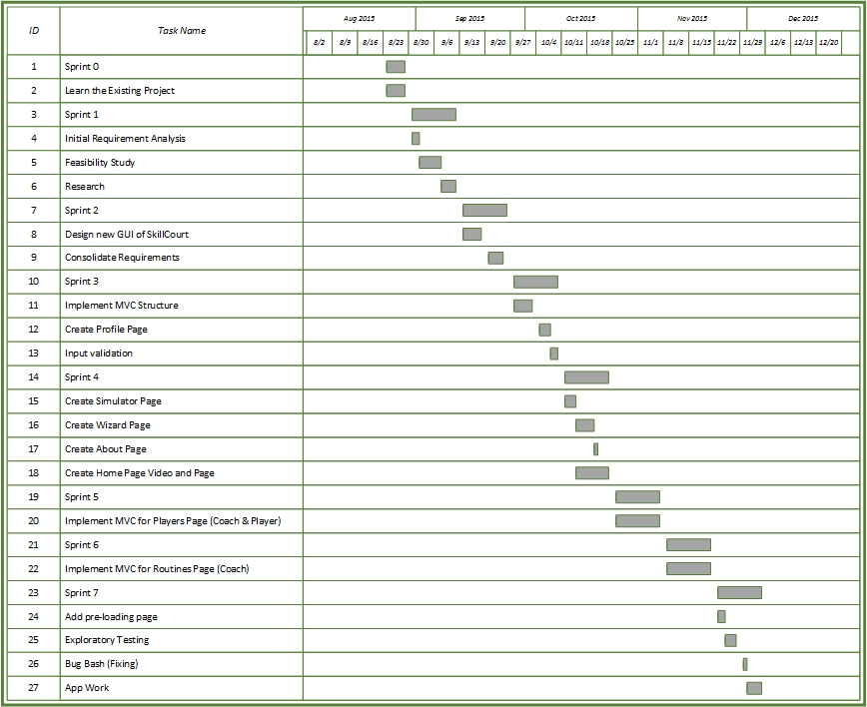
PROJECT MANAGEMENT

Slide 5
REQUIREMENTS
Implemented User Stories
Design MVC architectural design pattern in the SkillCourt system
Create dispatcher class to handle all requests in the system
Allow users to add their Favorite soccer teams
Design a new Profile page for users
Users will be able to Search for players from a redesigned interface
Users will be able to sign/release players from the Search interface
Users will be able to assign/unassign/edit/delete routines
Users will be able to create custom/default routines

Slide 6
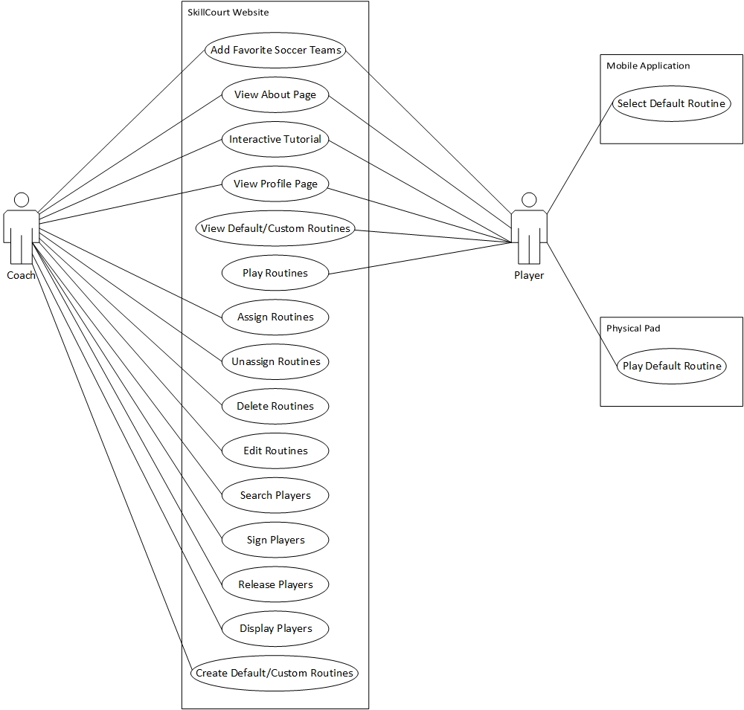
REQUIREMENTS
USE CASE DIAGRAM

Slide 7
USE CASE
Use Case ID: WAR569 – Coach User will be able to Sign Players
Details:
Actor: Coach User
Pre-conditions:
1. Web page has been loaded
2. User is Coach and has logged in
Description:
Use case begins when the user clicks on the Players link in the top navbar
The system shall provide the user with the Players page
The user shall click on the Select Players Link
The user shall click on the Sign/Release Players Link
The system shall provide the user with a template for searching Players
The user shall select the Filter by button and click Position and select Attacking Midfielder
The user shall then send the request by clicking on the Search button.
The system shall present the Coach all the users that match the given criteria
The user shall click on the SIGN button
Use case ends when the page loads and shows the player as taken

Slide 8
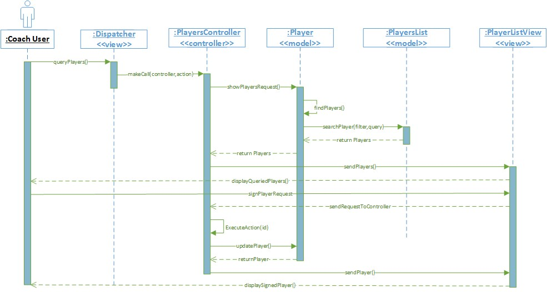
SEQUENCE DIAGRAM

Slide 9
USE CASE
Use Case ID: WAR442 – User will be able to retrieve routines.
Details:
Actor: Player User
Pre-conditions:
1. Web page has been loaded
2. User is Coach and has logged in
Description:
Use case begins when the user clicks on the Routines link in the top navbar
The system shall provide the user with the Routines page
The system shall provide the user with a view of all available Routines
The system shall present the user with all of the Players assigned Routines
Use case ends when the page loads and shows the Coach all of his/her Routines

Slide 10
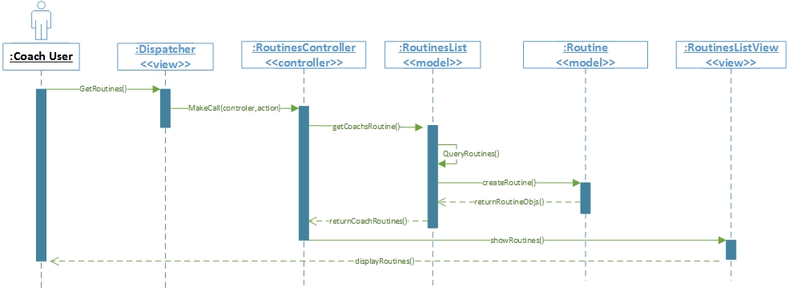
SEQUENCE DIAGRAM

Slide 11
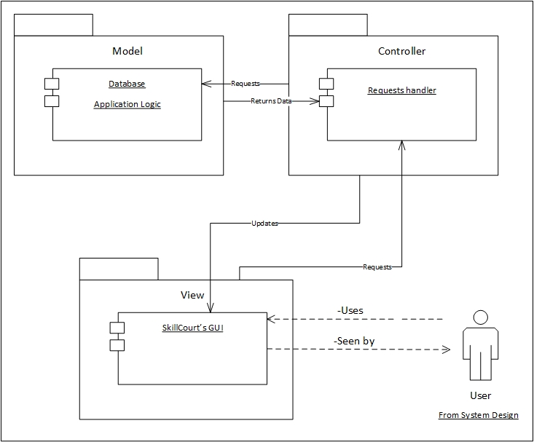
SYSTEM DESIGN

Slide 12
SYSTEM DEPLOYMENT
H/W Requirements:
Android Device with Bluetooth technology
Arduino Micro-Controller
PC with USB Ports
S/W Requirements:
Processing.js
PHP, JavaScript, jQuery, HTML & CSS
Parse.com
Android Studio

Slide 13
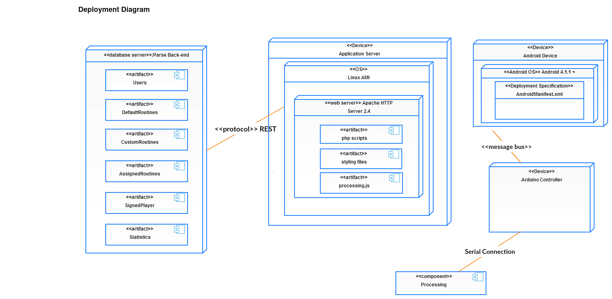
SYSTEM DEPLOYMENT

Slide 14
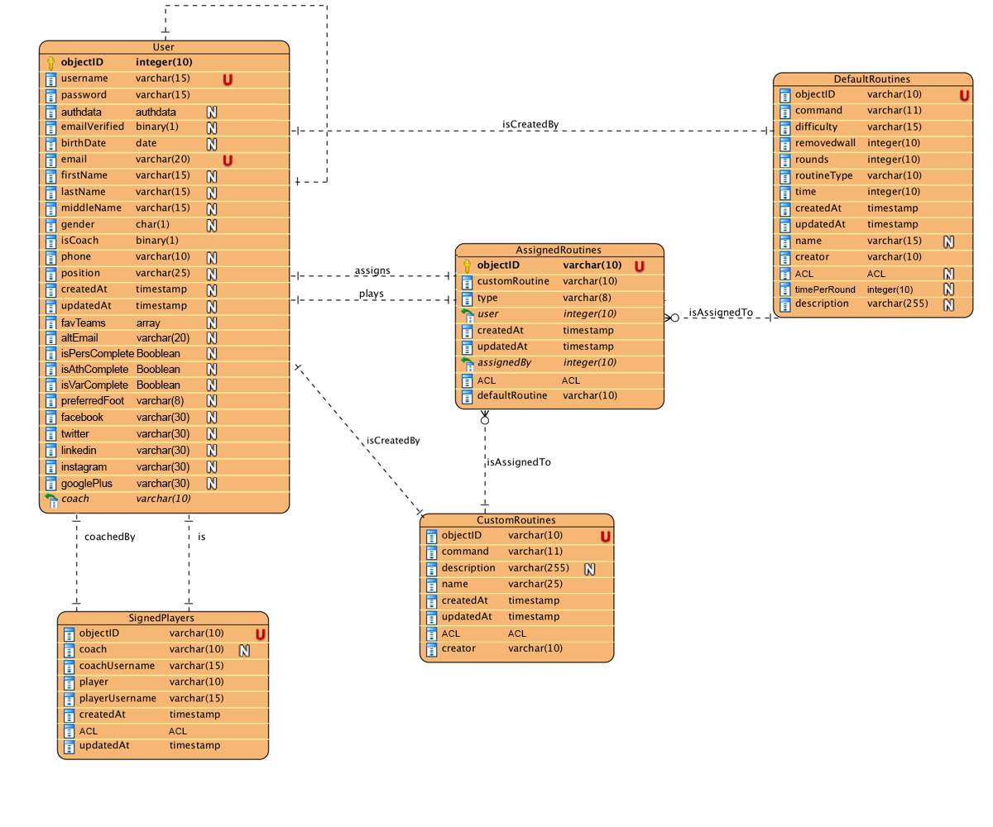
PERSISTENT DATA DESIGN

Slide 15

SECURITY AND PRIVACY
Encryption protocols over
sensitive data
Session Management

Slide 16
CLASS DIAGRAM
Skillcourt’s system

Slide 17
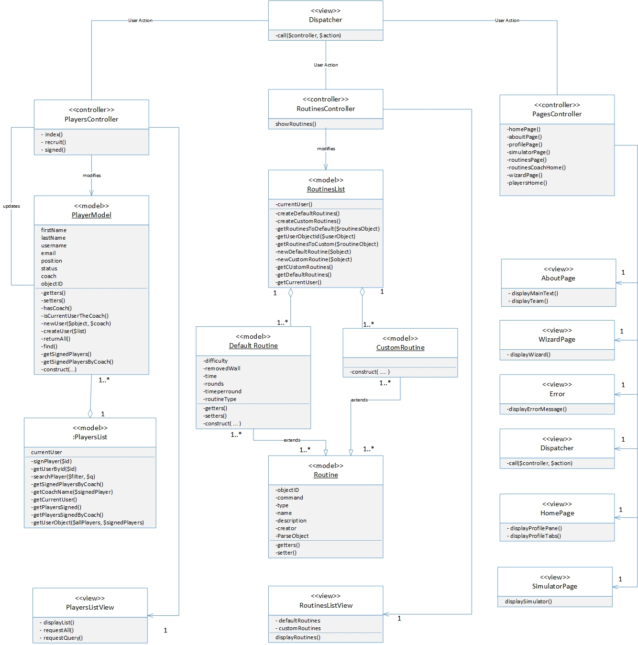

Slide 18
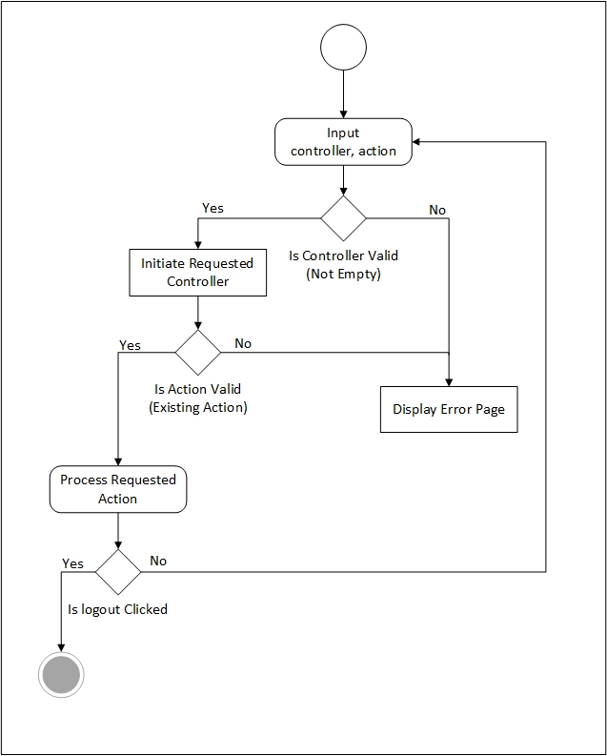
MAIN ALGORITHM

Slide 19
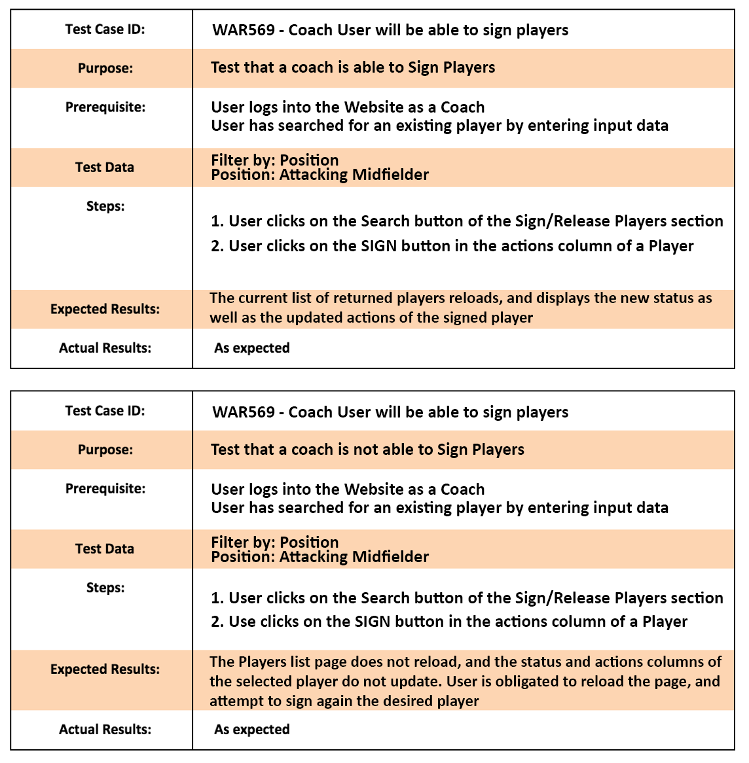
TEST CASES
SUNNY CASE
RAINY CASE

Slide 20
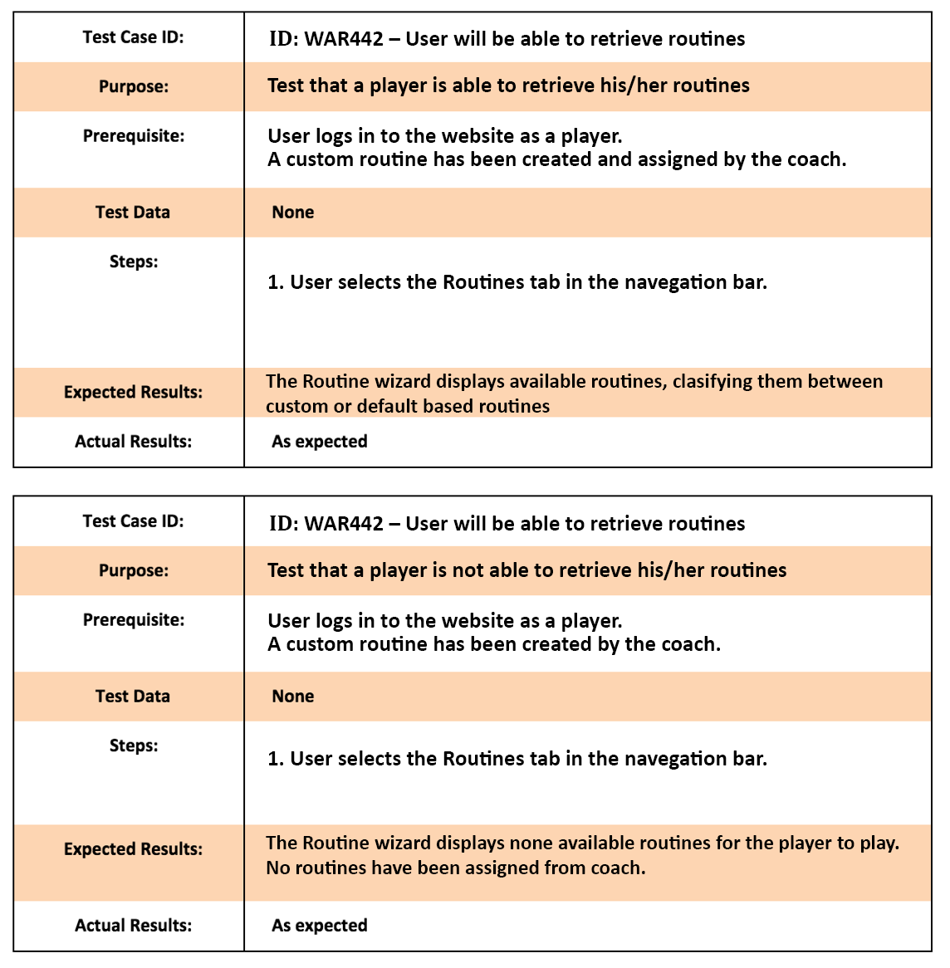
TEST CASES
SUNNY CASE
RAINY CASE

Slide 21
SUMMARY
My contribution to this project was to redesign the entire system. A MVC architectural design pattern was implemented in the system. This was done with the intention of making future modifications to the site a lot simpler and faster.
Will Rodriguez
Software Engineer.
iWill.Rodriguez@gmail.com

Slide 22

Thank you.
Questions?

