Slide 1

Senior project final presentation
fall2015
Mentors:
Team members:
Instructor:
Gummi Traustason & Jaime Borras
Will Rodriguez & Sergio Saucedo
Masoud Sadjadi

Slide 2
PROBLEM DEFINITION
Project Scope:
Team focused sport
Lack of an interactive training facility
Lack of qualified training staff
One coach per team
Specific Problems to Tackle:
Enhance the website’s usability and design limitations
Implement Interactive content and improved user experience
Improved website UIs

Slide 3
CURRENT SYSTEM
LIMITATIONS
Mobile application requires:
Arduino-Micro Controller connected via serial port to desktop Simulator for communication
SkillCourt 2.0 Website lacks:
Usability aspect of the subsystems
Lack of clear objective of the website for first-time users
Ambiguous steps to play/and or create routines.

Slide 4
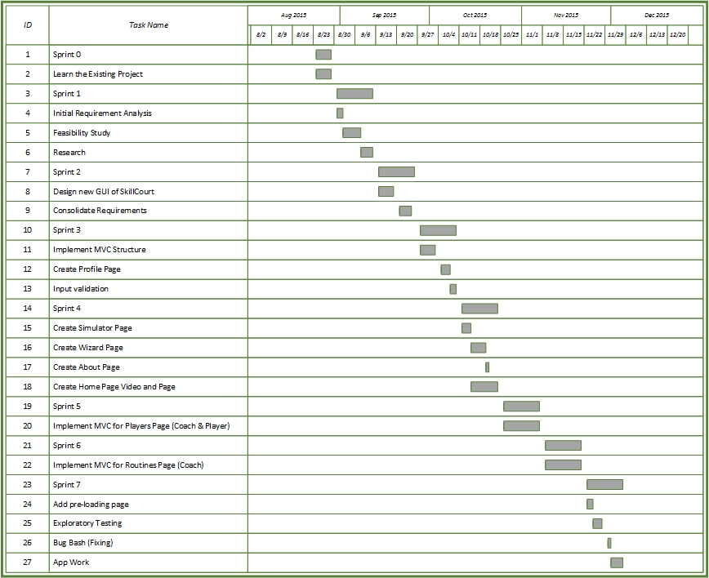
PROJECT MANAGEMENT

Slide 5
REQUIREMENTS
Implemented User Stories
Design Interactive Summary Table
Create Player Tutorial Interactive Guide
Create Coach Tutorial Interactive Guide
Enhance SkillCourt homepage
Enhance SkillCourt about Page
Produce Real-Life Demonstration Video
Implement Interactive Team Members Display
Help button Tutorial Implementation
Live Demo inside Interactive Summary Table

Slide 6
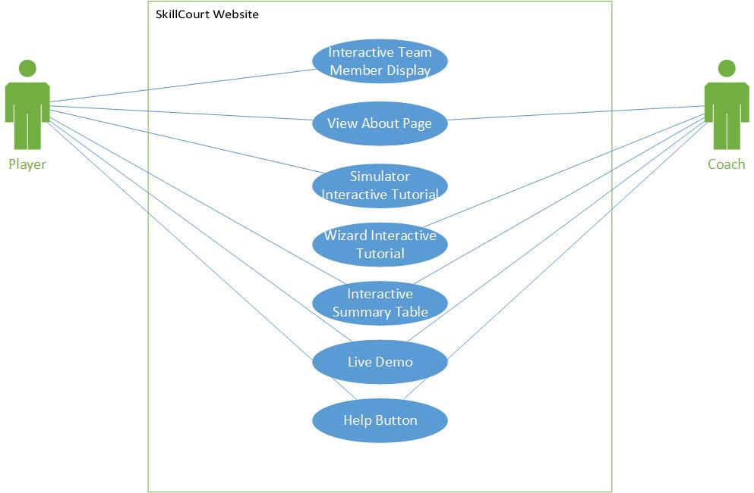
REQUIREMENTS
USE CASE DIAGRAM

Slide 7
USE CASE
Use Case ID: SLS630 – Simulator Interactive Tutorial
Details:
Actor: Player User
Pre-conditions:
1. Web page has been loaded
2. User is Player and has logged in
3. Player have gone into the Simulator view
Description:
Use case begins when the user clicks on the Help
The system shall start the simulator Tutorial
The user shall click Next through all the tutorial steps
The system shall block any click outside the tutorial’s controls
The system shall provide the user a Done button when there is no steps remaining
The user shall click on Done to end tutorial or
Use case ends when the tutorial interfaces disappear and simulator regains click control

Slide 8
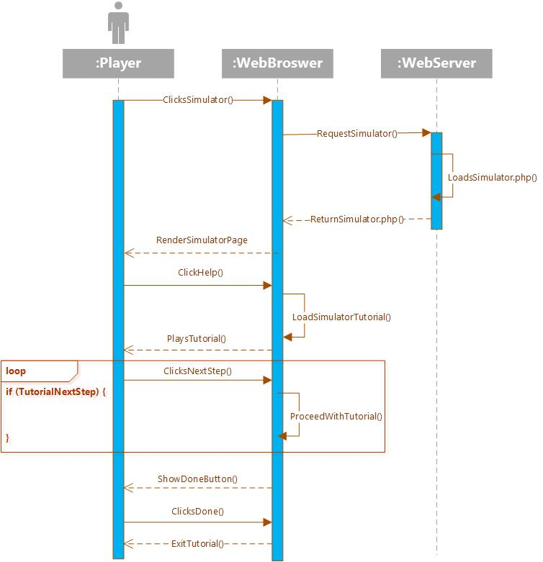
SEQUENCE DIAGRAM

Slide 9
USE CASE
Use Case ID: SLS613 – User will be able to change tab in the Interactive Summary Table.
Details:
Actor: Any User
Pre-conditions:
1. Web page has been loaded
Description:
Use case begins when the homepage is loaded
The system shall start playing automatically the Live Demo video
The user shall click in Simulator tab in the Interactive Summary Table
The system shall pause the video and present the user with the Simulator tab information
The user shall click in Live Demo tab
The system shall resume the video where it was left up
Use case ends when the video successfully resumes playing

Slide 10
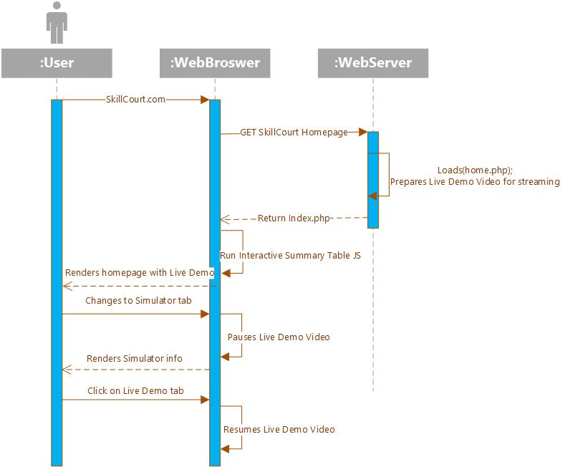
SEQUENCE DIAGRAM

Slide 11
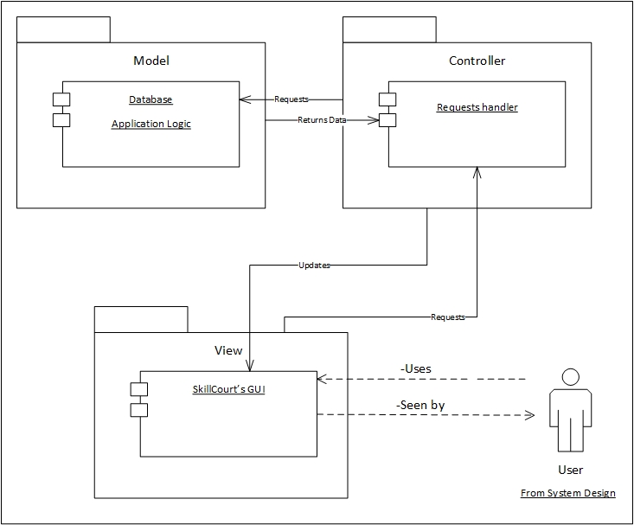
SYSTEM DESIGN

Slide 12
SYSTEM DEPLOYMENT
H/W Requirements:
Android Device with Bluetooth technology
Arduino Micro-Controller
PC with USB Ports
S/W Requirements:
Processing.js
PHP, JavaScript, jQuery, HTML & CSS
Parse.com
Android Studio

Slide 13
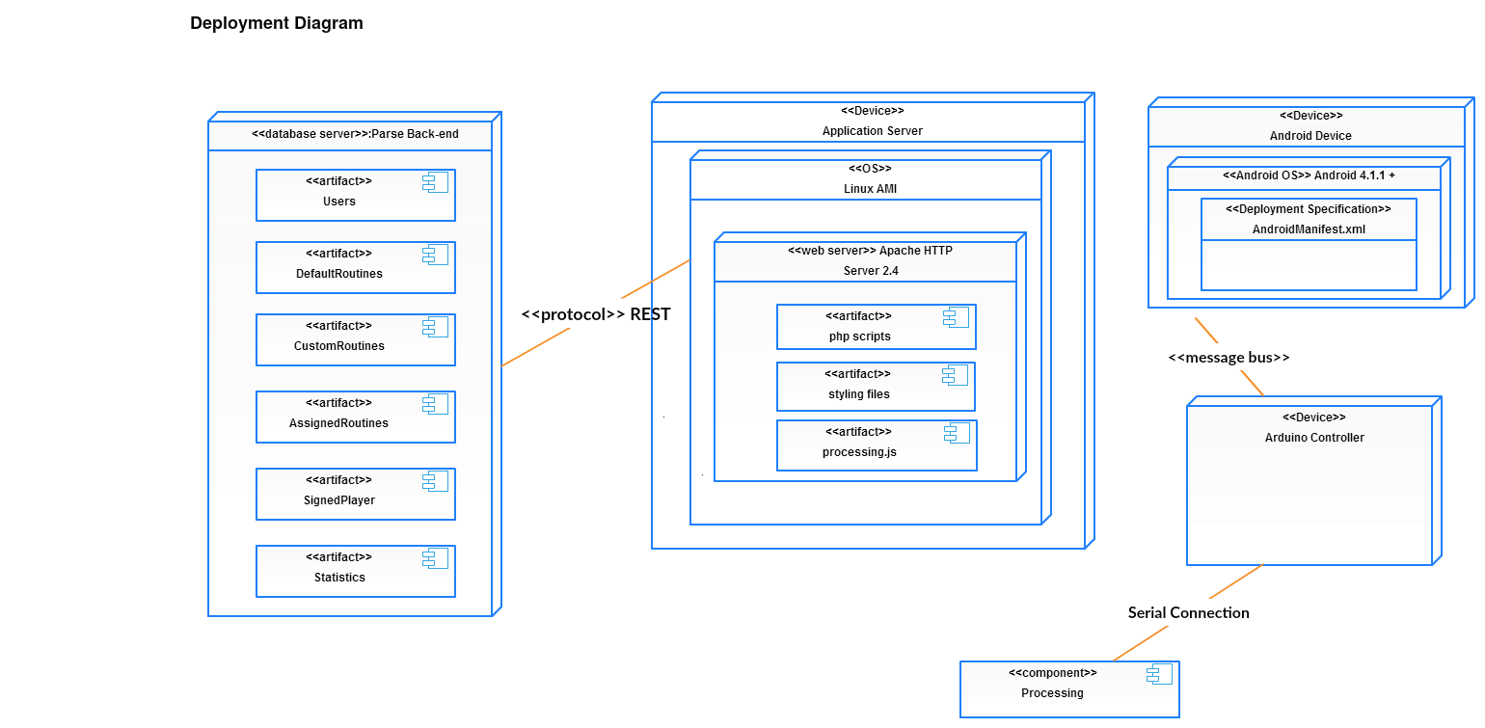
SYSTEM DEPLOYMENT

Slide 14
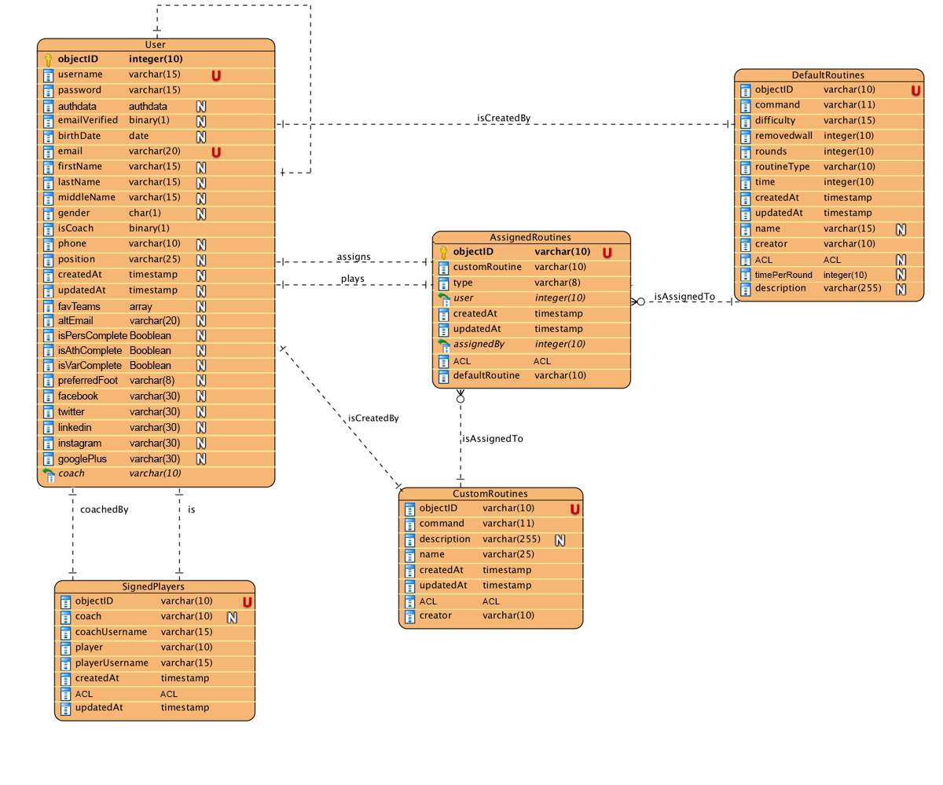
PERSISTENT DATA DESIGN

Slide 15

SECURITY AND PRIVACY
Encryption protocols over
sensitive data
Session Management

Slide 16
CLASS DIAGRAM
Skillcourt’s system

Slide 17
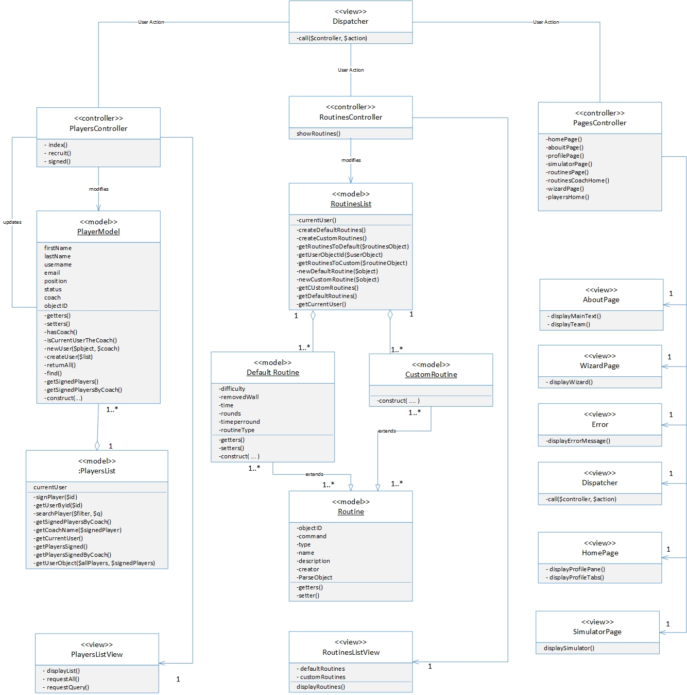

Slide 18
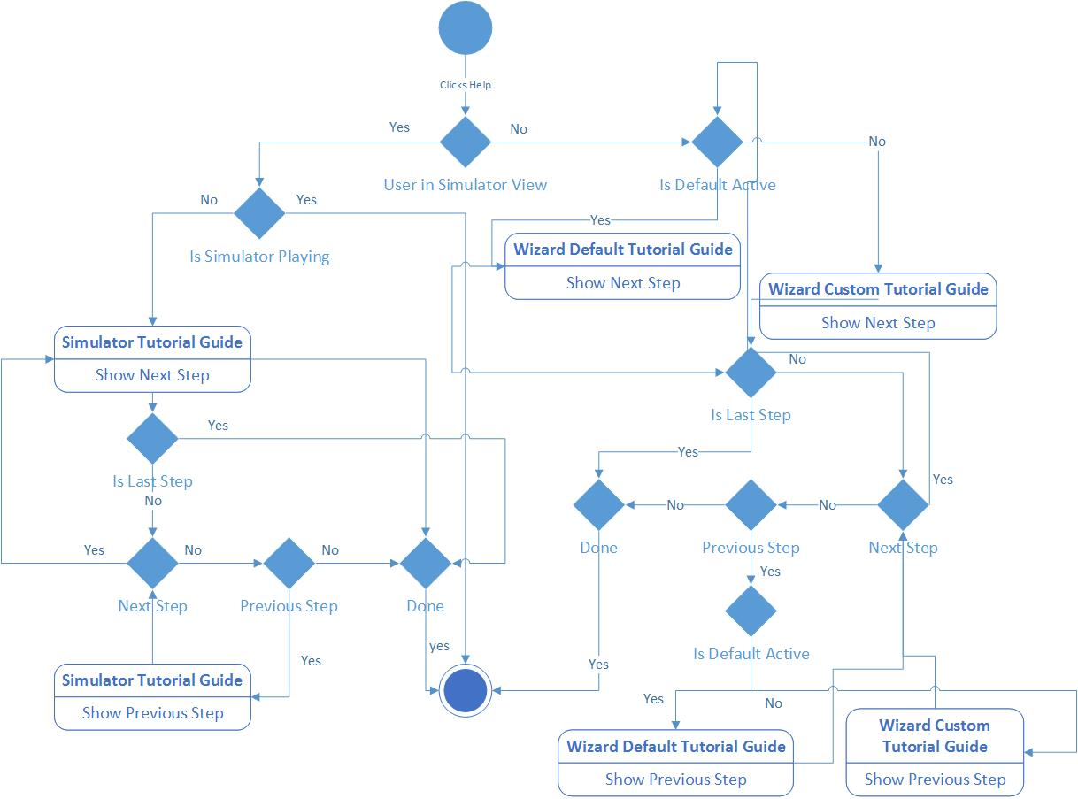
MAIN ALGORITHM

Slide 19
TEST CASES
Test Case ID: | Player_Tutorial_1
Purpose: | Test that simulator tutorial starts when user clicks on Help
Prerequisite: | User has logged in as player User is in the simulator view
Test Data | None
Steps: | 1. User clicks on the Help tab 2. User goes over the tutorial steps
Expected Results: | Simulator Tutorial Guide starts with the corresponding steps
Actual Results: | As expected
SUNNY CASE
RAINY CASE
Test Case ID: | Player_Tutorial_2
Purpose: | Test that simulator tutorial doesn’t starts when user clicks on Help
Prerequisite: | User has logged in as player User is in the simulator view User is in the middle of a routine simulation
Test Data | None
Steps: | 1. User clicks on the Help tab
Expected Results: | Simulator Tutorial Guide doesn’t start with the simulation on the way
Actual Results: | As expected

Slide 20
TEST CASES
Test Case ID: | Summary_Table_1
Purpose: | Test that a user is able change between tabs
Prerequisite: | User accesses the website homepage
Test Data | None
Steps: | 1. User clicks on SkillCourt tab 2. User clicks on Live Demo tab 3. User clicks on Player tab 4. User clicks on Coach tab 5. User clicks on Simulator tab 6. User clicks on Routine Wizard tab
Expected Results: | The interactive summary table changes to displays corresponding information
Actual Results: | As expected
SUNNY CASE
RAINY CASE
Test Case ID: | Summary_Table_3
Purpose: | Test that a user is not able change between tabs
Prerequisite: | User accesses the website homepage
Test Data | None
Steps: | 1. User clicks on User Modes 2. User clicks on Components
Expected Results: | The interactive summary table doesn’t change to displays as they are just separators
Actual Results: | As expected

Slide 21
SUMMARY
My contributions to this project were to enhance user experience by working on redesigning user interfaces and to improve system’s usability. Implementation of interactive tutorial guides solved one of the biggest problem for first-time user, since before, the system’s ambiguous steps for simulator and routine creation did not facilitate users to know how to use these functionalities.
Sergio Saucedo
Software Engineer.
sergiosaucedo91@gmail.com

Slide 22

Thank you.
Questions?

