Slide 1










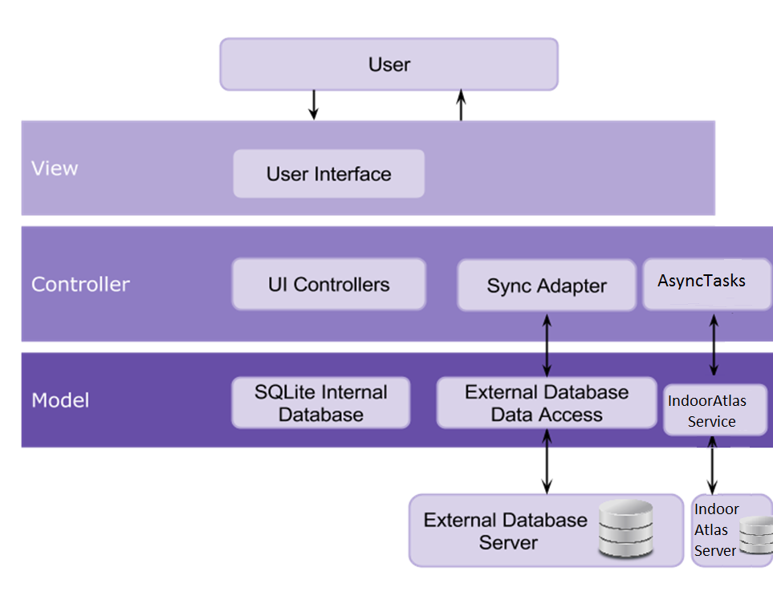
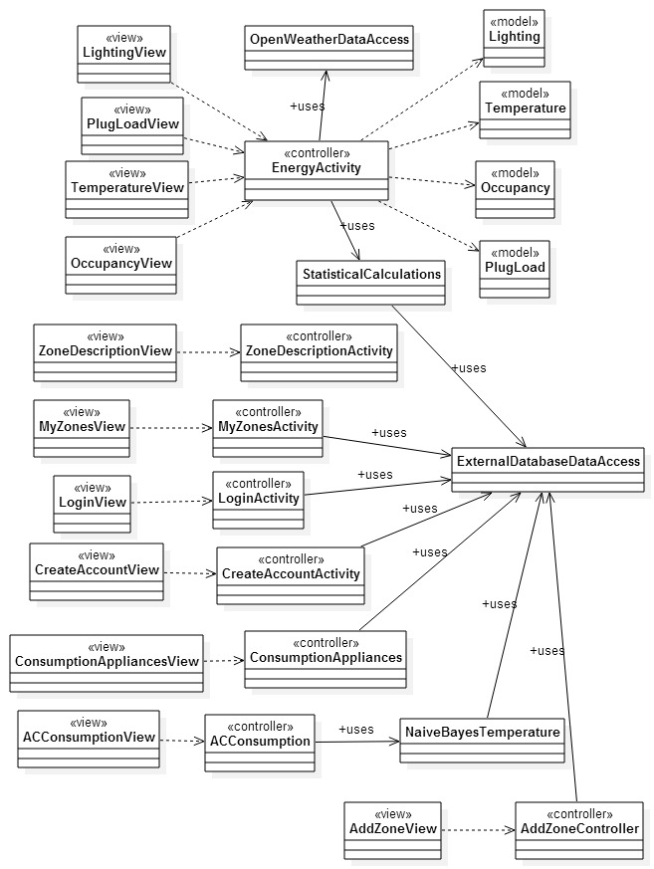
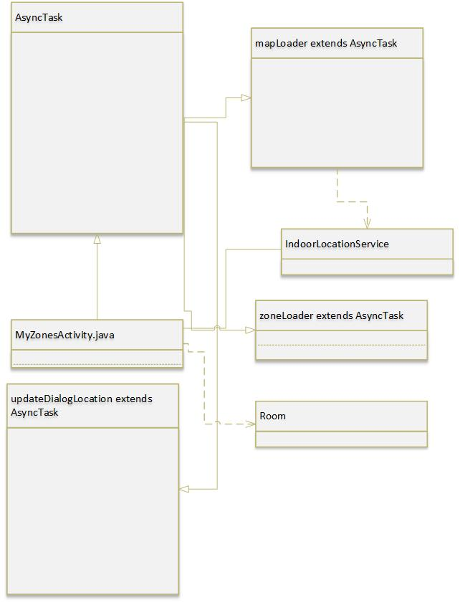
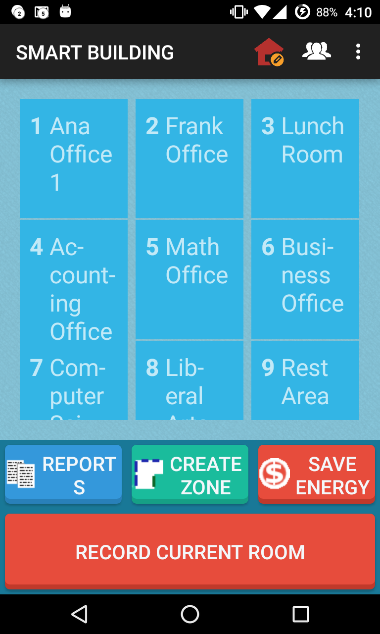
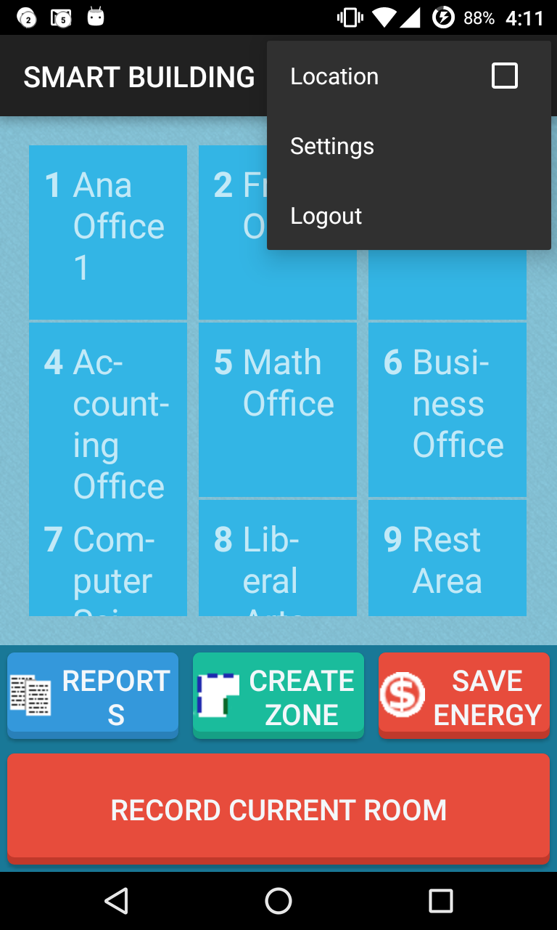
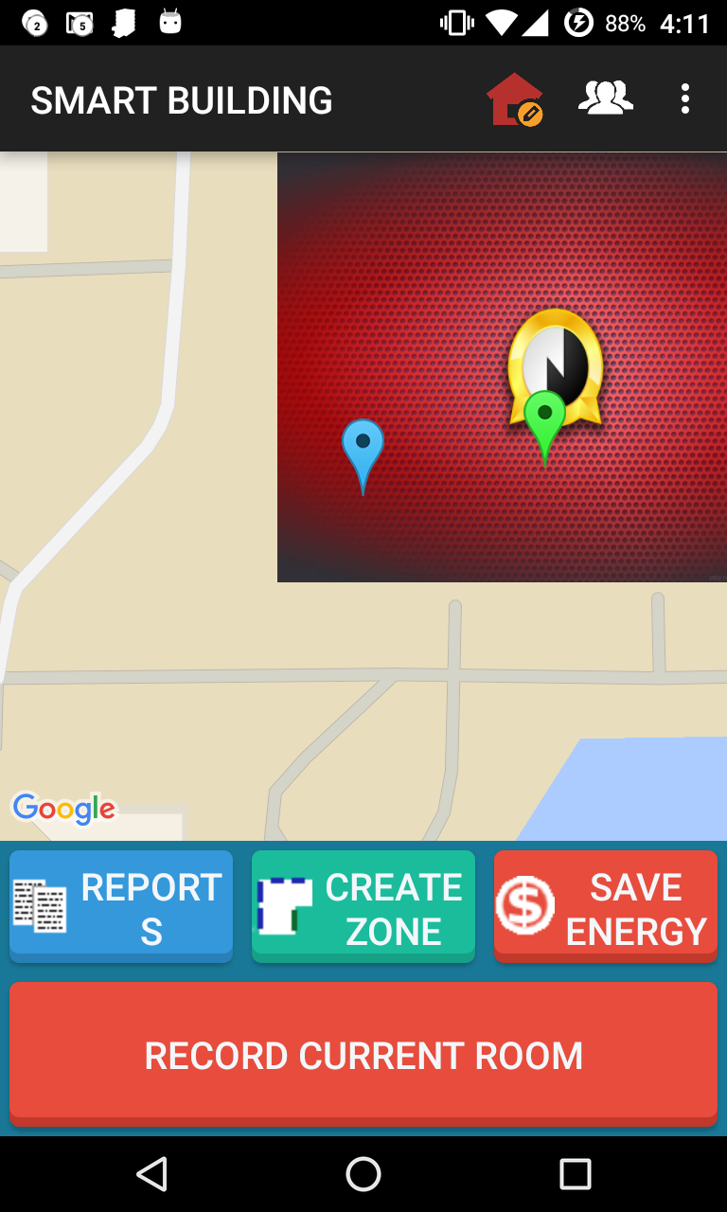
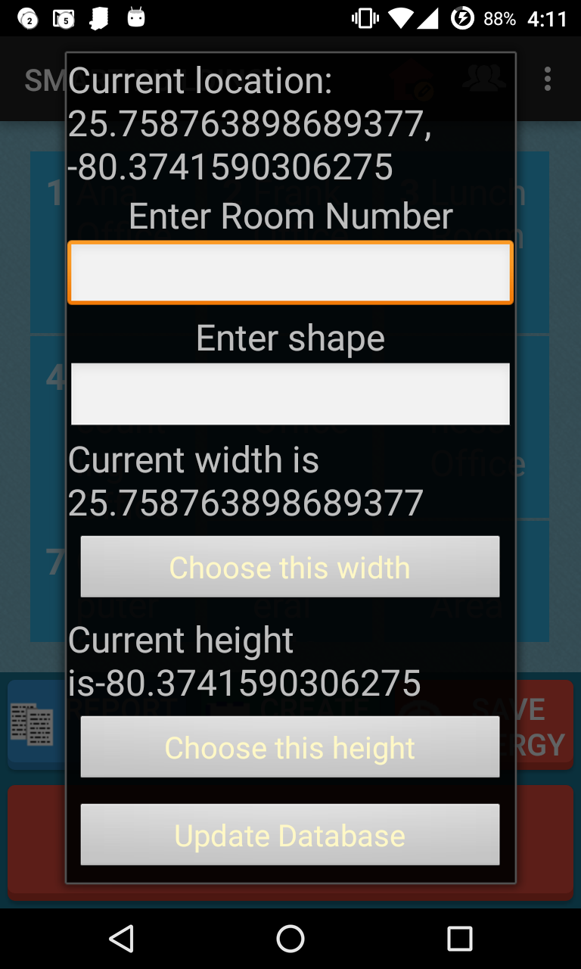
School of Computing & Information Sciences
Senior Project, 2015, Fall
Smart Systems for Occupancy and Building Energy Control
Student: Eduardo Castillo, Florida International University
Mentor: Leonardo Bobadilla and Ali Mostafavi, Florida International University
Instructor: Masoud Sadjadi, Florida International University
Problem
Current System
Requirements
Current system uses and Arduino board hooked up with infrared sensor to count number of people entering a zone and determine if a room is occupied or not. The problem with this implementation is the cost associated with adding the extra infrared sensor to every room just to determine if a room is occupied or not. This also doesn’t leave room to personalize the power consumption settings such as light level or temperature for each individual user that enters a room.
SSOBEC is a system comprised of a mobile android application with backend services and a web API to allow users to update a building’s lighting system, room energy usage, and other users. The first release of the system included basic functionality that allows users to connect to the service and view energy efficiency information, as well as statistics. The second release allowed for different user roles and functionality to add and remove users as well as follow and unfollow zones along with a primitive social gaming aspect by allowing users to accumulate points by conserving power. The current release adds some new optimizations for conserving battery life, more sophisticated zones and indoor localization without the use of GPS or wi-fi triangulation, instead using indoor magnetic field fingerprinting as method of tracking a user’s location indoors. The current system also transforms indoor coordinates into real world geo coordinates that are used with google maps integration to show current location indoors. Using a simple geo-fencing technique, recorded rooms will show up as rectangle that will change from red (unoccupied) to green (occupied).
The system shall…
Allow admin users to see other users location currently logged into the system.
Allow admin users to record room coordinates for use with the system.
Allow the user to opt in or out of tracking current indoor location.
Allow the user to visually see when they have entered a zone.
Allow the user to automatically switch from low power GPS to indoor localization using magnetic fields just by coming near the building.
Allow the user to rate how comfortable their current light and temperature is in current zone.
Allow the user to hide or show current location inside the building on the app GUI.
System Design
For the architectural pattern of our system, we implemented a model-view-controller and a client-server model.
Object Design
Implementation
SSOBEC is an Android application written natively in Java 8 and the Android 5.0 SDK API Level 23 (Marshmallow Version) with backwards compatibility to Android Version 4.1 API Level 16 (Jelly Bean).
The backend service of the application is hosted on Linux, Apache, MySQL, and PHP (LAMP) server with an API written in PHP 5 that allows the application to query and update a MySQL database.
The indoor localization is a cloud based solution using IndoorAtlas android SDK to use the magnetometer found inside most smartphones to fingerprint, read and report current magnetic field reading to IndoorAtlas server to calculate user’s current location inside building.
Verification
The system verification was divided in three parts:
Unit Testing: As the application was being developed, Espresso was used for UI automated testing.
Integration Testing: Done to validate the individual functionalities of the system.
System Testing: Analyze the behavior of all features working together while playing the role of the user or admin user.
Admin Zones Menu
Screenshots
Summary
Location Opt checkbox
The objective was to find a software solution to tracking individual users inside a building to show which rooms in the building were occupied or not. This latest release achieves this goal by using IndoorAtlas cloud service to calculate user location inside a building using magnetic field and accelerometer readings from a smartphone to calculate current location using real geo coordinates. Smart Systems for Occupancy and Building Energy Control (SSOBEC) has been augmented this release with the addition of indoor localization using google maps as the GUI. Using these technologies, the system can eventually be augmented further to provide real world heat maps of energy usage and personalized room settings (such as temperature and light level). Other highlights in this release include a new “record room” button for admin users to register a pre-fingerprinted room as a zone in the system and various performance improvments.
Indoor Localization UI (place holder floorplan image)
Record current Room dialog
Acknowledgement
The material presented in this poster is based upon the requirements specified by my mentors Leonardo Bobadilla, Ali Mostafavi and Perraya Inyim. Special thanks to my professors Masoud Sadjadi for all the feedback and support given throughout the semester.

