Slide 1


Introduction
Smart Systems for Occupancy and Building Energy Control
SSOBEC Version 2
Team: Diana Leante Boné, Irvin Steve Cardenas Mentor: Ali Mostafavi, Leonardo Bobadilla
Notes:
Hello guys,
This is an introductory video for the Summer 2015
Smart Systems for Occupancy and Building Energy Control project.
The team was composed of Diana Leante Boné, and myself Irvin Steve Cardenas.
The project itself based upon the ongoing research being conducted by Dr. Ali Mostafavi and Dr. Leonardo Bobadilla.
Both who served as our mentors.

Slide 2
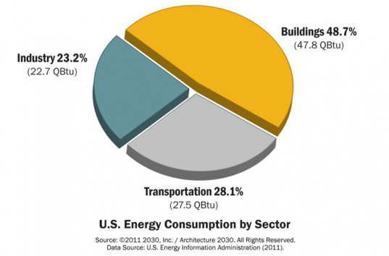
Problem Definition
Smart buildings, have a broader mission that involves providing energy efficiency (minimizing energy costs) and reducing environmental impact.
Users are key players
Positive or negative impact on the efficiency of a building.
Make users energy literate

Slide 3
Requirements – User Stories
Allow Facility Manager to add Users to existing Zone
Allow Facility Manager to create a Zone
Allow Facility Manager to remove Users from existing Zone
Create Facility Manager View
Create general user view
Allow User to unfollow a zone
View Wasteful Regions
View Account Reward Points
Allow Facility Manager to edit Zone

Slide 4
Requirements – User Stories
Allow User to add appliances to Zone
Turn off Light in Wasteful Region and earn points
Turn off Appliance in Wasteful Region and earn points
Generate User statistics reports
Generate Zone statistics reports
Allow users to earn points by sending notifications
Notify users of wasteful regions
Provide user rankings
Provide personalized feedback suggestions for users
Create User Manual
Refine Final Document

Slide 5
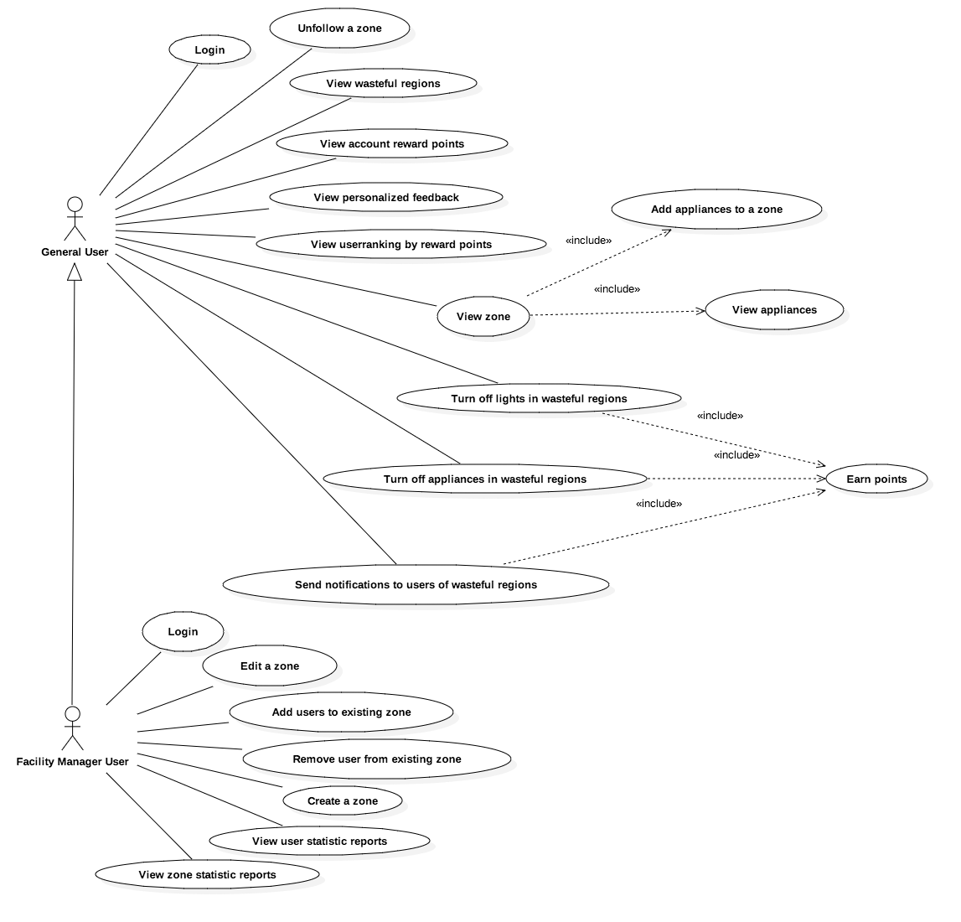
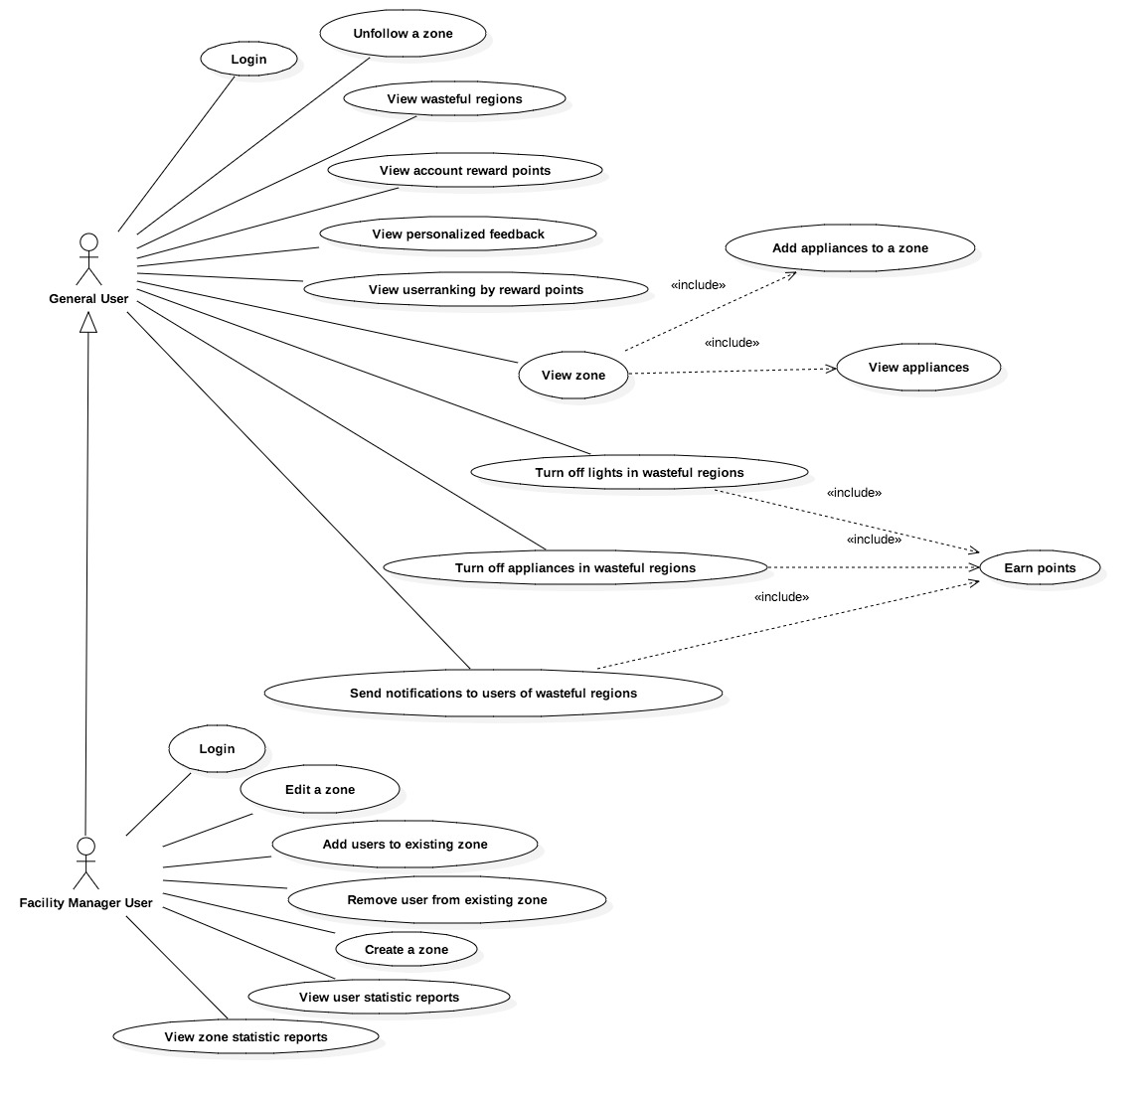
Use Cases

Slide 6
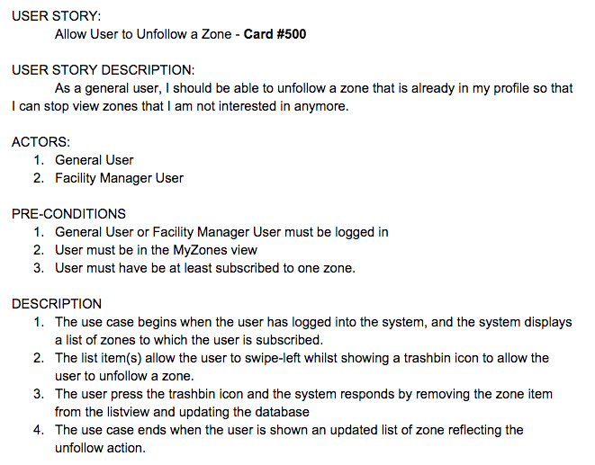
Use Cases

Slide 7
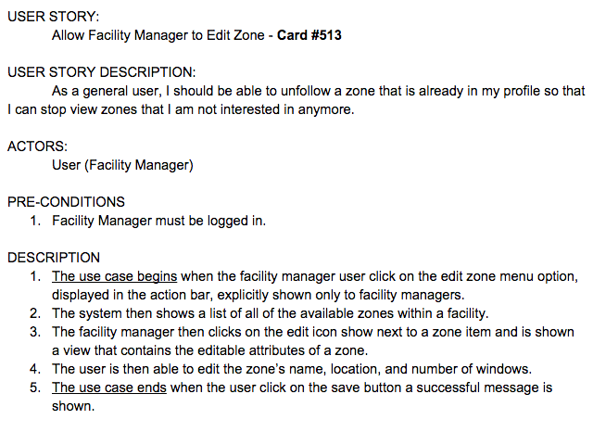
Use Cases

Slide 8
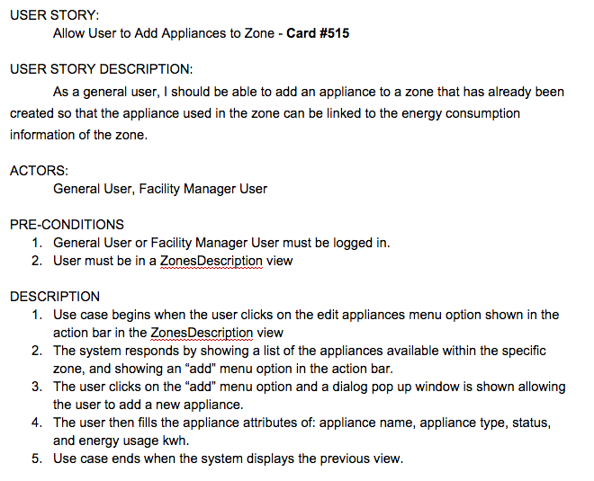
Use Cases

Slide 9
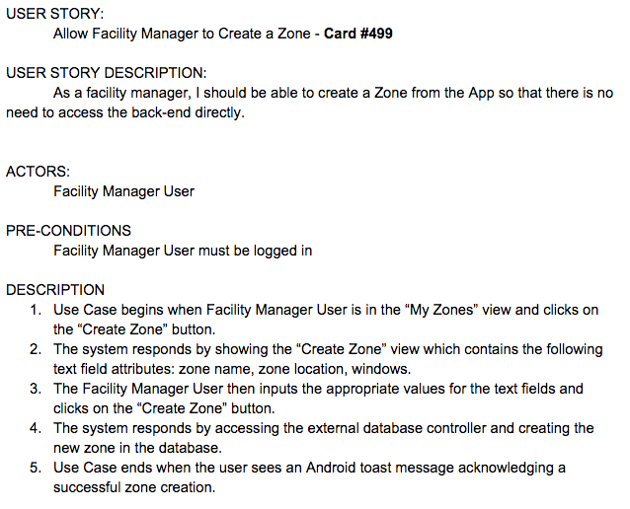
Use Cases

Slide 10
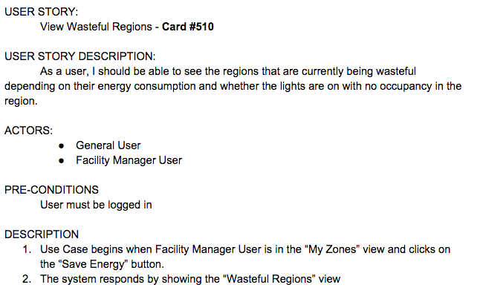
Use Cases

Slide 11
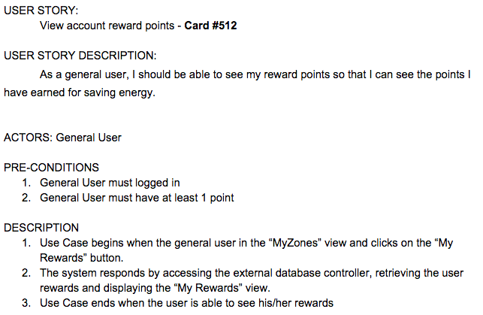
Use Cases

Slide 12
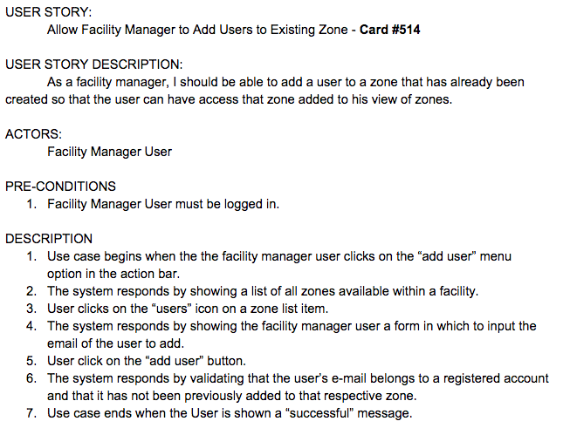
Use Cases

Slide 13
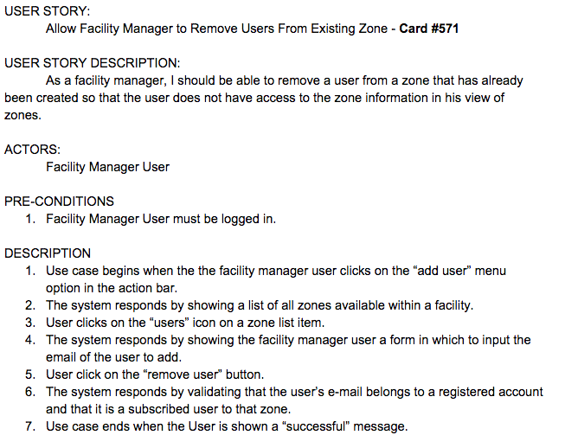
Use Cases

Slide 14
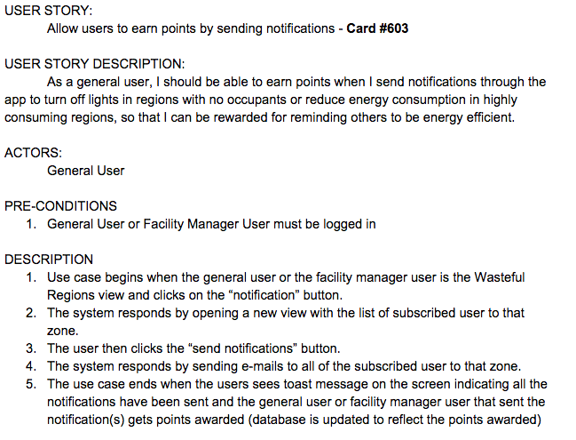
Use Cases

Slide 15
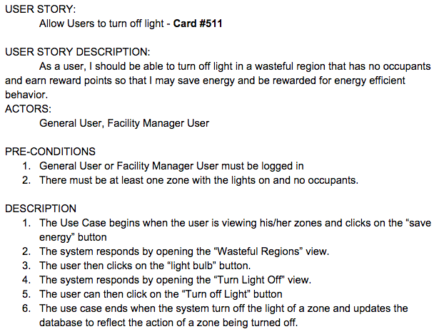
Use Cases

Slide 16
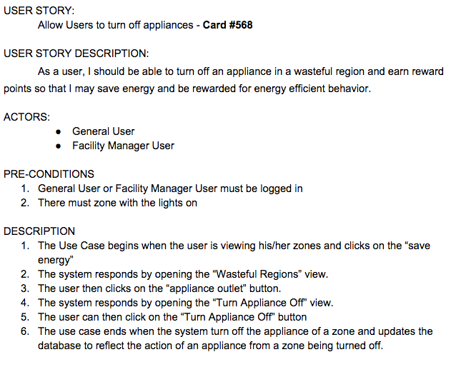
Use Cases

Slide 17
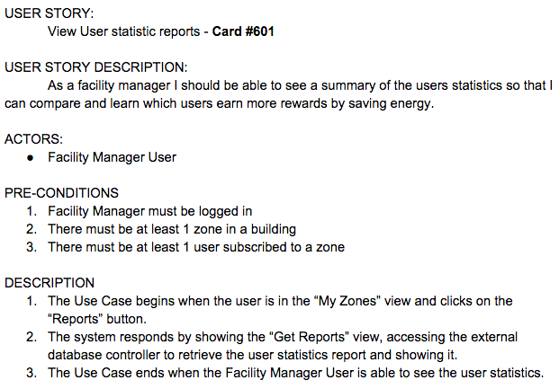
Use Cases

Slide 18
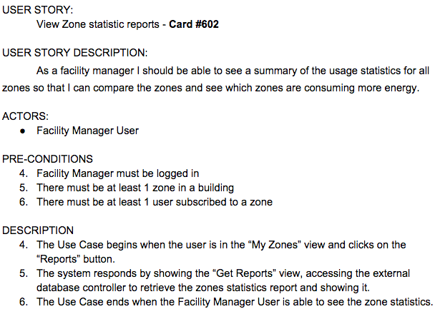
Use Cases

Slide 19
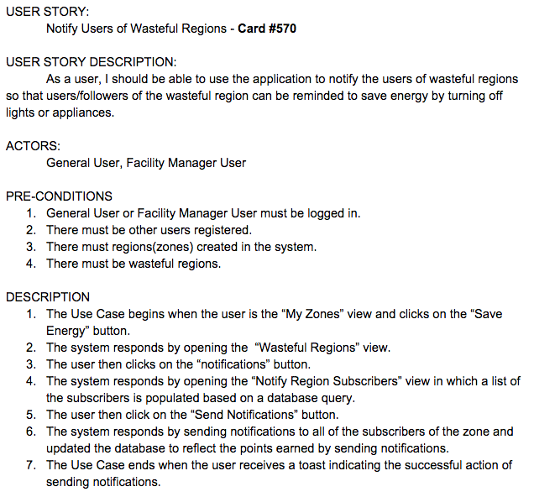
Use Cases

Slide 20
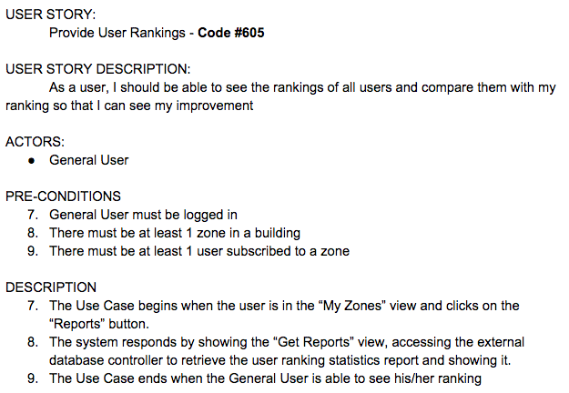
Use Cases

Slide 21
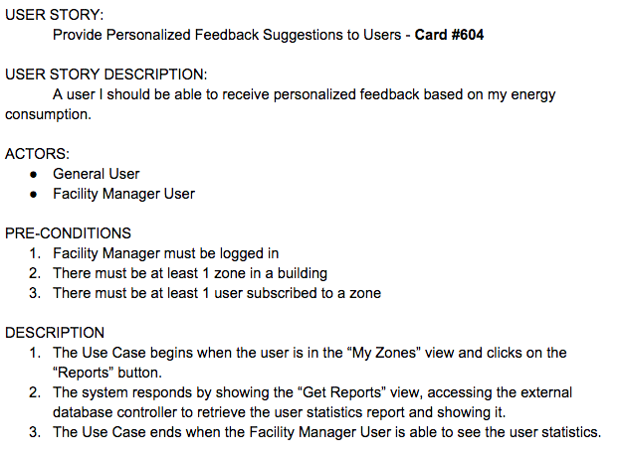
Use Cases

Slide 22
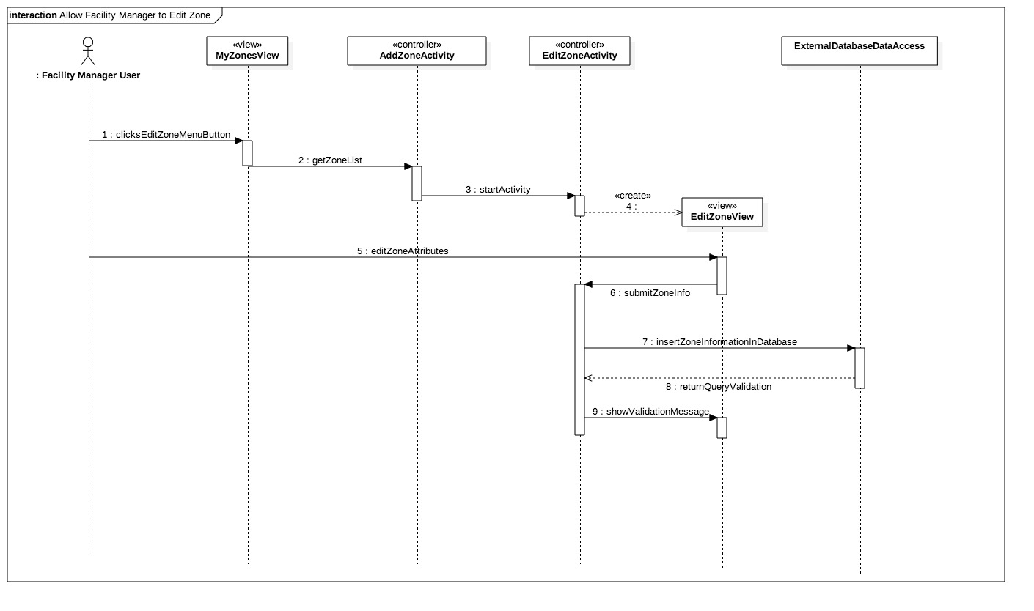
Sequence Diagrams

Slide 23
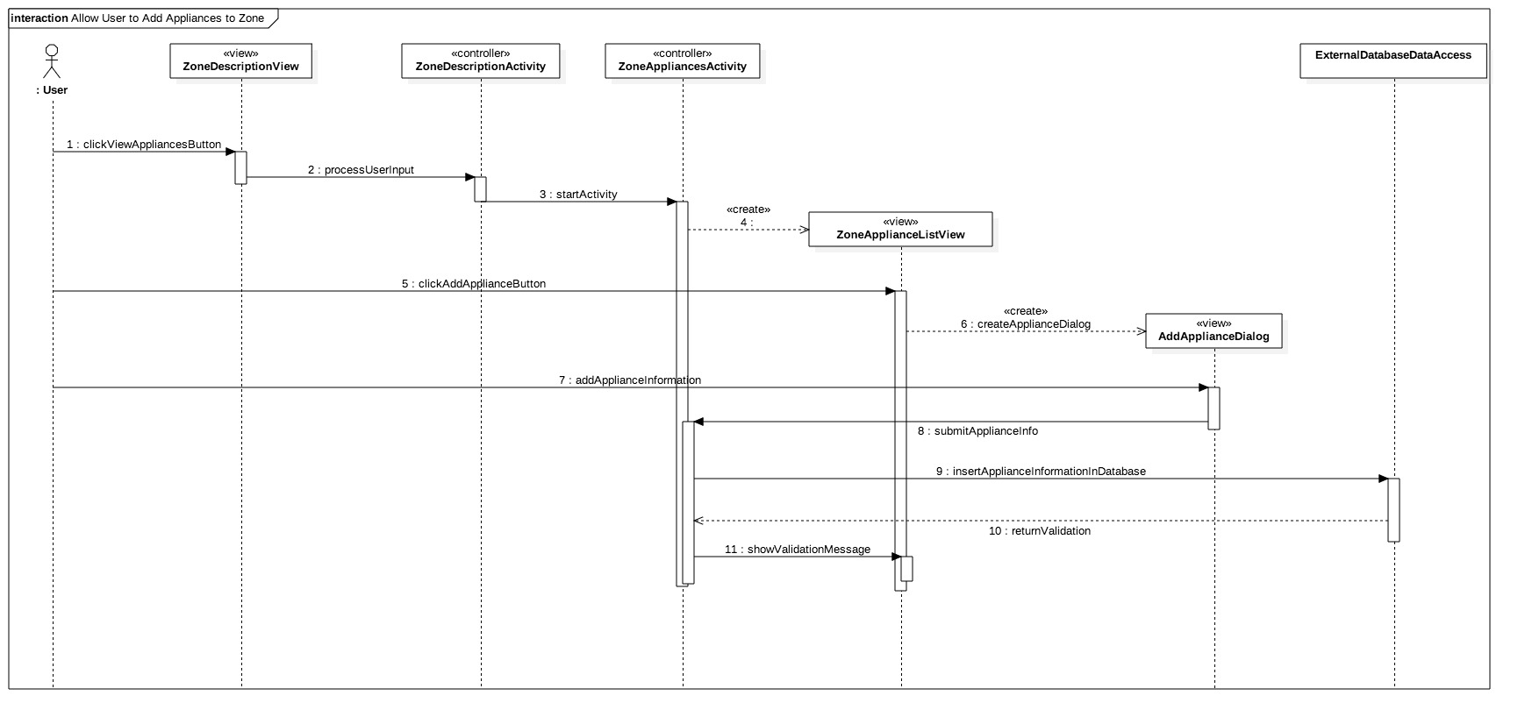
Sequence Diagrams

Slide 24
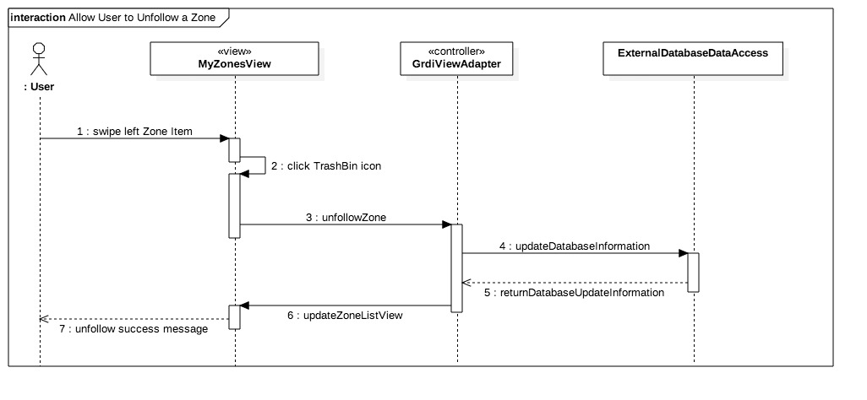
Sequence Diagrams

Slide 25
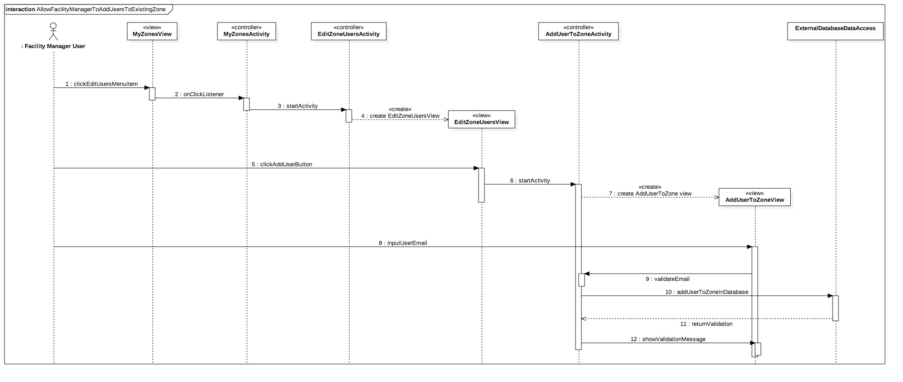
Sequence Diagrams

Slide 26
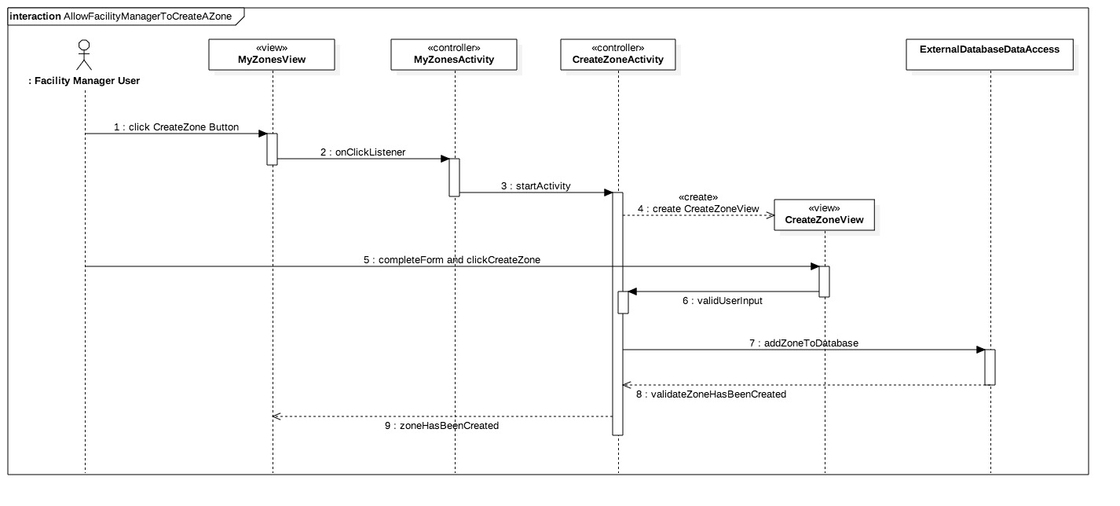
Sequence Diagrams

Slide 27
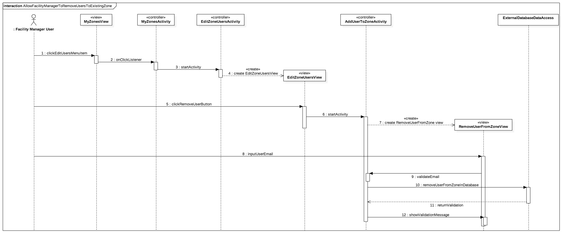
Sequence Diagrams

Slide 28
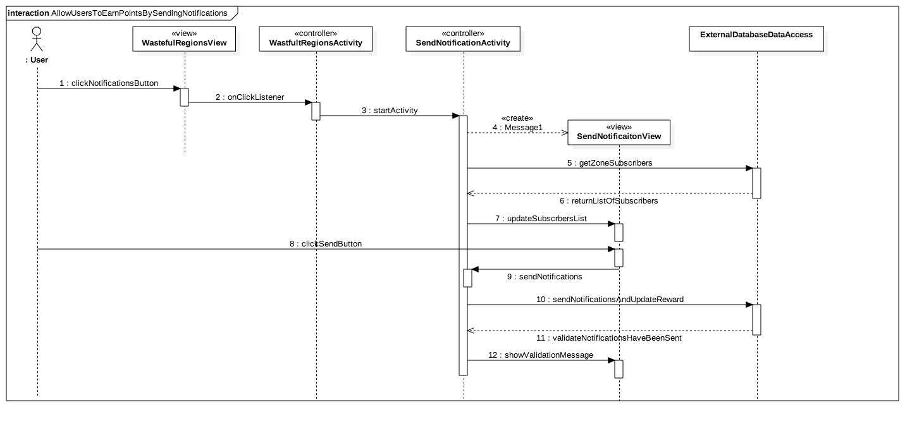
Sequence Diagrams

Slide 29
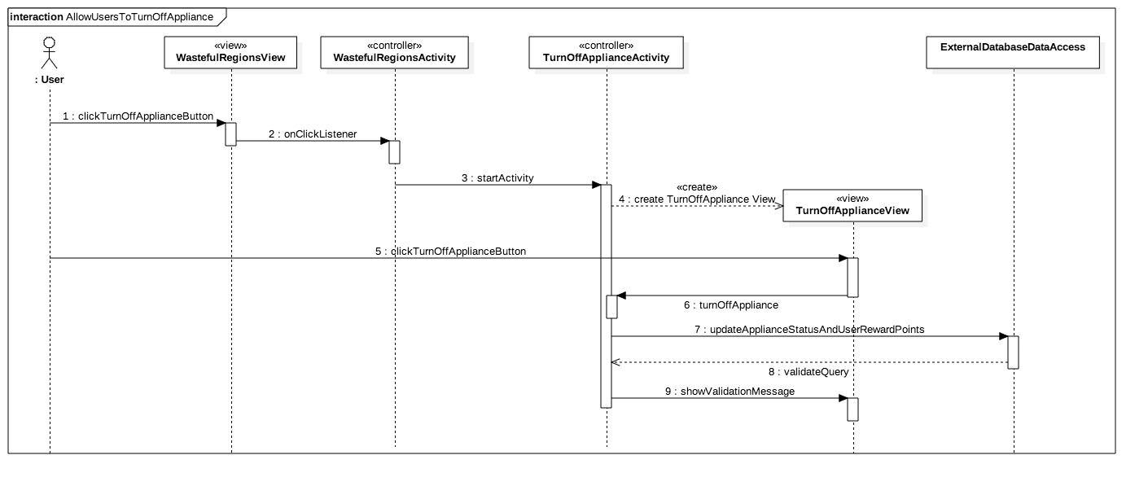
Sequence Diagrams

Slide 30
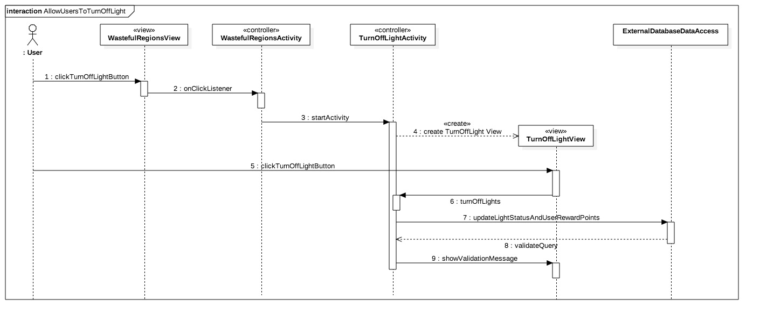
Sequence Diagrams

Slide 31
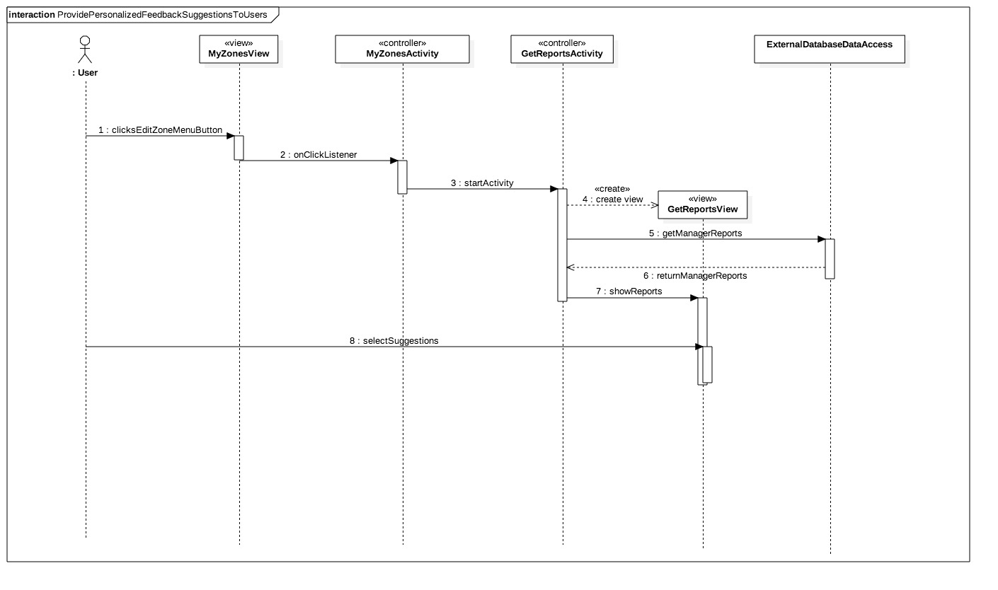
Sequence Diagrams

Slide 32
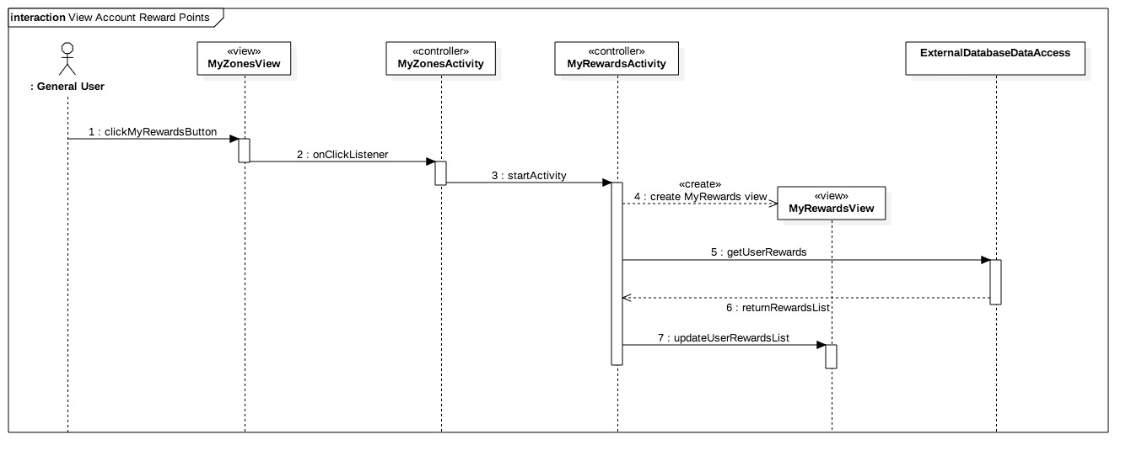
Sequence Diagrams

Slide 33
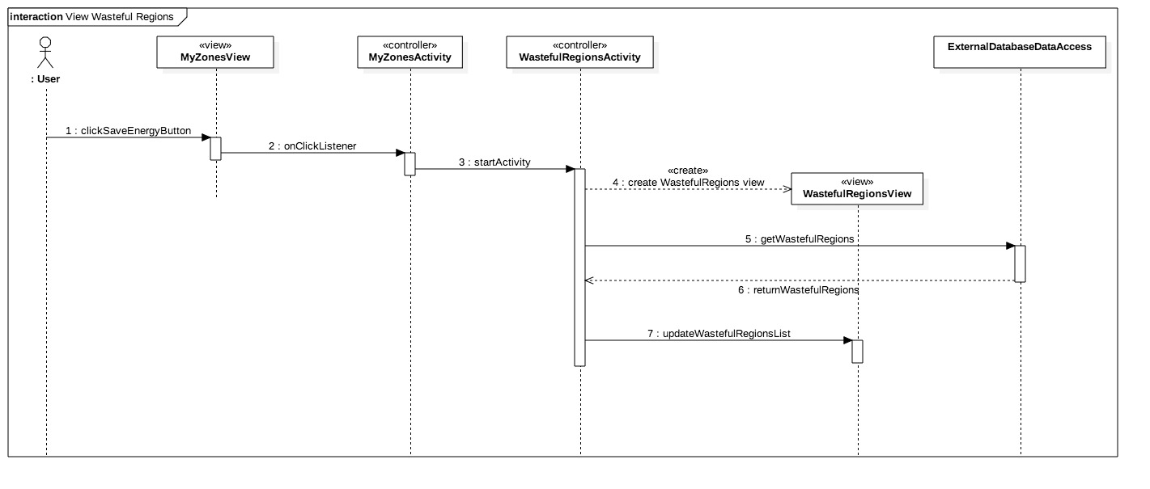
Sequence Diagrams

Slide 34
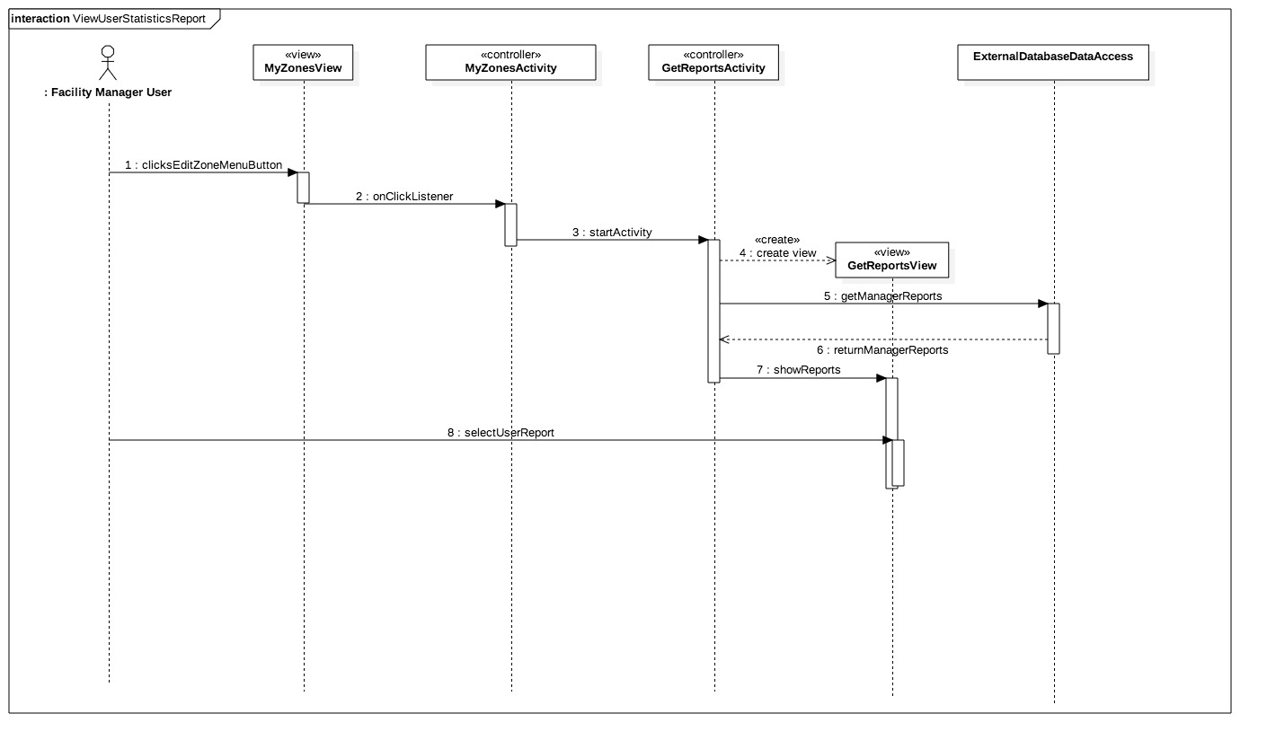
Sequence Diagrams

Slide 35

Sequence Diagrams

Slide 36
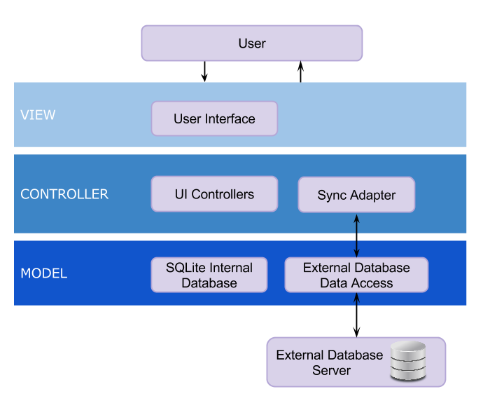
System Design - System Decomposition

Slide 37
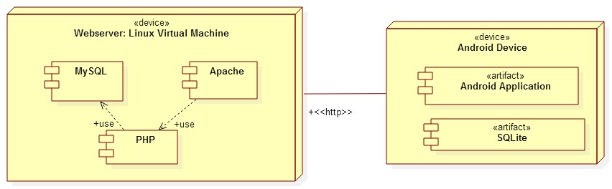
System Design - System Deployment

Slide 38
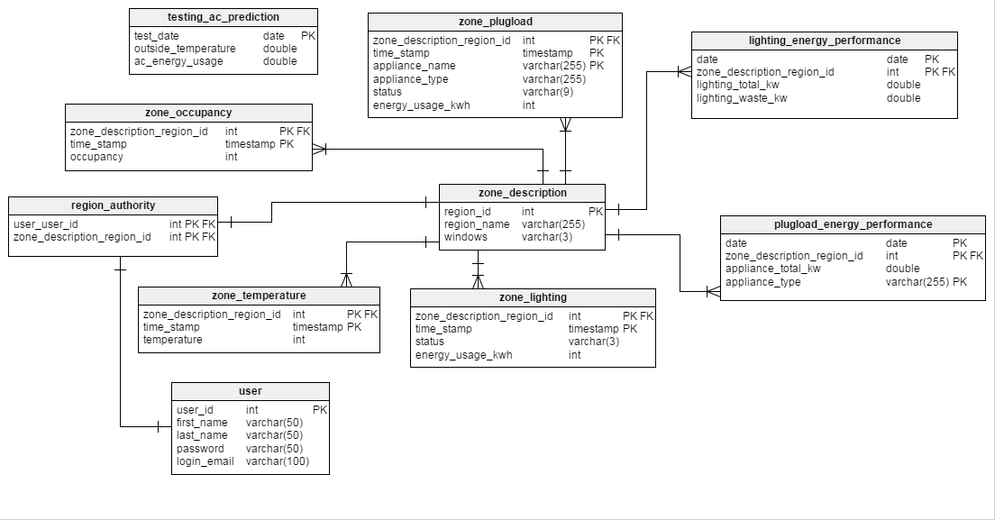
System Design - Persistent Data Design

Slide 39
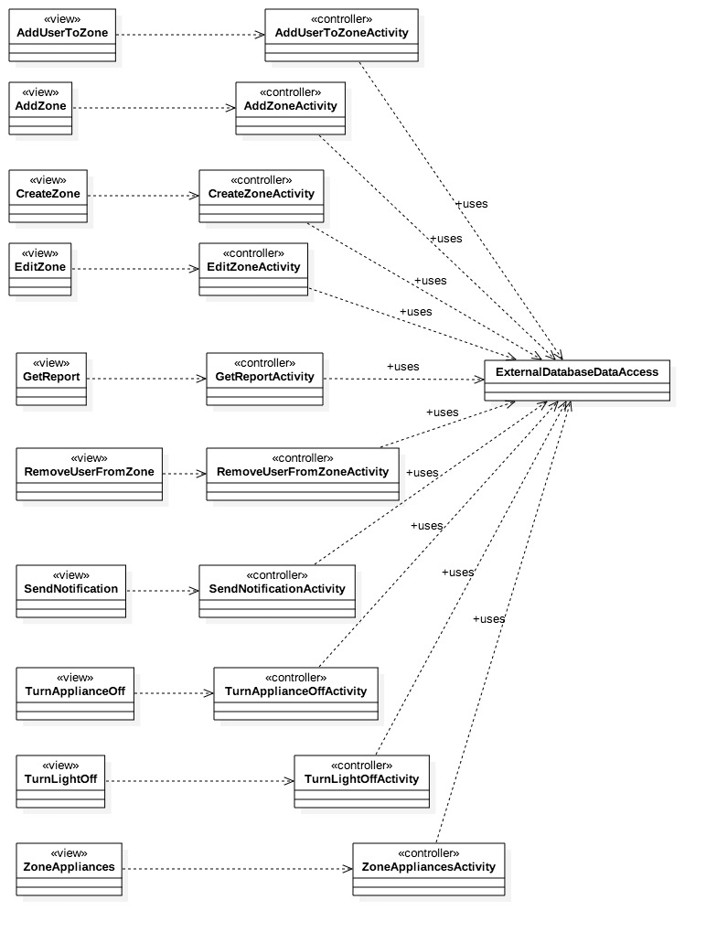
Minimal Class Diagram

Slide 40
State Machine
Stopped
Destroyed
onStop()
Paused
onResume()
onResume()
onPause()
Activity
Running
onCreate()
onResume()

Slide 41
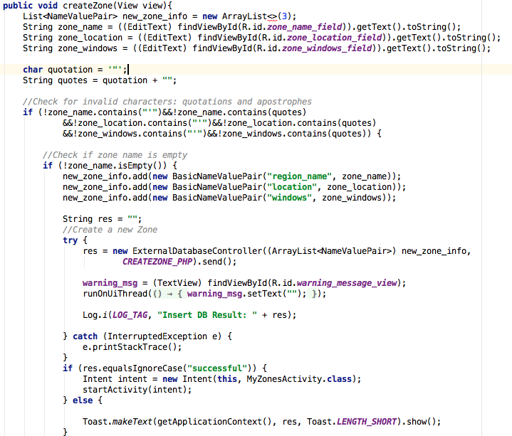
Algorithm for “Allow Facility Manager to Create a Zone”
Verify user is a Facility Manager
Validate zone attributes inserted by user
If zone attributes are invalid or empty reject attempt to create a zone
Else if zone attributes are valid attempt to insert into external database
Inform user if the database insertion was successful or not

Slide 42
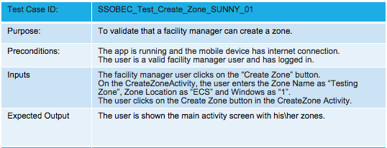
Validate That Facility Manager Can Create a Zone

Slide 43
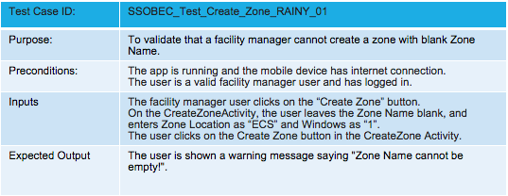
Validate That Facility Manager Can Create a Zone

Slide 44
Demo

