Slide 1










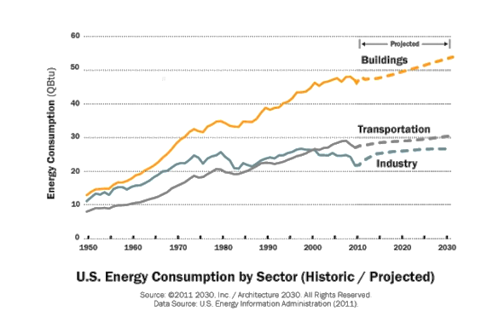
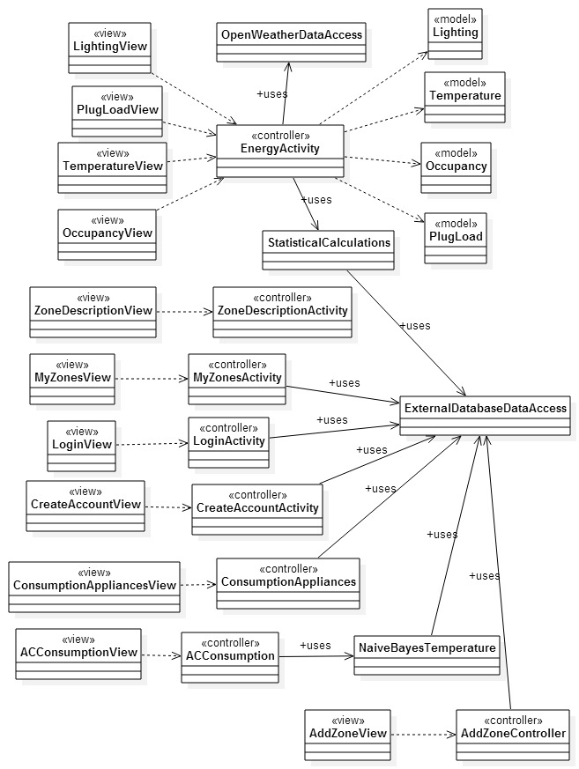
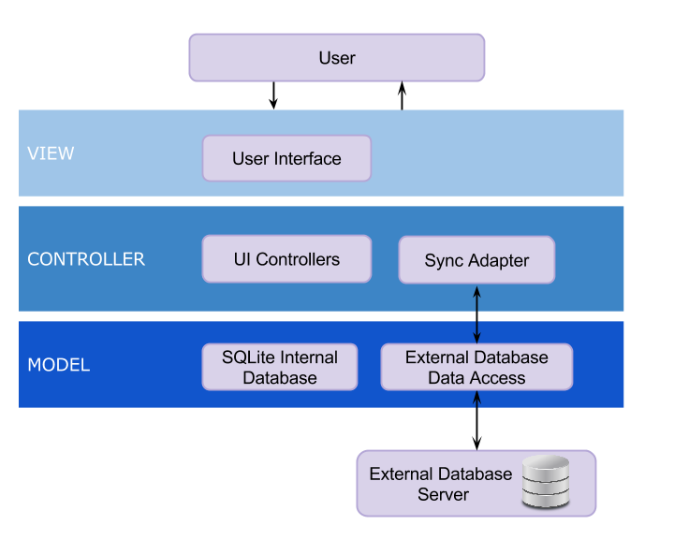
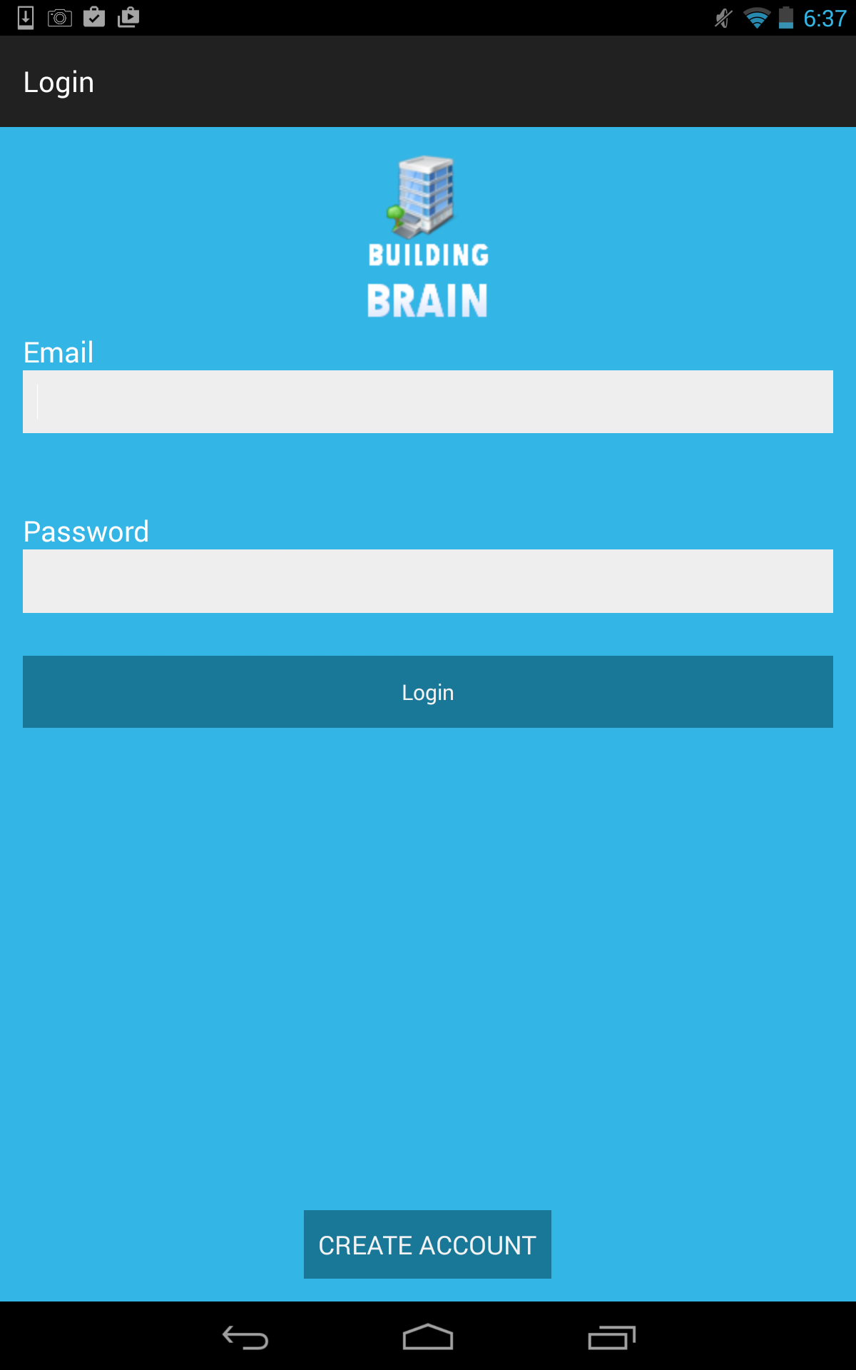
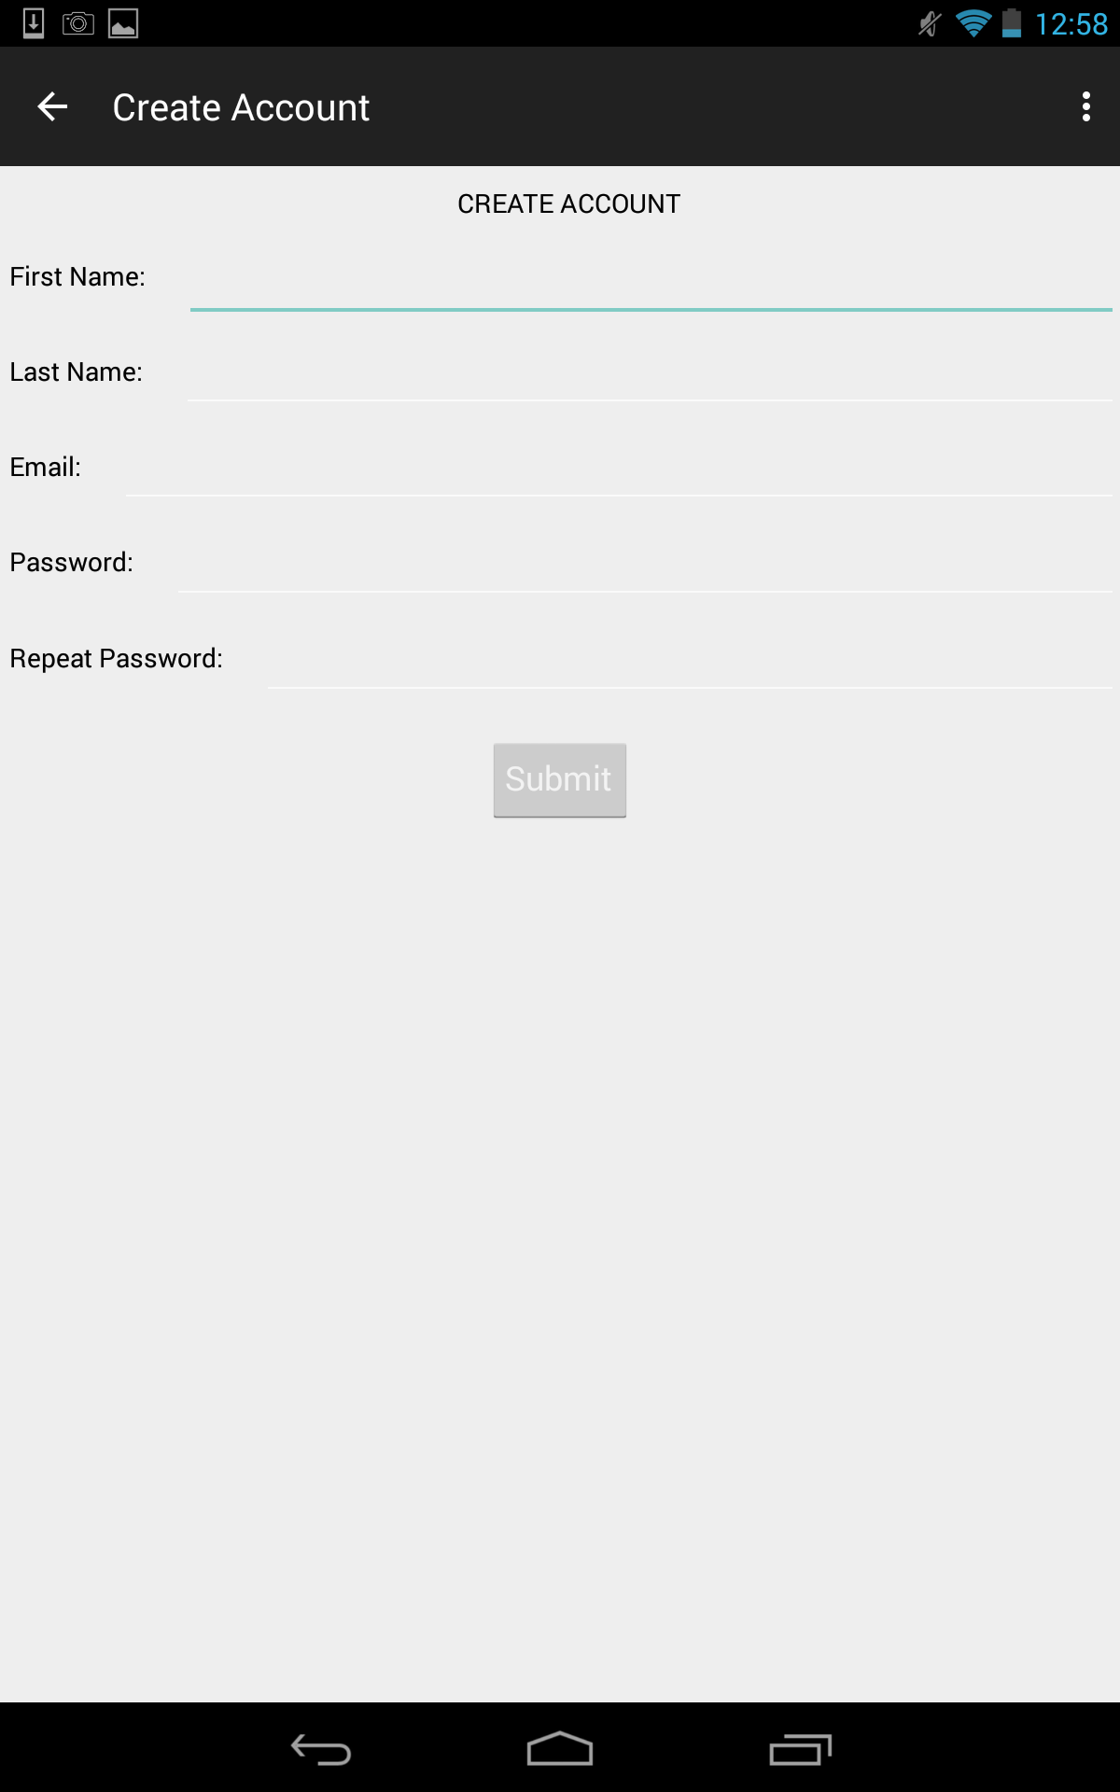
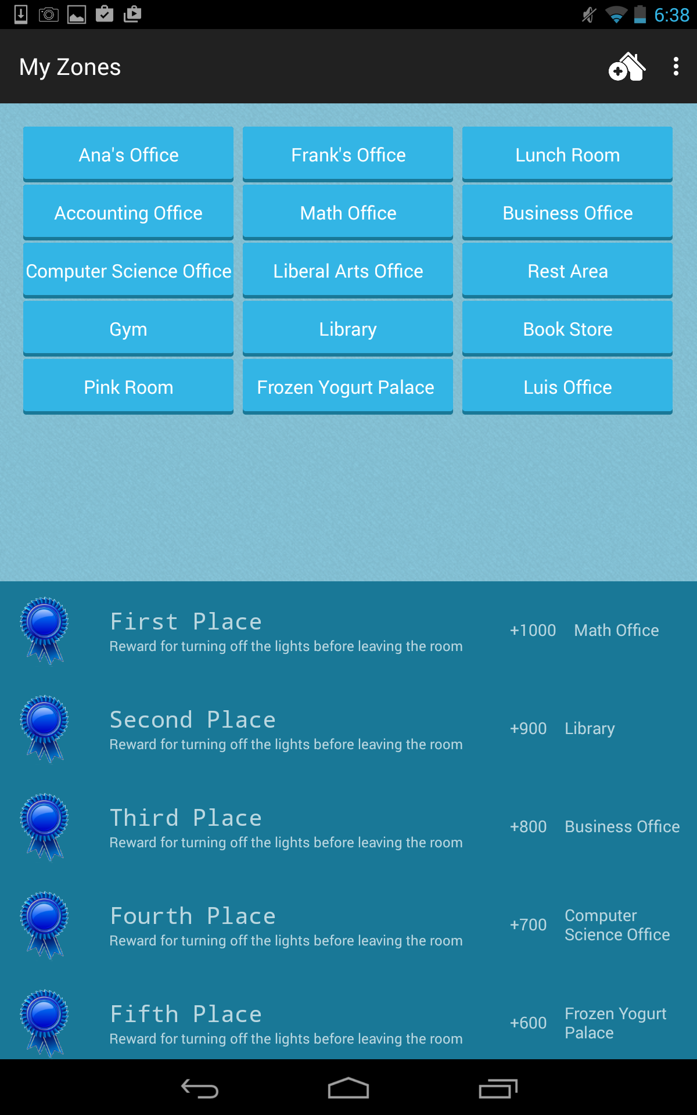
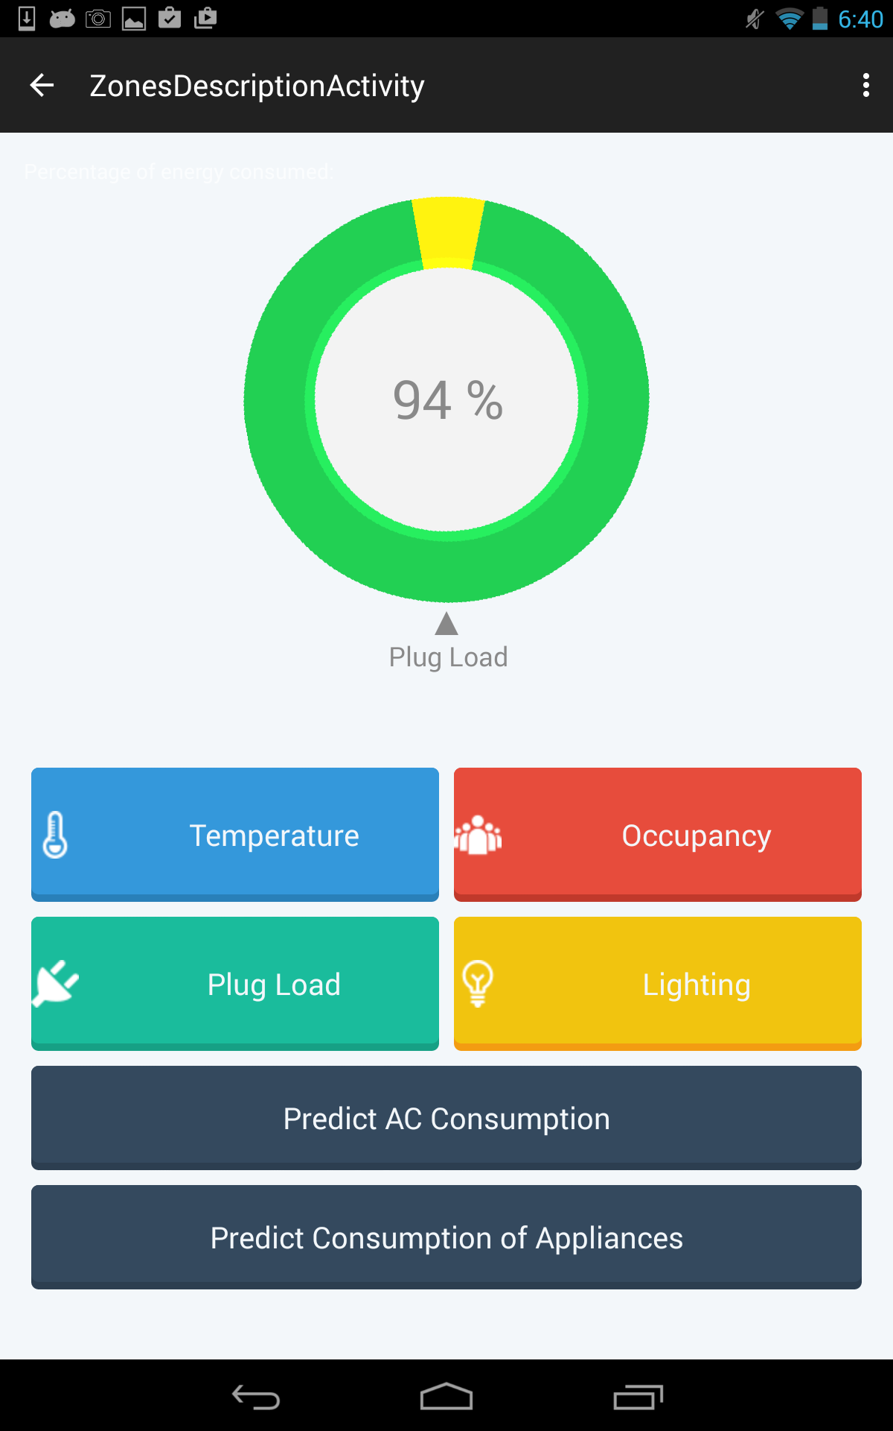
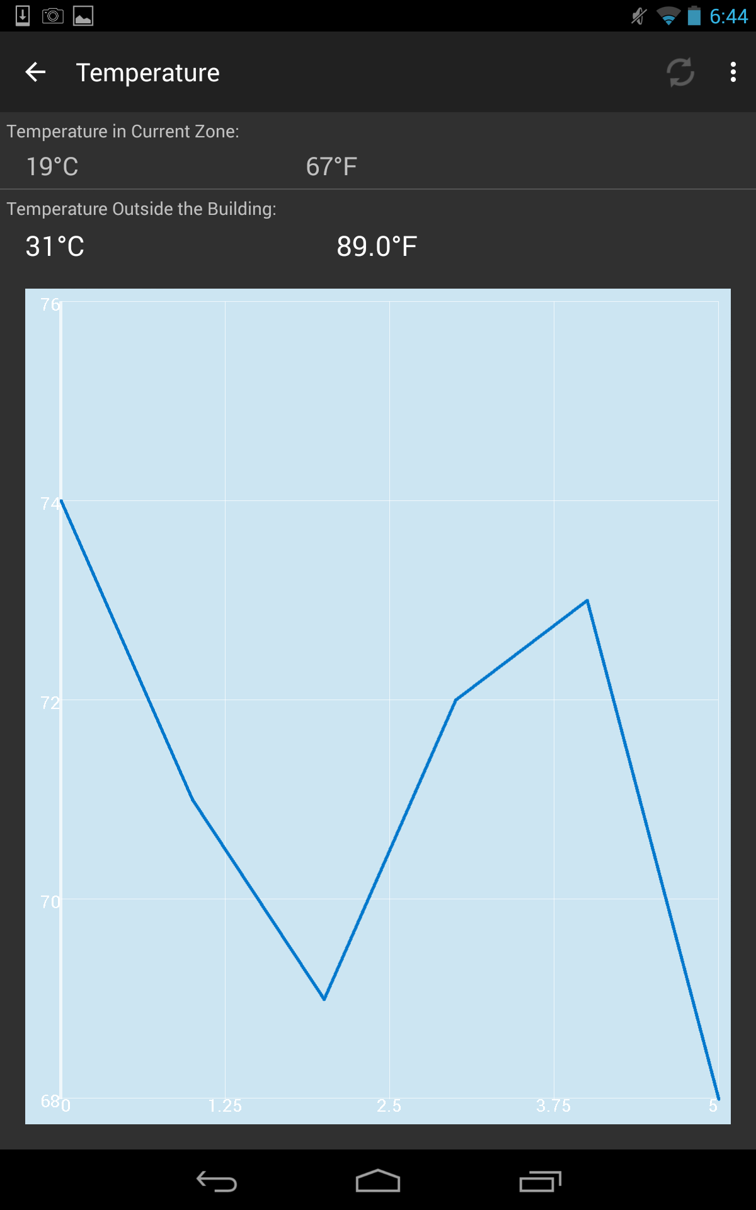
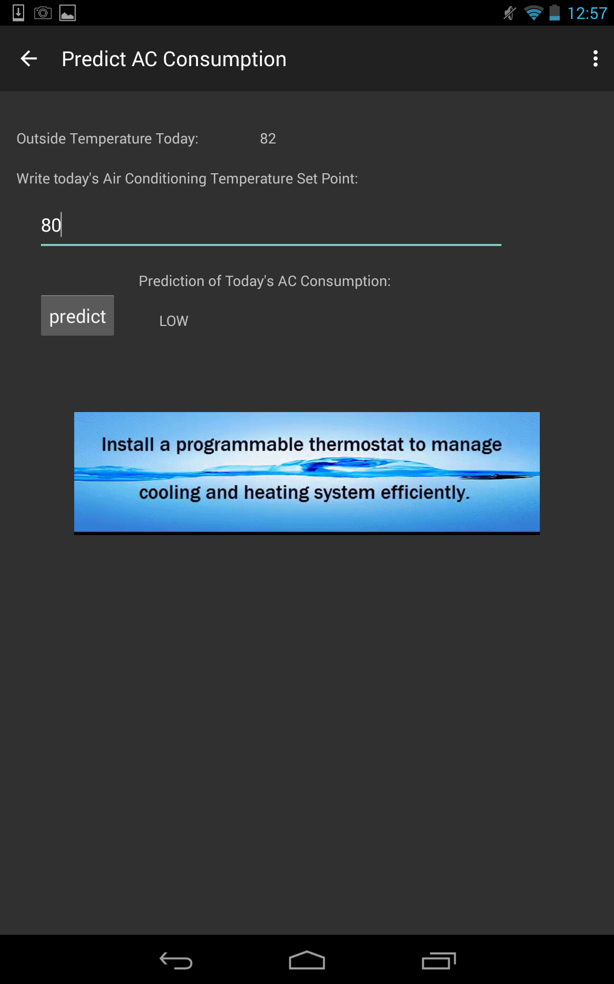
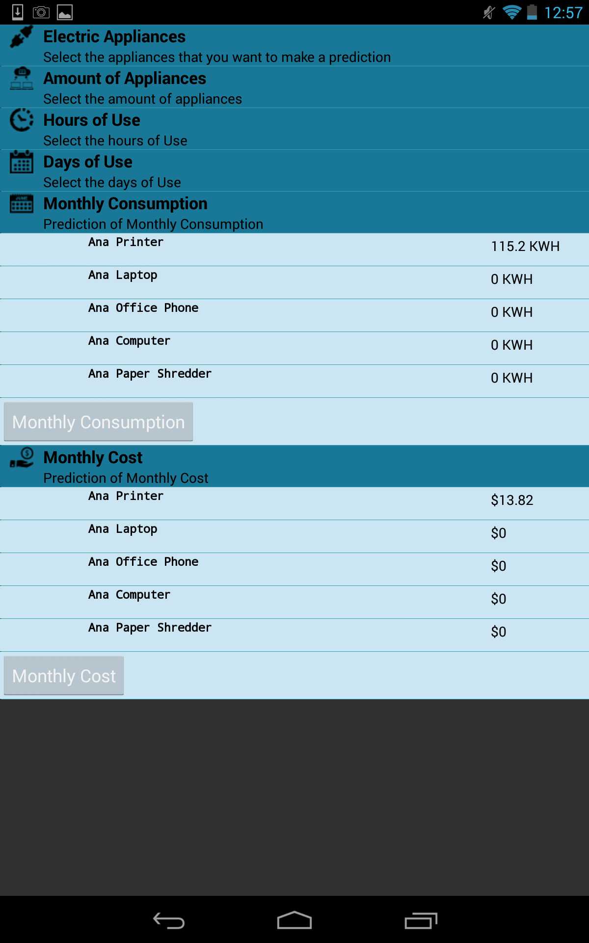
School of Computing & Information Sciences
Senior Project, 2015, Spring
Smart Systems for Occupancy and Building Energy Control
Student: Dalaidis Hidalgo Arencibia, Florida International University
Mentor: Ali Mostafavi and Leonardo Bobadilla, Florida International University
Instructor: Masoud Sadjadi, Florida International University
Buildings are the number one energy consumers in the United States and it is estimated that consumption will continue increasing in future years. Everyone knows that saving energy is a good thing, but most people will only be motivated to curtail their energy consumption when you can demonstrate just how much energy they are wasting, and how much potential there is for them to improve.
Currently there are no other applications that teach people how to save energy by modifying their behaviors. We proposed a system which can provide information on occupancy behaviors and can give users information about energy performance in a building. Occupant behaviors have been identified as a major cause of uncertainty in evaluation of energy performance in buildings. The ability to save energy is considered the top priority associated with this project.
The system shall…
Allow legitimate user login.
Allow user to logout from the application.
Allow user to create a account.
Allow user to view temperature inside the building.
Allow user to view temperature outside the building.
Allow user to view plug load.
Allow users to predict a zone more likely to waste energy.
Allow users to predict how energy saving literacy saves energy.
Allow users to view reward from people that save energy.
Allow users to view educational tips.
Problem
Current System
Requirements
Object Design
Android Studio was development IDE used for implementing the SSOBEC system. The User Interface was done using XML while the controller was done using Java. SQlite was also used for data storage in the mobile device.
Through HTTP the system accesses an External MySQL database which serves with the necessary data about the energy performance of the building.
System Design
Implementation
The goal of our project is to teach people how to save energy because simple changes in occupants behaviors can quickly lead to significant energy savings. This application provides information on occupancy behavior and energy consumption in buildings. This will include displaying the occupancy in different zones, artificial and natural lighting information, and temperature inside and outside the building, plug load information, predictions for air conditioning, predictions for consumption of some appliances and prediction for the monthly costs associated with energy expenditure. This application will display the information in real time so that it can help to teach people to use the electricity in an efficient way.
Summary
The Smart Systems for Occupancy and Building Energy Control verification was done using Unit Testing (Espresso for automating UI testing), Integration Testing and System Testing. The objective of our System Tests were to make sure that the system was behaving appropriately, as defined by the requirements provided by our clients.
Screenshots
Verification
Screenshots
Login View
Create Account
Reward Zone
Zone Description Option
Temperature View
Predict Consumption of Air Conditioning
Predict Consumption of Appliances
Acknowledgements
The material presented in this poster is based upon the ongoing research being conducted by Professors Ali Mostafavi and Leonardo Bobadilla. Special thanks to my family, my team partner Maria Eugenia Presa, our product owners Ali Mostafavi and Leonardo Bobadilla and our professors Masoud Sadjadi and Juan Caraballo for their support and advice.

