Slide 1










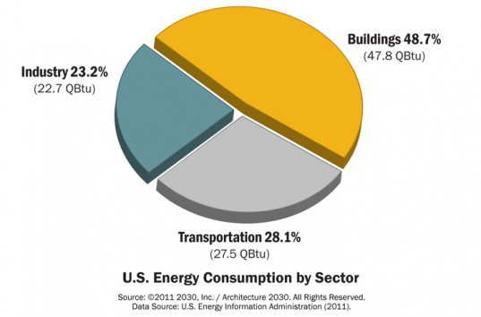
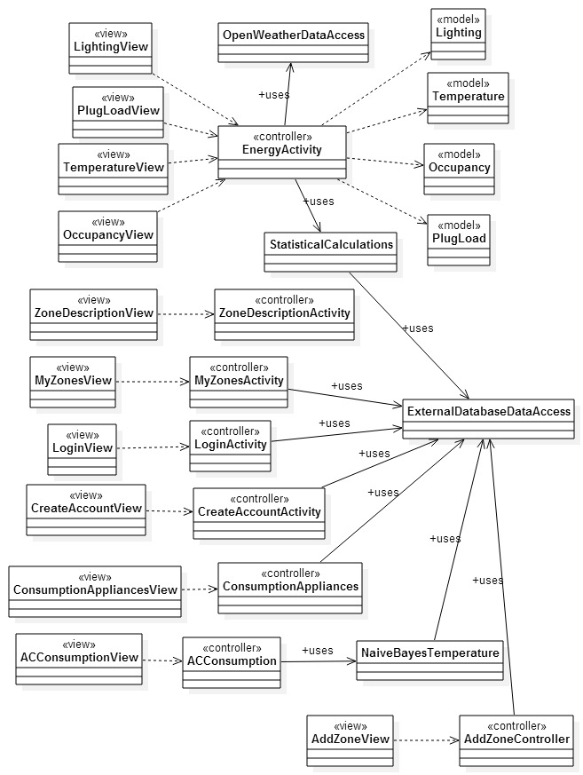
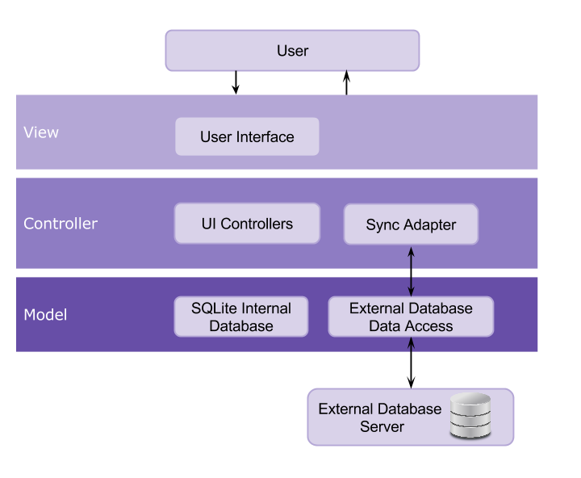
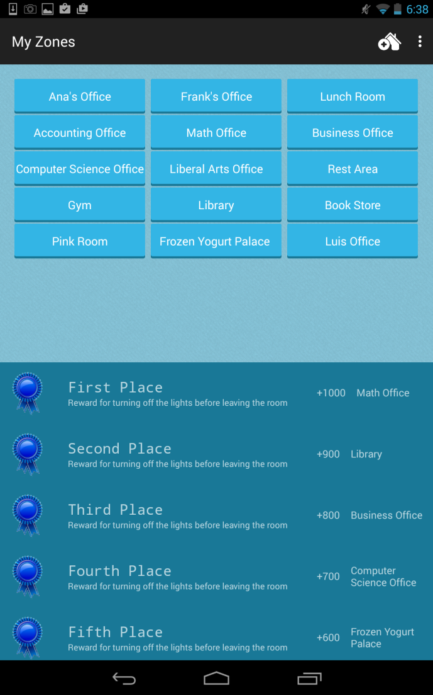
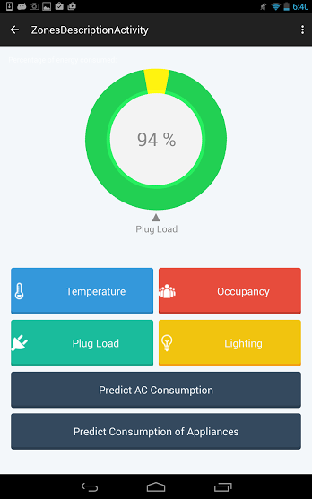
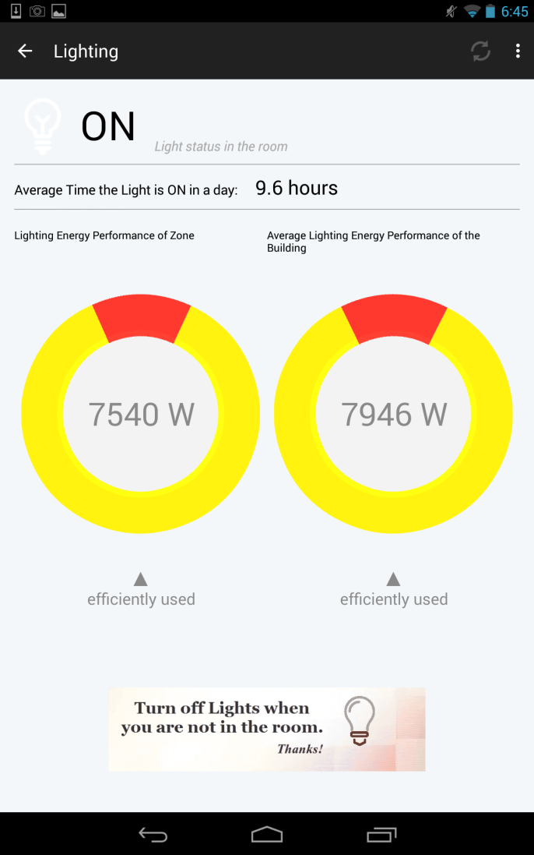
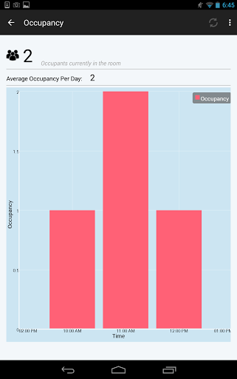
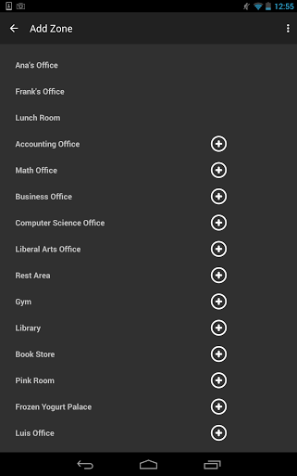
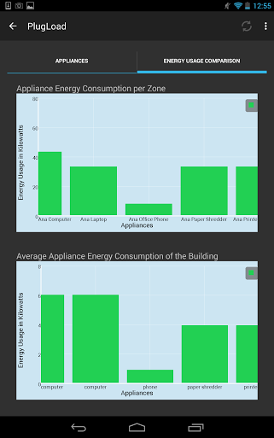
School of Computing & Information Sciences
Senior Project, 2015, Spring
Smart Systems for Occupancy and Building Energy Control
Student: Maria E. Presa Reyes, Florida International University
Mentor: Leonardo Bobadilla and Ali Mostafavi, Florida International University
Instructor: Masoud Sadjadi, Florida International University
Problem
Current System
Requirements
Buildings are the number one energy consumers in the United States. It has been estimated around 30% of the electricity consumed is being wasted through inefficient usage. Our goal is to be able to motivate people to save energy by demonstrating their energy performance and comparing the performance of one room with the rest of the building.
There is no current system that provides a smart approach to compare energy consumption of building with the occupancy behavior in different zones. Our goal is to provide a solution that can teach the user about energy consumption and motive him/her to save energy.
The system shall…
Allow the user to choose from different zones in a building.
Allow the user to have access to information on occupancy in different zones.
Allow the user to have access to information on lighting in different zones.
Allow the user to have access to information the statistics of temperature, lighting, occupancy and plug load of different zones.
Allow the user to add new zones he/she wants to have access to.
Allow the user to compare his/her room energy performance with the rest of the building.
Object Design
System Design
For the architectural pattern of our system, we implemented a model-view-controller and a client-server model.
Implementation
Android Studio was development IDE used for implementing the SSOBEC system. The User Interface was done using XML while the controller was done using Java. SQlite was also used for data storage in the mobile device.
Through HTTP the system accesses an External MySQL database which serves with the necessary data about the energy performance of the building. We used a Sync Adapter in order to transfer the data between the device and the server.
Screenshots
Zones List
Zone Description Options
Verification
Zone Lighting Information
Zone Occupancy Information
Summary
The system verification was divided in three parts:
Unit Testing – As we built the application we used the android testing tool Espresso for UI automated testing.
Integration Testing – Done to validate the individual functionalities of the system.
System Testing – Analyze the behavior of all features working together while playing the role of the user.
After several weeks of hard work, we have successfully implemented an application according to the requirements and specifications of the clients. The system will serve as a form of intervention that will educate and motivate users to save energy. An ideal future implementation of the system would be to feed the external database the data provided by the sensors in the building and to be able to synchronize the data with the application in real time.
Add Zone List
Zone Plug Load Information
Acknowledgement
The material presented in this poster is based upon the requirements specified by my mentors Leonardo Bobadilla and Ali Mostafavi. I am thankful to the help that I received from my partner in this project Dalaidis Hidalgo. Special thanks to my professors Masoud Sadjadi and Juan Caraballo for all the feedback and support given throughout the semester.

