Slide 1








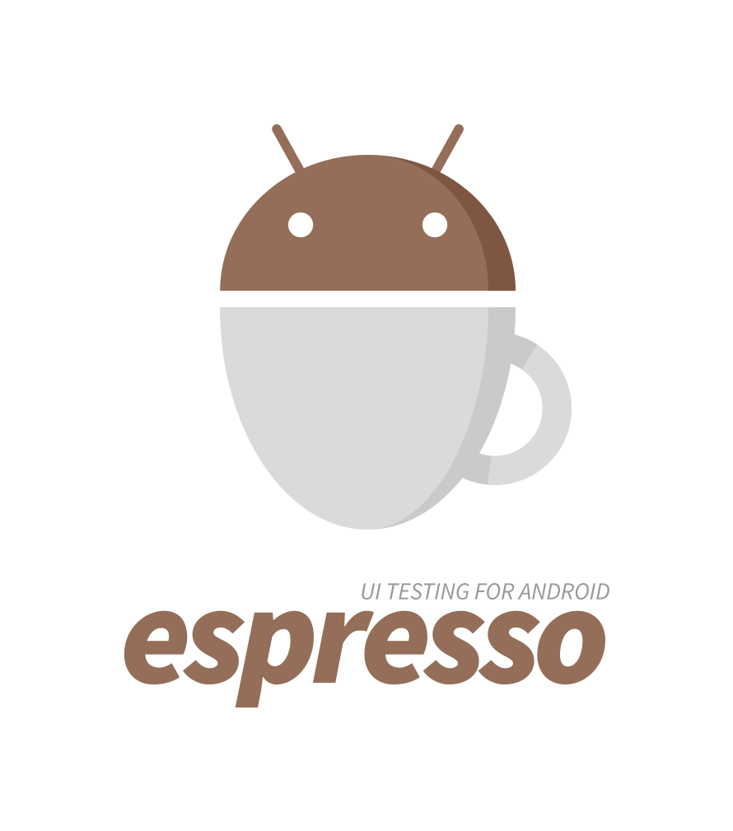


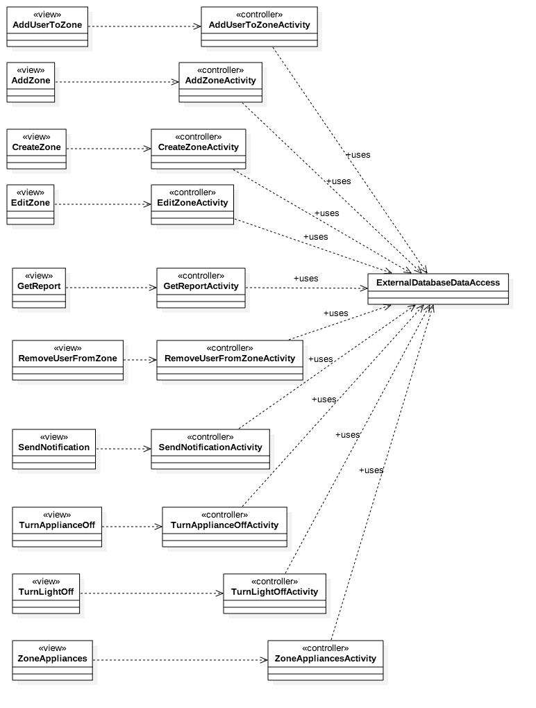
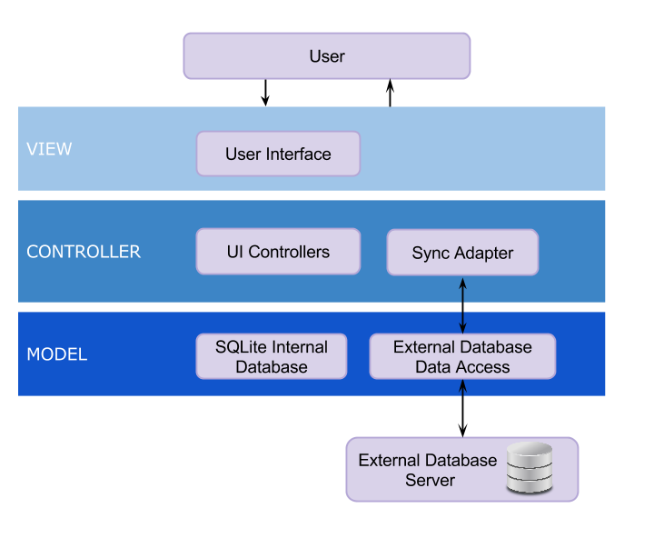
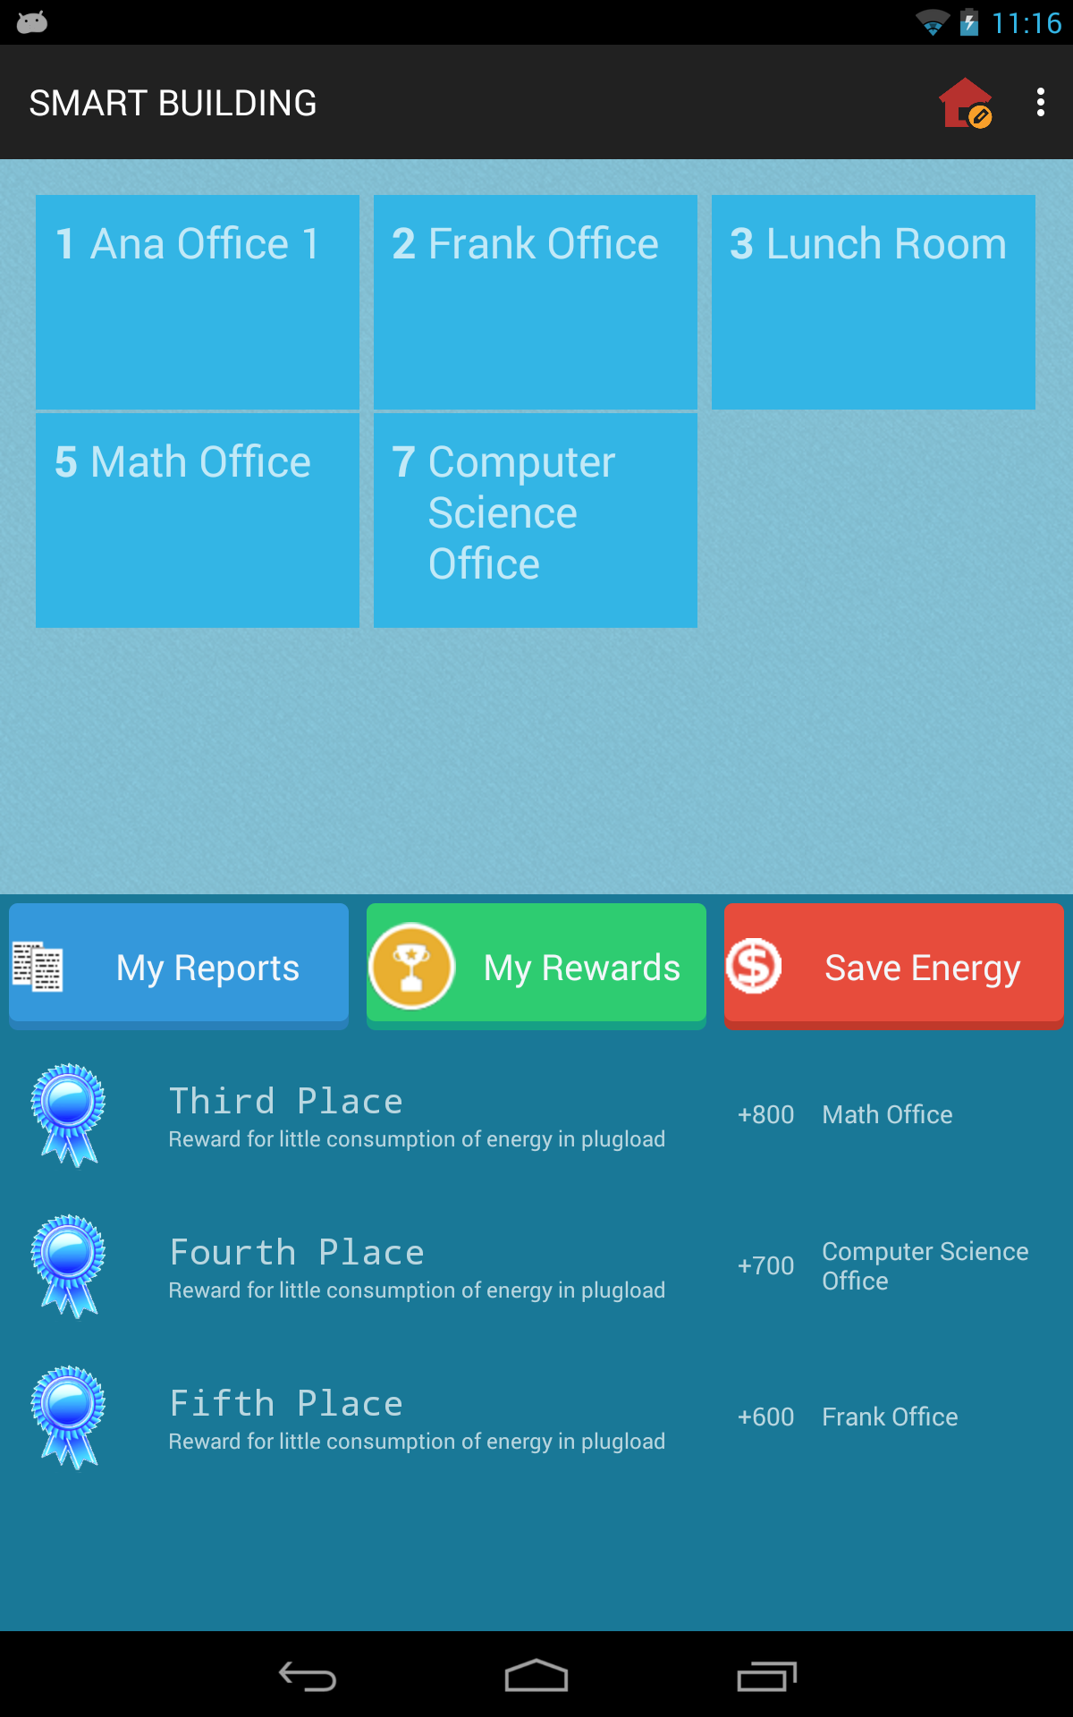
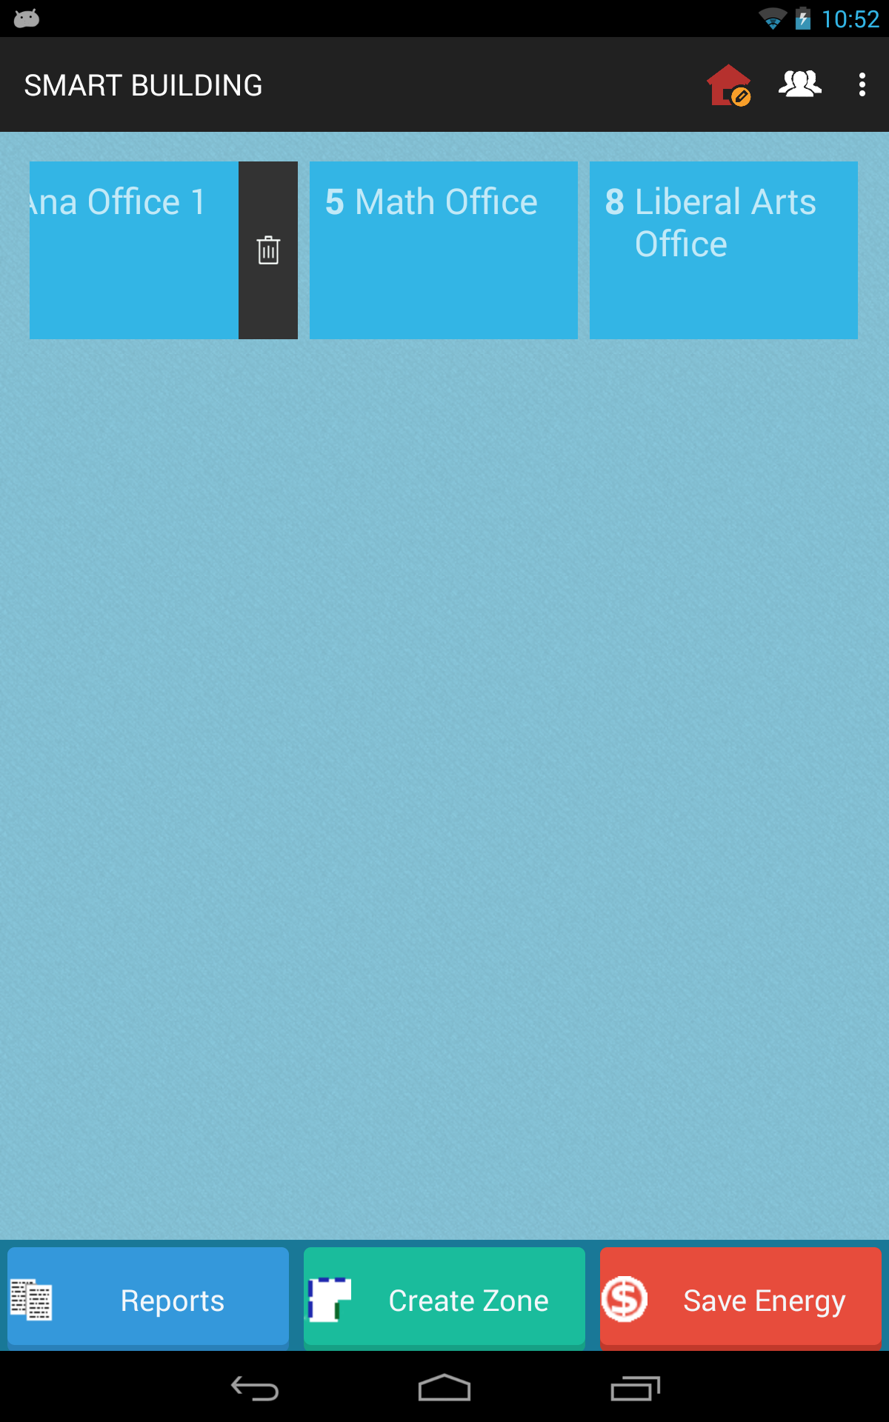
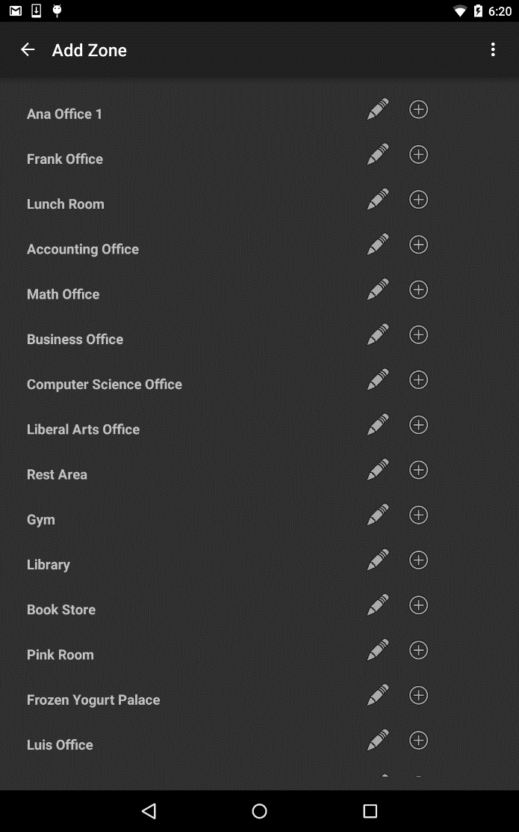
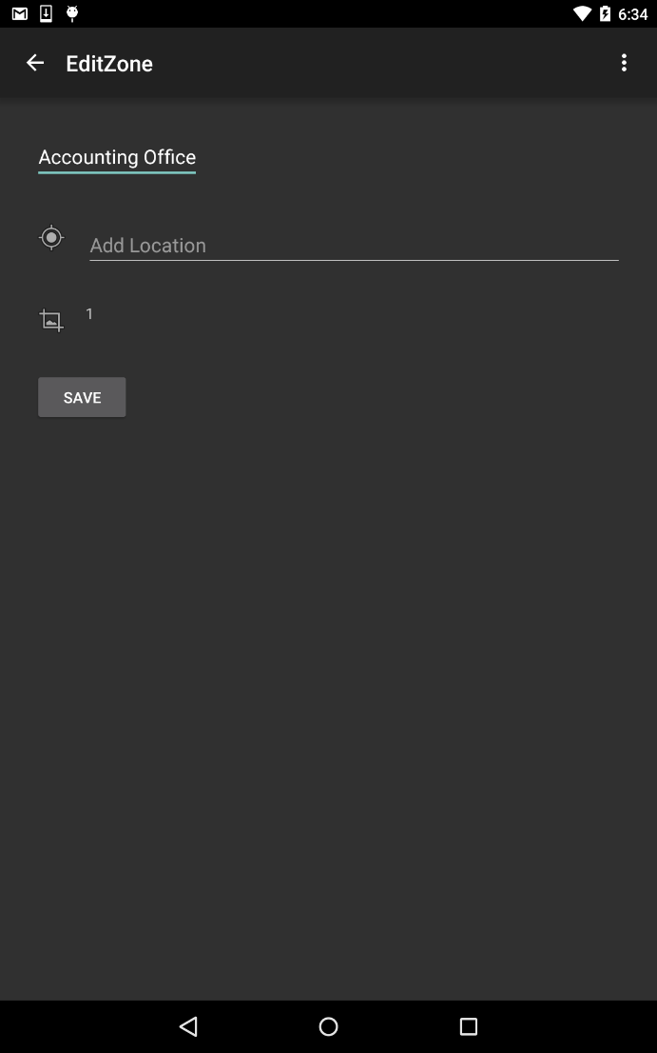
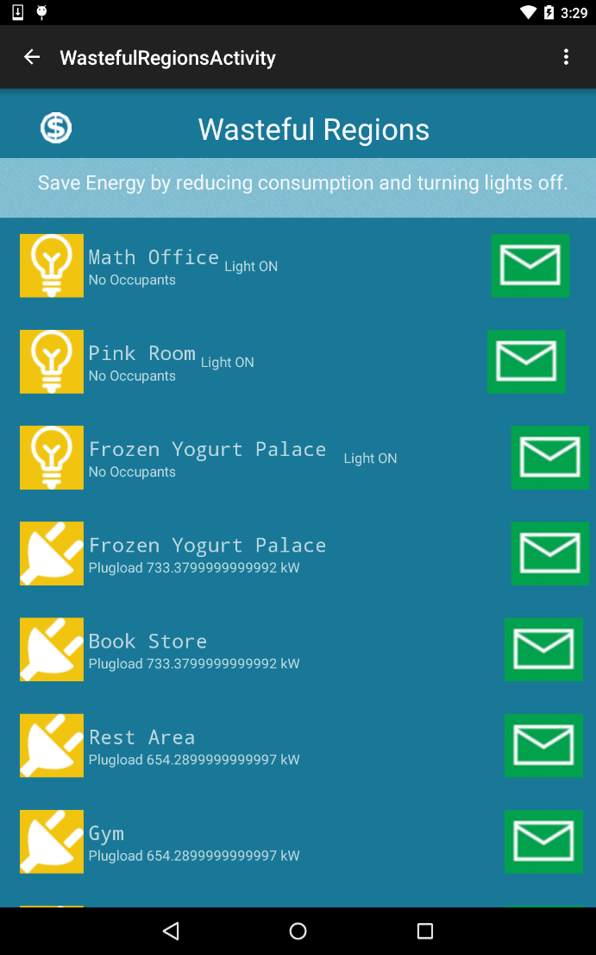
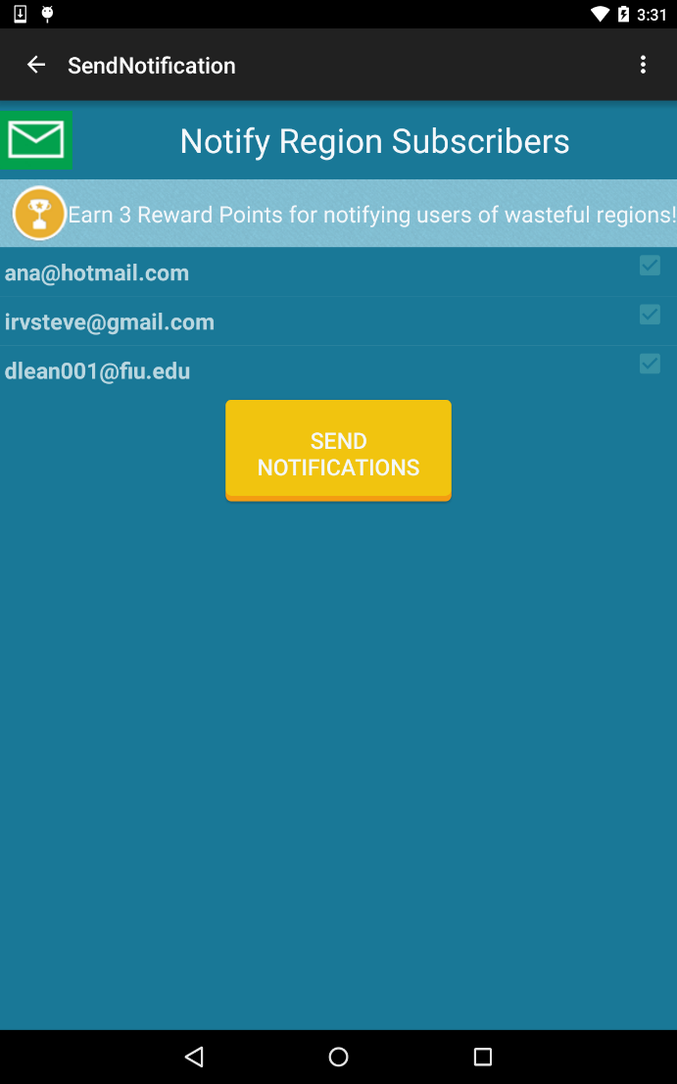
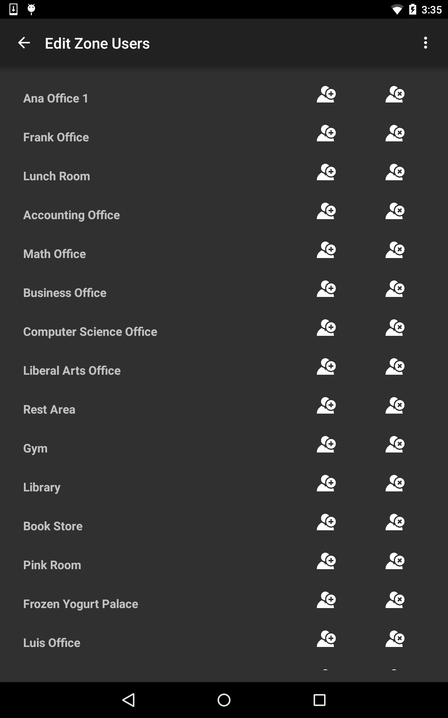
School of Computing & Information Sciences
Senior Project, 2015, Summer
Smart Systems for Occupancy and Building Energy Control
Student: Irvin Steve Cardenas, Florida International University
Mentor: Leonardo Bobadilla and Ali Mostafavi, Florida International University
Instructor: Masoud Sadjadi, Florida International University
Problem
Current System
Requirements
Literature review on the design and development of buildings delineate the development of these structures for the sole purpose of comfort and refuge.
Overtime, these buildings and its components have evolved with technology to provide the most comfort to its inhabitant.
But, state-of-the-art buildings, smart buildings, have a broader mission that involves providing energy efficiency (minimizing energy costs) and reducing environmental impact. Understanding the problem of developing such smart buildings entails the consideration of its users as key players who can either have a positive or negative impact on the efficiency of a building. Thus, the problem of developing a smart building begins by educating users on their energy consumption habits and making them energy literate.
SSOBEC is a novel system that is composed of a mobile Android application, a backend service and a web API that allows users to directly interact with a building's lighting system, appliances, and other users; all while becoming energy literate.
The first release of the system included the basic functionality that allows users to connect to the service and view energy efficiency information, as well as statistics.
The current release allows for different user roles, functionality to add users, follow and unfollow zones among other features. Most importantly, this release has added the aspect of social gaming by allowing user to earn rewards for positive energy conscious behavior. The latter is included, not only to educate users but to create a community-driven smart building that is energy efficient based on positive user behavior and incentive.
The system shall...
Allow the login of a General Users and Facility Manager User
Allow Users to unfollow a zone
Allow Users add appliances to a zone
Allow Users to earn points by sending notifications
Notify Users of wasteful regions
Allow Facility Manager User to edit a zone
Allow Facility Manager User to add users to existing zone
Allow Facility Manager User to remove a user from an existing zone
System Design
Object Design
Implementation
The Android mobile application follows the Model View Controller (MVC) design pattern. Where as the system as whole implements a client-server model.
SSOBEC is an Android application written natively in Java 8 and the Android 5.0 SDK API Level 22 (Lollipop Version) with backwards compatibility to Android Version 4.1 API Level 16 (Jelly Bean).
The backend service of the application is hosted on Linux, Apache, MySQL, and PHP (LAMP) server with an API written in PHP 5 that allows the application to query and update a MySQL database.
Validation of the mobile application was performed using the Espresso testing framework, provided by the Android Testing Support Library.
Summary
Smart Systems for Occupancy and Building Energy Control (SSOBEC) proposes a novel energy consumption monitoring system that enables real-time analysis of energy performance. SSOBEC gives way to continuous energy consumption improvements through reward-driven user behavior and social gaming.
The second release of the Android mobile application pushes the concept of energy literacy through social gaming. It enables multi-user interaction and allows users to earn rewards based on positive behavior that yields in improvement to a building’s energy efficiency. This release has features that include: different user roles, the ability to turn appliances and light fixtures on/off, and the ability to edit a building's virtual model. The latter includes adding or removing a zone, adding or removing users from a zone and being able to edit zone attributes.
Verification
Software Verification was performed on the application using the Android Espresso testing framework. Espresso enables the creation of static unit test as well as test that interact with GUI components or views of the mobile application. To test backwards compatibility, the tests were performed on devices that support API Level 22 (Lollipop) to API Level 16 (Jelly Bean).
The Espresso testing framework allowed for functional, behavioral, and integration testing.
Screenshots
Facility Manager
Unfollow a Zone
Follow a Zone
Edit a Zone
Wasteful Regions
Send Notifications
Add/Remove
User from Zone
Acknowledgement
The material presented in this poster is based upon the ongoing research being conducted by Dr. Leonardo Bobadilla and Dr. Ali Mostafavi. I am thankful for the help that I received from my partner Diana Leante and for the advice provided by Dr. Masoud Sadjadi.

