Slide 1
Smart Systems for Occupancy and Building Energy Control
Team: Dalaidis Hidalgo, Maria E. Presa Reyes Mentor: Ali Mostafavi, Leonardo Bobadilla
Project Plan
CIS 4911 Senior Project
School of Computing and Information Sciences
Florida International University
2/2/2015

Slide 2
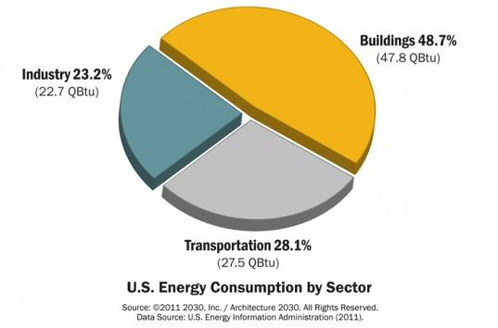
Problem
Buildings are the number one consumers in energy of the U.S.
Examples of impacts in energy performance while occupants are not around:
Leaving the lights on
Using certain plug-loads (e.g. TV)
Excess use of heat and cooling

Slide 3
Solution
An Android application for Occupancy and Energy Control.
Benefits:
Greater efficient use of electricity.
Rational use of energy resource.
Better protection of the family economy.
Preservation of our natural resources.

Slide 4
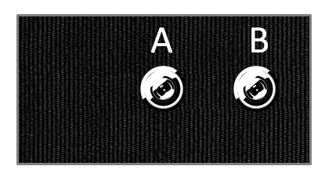

How the sensors work
Occupancy Behavior and Temperature Sensor
Different sensors to measure:
Occupancy Behavior
Current Temperature
Lighting Condition
Plug Load
Going from A to B
Entering the Room
Going from B to A
Leaving the Room

Slide 5

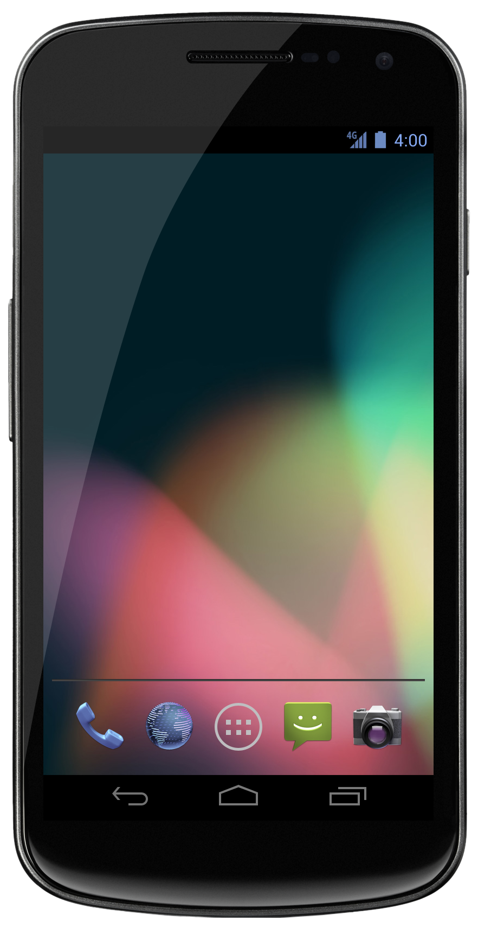
Our layer of focus
Sensors
...
Database
Android Application

Slide 6
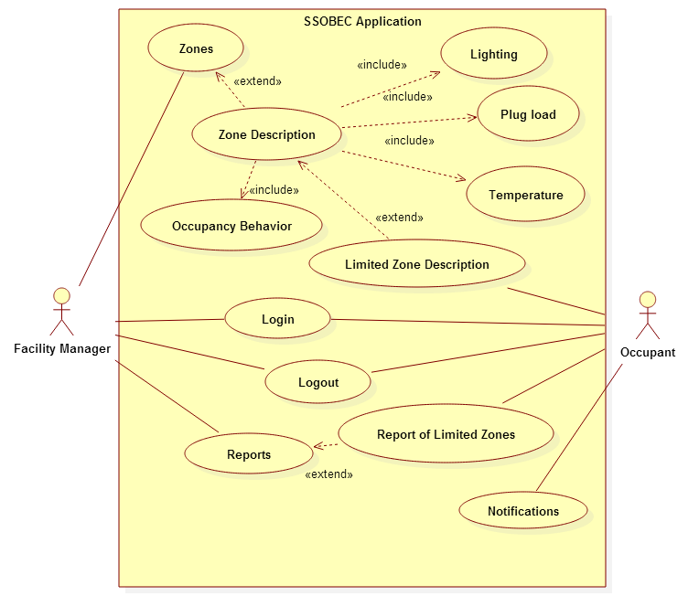
Use Case Diagram
Notes:
Dalaidis

Slide 7
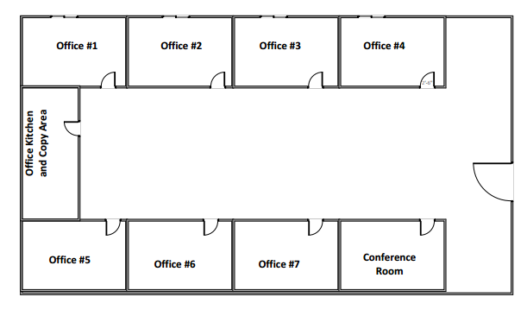
Floorplan of a building floor
Notes:
Maria

Slide 8
Representing different rooms
Zone 1
Zone 2
Zone 3
Zone 4

Slide 9

MyZonesActivity
ZoneDescriptionActivity
Zone 1
Zone 1
Zone 2
Occupancy
Occupancy Velocity:
Person-hour occupancy:
Occupancy-driven lighting variation:
Zone 3
Zone 4
Temperature
Plug Load
Lighting

Slide 10
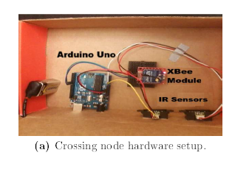
Feasibility Study (1)
Current System
Sensor data is saved in spreadsheets
Data visualization graphs are made using outside software
No device that tells you the data in real time
New System
Sensor data is saved in a database
Data visualization graphs will be made automatically
Will display the data of the current state of the room (e.g. current temperature, occupancy, ...)

Slide 11
Feasibility Study (2)
User Requirements
Own an Android device.
Have access to WiFi.
Be an occupant of a building that is using the sensors.
Alternative Solutions
Web Application
Desktop Application
iPhone Application

Slide 12
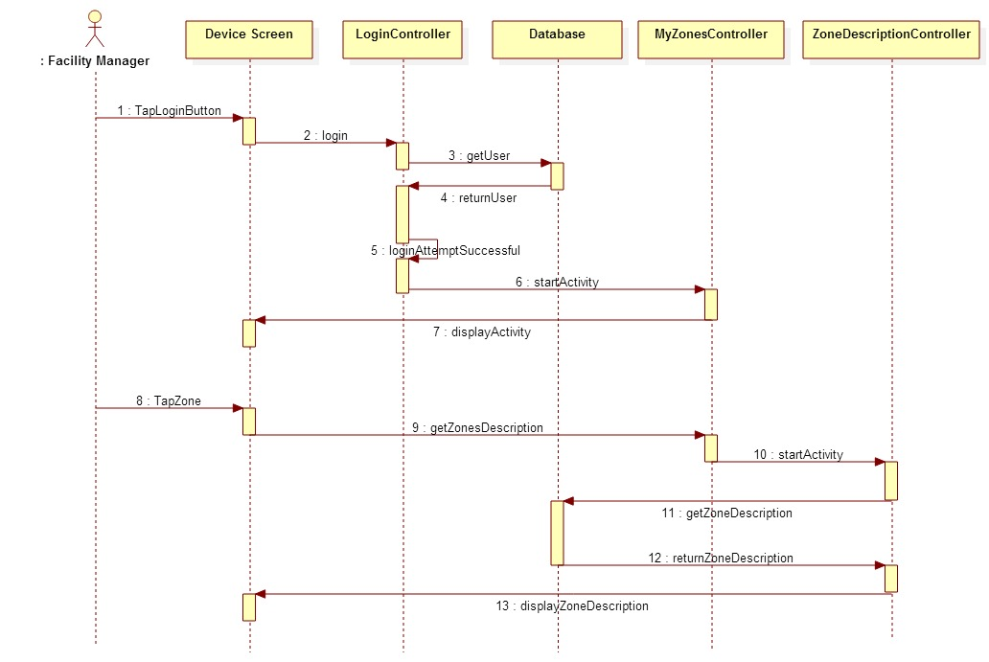
Sequence Diagram
Notes:
Maria

Slide 13
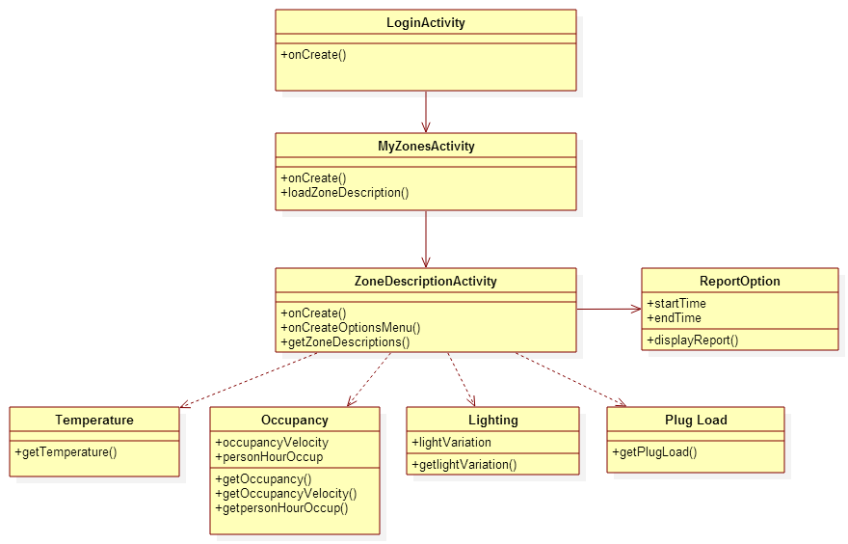
Class Diagram
Notes:
Maria

Slide 14
Questions?

