Slide 1
Smart Systems for Occupancy and Building Energy Control
Team: Dalaidis Hidalgo, Maria E. Presa Reyes Mentor: Ali Mostafavi, Leonardo Bobadilla

Slide 2
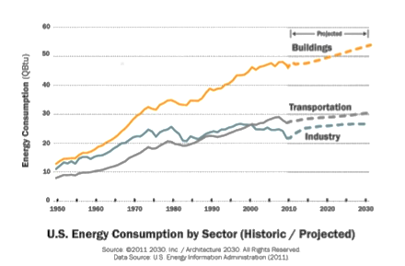
Problem Definition

Slide 3
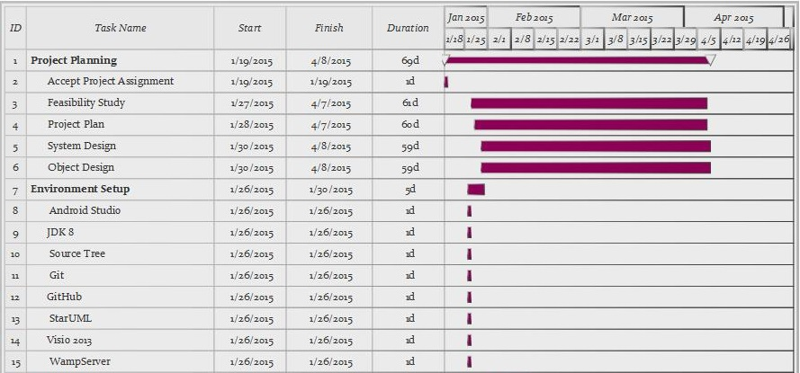
Project Management

Slide 4
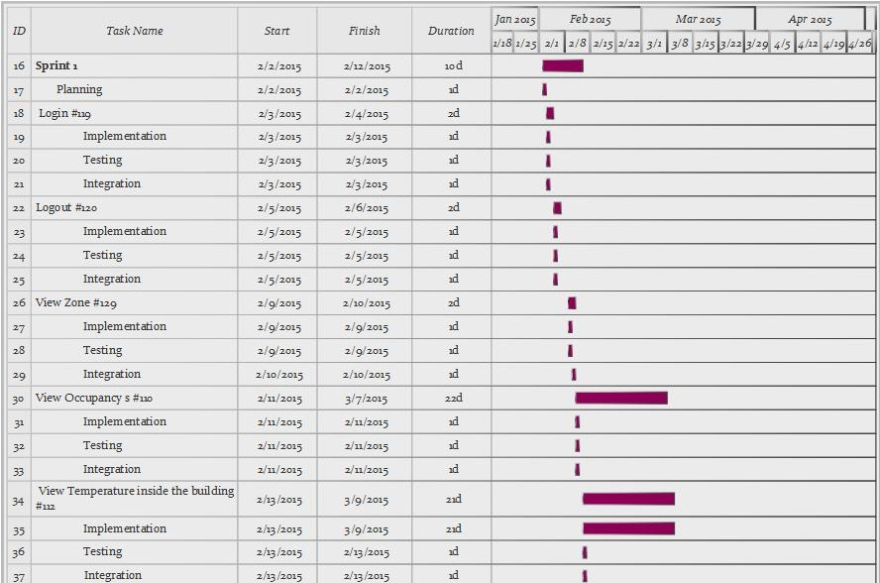
Project Management

Slide 5
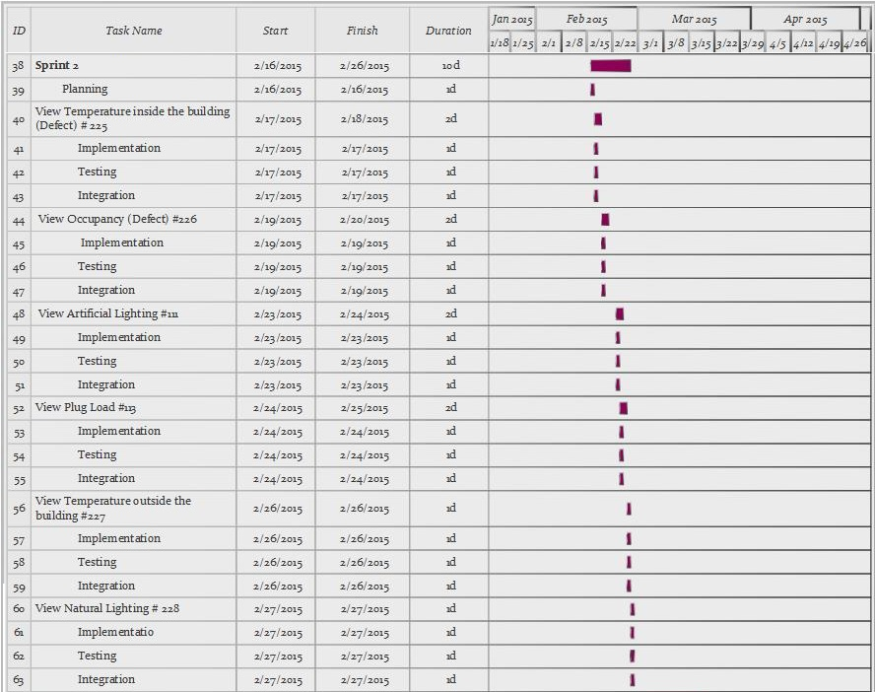
Project Management

Slide 6
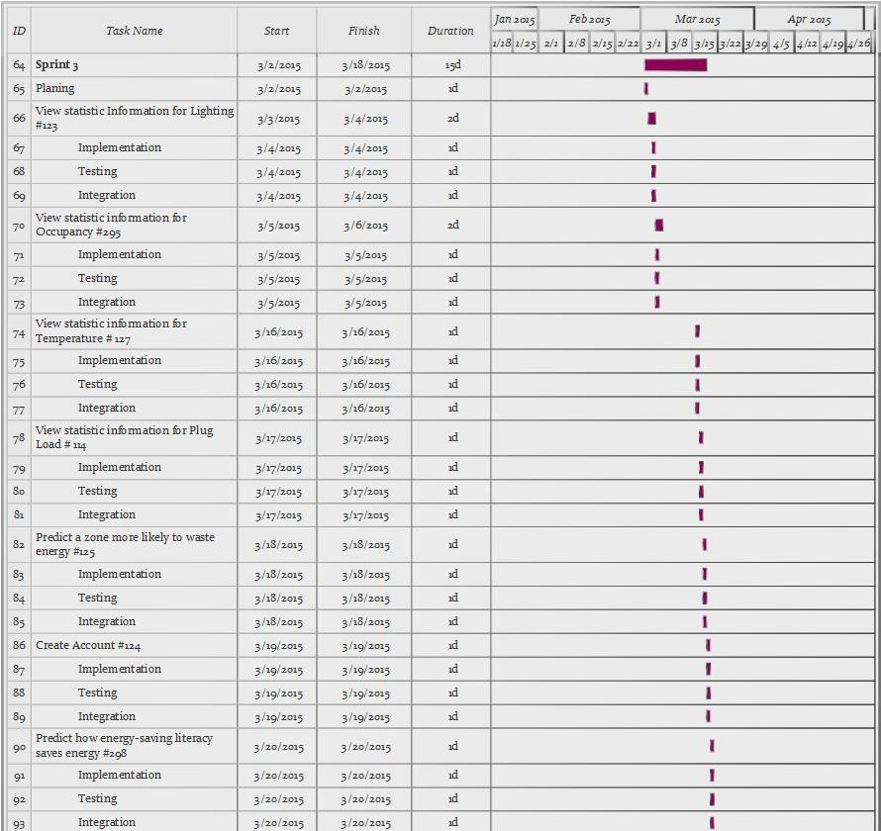
Project Management

Slide 7
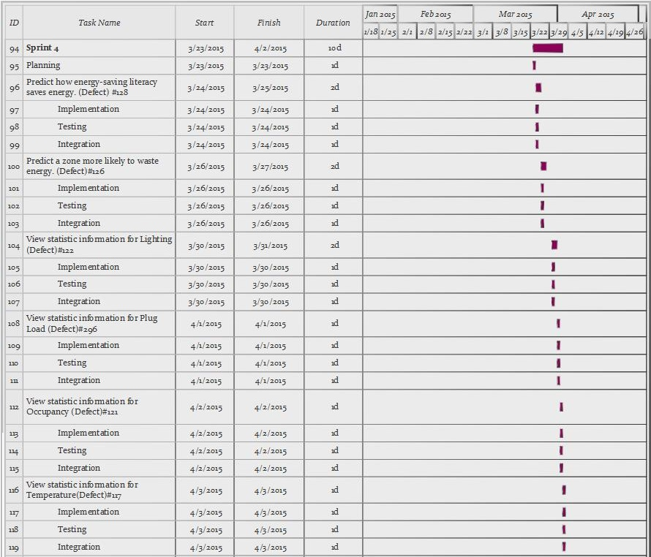
Project Management

Slide 8
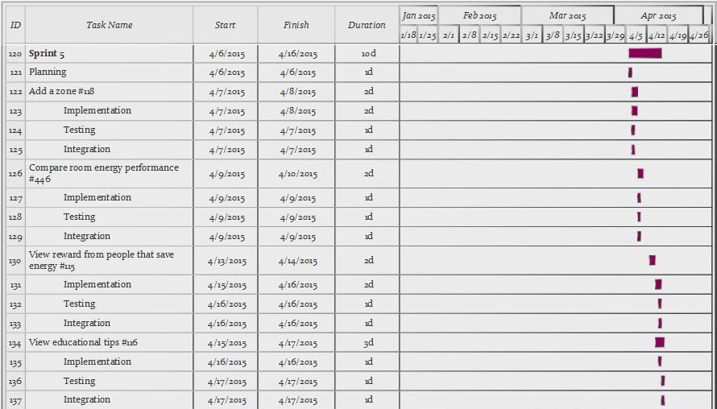
Project Management

Slide 9
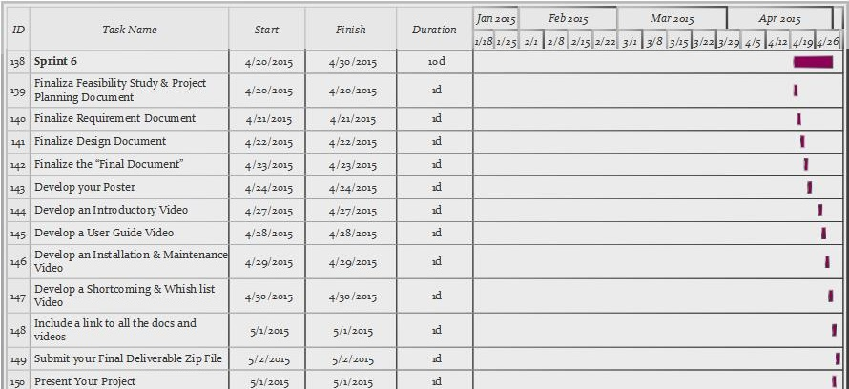
Project Management

Slide 10
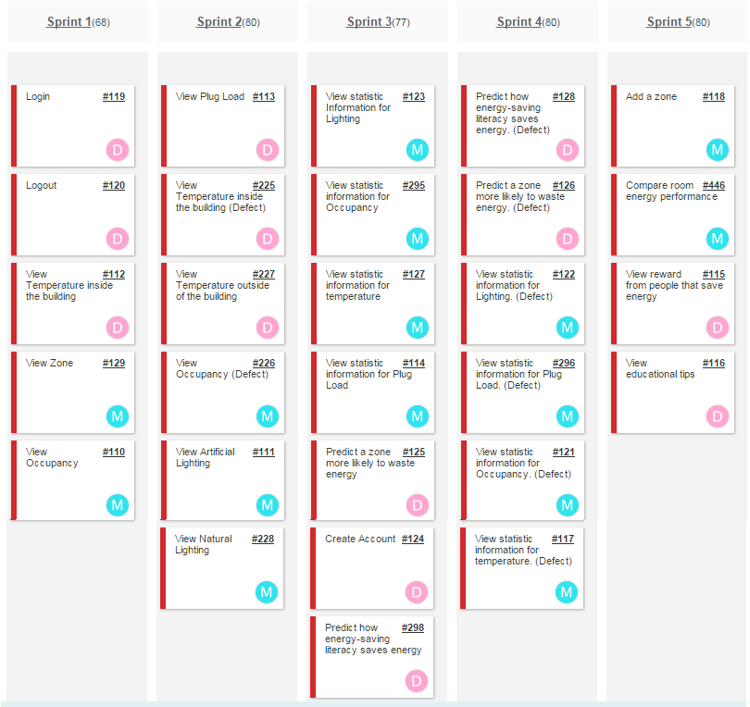
User Stories Implemented

Slide 11
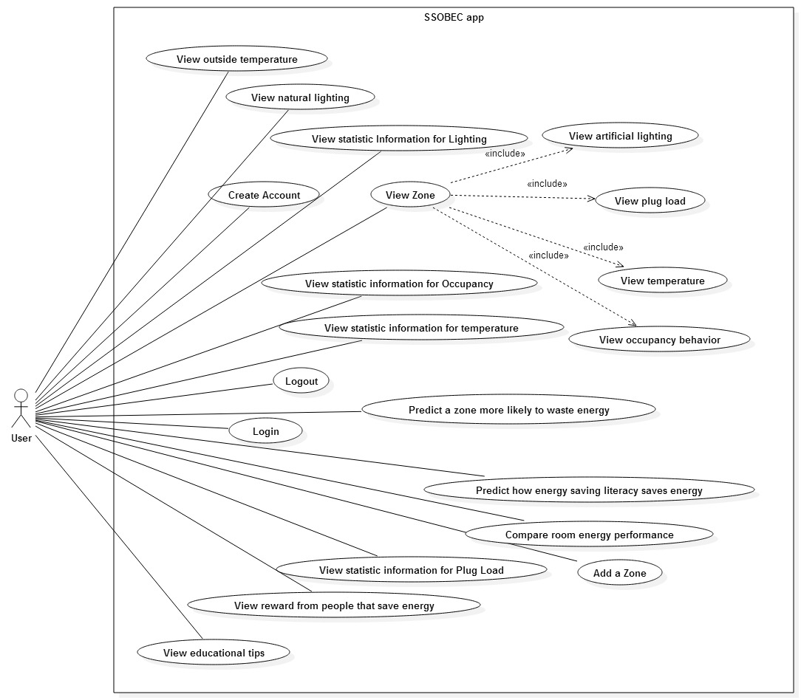
UML Use Case Model

Slide 12
SSOBEC15- Predict a zone more likely to waste energy
USER STORY DESCRIPTION: As a user, I need to be able to predict what zone is more likely to waste energy, so that I can make a better decision in order to save energy.
ACTORS:
User
PRE-CONDITIONS:
User is logged in.
User is in the Description View.
DESCRIPTION:
Use case begins when the User clicks on the prediction of air conditioning button in Zone Description View.
The System responds by getting the prediction of the zone more likely to waste energy in air conditioning using the Naïve Bayes algorithm which access the External Database, show the prediction of energy consumption.
Use case ends when the User is able to see the prediction of energy consumption of air conditioning in the View.

Slide 13
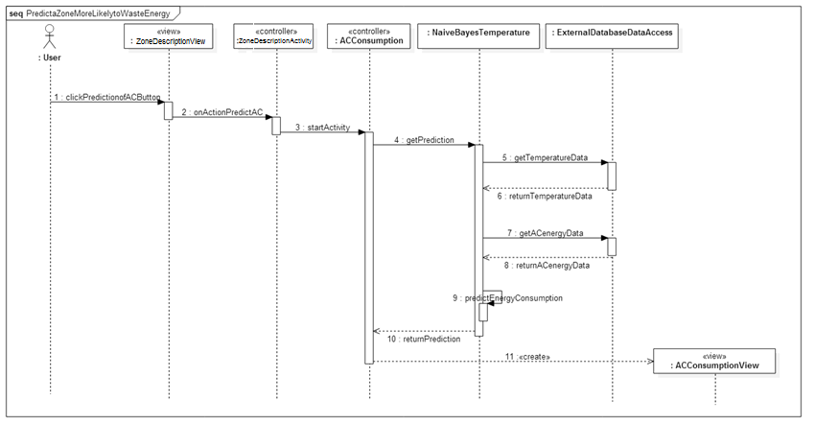
UML Sequence Diagram

Slide 14
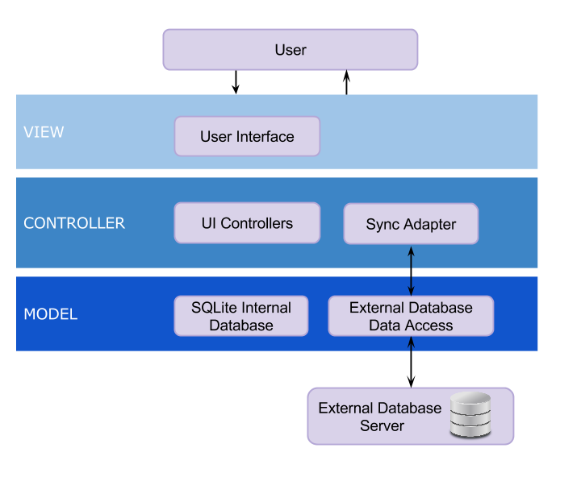
System Design

Slide 15
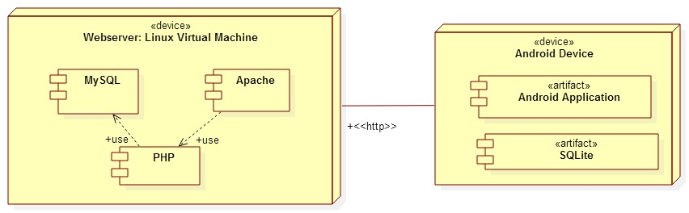
System Deployment
Notes:
As part of our system deployment, our application runs

Slide 16
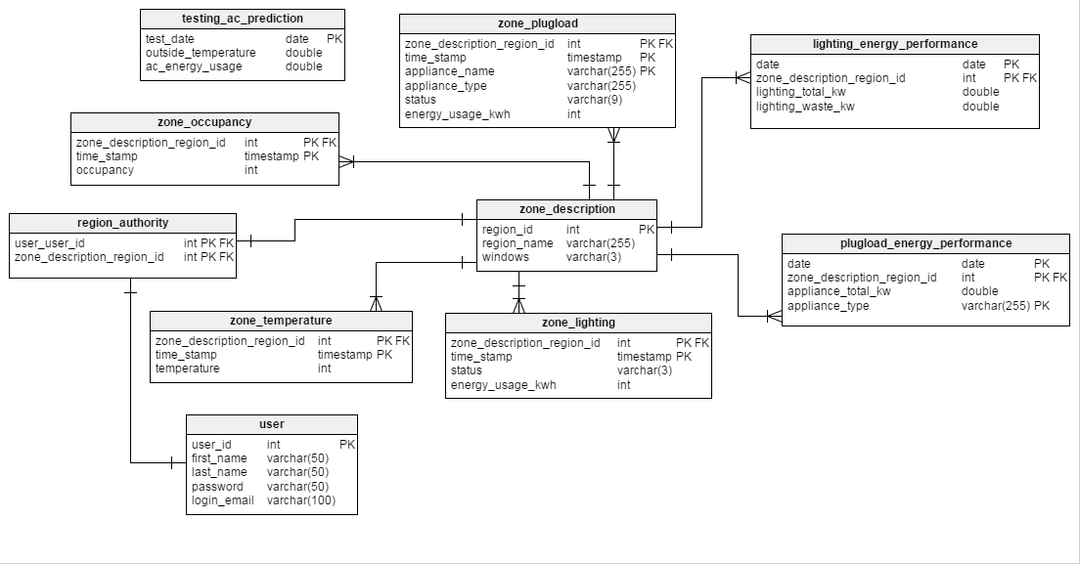
Persistent Data Design

Slide 17
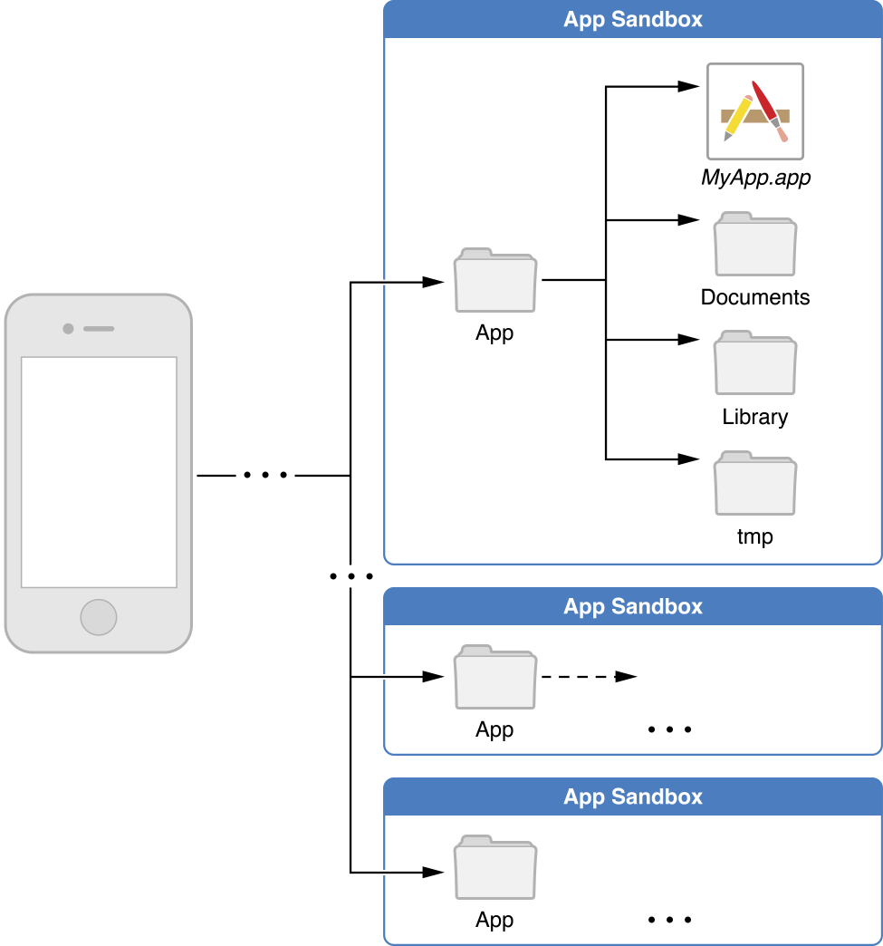
Security/Privacy

Slide 18
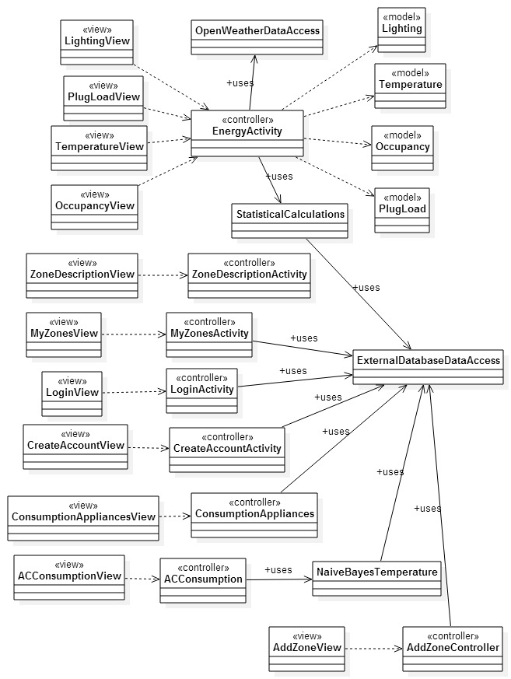
Minimal Class Diagram

Slide 19
State Machine
Stopped
onDestroy()
Destroyed
onStop()
Paused
onResume()
onResume()
onPause()
Activity
Running
onCreate()
onResume()

Slide 20
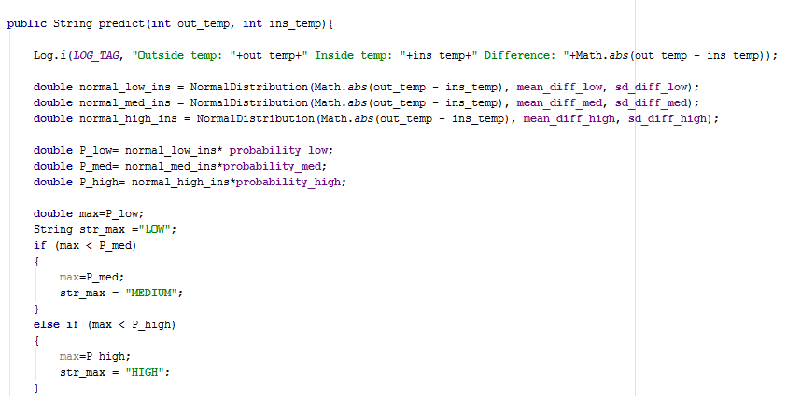
Main algorithm used for “Predict a zone more likely to waste energy ”
Use the algorithm Naïve Bayes to predict AC Consumption.
Get the outside temperature from the Open weather Database
Display result as LOW, MEDIUM or HIGH

Slide 21
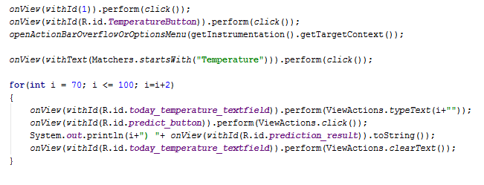
Predict a zone more likely to waste energy Testing Script

Slide 22
Predict a zone more likely to waste energy sunny day
Test Case ID: | SSOBEC_Unit_testACConsumptionPrediction
Purpose: | To make a prediction of AC Energy Consumption for a user.
Preconditions: | The app is running and the mobile device has internet connection The user Mandy is a valid user and has logged in Outside temperature is 77 according to external database of OpenWeather
Inputs | User selects zone by clicking “Ana’s Office” User clicks “Predict AC Consumption button” Type “80” in the box for “Write today’s Air Conditioning Temperature Set Point” Click “PREDICT”
Expected Output | The system displays predicted AC energy consumption as “Low”.

Slide 23
Predict a zone more likely to waste energy rainy day
Test Case ID: | SSOBEC_Unit_testACConsumptionPrediction
Purpose: | To make a prediction of AC Energy Consumption for a user.
Preconditions: | The app is running and the mobile device has internet connection The user Mandy is a valid user and has logged in Outside temperature is “77” according to external database of OpenWeather
Inputs | User selects zone by clicking “Ana’s Office” User clicks “Predict AC Consumption” The user does not type any value in the box Click “PREDICT”
Expected Output | The system displays “Unfortunately, SSOBEC has stopped”. And give the option to click “OK”. If the user clicks “OK” the system returns the user to the Zone Description View where he/she can make a new selection.

