Slide 1
Smart Systems for Occupancy and Building Energy Control
Team: Dalaidis Hidalgo, Maria E. Presa Reyes Mentor: Ali Mostafavi, Leonardo Bobadilla

Slide 2
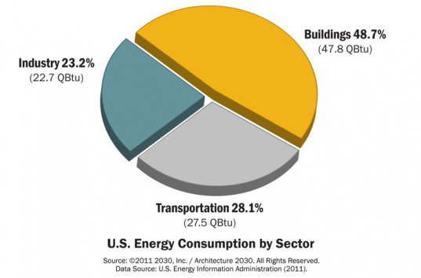
Problem Definition

Slide 3
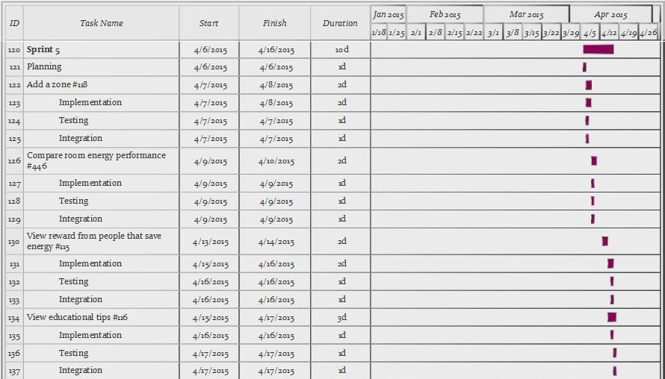
Project Management

Slide 4
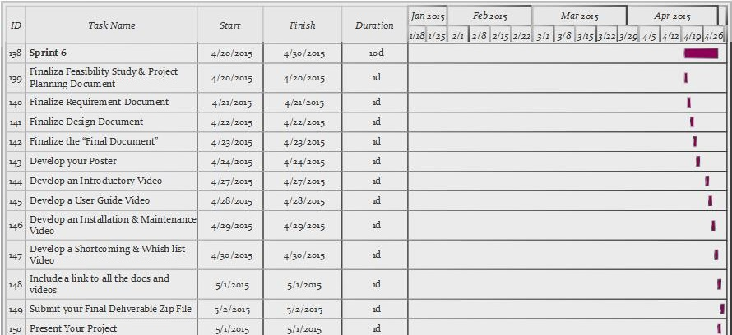
Project Management

Slide 5
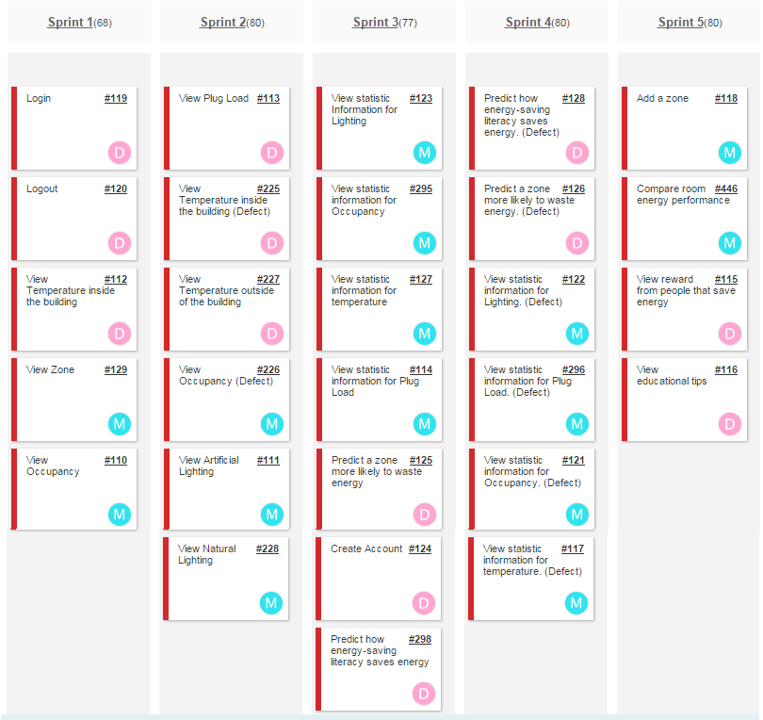
User Stories Implemented

Slide 6
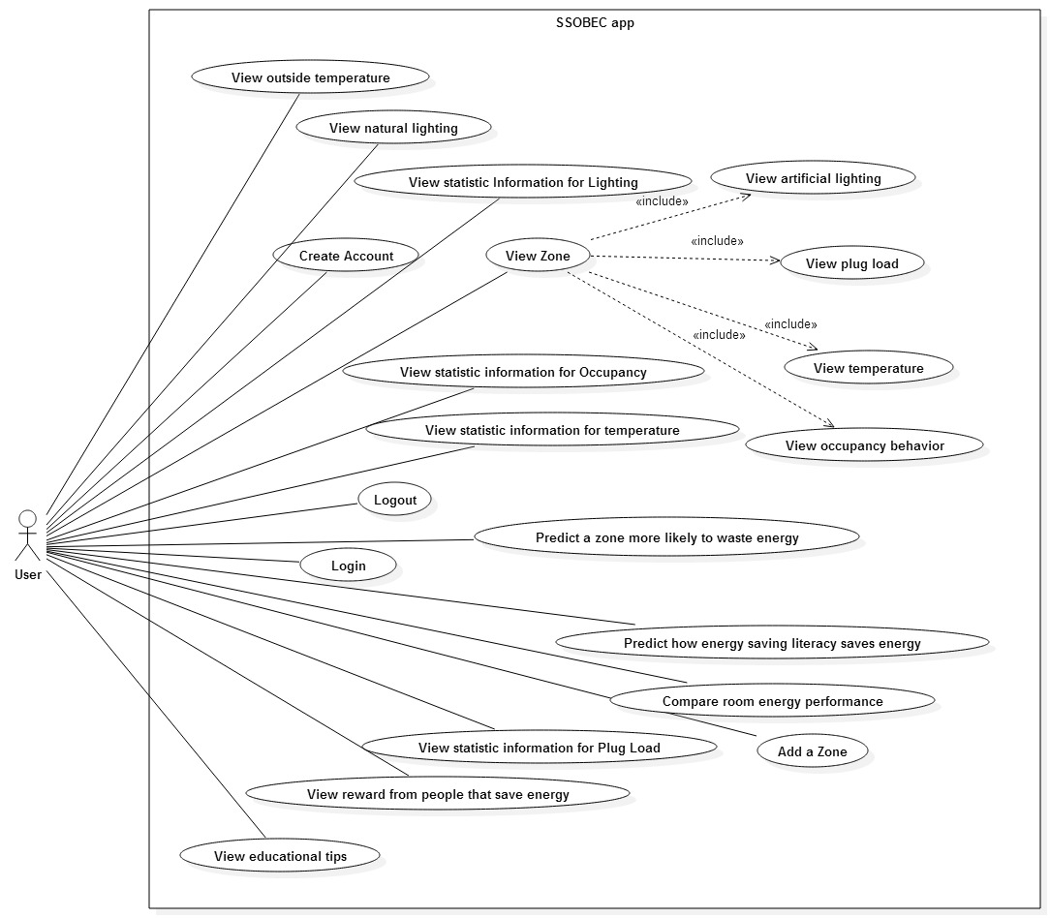
UML Use Case Model

Slide 7
SSOBEC11- View statistic information for lighting
USER STORY DESCRIPTION: As a user, I need to be able to see statistical data of lighting so that I can measure the behavior and energy performance of lighting throughout a given time.
ACTORS:
User
PRE-CONDITIONS:
User is logged in.
User is the ZonesDescriptionView view
User selects a zone.
DESCRIPTION:
Use case begins when the User clicks on the Lighting button in my ZoneDescriptionView.
The System responds by getting the Statistics for Lighting for that zone from the Statistical Calculation class which access the External Database, makes the statistical calculations and returns it.
Use case ends when the User is able to see the Statistic information for lighting View.

Slide 8
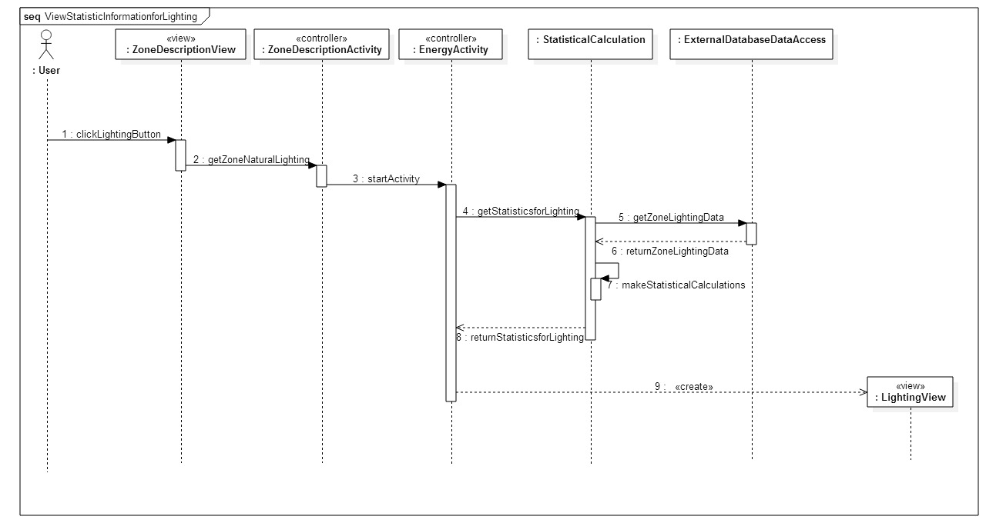
UML Sequence Diagram

Slide 9
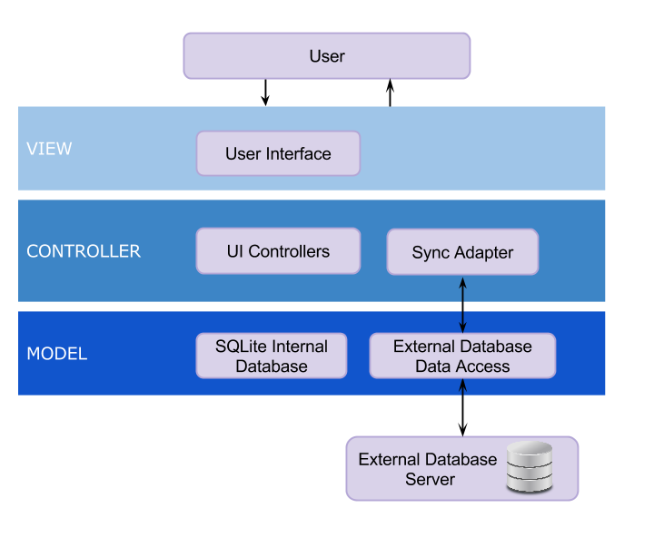
System Design

Slide 10
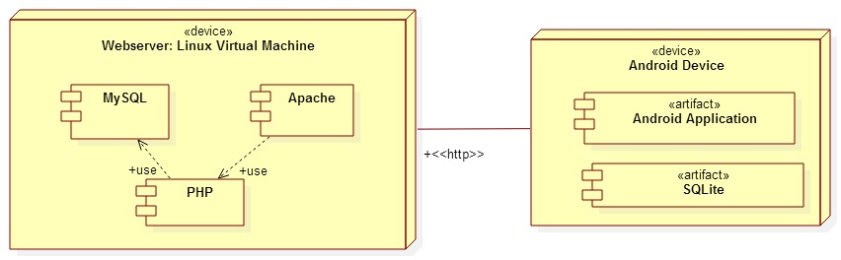
System Deployment
Notes:
As part of our system deployment, our application runs in a linux virtual machine. Our android application is installed in an android device

Slide 11
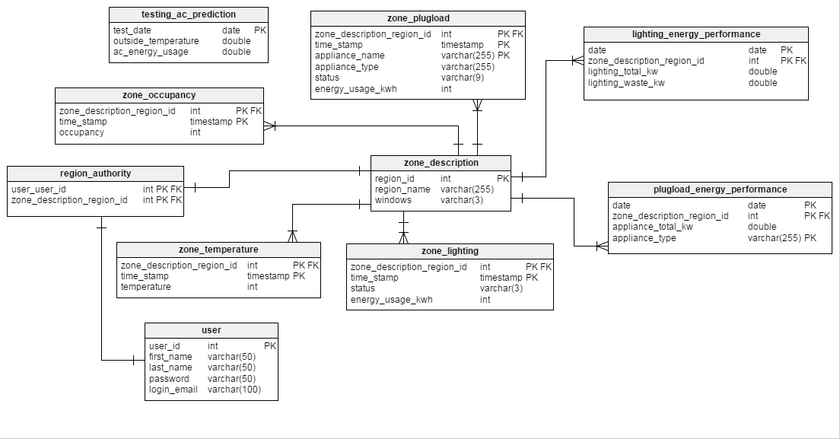
Persistent Data Design

Slide 12
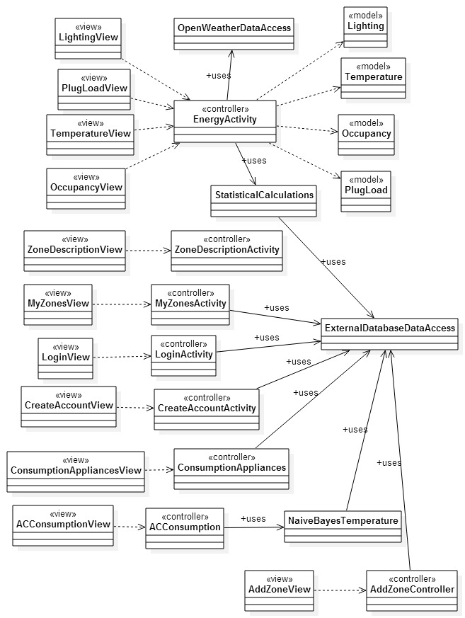
Minimal Class Diagram

Slide 13
State Machine
Stopped
onDestroy()
Destroyed
onStop()
Paused
onResume()
onResume()
onPause()
Activity
Running
onCreate()
onResume()

Slide 14
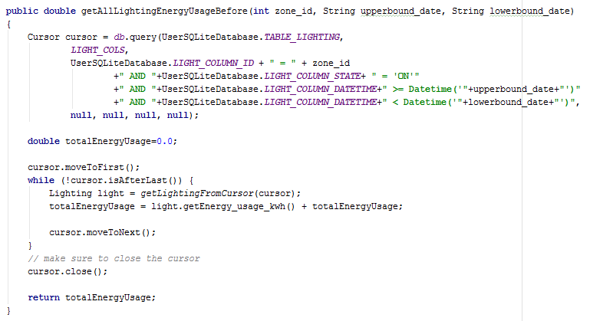
Main algorithm used for ‘’View statistic information for lighting”
Get the sum of the energy usage in one day for the specified zone.
Get the times a zone is empty.
If a zone was empty and the lights were ON consider the energy used as ‘wasted’.

Slide 15
View statistic information for lighting sunny day
Test Case ID: | SSOBEC_Unit_testDisplayPieChartforLightingEnergyUsage
Purpose: | To validate that the system correctly displays the pie chart for lighting energy usage inside a zone.
Preconditions: | The user’s phone is connected to the database
Inputs | User selects a zone in My Zones view. User clicks the Lighting button to see the lighting information of the zone.
Expected Output | The system retrieves the information from the database and displays a visualization

Slide 16
View statistic information for lighting rainy day
Test Case ID: | SSOBEC_Unit_testDisplayPieChartforLightingEnergyUsage
Purpose: | To validate that the system does not display the pie chart for both lighting energy usage inside a zone if the phone is not connected to Wifi.
Preconditions: | The user’s phone is connected to the database The user’s phone is not connected to Wifi
Inputs | User selects a zone in My Zones view. User clicks the Lighting button to see the lighting information of the zone.
Expected Output | The system displays a message that “Unfortunately, SSOBEC has stopped”.

