Slide 1



Smart Systems for Occupancy and Building Energy Control Version 2
Team: Diana Leante Boné, Irvin S. Cardenas Mentor: Ali Mostafavi, Leonardo Bobadilla

Slide 2
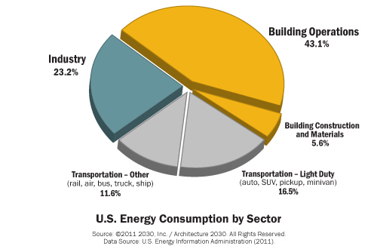
Problem Definition
Smart Systems have a broader mission that involves providing energy efficiency, minimizing energy costs and reducing environmental impact.
Users are key players in energy efficiency of buildings.
Users must become energy literate.

Slide 3
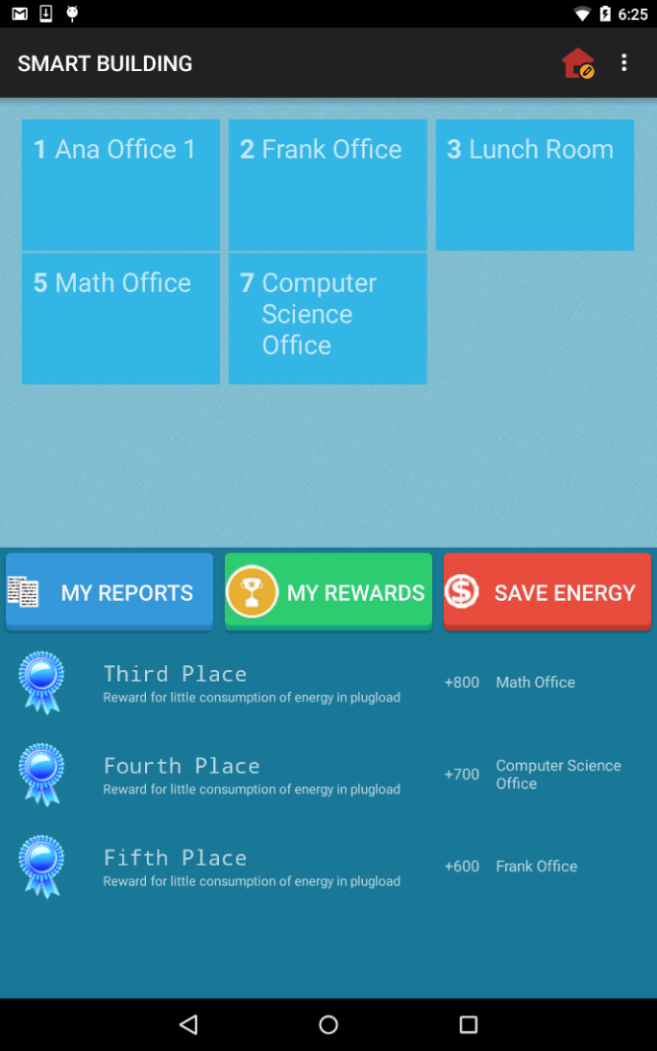
Proposed Solution
Educate users about their energy consumption.
Motivate users to save energy in a building through user rewards system.
Use intervention techniques to help users identify wasteful regions.

Slide 4
User Stories Implemented
Create Facility Manager View
Create general user View
Allow Facility Manager to add Users to existing Zone
Allow Facility Manager to create a Zone
Allow Facility Manager to remove Users from existing Zone
Allow User to unfollow a zone
View Wasteful Regions
View Account Reward Points
Allow Facility Manager Edit a Zone

Slide 5
User Stories Implemented
Allow User to add Appliance to a Zone
Turn off Light in Wasteful Region and earn points
Turn off Appliance in Wasteful Region and earn points
Generate User statistics reports
Generate Zone statistics reports
Allow users to earn points by sending notifications
Notify users of wasteful regions
Provide user rankings
Provide personalized feedback suggestions for users
Create User Manual
Refine Final Document

Slide 6
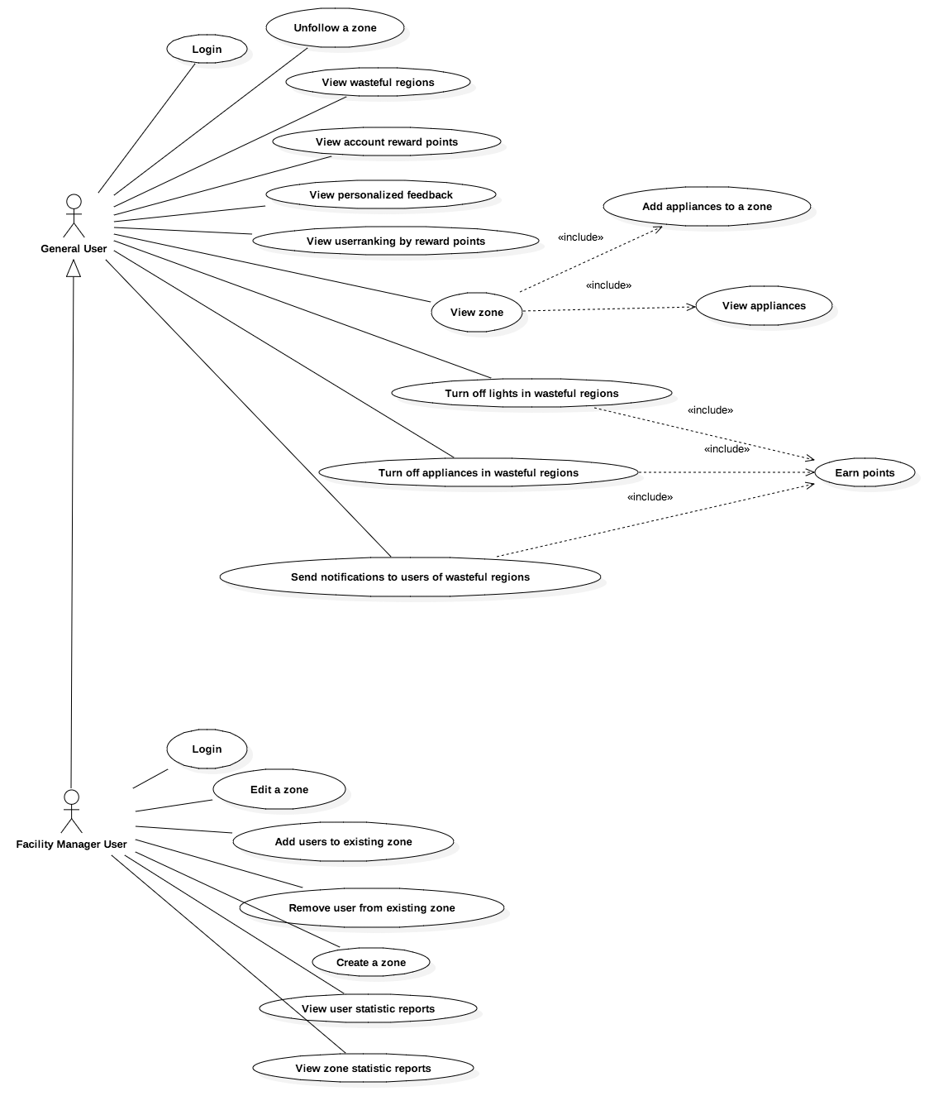
UML Use Case Diagram

Slide 7
Use Case: Allow Facility Manager to create a Zone
User Story Description: As a facility manager, I should be able to create a Zone from the App so that there is no need to access the back-end directly.
ACTORS:
Facility Manager
PRE-CONDITIONS:
Facility Manager is logged in.
DESCRIPTION:
Use case begins when the Facility Manager clicks on the Create Zone button in the main screen.
The system displays the activity to create a zone and the facility manager is prompted to enter Zone Name, Zone Location and number of Windows of the zone.
The facility manager enters a valid Zone Name, Zone Location and number of windows and selects to Create Zone.
Use case ends when the system creates the zone successfully and the facility manager is redirected to the main screen.

Slide 8
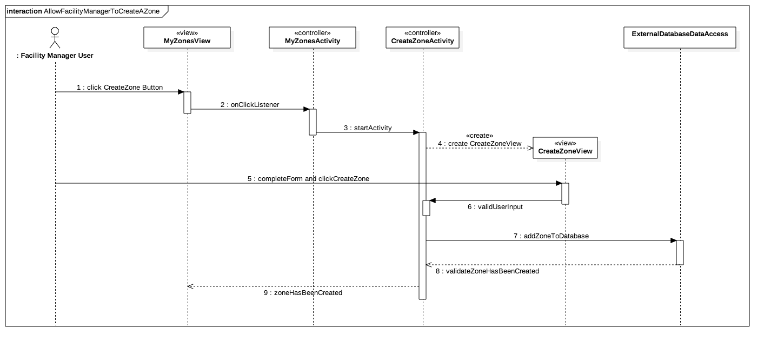
UML Sequence Diagram

Slide 9
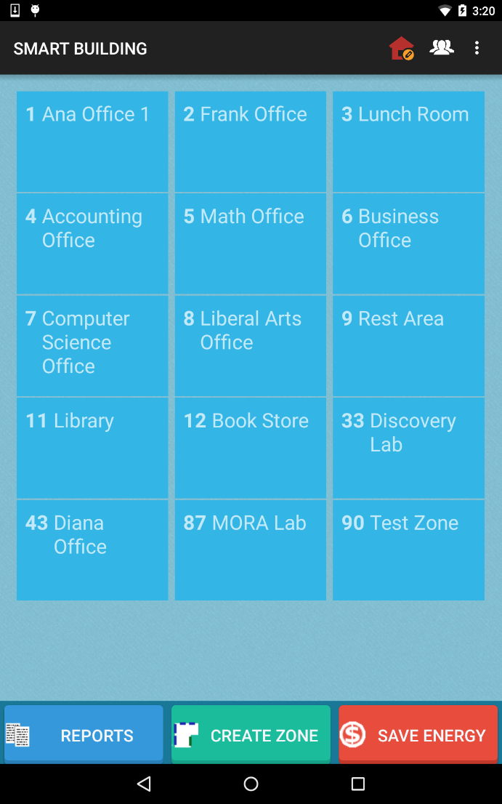
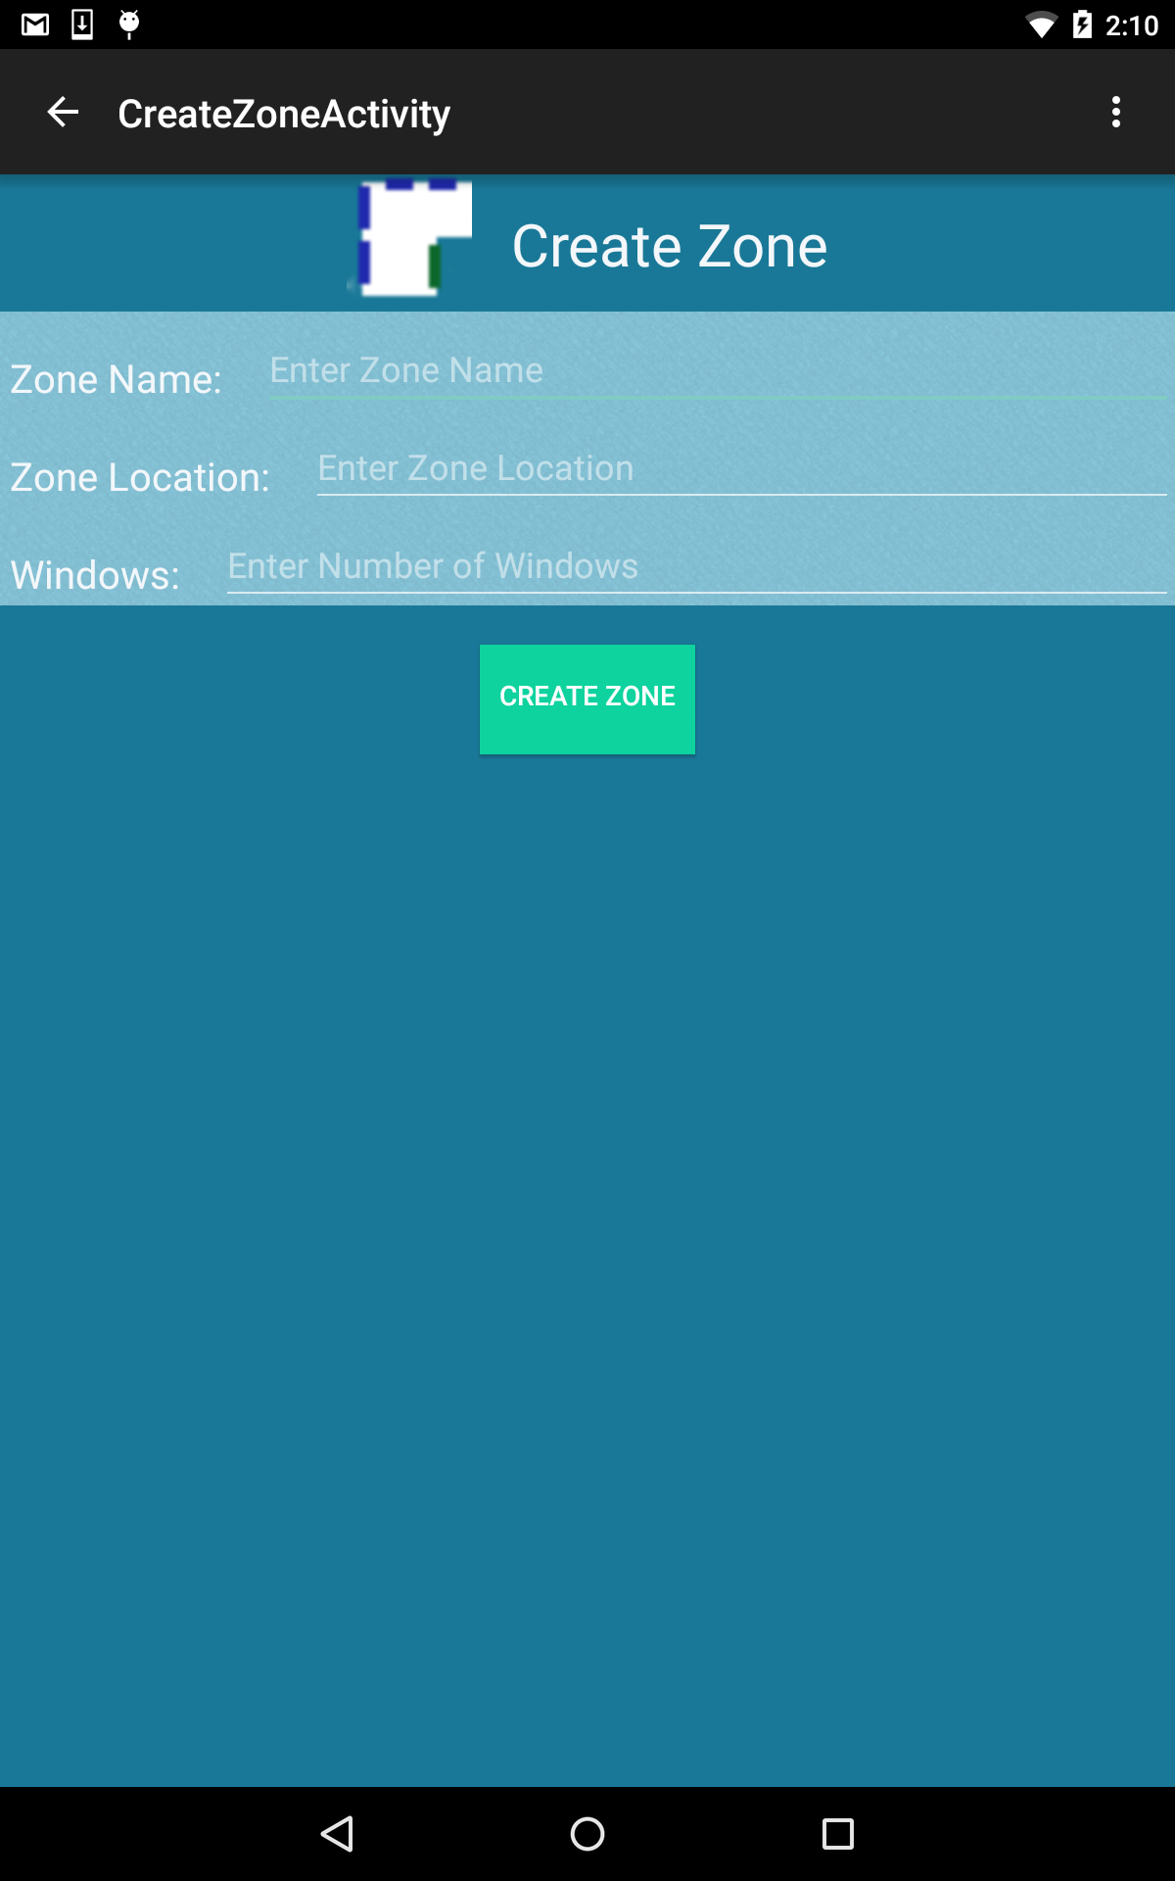
Create a Zone
Facility Manager Feature
From the Main Screen for a logged in Facility Manager user, click on CREATE ZONE button.
The facility manager user can then enter the data for a zone such as Name, Location and number of Windows and select the CREATE ZONE button.

Slide 10
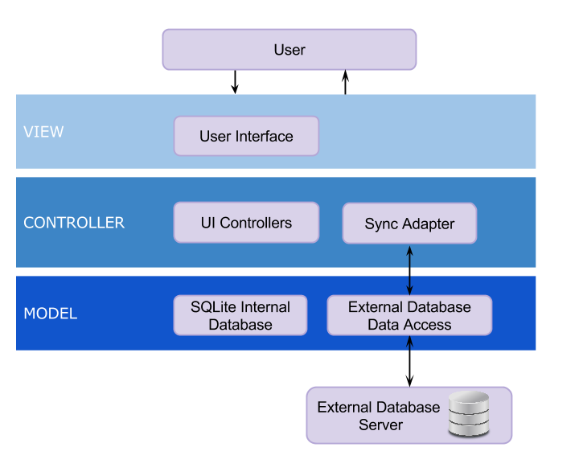
System Design

Slide 11
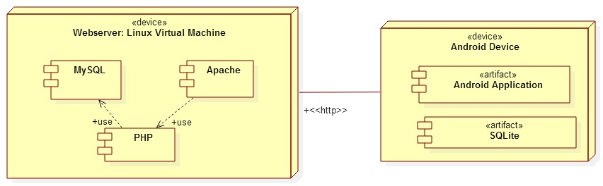
System Deployment
Notes:
As part of our system deployment, our application runs in a linux virtual machine. Our android application is installed in an android device

Slide 12
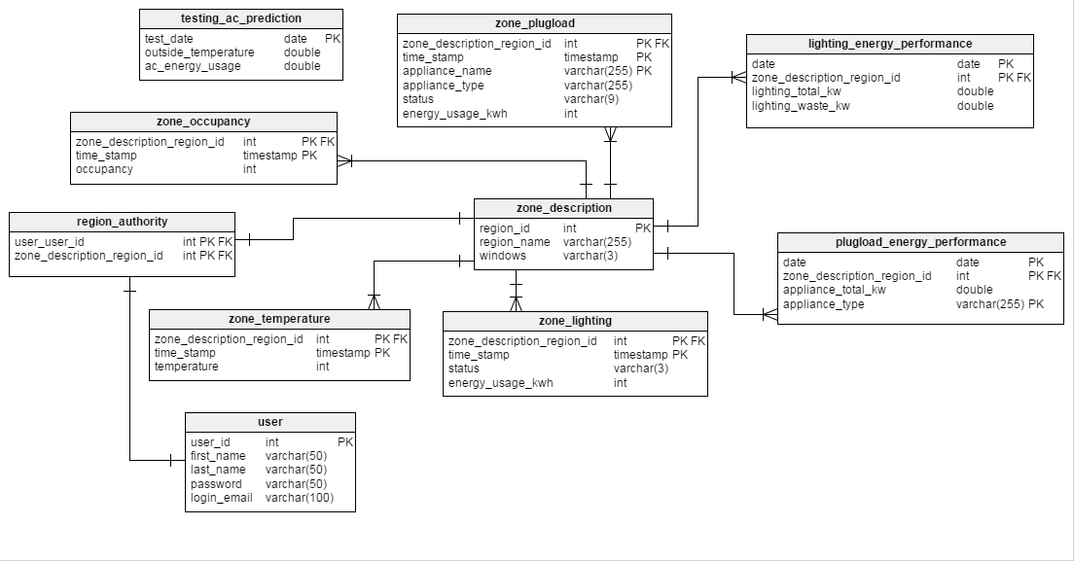
System Design - Persistent Data Design

Slide 13
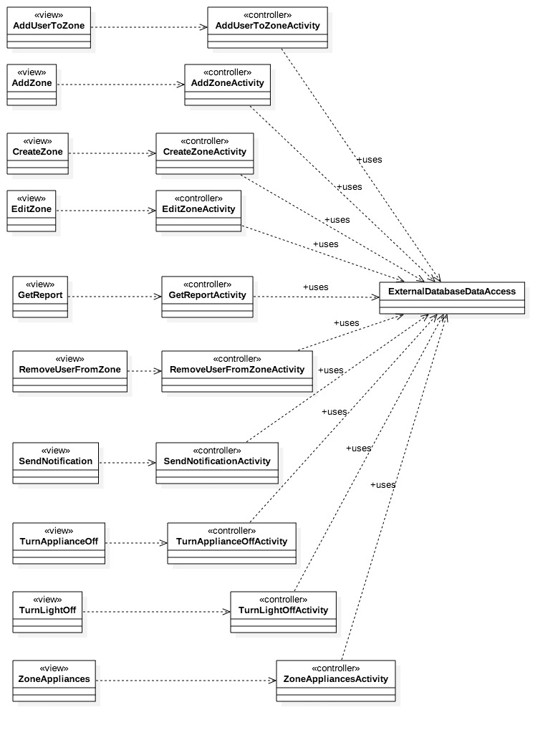
Minimal Class Diagram

Slide 14
State Machine
Stopped
Destroyed
onStop()
Paused
onResume()
onResume()
onPause()
Activity
Running
onCreate()
onResume()

Slide 15
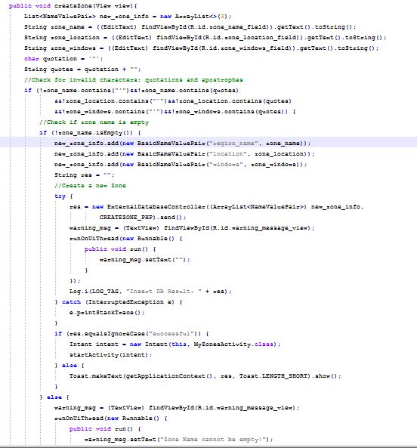
Algorithm for “Allow Facility Manager to Create a Zone”
Verify user is a Facility Manager
Validate zone attributes inserted by user
If zone attributes are invalid or empty zone name, show warning message
Else if zone attributes are valid, attempt to insert zone into External Database
Inform user if zone was created in database successfully or not

Slide 16
Test Case Sunny Day: Allow Facility Manager to create a Zone
Test Case ID: | SSOBEC_Test_Create_Zone_SUNNY_01
Purpose: | To validate that a facility manager can create a zone.
Preconditions: | The app is running and the mobile device has internet connection. The user is a valid facility manager user and has logged in.
Inputs | The facility manager user clicks on the “Create Zone” button. On the CreateZoneActivity, the user enters the Zone Name as “Testing Zone”, Zone Location as “ECS” and Windows as “1”. The user clicks on the Create Zone button in the CreateZone Activity.
Expected Output | The user is shown the main activity screen with his\her zones.

Slide 17
Test Case Rainy Day: Allow Facility Manager to create a Zone
Test Case ID: | SSOBEC_Test_Create_Zone_RAINY_01
Purpose: | To validate that a facility manager cannot create a zone with blank Zone Name.
Preconditions: | The app is running and the mobile device has internet connection. The user is a valid facility manager user and has logged in.
Inputs | The facility manager user clicks on the “Create Zone” button. On the CreateZoneActivity, the user leaves the Zone Name blank, and enters Zone Location as “ECS” and Windows as “1”. The user clicks on the Create Zone button in the CreateZone Activity.
Expected Output | The user is shown a warning message saying "Zone Name cannot be empty!".

Slide 18
Conclusion
The application Smart System for Occupancy and Building Energy Control allows users to view energy consumption data of zones and to draw conclusions based on statistical analysis of the data.
Through the use of intervention techniques and a user rewards system the application motivates users to save energy and helps educate users on their energy consumption.

