Slide 1
Test Case Management and Automation
Student: Justin Phillips
Mentor: Tariq King and Dionny Santiago
CIS 4911 Senior Project
School of Computing and Information Sciences
Florida International University

Slide 2
Project Introduction
Management of test plans, including: test plans, test suites, test cases, and test steps.
Centralized system which allows for aggregation and manipulation of test plan information from one user interface.
Rapid test plan create via a rich user interface and front-end programming of key binds, etc…
The ability to sync test plan models across 3rd party test management systems, such as TFS.

Slide 3
The Idea
Other 3rd Party Management Systems
TestFlow
User Interface
IBM ClearQuest
TestFlow
Backend
TFS

Slide 4
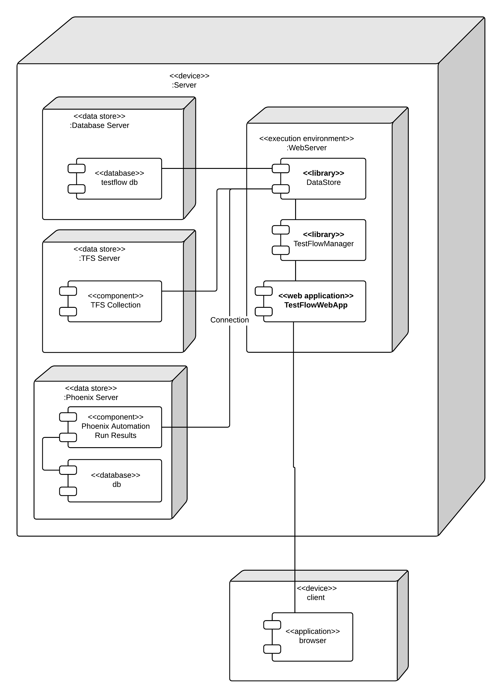
Design
Iterative process beginning with many iterations of the user interface
Next was the adapter interface realized by a suite of composite interfaces
Finally the database and TFS adapters were implemented and facades were created to manipulate these adapters.

Slide 5
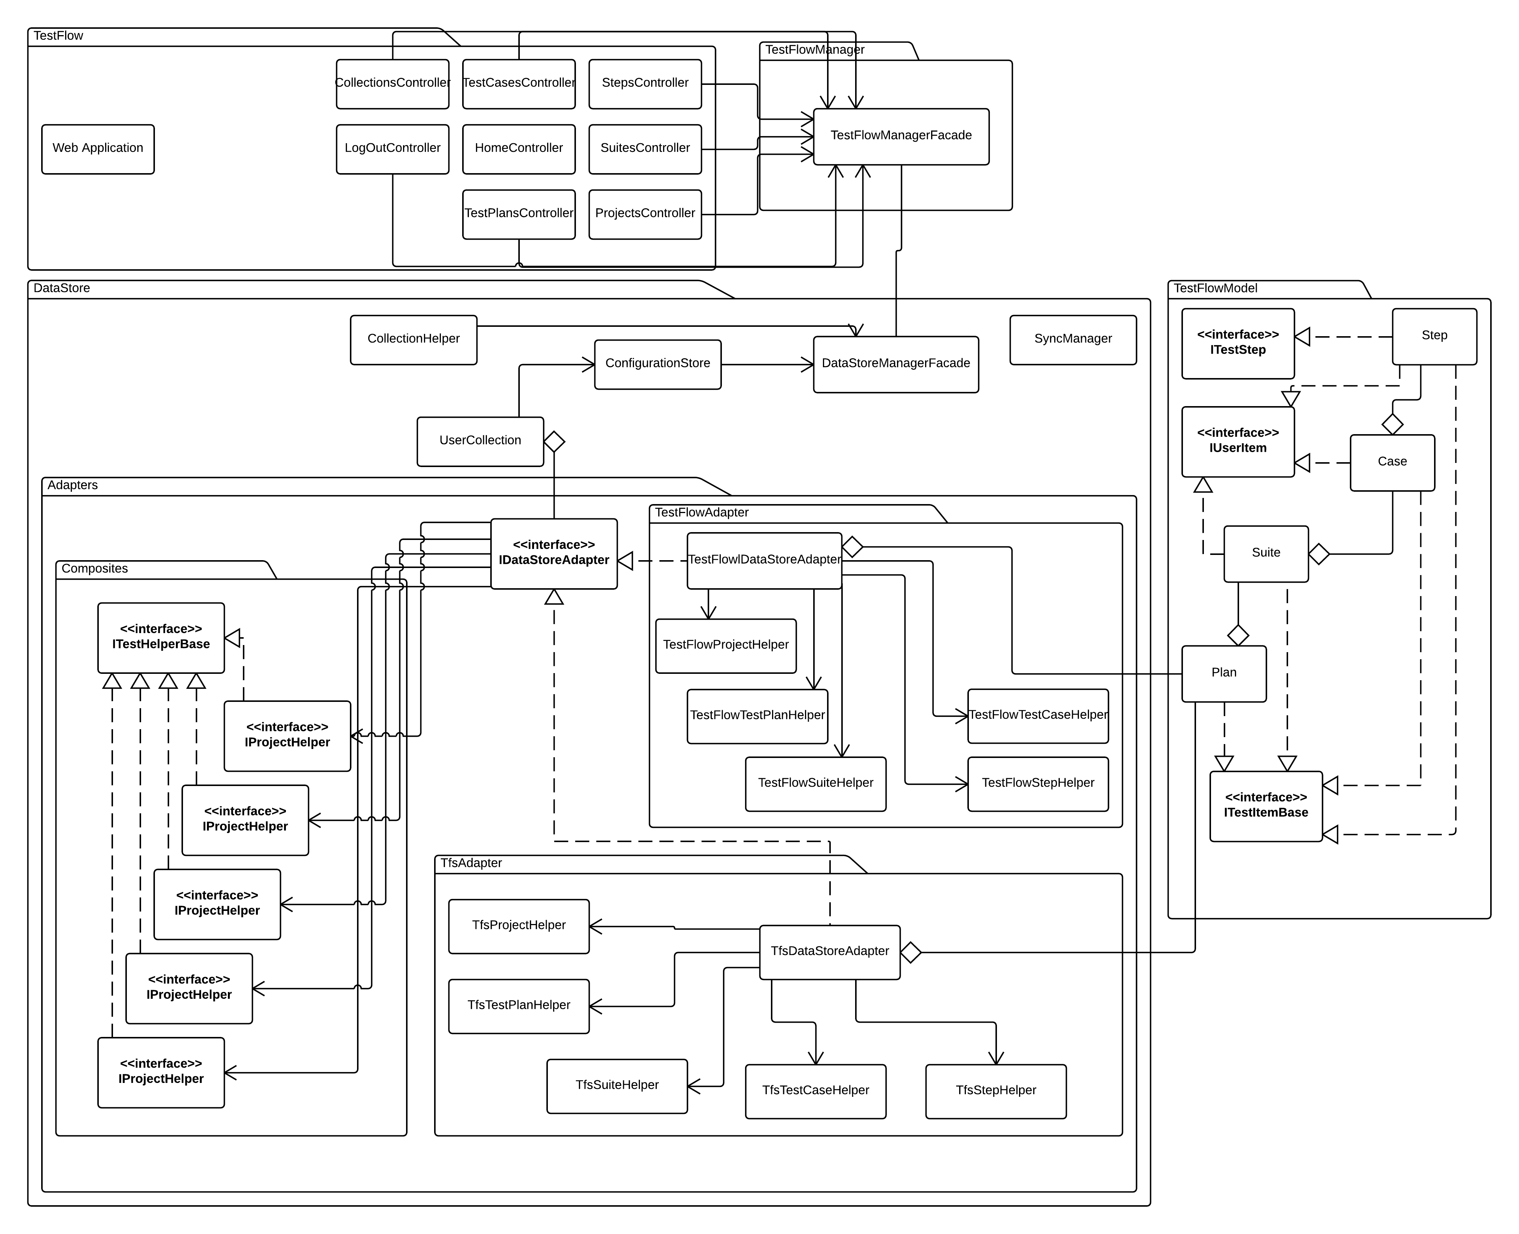

Slide 6
Implementation
System implemented with many of the latest technologies including WebAPI 2.0, ASP.NET MVC 4, Entity Framework, AngularJS, and other frameworks.
Implemented in a iterative manner using the bottom up approach once the user interface was nearly completed.
Unit testing done via Visual Studio and system testing done manually at the end of each of the back-end system’s development iterations.

Slide 7
Demo

