Slide 1




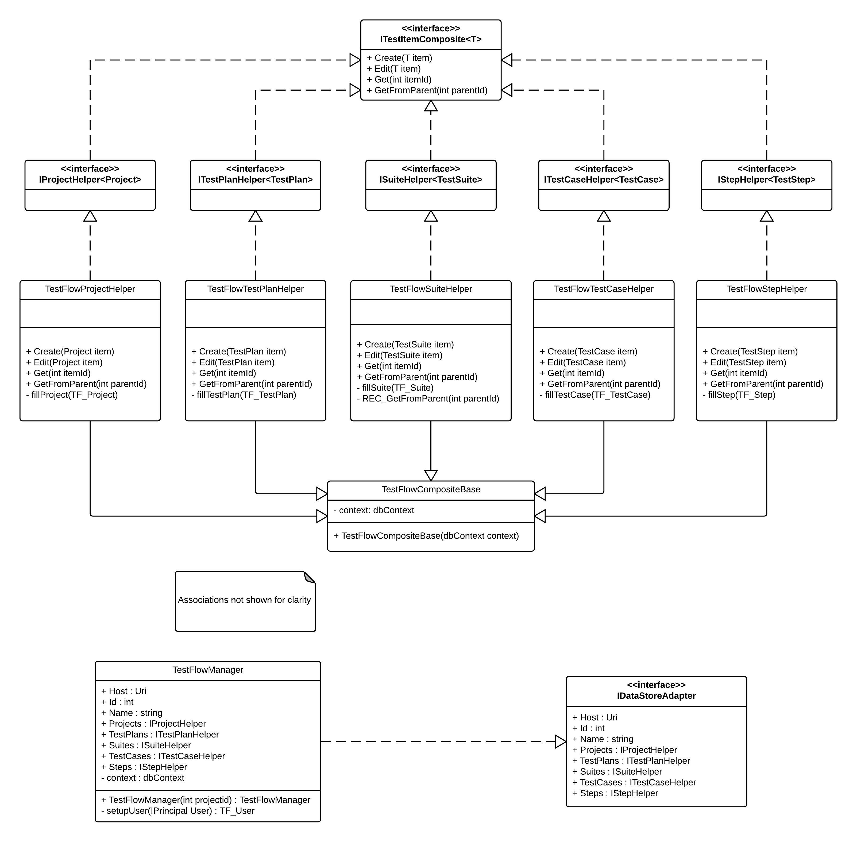

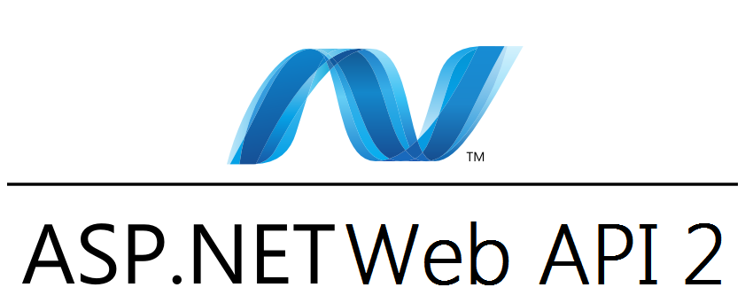








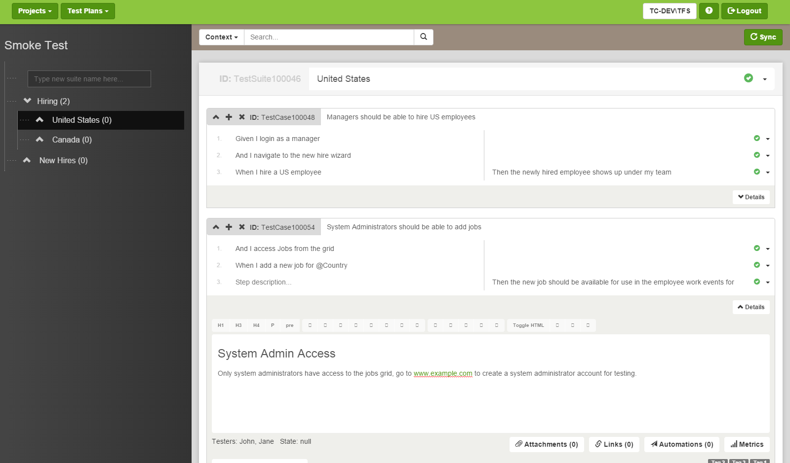
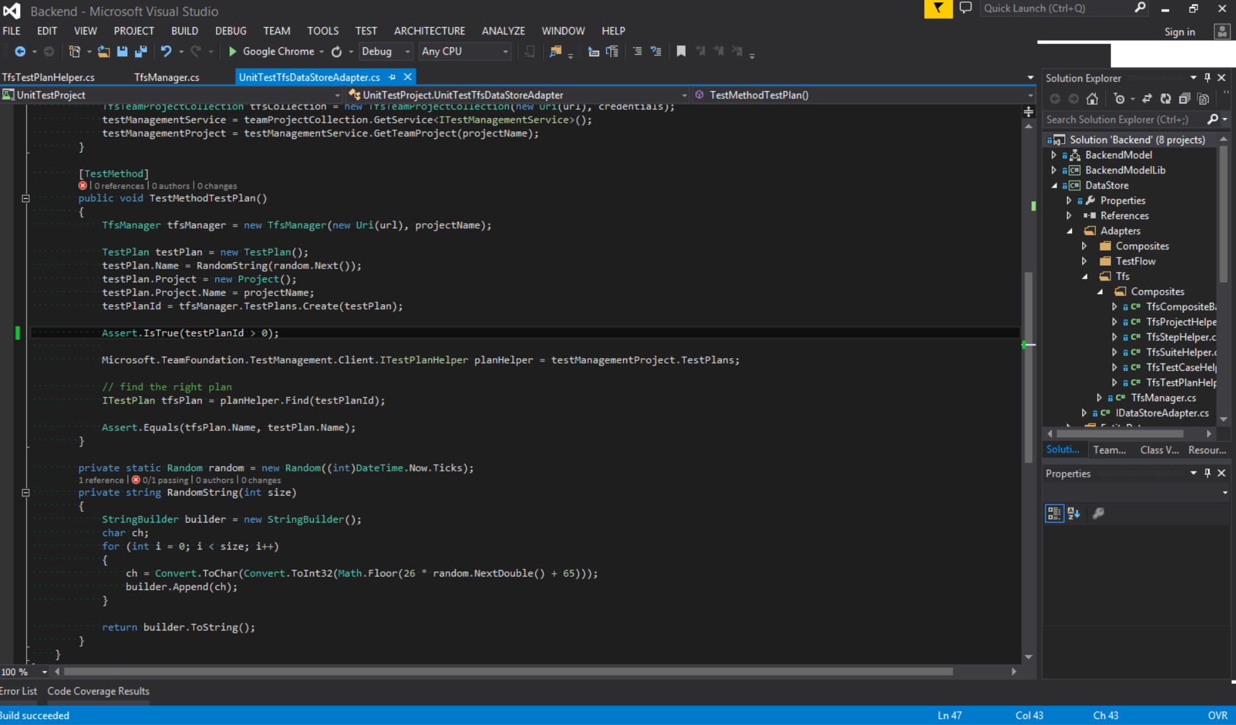
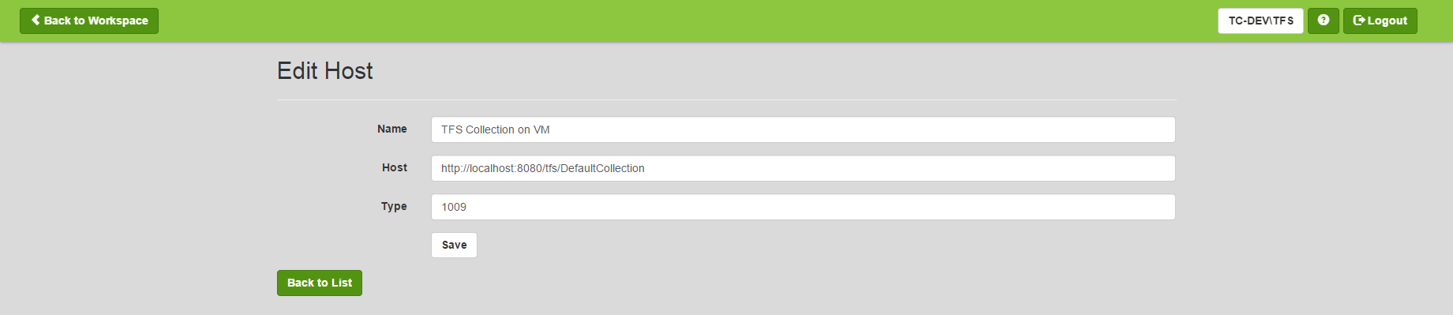
School of Computing & Information Sciences
Senior Project, 2014, Fall
Test Case Management and Automation
Student: Justin Phillips, Florida International University
Mentor: Tariq King, Ph.D., FIU / Ultimate Software ; Dionny Santiago, Ultimate Software
Instructor: Masoud Sadjadi, Ph.D., Florida International University
Problem
Current System
Requirements
Imagine a verification process which includes various test management systems (best-of-breed), each management system requiring a different client and experience to maintain the test plans housed by that system. What if a system could integrate into this eco-system and allow for the creation and maintenance of test plans to be done from a centralized location with a single user experience? Realizing a centralized system like the one presented above is the problem which this project undertook to solve.
Ultimate Software’s current system utilizes Microsoft’s Team Foundation Server (TFS) 2013 as one of their test management systems. Testers and test architects create, edit, and maintain test stored in TFS via Microsoft Test Manager (MTM) where they can create, maintain, and execute test plans which are made up of suites, test cases, shared steps, and test steps. Additionally, file based attachments may be added. Automations can also be tied to test cases and run remotely via MTM or TFS’s web interface.
This project required the team to plan, design, and develop a web based system which would be able to create and maintain test plans across Ultimate Software’s test management systems. The system required TFS interoperability as well as connectivity for GIT and SVN source code repositories. Single sign-on via Windows Domain was required for authentication and security. Finally, the system was to be user friendly and promote rapid test plan creation and maintenance. From these elicited requirements two artifacts were created, the feasibility study and the requirements document.
System Design
Object Design
Implementation
The system was modelled using a 4-tier architecture in which the data layer facade provides connectivity and operations on external test management systems. The local database and remote systems are manipulated via a common adapter interface. The usage of the adapter pattern allows for a clear method of extending the test management system connectivity options. The other tiers are the presentation tier, service tier, and logic tier. This architecture is depicted in the graphic within Figure 1.1.
Central to the design of the system is the adapter interface, depicted in Figure 1.2 as IDataAdapter, which is composed of a suite of composite interfaces that allow for a uniform method of manipulating a data store, local or external to the system. These adapters are managed via the data store facade named DataStoreManager which propagates test plan operations into whichever external systems the user has registered with the system.
The logic and data layers were designed to be libraries which would be accessed via the Manager facade named TestFlow. A series of RESTful services were designed to realize the service layer and expose the manager operations to the presentation layer consisting of a user interface. These services were broken down by task and test item type.
The system was implemented in an iterative, Agile process with many of the latest web technologies. The first few development iterations encompassed creating a user interface. Once the client approved the user interface, development began on the back end of the system starting with the data layer adapters. These were implemented on a console application. The data model was then exposed to a logic layer and algorithms were created to support the synchronization of the data between systems. Finally RESTful services were created to support the user interface’s access to the backend’s operations.
Angular JS and HTML5 were utilized for the presentation layer as the user interface need to be intuitive, feature rich, and perform operations quickly on data models. The entire server component of the system used Microsoft’s .NET technologies as they allowed for rapid TFS integration and web service creation. ASP.NET Web API 2 was employed for the services layer to leverage the ability to quickly create and test RESTful services. The logic and data layers were implemented using .NET libraries and Entity Framework in conjunction with MS SQL Server which allowed for object oriented access to the database and generation of the test plan model in code.
Presentation
User Interface
Service
Connectivity Services
Logic
Manager Facade
Sync Manager
Data
Data Store Facade
DB Adapter
TFS Adapter
Remote Data Stores
Database Server
TFS Server
Figure 1.1: High level system architecture showing flow of data
The logic tier handles all of the synchronization between the data from the external adapters and maps it to the local database. The sync manager handles all of the mapping of data to and from the various adapters for the manager facade. The logic tier exposed to the service tier through the manager facade. The service tier provides access to the system for clients such as user interfaces.
Figure 1.2: Class Diagram of the DB Adapter and Interfaces
Figure 1.3: A sample of the frameworks, tools, and software used to implement the system.
Verification
Summary
At the end of each development iteration verification would be performed on what was developed. If tests failed a new iteration began to fix any defects found in the tests.
The system was verified by developing a set of unit test with Visual Studio 2013 and performing manual system tests with a sample test plan provided by Ultimate Software. In Figure 1.4 the output of a unit test on the TFS adapter can be viewed.
This project was a great experience as it allowed for further knowledge of the process of software engineering to be gained and provided a great look at how the industry manages and conducts software testing. The project began with a feasibility study which lead into requirements elicitation and documentation and finally system design. This was followed by an iterative cycle of object design, implementation, and verification which finally resulted in a prototype of the test management system and automation system.
Figure 1.5: Screenshot of a test plan in the system
Test Flow
Figure 1.4: Output of an early unit test run
Figure 1.6: Screenshot of collection configuration
Acknowledgement
The material presented in this poster is based upon the work supported by … I am thankful to the help that I received from my group members, … .

