Slide 1




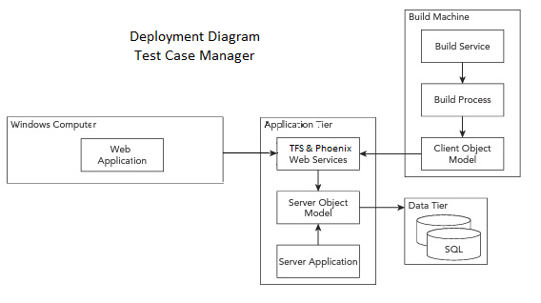


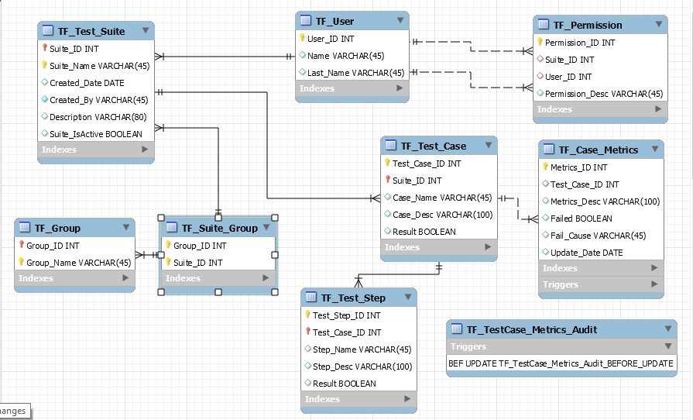


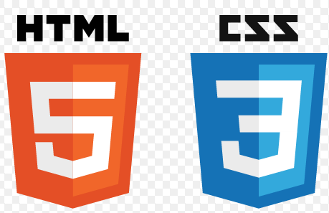



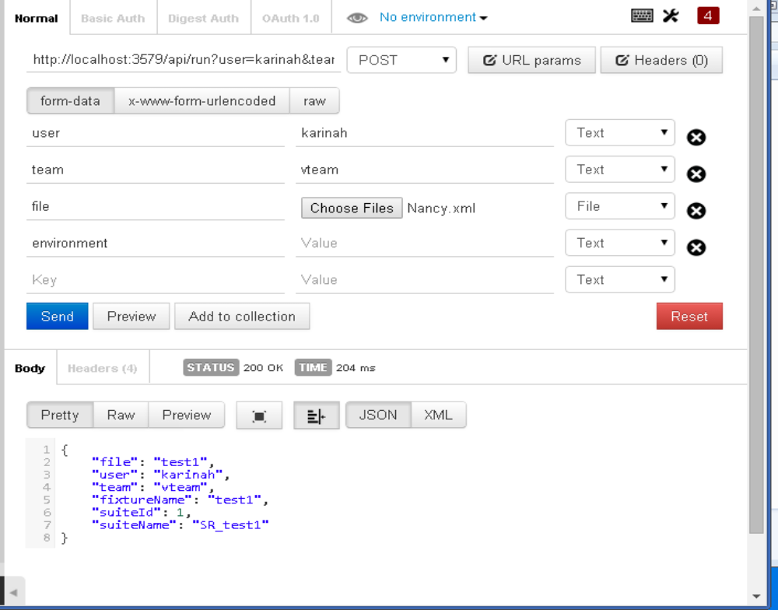
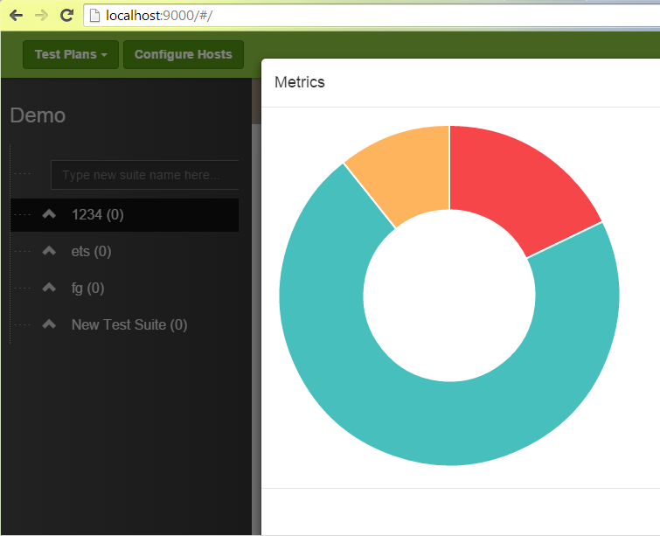
School of Computing & Information Sciences
Senior Project, Spring 2015
Test Case Management and Automation
Student: Karina A. Harfouche, Florida International University
Mentor: Tariq King: FIU/Ultimate Software - Dionny Santiago, Richard Hernandez: Ultimate Software
Instructor: Masoud Sadjadi, Juan Caraballo - Florida International University
Problem
Current System
Requirements
Imagine you are in the position of a software tester that runs dozens of test cases a day! Even if you have an excellent memory, as a software tester you need rely on endless amounts of logs scattered across different applications in order to accurately keep track of failures and its regular tendencies. However, common causes of legitimate or false failures are often overlooked due to the large amount of details required to analyze test results and conclude it’s resolution with the correct form of action on a timely matter.
Ultimate Software’s current system utilizes Microsoft’s Team Foundation Server (TFS), Microsoft Test Manager (MTM) and Phoenix to manage their automated test cases and test results. Quality Assurance engineers access these multiple applications in order to acquire useful data about the current test cases as well as previous and new test automation results. Automation results are linked via Phoenix to test cases that run remotely in conjunction to MTM or TFS.
The overall requirement of the project was to elaborate the design and implement a web application able to support prominent activities and tasks performed daily to manage, run and analyze test plan artifacts of Ultimate Software. The following are the system’s major functionalities worked on by the team members of this project:
TFS, MTM and Phoenix interconnection to the application.
User friendly and efficient test plan creation and Maintenance.
Test Result Metrics with the generation of a final report per test suite
System Design
Object Design
Implementation
The following is the system architecture layout designed for the organization of the test case manager backend major components.
The below ER Diagram displays each of the entities necessary for the correct functioning of the test case manager. This diagram includes basic entities such as user account objects to more elaborate tables involving the metrics and test plan components to be used in the database and within the overall system implementation.
The system was implemented using Angular JS and HTML5 for the user interface, with ASP.NET Web API 2 as the connectivity layer, and a data layer which utilized the Phoenix API.
Figure 1.1: system architecture
Figure 1.2: ERD Diagram of Test Case Manager
Verification
Summary
The system was verified by developing a set of unit test with Visual Studio as well as Selenium to test the web application’s GUI and Postman Chrome App in order to verify the functionality of the REST service calls and returned JSON strings. Manual system tests where also performed as adequate for UI testing purposes.
This project allowed further insight into the world of software testing, its challenges as well as its day to day practice as a crucial phase of the software engineering process. The project’s deliverables included a feasibility study, a requirements elicitation document and culminated with the system’s design. The major components of Software Engineering where thoroughly practiced and internalize during each phase of the test case manager and shows that the possibilities are endless when it comes to designing a software solution.
Figure 1.3: Postman Screenshot
Figure 1.4: Screenshot of Metrics Chart
Acknowledgement
The material presented in this poster is based upon the work supported by FIU & Ultimate Software. I am thankful to the help that I received from my group members: Justin Phillips

