Slide 1











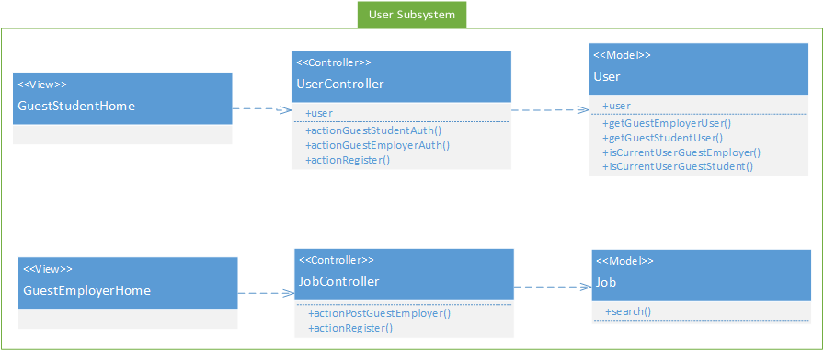
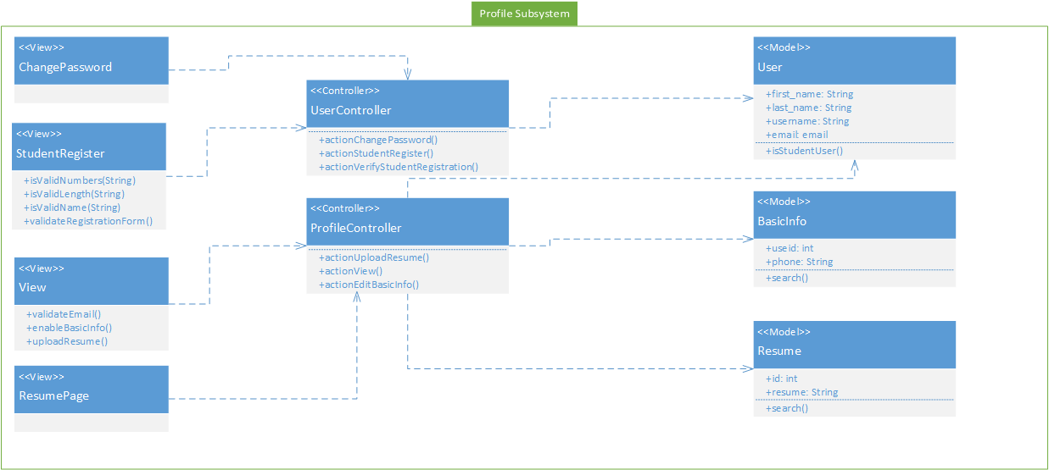

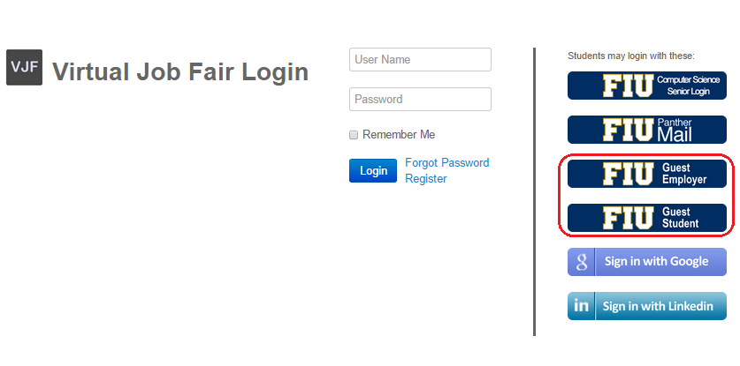
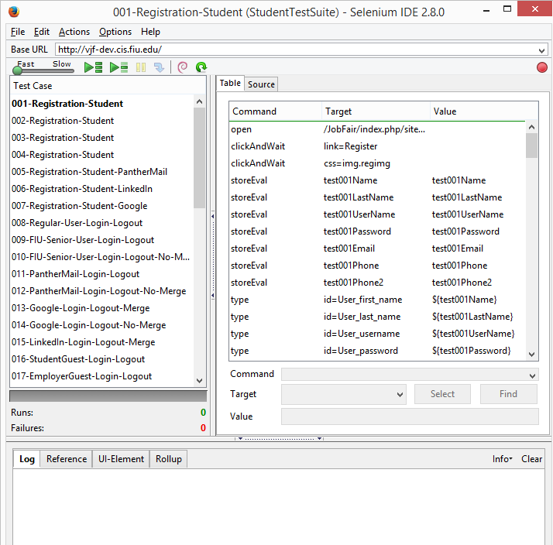
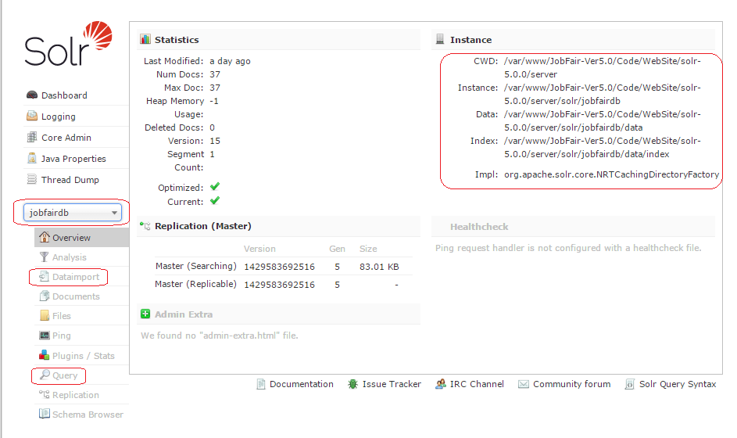










School of Computing & Information Sciences
Senior Project, 2015, Spring
Virtual Job Fair v5.0
Student: Rogelio Alonso, Florida International University
Mentor: Juan Caraballo, IBM & FIU
Instructor: Masoud Sadjadi, Florida International University
V5.0
Problem
Current System
Requirements
Employers are unable to tap local talent at universities or job fairs due to geographical barriers. These employers don’t have the economic or logistical capabilities to seek for talent in multiple locations. Simultaneously, students don’t have the time or resources to meet potential employers in person. Most students are new to the job market before and after graduation and are unable to display especial skills, experience and talents via emails. Finally, students and Employers are not able to connect in real time.
The current system does not provide a way to welcome guest employers and guest students. In the same way, it lacked a functionality for the replacement of student resumes. Search results are not fully accurate and system need stability fixes.
Allow Guests Employer and Guest Student accounts to the system and provide limited functionality. Test the Student/Employer Actor User Stories and System General Features. Create data driven automated regression test script. Allow the student to replace their PDF and Video resume. Feasibility study for a search engine to incorporate to our search subsystem. Solr search server setup and configuration. Solr indexing of MySQL database. Provide major system stability in the search, student profile and API subsystems.
System Design
Object Design
Implementation
The system still follows a three-tier architecture as previous version. Implemented by a Model View Controller design patter provided by the Yii framework.
Bellow figures are object modified in order to accomplish the story requirements.
Virtual Job Fair v5.0 was implemented in an Agile process, building up on the previous versions. The first sprint included creating new guest actors and provide them with limited functionality. Once approved, the student and employer actor functionalities were tested and bugs were recorded to later be fixed on following sprints. These fixes revealed the necessity to expand on existent functionalities in the API, Student Profile and Messaging subsystems. Finally, a feasibility study for a search engine, followed by the installation, core configuration and database indexing of Solr search engine were made with XML config and schema files to map SQL views to XML entities.
JavaScript and jQuery were used on the front-end for validation, and combined with HTML5 and Bootstrap to present the user interface. The entire back-end was developed under the Yii Framework, a PHP component based framework, taking advantage of the MVC pattern. The automated regression test scripts were written in HTML5, CSS3 and JavaScript on Selenium IDE Tester using XPath to navigate through web attributes.
1-HTTP Request
Yii Router
7-HTML
2-Action
User Subsystem Class Diagram
View
5-Invoke
Controller
3-Call
Model
6-HTML
4-Send Content
Profile Subsystem Class Diagram
Verification
Screenshots
Summary
The system was tested after the code completion of every task ensuring the proper behavior of the application. It was accomplished by developing script automated system test cases with Selenium IDE. Integration tests were perform at the end of every sprint and test suite developed for each sprint. Regression testing was introduced after sprint 2 as part of the integration testing process.
The Virtual Job Fair project was an excellent experience allowing me to be exposed to new technologies. After 5 sprints of Agile Development, students, employers, admin users and future developers can take advantage of a stable and reliable system. Student users can upload a video resume of size up to 80 MB, and replace video or PDF resumes to keep them up to the latest version. The system provides easy access to guest, employers or students. A regression test script is introduced for integration testing. The system is ready to use Solr search engine, and provide a richer search experience.
Acknowledgement
The material presented in this poster is based upon the work supported by Masoud Sadjadi and Juan Caraballo.
I am thankful to the help that I received from professors and family, especially from my wife, Heidy Gutierrez.

