Slide 1






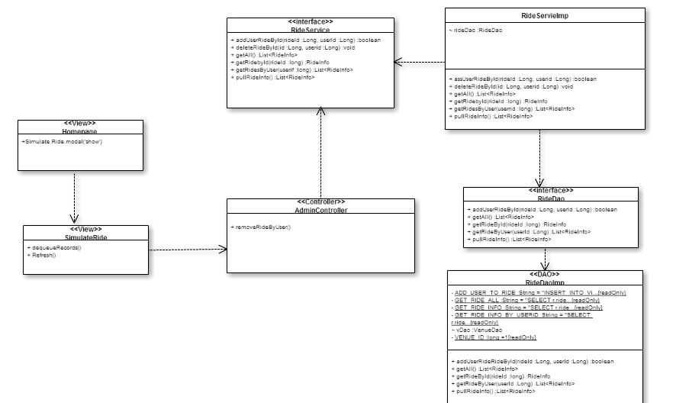
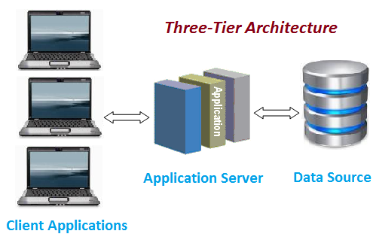
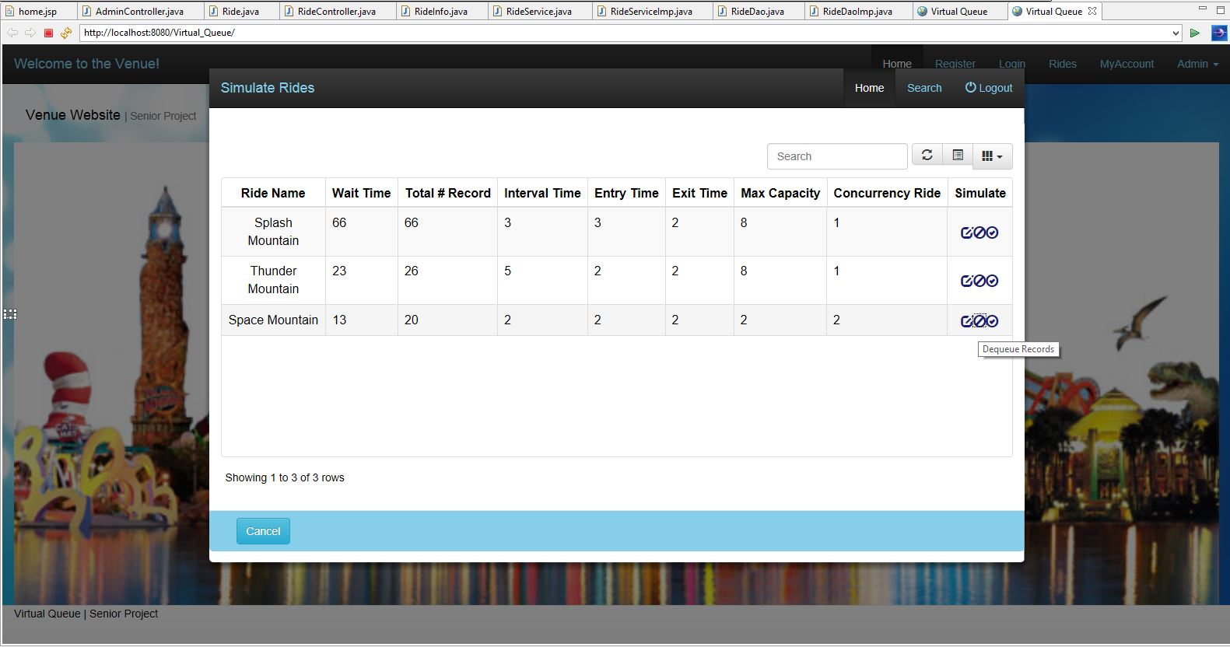
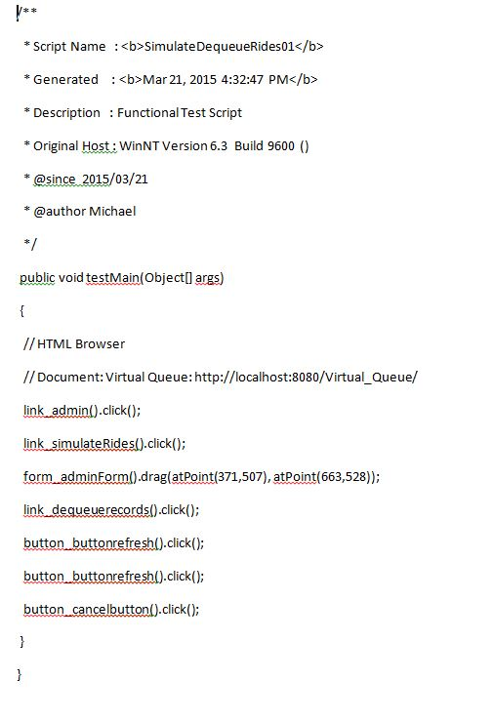
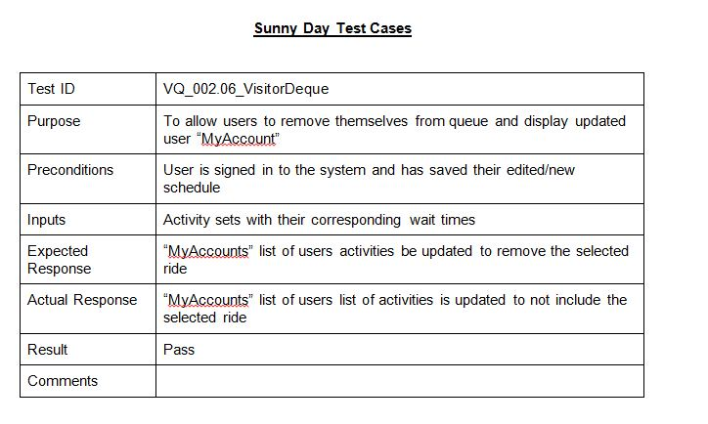
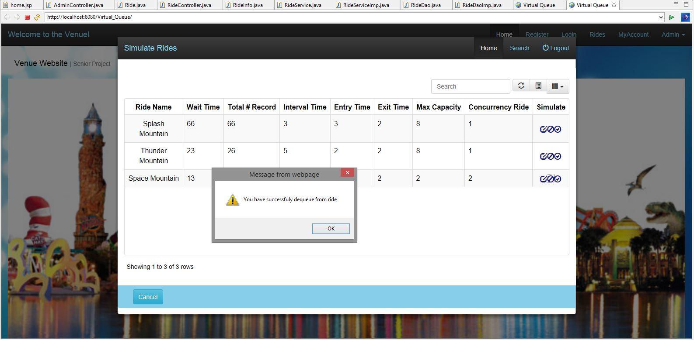
School of Computing & Information Sciences
Senior Project, 2015, Spring
Virtual Queue v2.0
Student: Michael Lazo, Florida International University
Mentor: Bernard Parenteu, Florida Atlantic University
Instructor: Masoud Sadjadi, Florida International University
Problem
Current System
Requirements
Theme parks today as they grow in popularity have one fundamental flaw, the constant waiting in line for each ride. With each of the top tier rides constantly growing in wait time, this only makes matters worse for the average visitor. Standing in line begins to spend the majority of their time rather than sightseeing, exploring, or enjoying some tasty snacks at any store within the park and buying souvenirs. To make matters worse this is not taking into consideration weather conditions the standard waiting line may be under. As for the business aspect, it would be to the theme parks benefit to have more guests spending their time browsing the souvenir shops or food stands rather than spending their time idle while waiting for their turn to get on an attraction. Every minute longer the guests spend active can potentially increase park revenue.
Thus was the creation of the Virtual Queue System, it is the proposed solution to the problem. The system provides the visitors the freedom and flexibility to spend their time doing exactly as they wish while simultaneously waiting in line to ride the attraction they want
Virtual Queue v.1.0 currently allows the visitors the ability to log into the web page and add certain rides into their accounts. However it is currently limited in the regard that users are unable to register their own accounts, as well as there is currently no existing administrative accounts or accessibility. The visitors will be given a daily code while entering the park, but the code will never expire and can be reused daily.
The current system does not have a protocol set for automatically removing users from their rides upon completion. The system also currently have no method in which the theme park can make any adjustments to a ride to accommodate for any changes, or have any method to keep track of users in line for any particular ride.
Virtual Queue v. 2.0 provides an online alternative to standard waiting line that currently exist. The system must be able to store visitor records as they are registered dynamically per ride as well as maintain wait time as the queue builds and shrinks.
The system will also grant administrative abilities which include administrators the ability to add/remove user accounts as well as editing currently existing ride instances.
The requirements that relate to my role include:
  Administrative abilities to Remove visitors from the queue
  Administrative abilities to Edit ride information to accommodate change in ride instances
  Allows visitors to enter the queue for an attraction of their choosing
System Design
Object Design
Implementation
Our system uses a three-tier and multi layered architecture. These will allow for horizontal scalability, which will let to multiple server instances to easily handle high traffic of the visitor using the web application in a venue.
The Admin Controller Subsystem houses to majority of the changes made.
The System was implemting utilizing Java, MySql, Apache Tomcat, Spring tools framework 4.0, HTML 5, Bootstrap 3.
The system was developed in mind in order to support high volume of traffic. The system aims to minimize the MySql database calls by saving states of the database in the Java implantation. In order to reduce the heavy calls and increase order running time. With a friendly user interface, park visitors and administrators alike can easily pick up the application and immediately be on their way.
This diagram depicts the exact components worked on in order to achieve administrative abilities such as removing visitors from queue, and how each class communicate to accomplish this task,
Verification
Screenshots
Summary
Virtual Queue v2.0 was tested using the regression approach utilizing the testing tool IBM Rational Functional Tester. We have provided a snip-it of the results returned from a test case below.
The Virtual Queue v2.0 results in an online alternative
to standard waiting lines the currently exist in Theme
Parks across the nation. It provides visitors with the
Freedom and Flexibility to do what they want, when they
want, when they are on vacation. It provides Theme Parks
with an online tool, they can use to aid in the automation
of the current attractions.
By providing Theme Parks with an online alternative
to the standard waiting lines, visitors can now better spend
their time waiting roaming around the park potentially
spending their time and money on other things; which in
turn can increase profits to the Venue.
*Screen Shot demonstrating how Admin Dequeue works
*Example of a sunny day case for the VisitorDequeue
Acknowledgement
The material presented in this poster is based upon the work supported by Bernard Parenteau. I am thankful to the help that I received from my group members, Micheal Lazo

