Slide 1









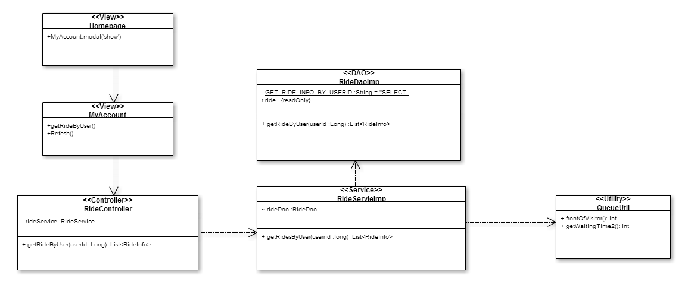
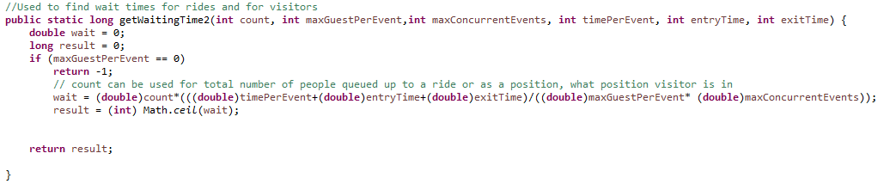
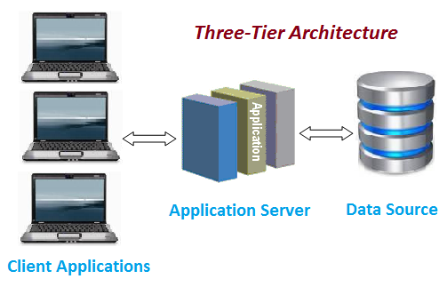
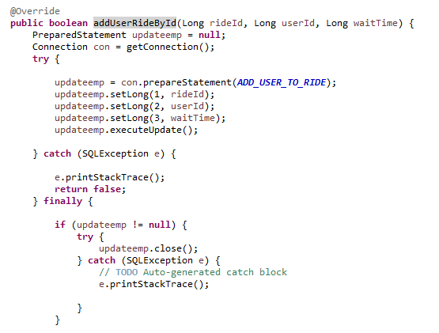
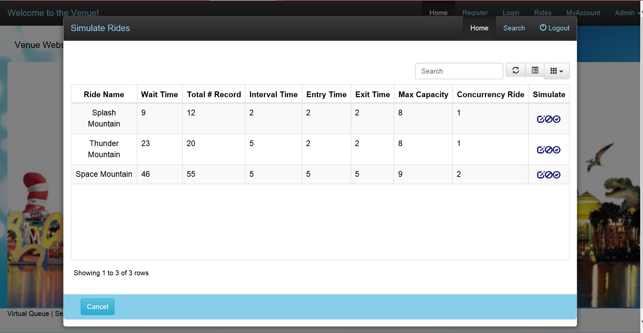
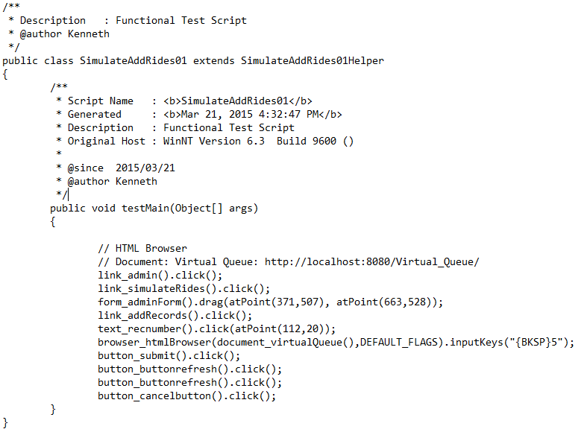
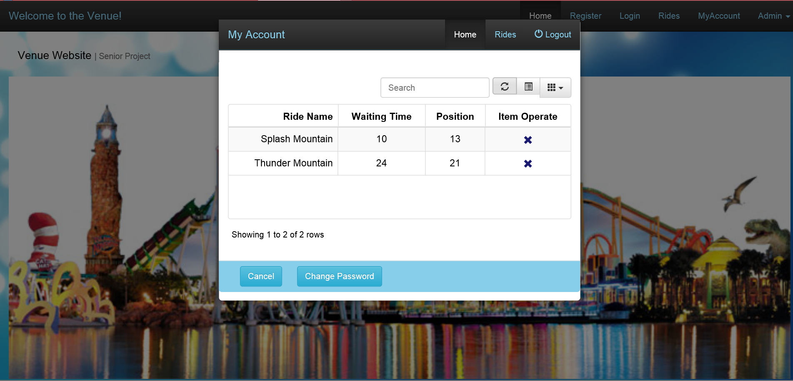
School of Computing & Information Sciences
Senior Project, 2015, Spring
Virtual Queue v2.0
Student: Kenneth Kon, Florida International University
Mentor: Bernard Parenteau, Florida Atlantic University
Instructor: Masoud Sadjadi, Florida International University
Problem
Current System
Requirements
When families go to a theme park or similarly related venues. Most of their time is often spent idling around while waiting for the long lines to get on their favorite attractions. Even though they will be spending money to get into the theme park, there is still a significant amount of time that the theme park can be profiting by having the visitors spend their time roaming the park rather than standing in place for an attraction. So what the Virtual Queue aims to achieve get rid of those physical lines and let visitors line up virtually. Which would mean that they would not need to wait in long lines for their activities and consequently lets them roam the park more freely.
.
The current system requires the customers to buy the their tickets to get into the park and then wait in line for their ride or event. Some major theme parks allows visitors to schedule a fast pass for specific event or a ride ahead of time before getting there. But there is a limit on how many fast passes they can schedule on a specific day.
Even with this fast pass scheduling system the visitors will still need to wait in line if the ride is crowded. There is no system that allows the visitors to register and sign in to just queue themselves onto a ride within a venue. There is no system that allows visitors to easily check the status of the rides.
The Virtual Queue gives users the functionality that allows them to see all the available activities and their respective waiting time. We are building upon the previous versions that already includes the front end framework and the specific functionality mentioned above.
The specific requirements that related to my role are as follows:
The system shall dynamically find wait time according to number of visitors waiting in the ride at that time.
The system shall be able to queue visitors when they add themselves to a ride.
System Design
Object Design
Implementation
Our system uses a three-tier and multi layered architecture. These will allow for horizontal scalability, which will let to multiple server instances to easily handle high traffic of the visitor using the web application in a venue.
The main subsystem I was focused on was the Ride Operation Subsystem.
The system was implemented using Java, MySQL, Tomcat, HTML 4, jQuery, Spring Framework 4.0, and Bootstrap 3.
Picture above is a example of the algorithm used to finding wait time for a ride.
This diagram shows specific component in ride operation that dynamically finds wait time for a activity. View object MyAccount displays the list of ride received from the service from the DAO.
Picture above is a shows snip it code from Ride Data Access object to add User to a specific ride inside the database.
Verification
Screenshots
Summary
IBM Rational Functional Tester was used to functional test our web application.
The Virtual Queue v2.0 offers user ability to wait in line in a venue without actually having physically stand in line.
It allows users to quickly access the web application to see activity status and easily add themselves to a activity. It also sends notification if the user they are nearing the front of the virtual line.
This system relies on modern day smart phone devices that which is common. Which allows venues to not need to spend money on additional hardware's.
Test ID | VQ_002.01_Simulate_Add_Rides
Purpose | To successfully add records to the queue for the specified ride.
Preconditions | Venue Admin is signed in to the system, has Simulate ride table open. Clicks on add records for "Splash mountain."
Inputs | Add Random Records: 10 Ride Id: 1
Expected Response | Splash Mountain should be the only record updated with increase in # of records and increase in Wait Time.
Actual Response | In Simulate Ride Table: Splash Mountain: (Total # records)+10 and Wait Time Increased.
Result | Pass
Comments | N/A
Screen shot of Simulate Rides Window in Virtual Queue 2.0
Example of Rainy Day for Simulate Add Ride.
Screen shot of My Account window, with couple of rides queued up.
Acknowledgement
The material presented in this poster is based upon the work supported by Bernard Parenteau. I am thankful to the help that I received from my group members, Michael Lazo.

