Slide 1






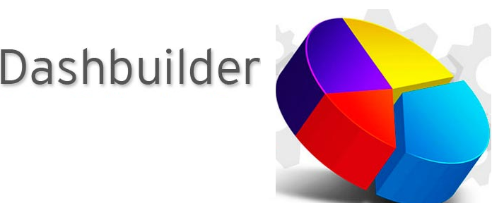
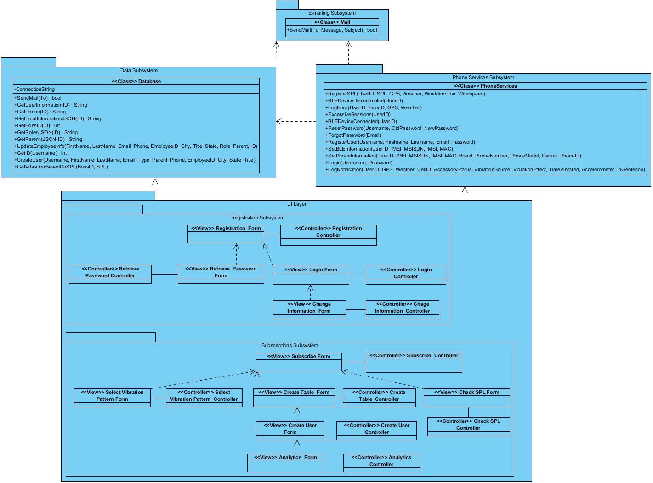
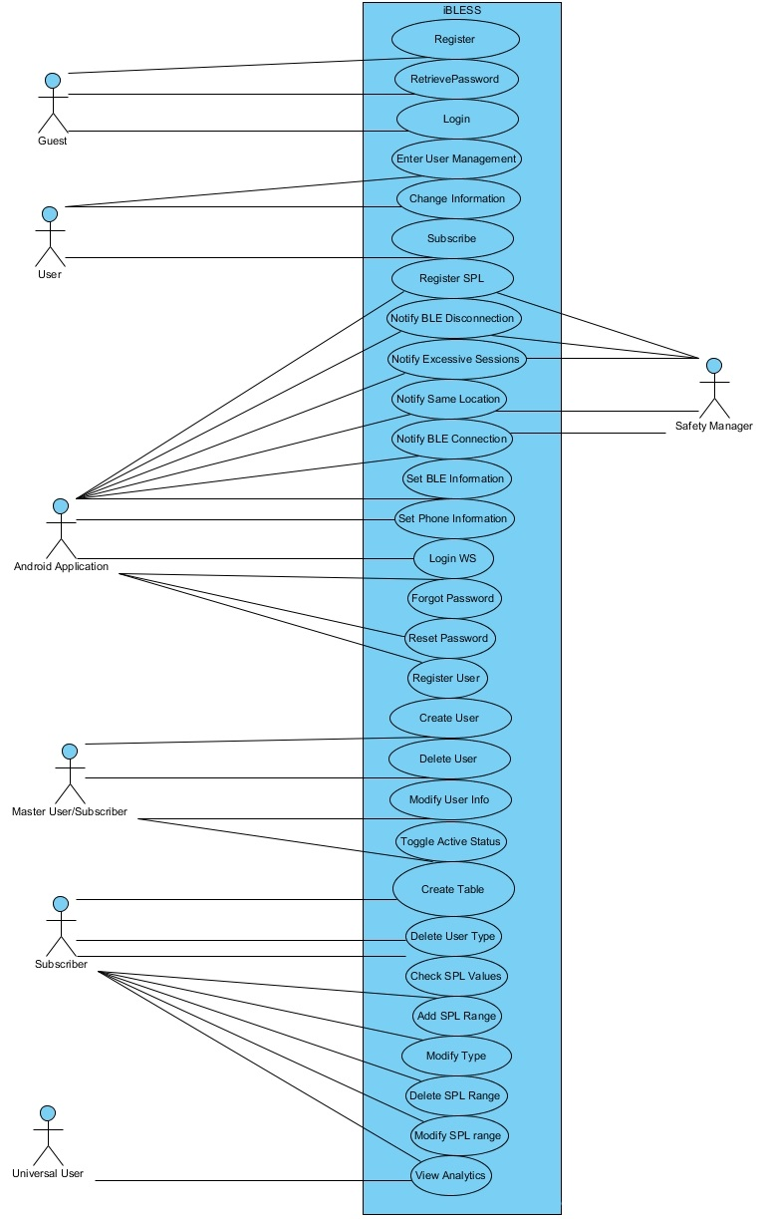
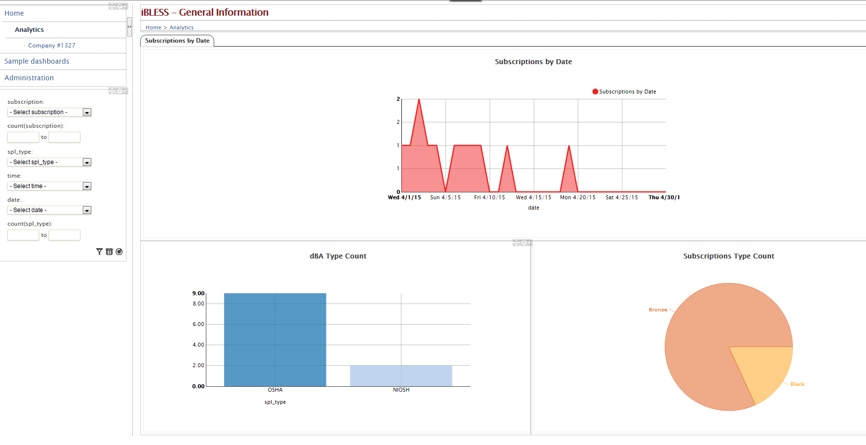
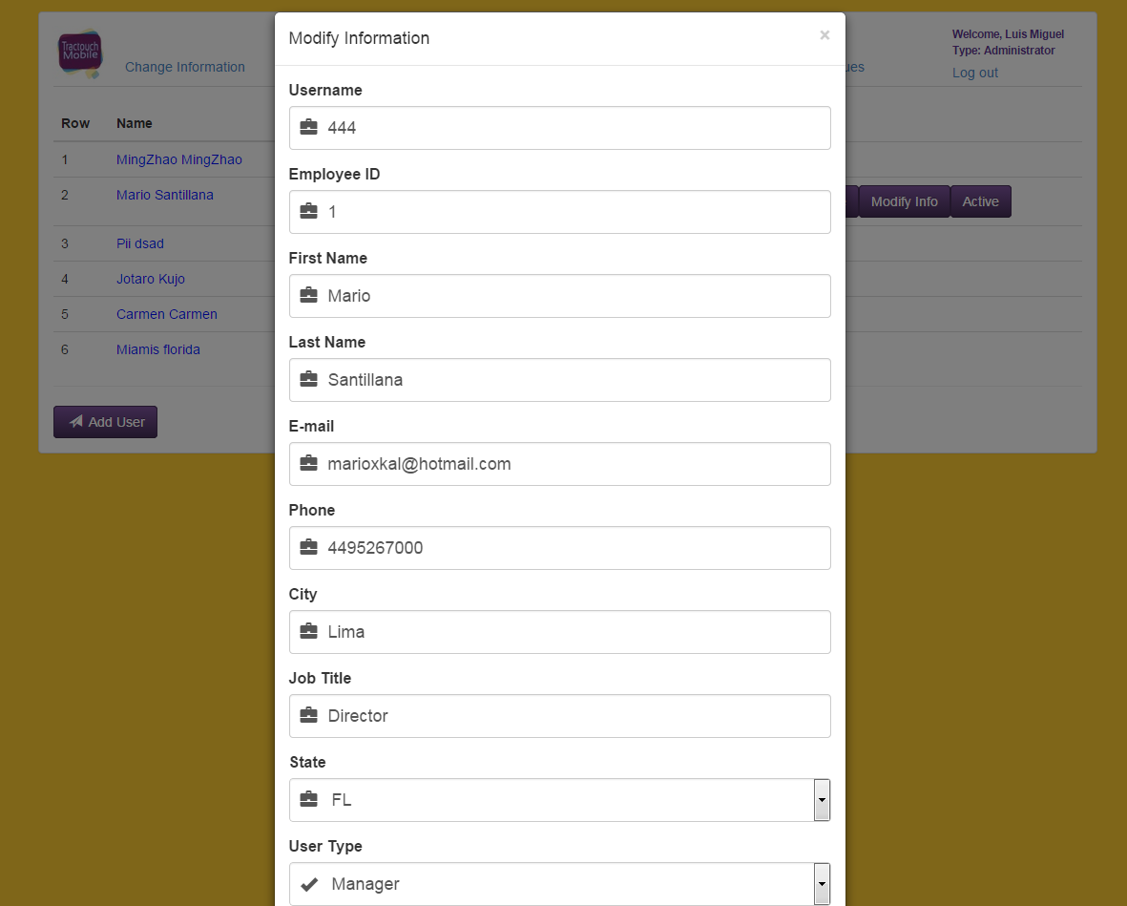
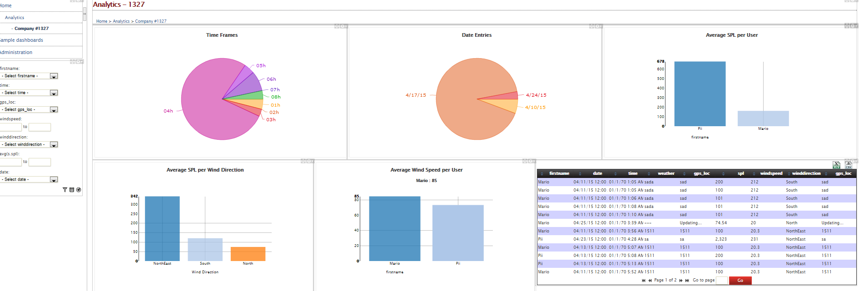
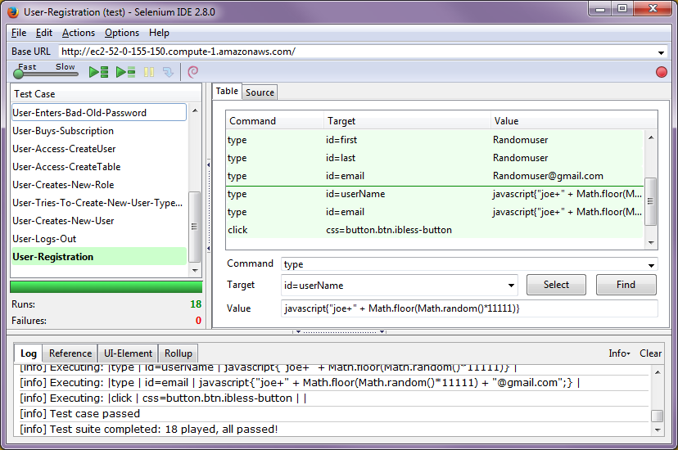
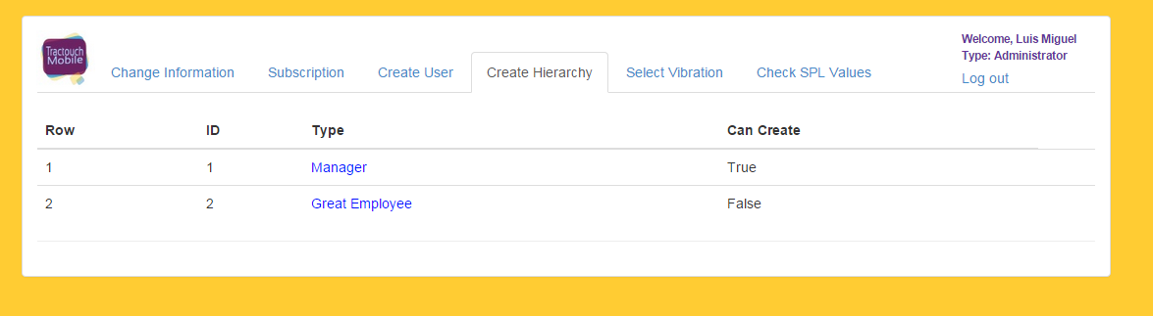
School of Computing & Information Sciences
Senior Project, 2015, Spring
iBLESS
Student: Luis Miguel Carrillo, Florida International University
Mentor: Jaime Borras, Tractouch Mobile
Instructor: Masoud Sadjadi, Florida International University
Problem
Current System
Requirements
Communications play a major role in our society. They serve many purposes: medicine, construction, businesses, to name a few. In the last two decades there have been many improvements to communication devices such as the invention of the smart phone and the usage of vibrations. Even with these improvements one problem persists: missing a call. What iBLESS fixes is that very need. IBLESS is a system which manages vibration devices with amplitudes up to 10G.
Imagine a construction business which needs quick and reliable messages in order to operate at 100%. In construction there is a lot of noise and movement; therefore normal communications means are ineffective. Here is where iBLESS comes to play. IBLESS captures the environmental noise and sets the vibration device to a perfect amplitude so that, regardless of the noise, the user can feel the vibration, thus saving time and money.
Currently there is no system which solves the previous problem.
As a subscriber, I want to:
Create a hierarchy for my users.
Create users using the previous hierarchy.
Check dBA records for each user.
Modify users' information.
Modify my information.
Analyze all data regarding my company.
Receive notifications about my employees.
As an employee (android app), I want to:
Record environment noise.
Record wind speed, and wind direction.
Record GPS.
Record BLE device status.
Log any error that might occur.
Reset my password.
Notify of excessive amount of SMS/calls.
Our System
IBLESS (Intelligent Bluetooth Low Energy SaaS) provides a platform for customers to:
Vibration amplitude automatic modulation.
Register.
Buy the service.
Manage their employees.
Send messages to employees.
Manage the vibration settings.
Record environment noise.
Analyze information.
Analyze dBA records.
Instant notification when dBA is high.
System Design
Object Design
Implementation
Package diagram showing iBLESS' subsystems
IBLESS' Use Case Diagram
Analytics is implemented using MySQL, Maven, Java, and Dashbuilder.
The website is hosted on Windows Server 2012 running IIS 8.0. The server side was developed using C#, with the ASP.NET framework.
The client side was developed with JavaScript, Jquery, HTML5, and TwitterBootstrap.
The webservices were developed using SOAP as the protocol.
The android application communicates using the SOAP web services.
MySQL is also used for persistent data storage.
Verification
Screenshots
Summary
Given the website nature of iBLESS, Selenium was chosen as the main testing tool. Unit tests were developed per subsystem, which put together in Selenium made a perfect testing suite.
Integration testing was also carried out with Selenium.
The web services were tested using Visual Studio 2013.
IBLESS provides solutions to missing SMS, and calls due to environment reasons.
IBLESS helps analyze usage statistics, as well as environments by wind speed, dBA, to name a few fields.
IBLESS is permanently getting information from each user that submits new information via the iBLESS android application.
Managers are permanently informed about users' actions.
From the iBLESS team: thank you for reading!
Acknowledgement
I thank my mentor Jaime Borras for providing support and great advice. I also want to thank Alain Edwards, who is a fellow software engineer, for providing guidance and assistance as well as encouraging words. I want to thank Mauricio Bendeck for suggesting the usage of Dashbuilder. Final but not least, I want to thank Dr. Masoud Sadjadi and Juan Caraballo for helping me improve this whole semester.
Notes:
<number>

